Slide 1
What is Conductors & Insulators?

Slide 2
Conductors
A conductor is an object or type of material that allows the flow of charge (electrical current) in one or more directions.
Materials made of metal are common electrical conductors.
Electrical current is generated by the flow of negatively charged electrons, positively charged holes, and positive or negative ions in some cases.
Conduction materials include metals, electrolytes, superconductors, semiconductors, plasmas and some nonmetallic conductors such as graphite and Conductive polymers.
Copper has a high conductivity. Copper, Silver, Gold, Aluminum are the examples of good conductor.

Slide 3
Insulators
An electrical insulator is a material whose internal electric charges do not flow freely; very little electric current will flow through it under the influence of an electric field.
This contrasts with other materials, semiconductors and conductors, which conduct electric current more easily.
The property that distinguishes an insulator is its resistivity; insulators have higher resistivity than semiconductors or conductors.
Electrical insulation is the absence of electrical conduction.
Wood, Plastic, Rubber, Wool, Paper, Wax, Glass, Ebonite are the examples of insulators.

Slide 4
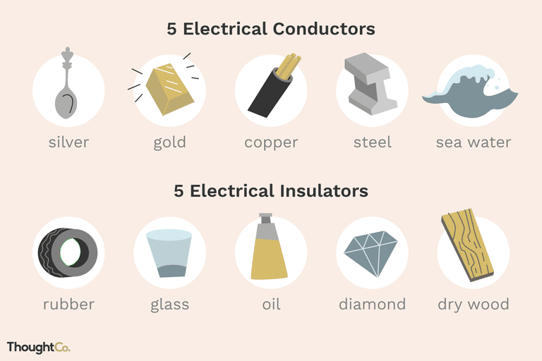
Examples of Conductor & Insulator

Slide 5
Thank you…

