Slide 1

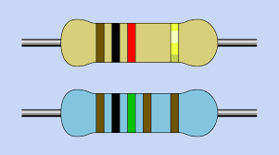
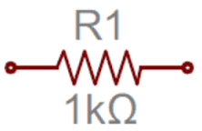
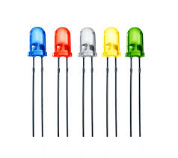
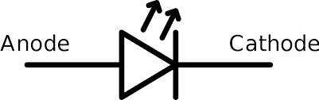
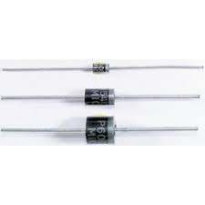
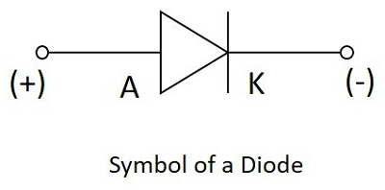
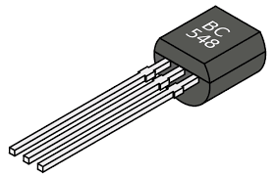
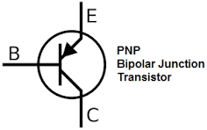
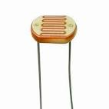
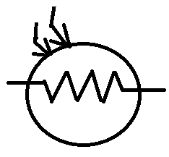
BASIC ELECTRONICS
Basic electronic component:-
Sr.No | Component name. | Image. | Symbol. | Unit.
1. | Resistor |  |  | Ω
2. | LED |  |  | V
3. | Diode |  |  | V
4. | Transistor |  |  | -
5. | LDR |  |  | -

Slide 2
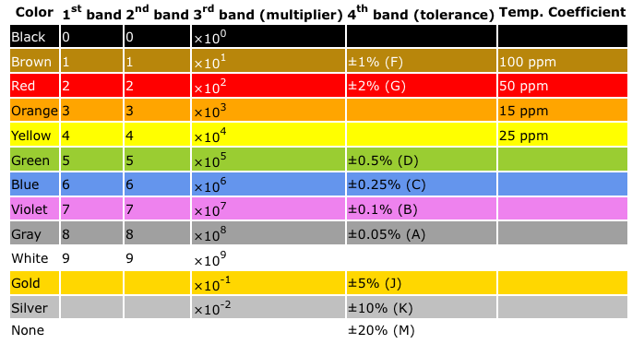
RESISTOR COLOUR BAND TABLE

Slide 3
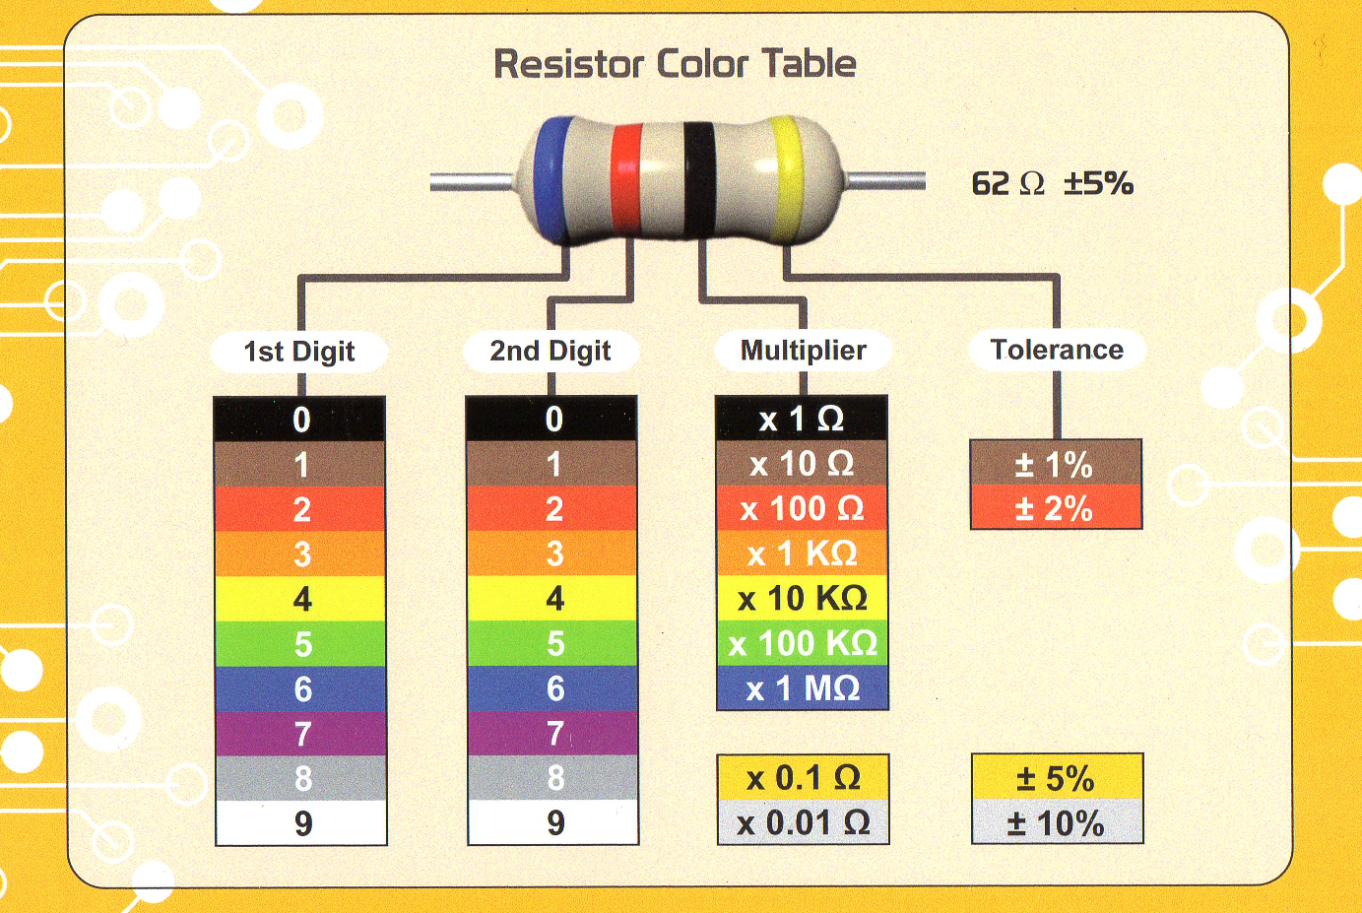
HOW TO CALCULATE RESISTOR VALUE USING COLOUR BAND TABLE?
http://www.hobby-hour.com/electronics/resistorcalculator.php-

Slide 4
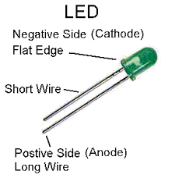
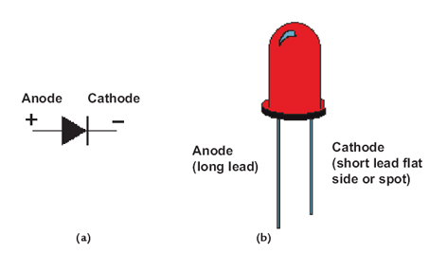
WHAT IS LED ?
Light Emitting Diode:-
1 LED MIN REUIRED 2.4 V SUPPLY.

Slide 5
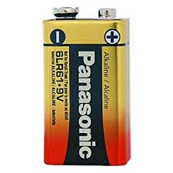
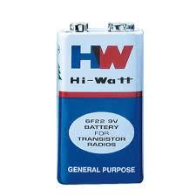
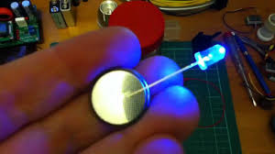
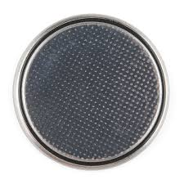
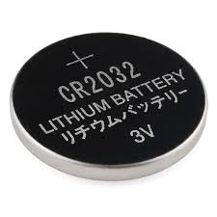
INTRODUCTION ABOUT BATTERY
9VBATTERIES
BUTTON CELL / 3V BATTERY

Slide 6
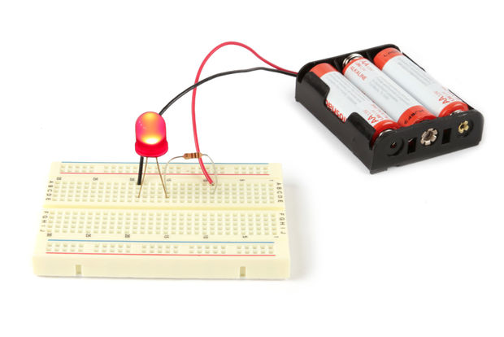
HOW TO CONNECT LED WITH 9V BATTERY ?
Why here used resistor for connecting battery and LED?
Answer:- Because we give 9V supply,& LED required 3V supply resister resist it.

