Slide 1
What IS Relay?

Slide 2
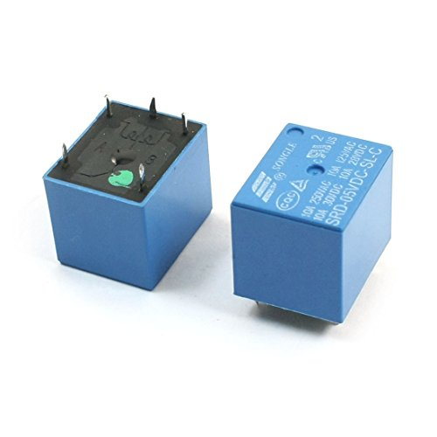
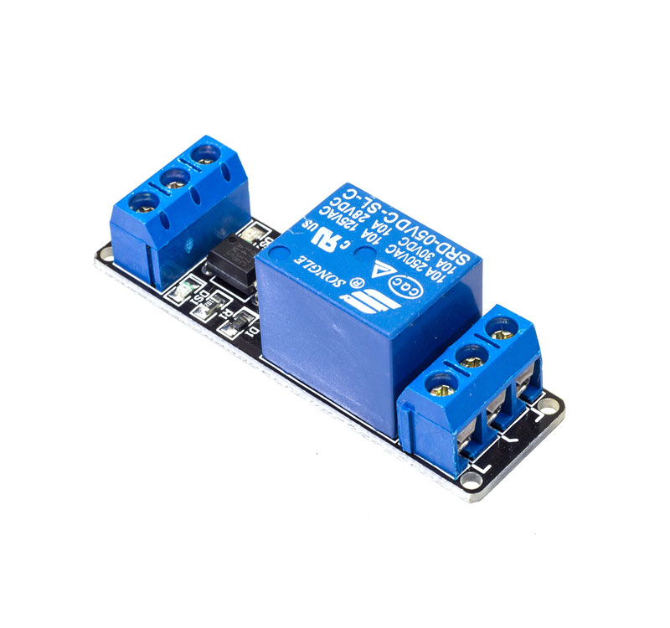
Relay

Slide 3
Relay
A relay is an electrically activated switch.
5V Relay Module 10A.
This small Relay Board works from a 5V signal.
It uses a transistor to switch the relay on so can be connected directly to a microcontroller pin.
When the relay is not activated, the common pin is in contact with the NC pin and when it is activated, the common pin will break away from contact with the NC pin and subsequently makes contact with the NO pin.

Slide 4
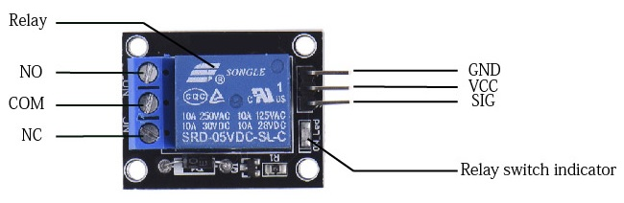
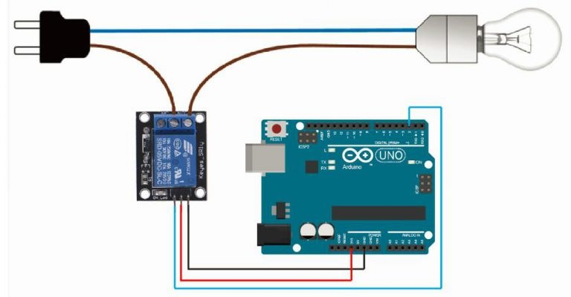
Relay Connection

Slide 5
Features of 5-Pin 5V Relay
Trigger Voltage (Voltage across coil) : 5V DC
Trigger Current (Nominal current) : 70mA
Maximum AC load current: 10A @ 250/125V AC
Maximum DC load current: 10A @ 30/28V DC
Compact 5-pin configuration with plastic moulding
Operating time: 10msec Release time: 5msec
Maximum switching: 300 operating/minute (mechanically)

Slide 6
Applications of Relay
Commonly used in switching circuits.
For Home Automation projects to switch AC loads
To Control (On/Off) Heavy loads at a pre-determined time/condition
Used in safety circuits to disconnect the load from supply in event of failure
Used in Automobiles electronics for controlling indicators glass motors etc.

Slide 7
THANK YOU….

