Slide 1
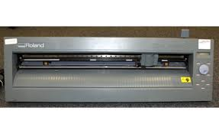
Vinyl Machine

Slide 2
Table of Content:
Introduction and models
Why we need this machine/ Use-fullness
Vinyl machine types
Vinyl machine specification
Machine installation
Software requirement
Vinyl Machine working steps
Material , Speed, Power requirement
Safety precautions
Machine Maintenance
Training and promotion
Machine selection/ comparison

Slide 3
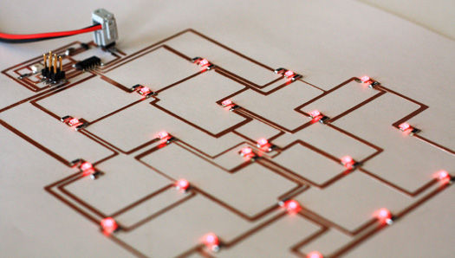
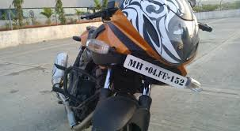
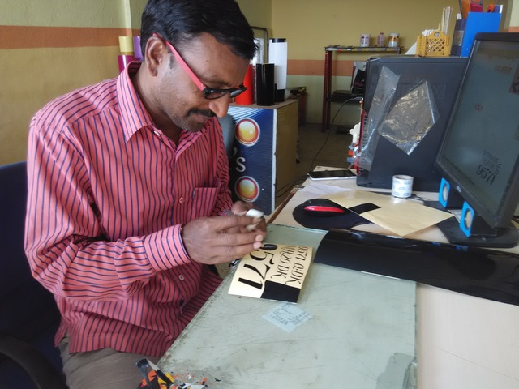
Projects
We Can Do Following things with Vinyl cutting Machine

Slide 4
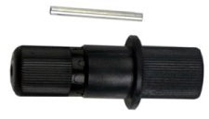
Introduction:
Vinyl cutter Camm1 CX24:
X-Y Plotting machine which can cut name on radium paper also we can print
Circuit on copper adhesive paper.
Engraving tool holder
Blade assembly

Slide 5
Need of Machine / Use-fullness :
Training and business
Converts prototype into products
Makes ideas into reality
Resolution, Accuracy differs it from Handmade .
Machine makes machine

Slide 6
Roland DGA corporation:
Driving method- Digital control servo motor:
Cutting method-Media-moving method;
Media width - 2” to 27.5”(50 to 700mm)
Cutting speed - -4 to 20ips (10 to500mm/sec)
Blade force - 30 to 250gf; Mechanical
resolution - 0.000984” (0.025mm)
Printing and cutting when loading printed material –
(1) (3) (+/- 1mm)
Machine specification

Slide 7
SOFTWARE
Design software
Machine software
Inkscape
AutoCAD
FAB Modules
Dr.sticka plus
any 2D design software
Dr.sticka plus
Cutstudio
Roland Driver
Illustrator
File formats: .png

Slide 8
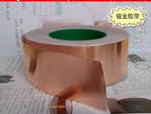
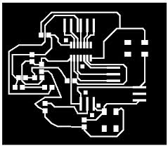
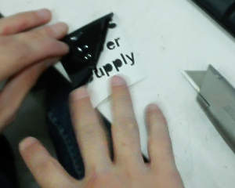
Start machine and
check alignment of bed
Fixed cu or radium paper inside
Make design file ready
Working steps
Adjust X-Y axis plane on machine
Import design file inside
Machine software-upload
Start printing & after printing remove material

Slide 9
Material can be printed:
Copper adhesive paper
Vinyl paper, radium paper
Applications:
Making flexible PCB
Invitation card, Office card
T shirt printing
Screen printing
Number plate, decoration things

Slide 10
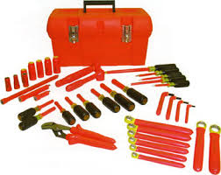
Use brush or vacuum cleaner after you finished
Clean rods with rust cleaner in every day, use specified drill bits
Use of align key must
Check all connection wiring every week
Maintain maintenance
box
Maintenance
Remove unwanted material from blade after use
Clean machine after every use
Sensor should be clean

Slide 11
