Slide 1
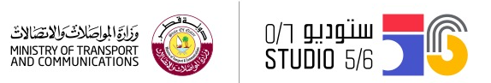
3D Print a mini city
3D modeling and digital fabrication
Studio56.qa

Slide 2
OUR TEAM!
WASIM
MOATH
FERAS
ILARIA
SARAH
MAHA
AYSHA
Studio56.qa
Notes:
Introduce students to Fablab Studio 5/6.
Introduce ourselves.
Ask the participants to introduce themselves.
Make the icebreaking activity (best cities you have been visited).

Slide 3
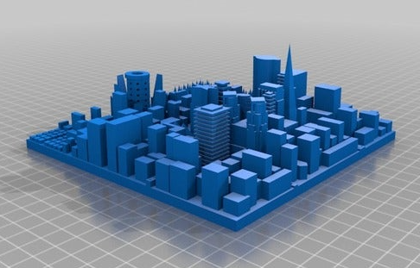
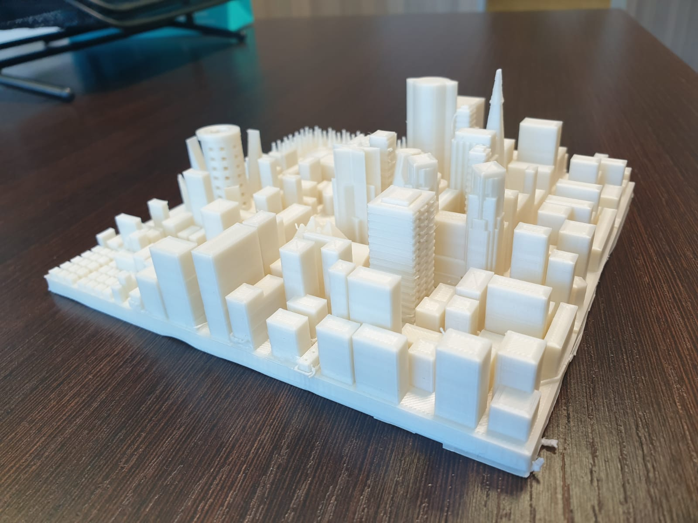
صمم وصنع مدينة مثالية بطريقة ذكية
Design and Fabricate an ideal city in smart way
Studio56.qa
Notes:
❶ Identify the Problem/Need
Distribute the client letter.
Give students time to go through the letter and identify the challenge.
I identify the problem.
❷ Research the problem / Gather information
Discuss with students the concept of smart cities and the best technology to solve the challenge.
Identify the “Need to knows so solve the problem.
Ask students to identify the best solution independently.
Brainstorming.

Slide 4
Maha is a designer and she want to improve the city for kids that have a necessary need, so she will be glad to get your ideas to help and develop a 3D design for a new city.
مها مصممة وتريد تحسين المدينة للأطفال الذين يحتاجون إلى اشياء مهمة ، لذلك ستكون سعيدة للحصول على أفكارك للمساعدة وتطوير تصميم ثلاثي الأبعاد لمدينة جديدة
Studio56.qa
Notes:
❶ Identify the Problem/Need
Distribute the client letter.
Give students time to go through the letter and identify the challenge.
I identify the problem.
❷ Research the problem / Gather information
Discuss with students the concept of smart cities and the best technology to solve the challenge.
Identify the “Need to knows so solve the problem.
Ask students to identify the best solution independently.
Brainstorming.

Slide 5
التصنيع الرقمي
Digital fabrication
التصنيع الرقمي ؟
هو عملية تحويل الملفات الرقمية على الحاسوب إلى أجسام مادية ملموسة باستخدام آلات وأدوات مختلفة
It is the process of converting digital files on our computers to physical objects using different tools and machines
Studio56.qa

Slide 6
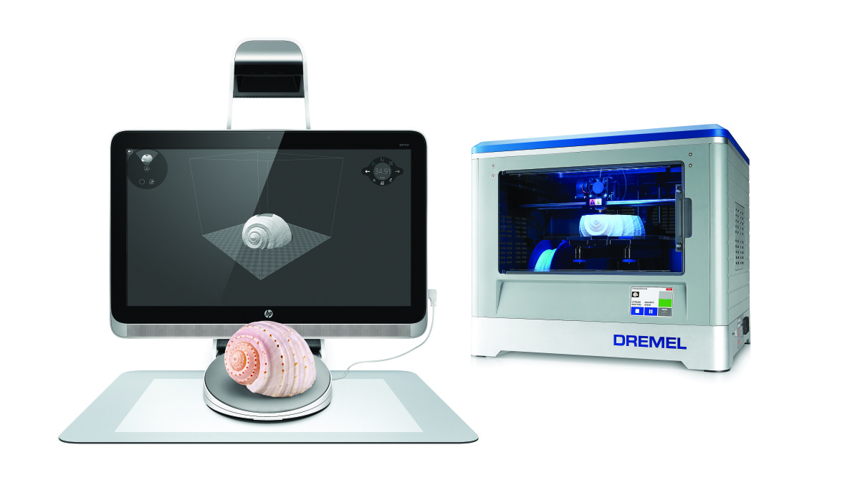
التصنيع الرقمي
Digital fabrication
ماهي هذه الماكنة؟
What is this machine?
Studio56.qa
Notes:
Engage students in discussions, what is this machine ??
Have you heard about this machine before?
Have you seen it before?

Slide 7
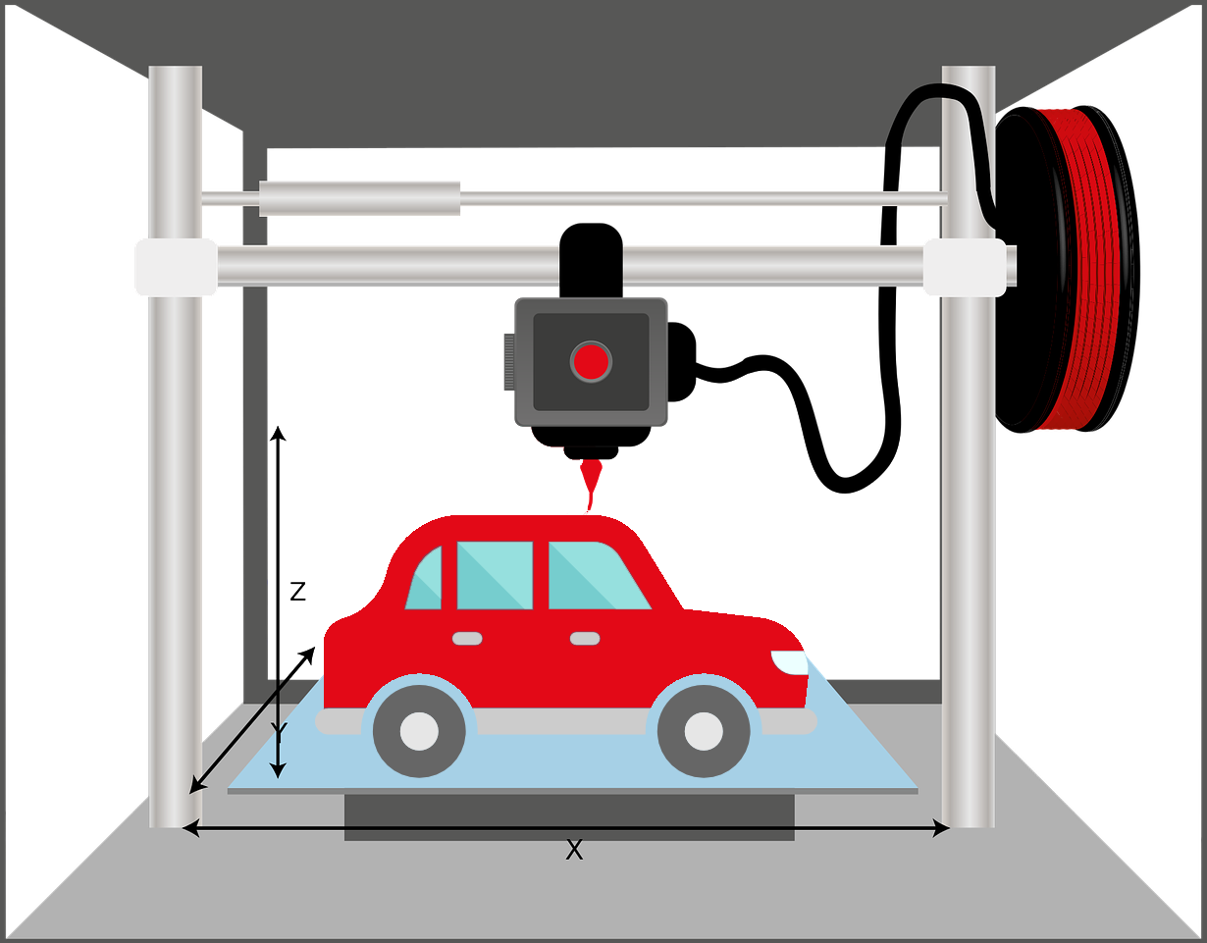
تكنولوجيا الطباعة ثلاثية الابعاد
3D Printing Technology
It is one of the manufacturing techniques in addition, where the pieces are manufactured by printing a layer on top of the other until the final shape is formed.
هي إحدى تقنيات التصنيع بالإضافة، حيث يتم تصنيع القطع عن طريق طباعة طبقة فوق الأخرى حتى يتكون الشكل النهائي.
Studio56.qa
Notes:
Define the 3D Printer
Display a short video about 3D printing .
Show participants different 3D projects.
Encourage the participants to hold and touch the 3D projects.

Slide 8
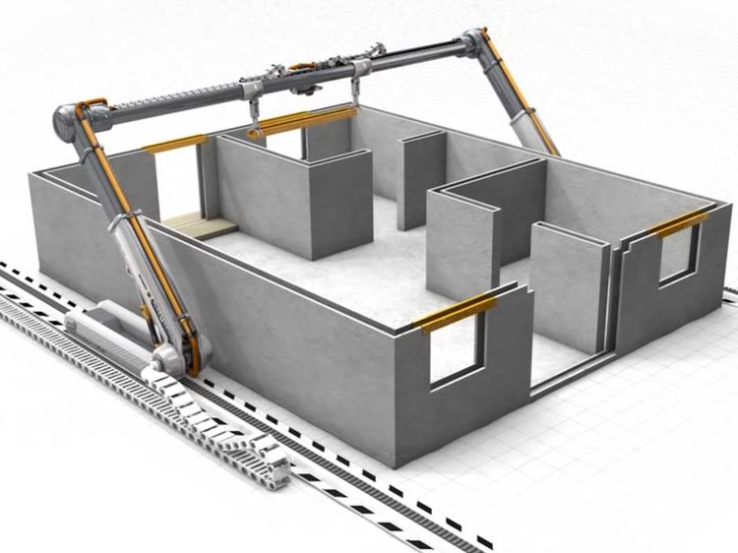
هناك العديد من الاشكال والمجسمات التي يمكن طباعتها ومن الأمثلة على هذه الأشياء البيت المطبوع
3D PRINTING A HOUSE is an example of the ability of a 3D printer.
Studio56.qa
Notes:
Mention the advantages of using 3d printing in houses such like time and cost.
Give an example of a printed house.

Slide 9
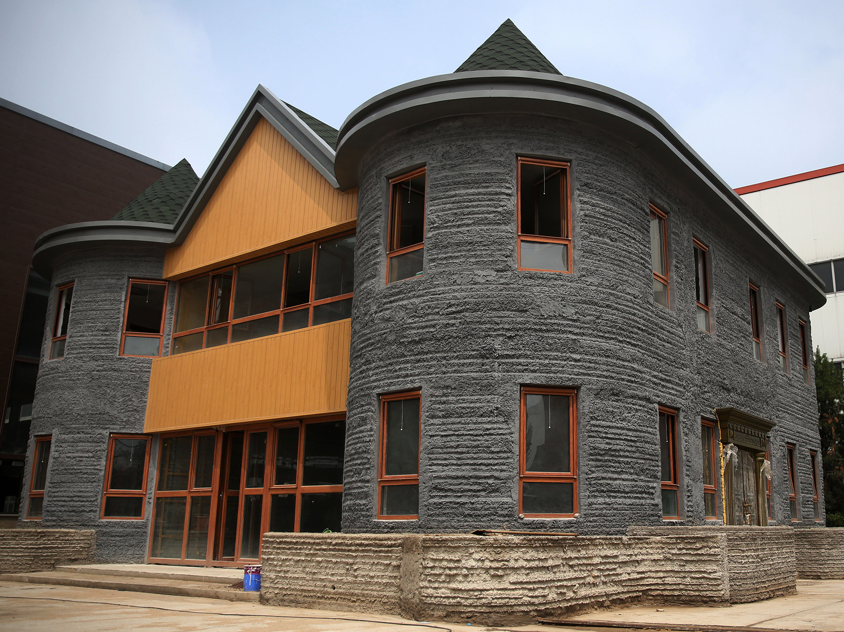
بيت مطبوع بطابعة ثلاثية الابعاد
3D Printed house
Studio56.qa

Slide 10
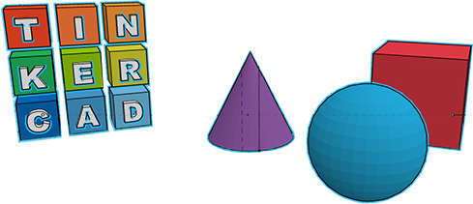
التصميم الثلاثي الابعاد
3D Design
إنشاء تمثيل ثلاثي الأبعاد لأي شكل في مساحة ثلاثية الأبعاد
creating a 3D representation of any surface or object in 3D space.
TINKERCAD
Studio56.qa
Notes:
ask then if they used a design software before.
Explain the 3D design.
Explain what the tools that help to make a 3D design.
Introduction to how to digital fabricate any part through the CAD & CAM process.
Introduction about Tinker cad [8 mins] :
Introduce students to Tinker cad.
Explain to students the basic features.
Encourage students to explore the software

Slide 11
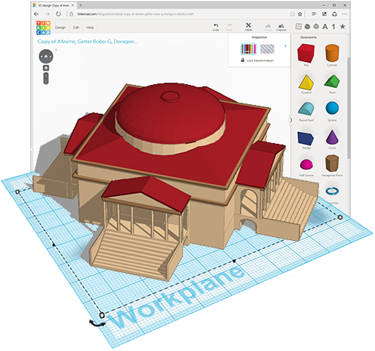
Design & Create A City صمم واصنع مدينة
هيا بنا لنستكشف برنامج التصميم
Lets explore the design software
Studio56.qa
Notes:
3D Designing the city:
Guide the students through designing part of the City.
Challenge the students to complete the 3D design independently. [20 mins]
1- Design the Ground or the base
2- Design Streets and trees
3- Design houses and buildings

Slide 12
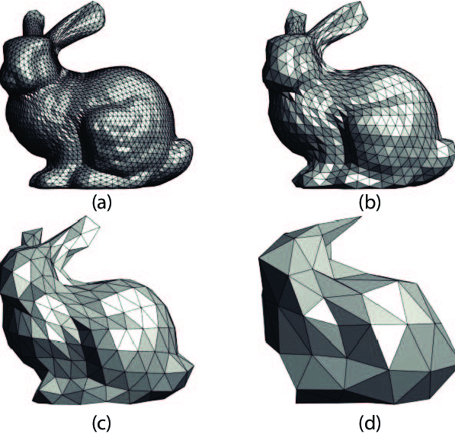
هو امتداد لملف مجسم ثلاثي الابعاد ويتشكل من العديد من المثلثات.
.STLملف
.STL file
An extension of a three-dimensional stereoscopic file consisting of many triangles.
Studio56.qa
Notes:
Define the STL file.
how we can export STL file.

Slide 13
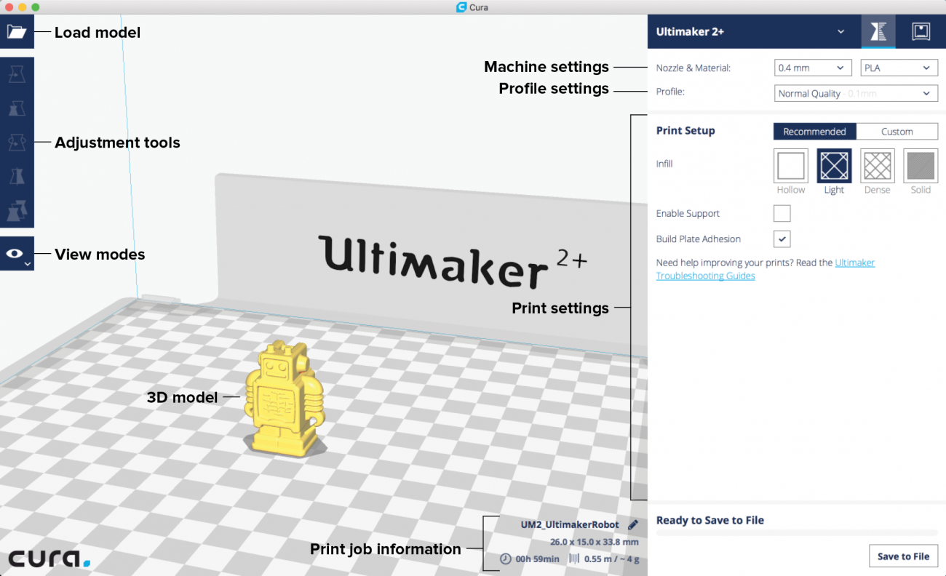
برنامج التصنيع كيورا
CAM software - Cura
Studio56.qa
Notes:
Introduce students that Cura is a software for digital machines like 3d printers
What is the digital machines?
What does cura do? Control the machine
What we can control?
How we can fabricate a part using digital machine?

Slide 14
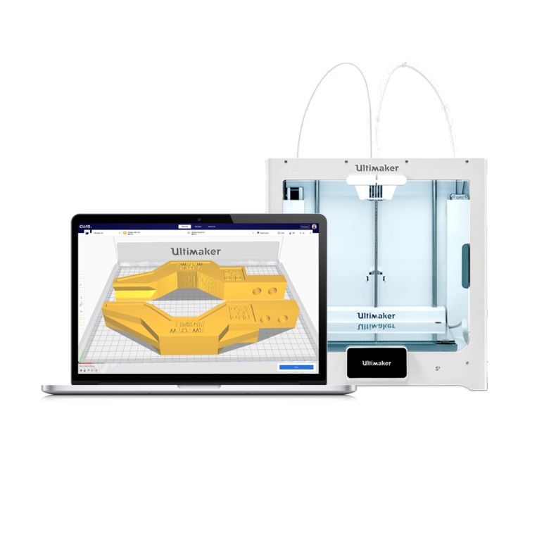
من الالف الى الياء، برنامج كيورا و الطباعة الثلاثية الابعاد
FROM A to Z, CURA SOFTWARE
and 3D Printing
Studio56.qa
Notes:
❶ Introduction to Cura:
Explain and show to students how to export the design from Tinkercad.
Introduce students to Cura software.
Explain to students how to prepare the model for printing using Cura.
❷ Introduce students to the 3D printer.
Explain the mechanism of the 3D printer.
Guide students through the process of printing a file.
Allow students to operate the printer and print the city.

Slide 15
THANKS
info@studio56.qa
Studio56.qa

