Slide 1
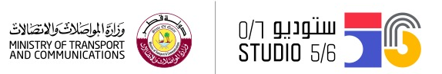
PHYSICS WITH ARDUINO
Summer Workshop
Notes:
1- We are Fablab studio 5/6 and our Vision is to expand knowledge of technology and Empower learners to become technology makers instead of technology consumers.
2- Introduce ourselves
3- Ask the participants to introduce themselves
4- Make the alphabet game – icebreaker

Slide 2
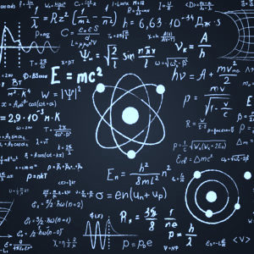
الفيزياء
Physics
Notes:
Introduce the students to physics and ask them about things that is related to it with focusing on light and distance
الفيزياء هو علم يهتم بقياس الاشياء مثل السرعة الجاذبية المسافة الطاقة او الاضائة وابتكار طرق جديدة لقياسها والتي تكون اكثر دقة والهدف هو تفسير و اثبات بعض الظاواهر
مثال على نظرية المسافة وقياسها والاستنتاج ان علم الفيزياء قائم على التجرية
- In schools u learn a lot of theorems and we use equations and complicated formulas to prove them, but today in this workshop we will create a new way by using the technology of digital fabrication instead to prove a physical theorem.

Slide 3

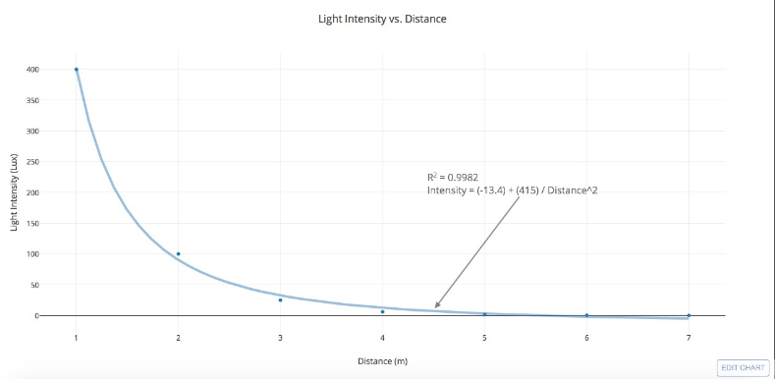
Case study: The intensity of light at the change of distance
Notes:
Demonstrate the equation and the curve

Slide 4
We will build a device with small computer called Arduino and integrated some sensors, and We will prove the equation using this device
سوف نقوم اليوم بصناعة جهاز يحتوي على كمبيوتر صغير يسمى الاردوينو و دمج بعض المستشعرات معه، وسنقوم باثبات المعادلة باستخدام هذا الجهاز
Studio56.qa
Notes:
What we are going to do!

Slide 5
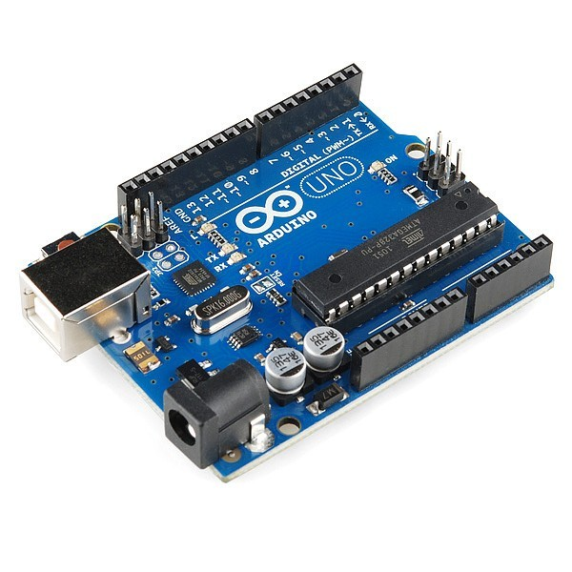
الاردوينو
Arduino
Studio56.qa

Slide 6
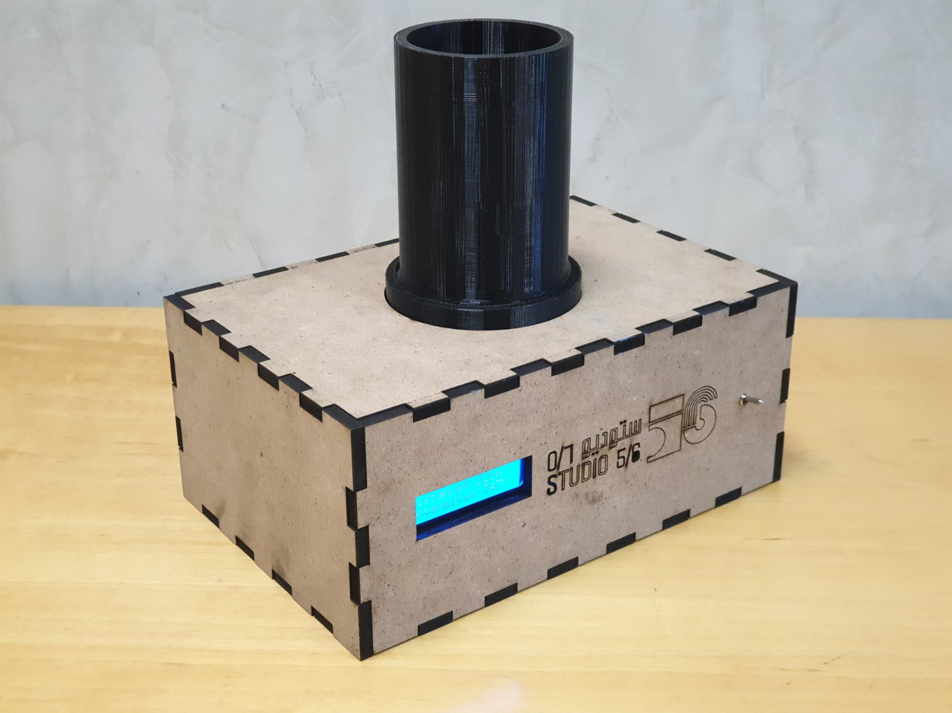
Testing tube prototype to simulate a dark room and prove the physics formula
نموذج انبوب الفحص لمحاكاة غرفة مظلمة لاثبات المعادلة
Studio56.qa
Notes:
1- Demonstrate in details what is the function of the project and its components
2- Mention the microcontroller and engage with the computer concept

Slide 7

الكمبيوتر
The computer
هو جهاز يقبل المعلومات ويعالجها لبعض النتائج بناءا على برنامج او متتالية من التعليمات على كيفية معالجة البيانات.
A computer is a device that accepts information and manipulates it for some result based on a program or sequence of instructions on how the data is to be processed.
Studio56.qa
Notes:
1- Mention that there are a lot of computers around us such as …..and the simplest example is the calculator
2- As we communicate in our language the computer has its own language, it only two numbers (1 and 0), (on and off) (Binary system).
3- One which probably mean that there is a close circuit
4- Zero which probably mean that there is an open circuit

Slide 8
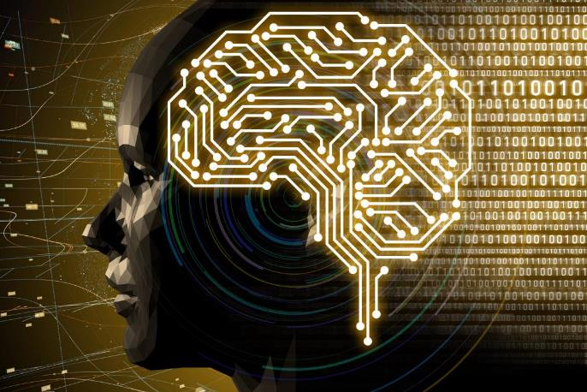
الانسان و الكمبيوتر
Computer and Human
Studio56.qa
Notes:
In this slide let the students to make the group paper activity (Brain Storming) about the differences between the human and computers
Computers are programmed devices by the human like the robots
Let the students imagine that our brain is like the MCU, our senses are like devices and sensors.....

Slide 9
البشر يعتقدون ، وأجهزة الكمبيوتر لا.
البشر يدركون وجودنا وأجهزة الكمبيوتر ليست كذلك.
هناك القليل جدا من القواسم المشتركة بين البشر وأجهزة الكمبيوتر.
في بعض الأحيان تخدعنا أجهزة الكمبيوتر بالاعتقاد بأن لديهم عقلًا. لماذا ا؟ هذا ليس خطأهم ، إنه مجرد غريزتنا. نتخيل أن الأشياء من حولنا لها عقول ، ونحن نحاول أن نتخيل عقولهم ، ونحاول التفكير كما تفعل.
Humans think, and computers do not. Humans are aware of our existence and computers are not. There is very little in common between humans and computers.
Sometimes computers fool us into believing they have a mind. Why? It's not their fault, it's just our instinct. We imagine that things around us have minds, and we try to imagine their minds, and we try to think as they do.
Studio56.qa
Notes:
1- The main difference between computer and human that human can think and they have perception.
2- Give example about human perception

Slide 10
البرامج و الاجهزة
Software and Hardware
Studio56.qa

Slide 11
البرنامج
Software
البرنامج ، بمعناه العام ، عبارة عن مجموعة من التعليمات أو البرامج التي تُوجِّه الكمبيوتر للقيام بمهام محددة.
Software, in its most general sense, is a set of instructions or programs instructing a computer to do specific tasks.
Notes:
Software has many definitions, just let the students to understand that it’s the programs and instructions of any computer.

Slide 12
الاجهزة
Hardware
من الأفضل وصف الأجهزة بأنها أي مكون فعلي لنظام الكمبيوتر الذي الذي يحتوي على لوحة دوائر كهربائية أو غيرها من الأجهزة الإلكترونية.
Hardware is best described as any physical component of a computer system that contains a circuit board, ICs, or other electronics.
Studio56.qa
Notes:
Hardware can be anything touchable in the computer, like Arduino board.

Slide 13
Software and Hardware
البرامج و الأجهزة
الأوراق هي الأجهزة والمعلومات الموجودة في الكتاب هي البرنامج
The papers are the hardware and the information in the book are the software
Studio56.qa
Notes:
Book example, the papers are the hardware and the information is the software
Ask them what is the software and hardware I a computer.

Slide 14
Input devices
أجهزة الادخال
هو اي جهاز يرسل البيانات الى الكمبيوتر، مما يتيح لك التفاعل مع جهاز الكمبيوتر والتحكم فيه.
An input device is any hardware device that sends data to a computer, allowing you to interact with and control the computer.
Studio56.qa
Notes:
Types of input devices:
Audio conversion device
Barcode reader
Biometrics (e.g. fingerprint scanner)
Business Card Reader
Digital camera and Digital Camcorder
Electroencephalography (EEG) - monitoring method to record electrical activity of the brain
Finger (with touchscreen or Windows Touch)
Gamepad, Joystick, Paddle, Steering wheel, and Microsoft Kinect
Gesture recognition
Graphics tablet
Keyboard
Light gun
Light pen
Magnetic ink (like the ink found on checks)
Magnetic stripe reader
Medical imaging devices (e.g., X-Ray, CAT Scan, and Ultrasound images)
Microphone (using voice speech recognition or biometric verification)
MIDI keyboard
MICR
Mouse, touchpad, or other pointing devices
Optical Mark Reader (OMR)
Paddle
Pen or Stylus
Punch card reader
Remote
Scanner
Sensors (e.g. heat and orientation sensors)
Sonar imaging devices
Touchscreen
Voice (using voice speech recognition or biometric verification)
Video capture device
VR helmet and gloves
Webcam
Yoke

Slide 15
Sensors
المستشعرات
يعتبر المستشعر من أجهزة الادخال هو جهاز يكتشف ويستجيب لبعض أنواع المدخلات من البيئة مثل الدخان، الحرارة، الرطوبة ....الخ .
A sensor is an input device that detects and responds to some type of input from the physical environment such as heat, humidity, smoke..etc. .
Studio56.qa
Notes:
In the broadest definition, a sensor is a device, module, or subsystem whose purpose is to detect events or changes in its environment and send the information to other electronics, frequently a computer processor.
Sensors are used in everyday objects such as touch-sensitive elevator buttons (tactile sensor) and lamps which dim or brighten by touching the base, besides innumerable applications of which most people are never aware.

Slide 16
Sensors المستشعرات
البشر لديهم العديد من أجهزة الاستشعار.
البصر، السمع ، الذوق ، الرائحة ، اللمس هي الحواس الخمسة المعترف بها تقليديًا.
Humans have a multitude of sensors. Sight (vision), hearing, taste, smell, and touch are the five traditionally recognized senses.
Studio56.qa
Notes:
Tell them about the human senses and how we get the signals from our world (our cells will sense the signal from our world and send it to our brain).
The same in computer, sensors and input devices send the signals to computer.

Slide 17
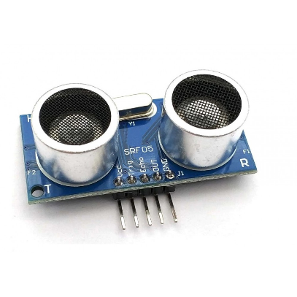
حساس الموجات فوق الصوتية
Ultrasonic sensor
Studio56.qa
Notes:
1- Its an input device used to measure the distance
to know more about this sensor lets see the next picture.

Slide 18
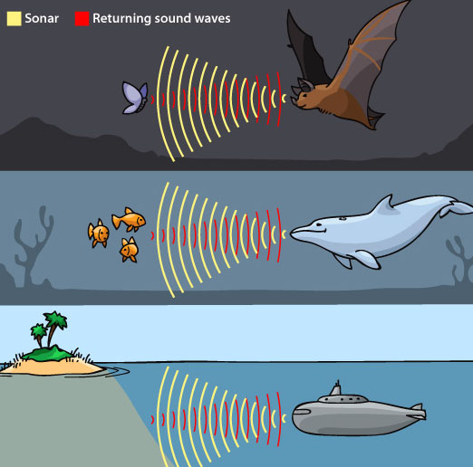
Notes:
What are these waves?
Why we cannot hear this sound?
What is the human detectable frequency
Ultrasonic waves are sound waves transmitted above the human-detectable frequency range, usually above 20,000 Hz. They are used by some animals and in medical or industrial technological devices.

Slide 19
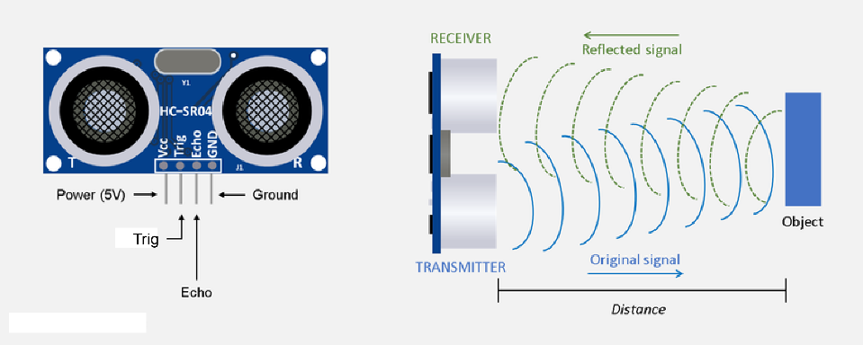
Studio56.qa
Notes:
-How does it works
- Range of the sensor

Slide 20
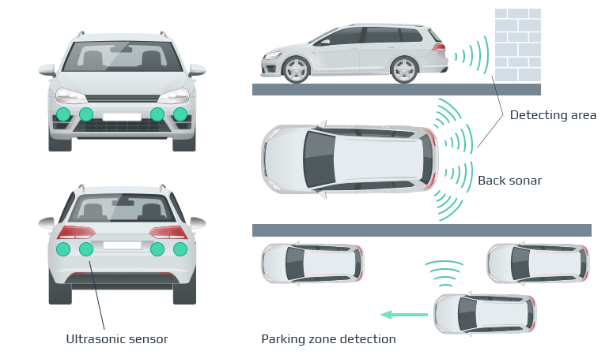
Studio56.qa
Notes:
- Application
The distance sensor in the car

Slide 21
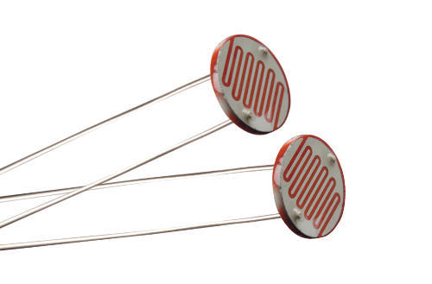
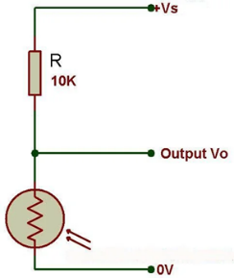
مستشعر الضوء
LDR Sensor
LDR - Light Dependent Resistor
Studio56.qa
Notes:
The Arduino, with its built-in ADC (analog-to-digital converter), then converts the analog voltage (from 0-5V) into a digital value in the range of (0-1023)

Slide 22
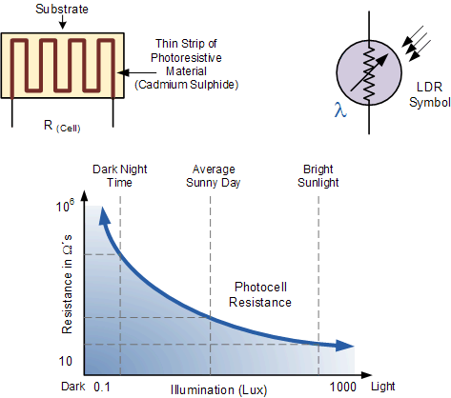
Variation in resistance with changing light intensity
Studio56.qa
Notes:
The most common type of LDR has a resistance that falls with an increase in the light intensity falling upon the device (as shown in the image above). The resistance of an LDR may typically have the following resistances:
Daylight = 5kΩ
Dark = 20MΩ

Slide 23
أجهزة الاخراج
Output devices
أي جهاز يستقبل معلومات تمت معالجتها وإرسالها من جهاز كمبيوتر أو جهاز مشابه ثم يحولها الى مخرجات مثل السماعات، الطابعة ....
An output device is any device used to send data from a computer to another device or user. Most computer data output devices used by humans monitors, projectors, speakers, headphones and printers.
Studio56.qa
Notes:
Any information that has been processed by and sent out from a computer or similar device is considered output.
A simple example of output is anything you view on your computer monitor.
The bottom half of the image to the right shows data being sent from a computer to a printer, which is considered output.
That data is then printed onto a piece of paper, also considered a form of output.

Slide 24
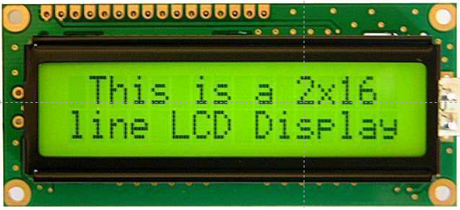
LCD Screen its acronym or abbreviation of
Liquid Crystal display
شاشات عرض الكريستال السائل
Studio56.qa

Slide 25
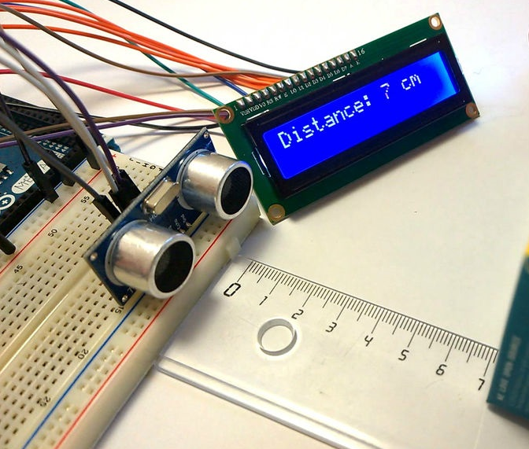
Studio56.qa
Notes:
Say that it is an output device

Slide 26
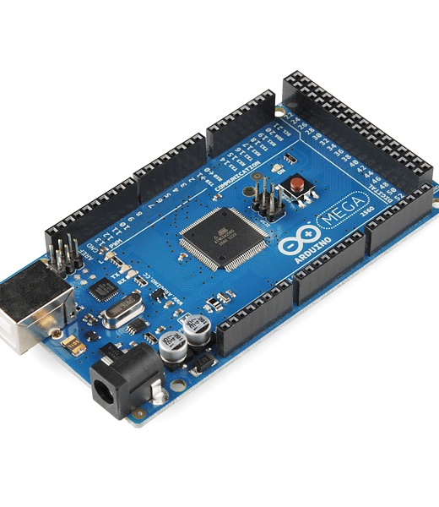
Arduino
عبارة عن منصة إلكترونية مفتوحة المصدر تعتمد على أجهزة وبرامج سهلة الاستخدام. إنه مخصص لأي شخص يقوم بتنفيذ مشاريع تفاعلية.
Arduino is an open-source electronics platform based on easy-to-use hardware and software. It's intended for anyone making interactive projects.
Studio56.qa
Notes:
How easy to deal with Arduino.
Explain what open source does mean.

Slide 27
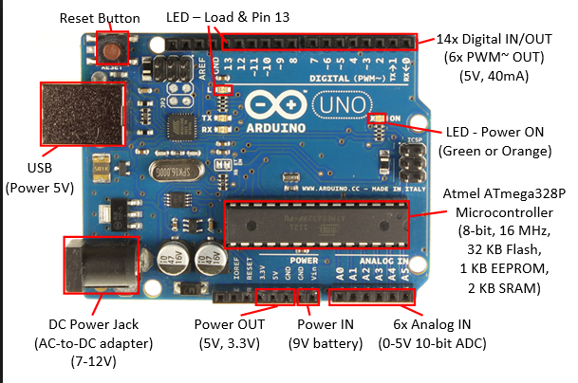
Arduino Uno
Studio56.qa
Notes:
Let them see their Arduino’s.
Explain for them its components, like:
The microcontroller, I/O pins, oscillator.

Slide 28
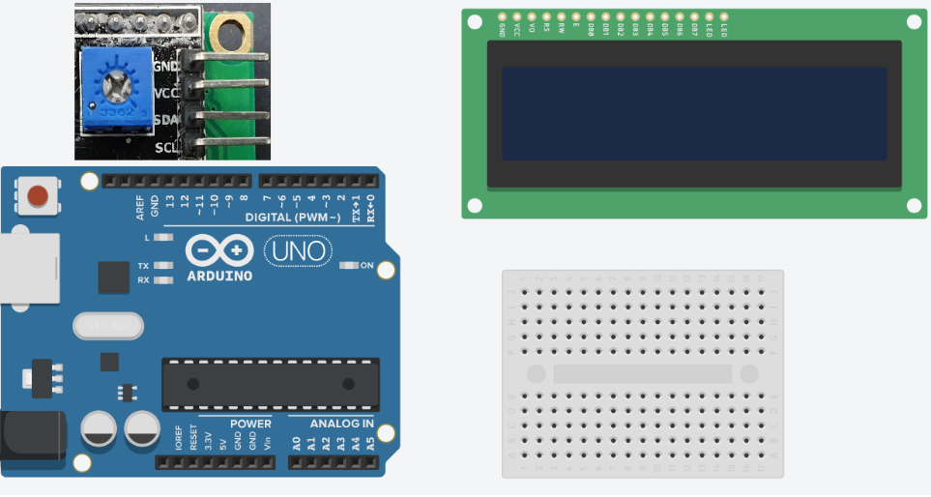
Activity 1 النشاط
Hello world
LCD Arduino
GND------------→GND
VCC-------------→VCC
SCL------------→A5
SDA-----------→A4
Studio56.qa
Notes:
Explain the Breadboard

Slide 29
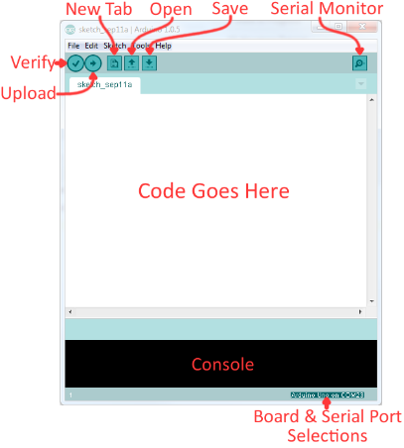
1- connect the Arduino with the USB
2- Open Arduino IDE
2- Press Open →LCD code 1
3- Press Upload
Studio56.qa
Notes:
Arduino IDE is the same of other ordinary software's.
Button number 1 is to check if the Arduino code is true or false.
Button number 2 is to upload the Arduino code to the Arduino.
Button number 3 is to make a new file.
Button number 4 is to open Arduino code from the computer.
Button number 5 is to save the Arduino code to the computer.
Button number 6 is to open serial monitor.
Button number 7 is the tab of Arduino code.
Button number 8 is the workspace of the Arduino code.

Slide 30
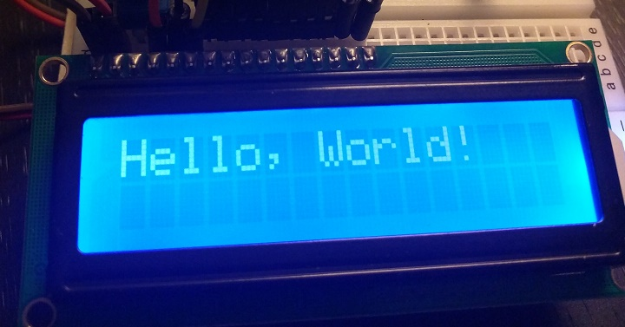
Studio56.qa

Slide 31
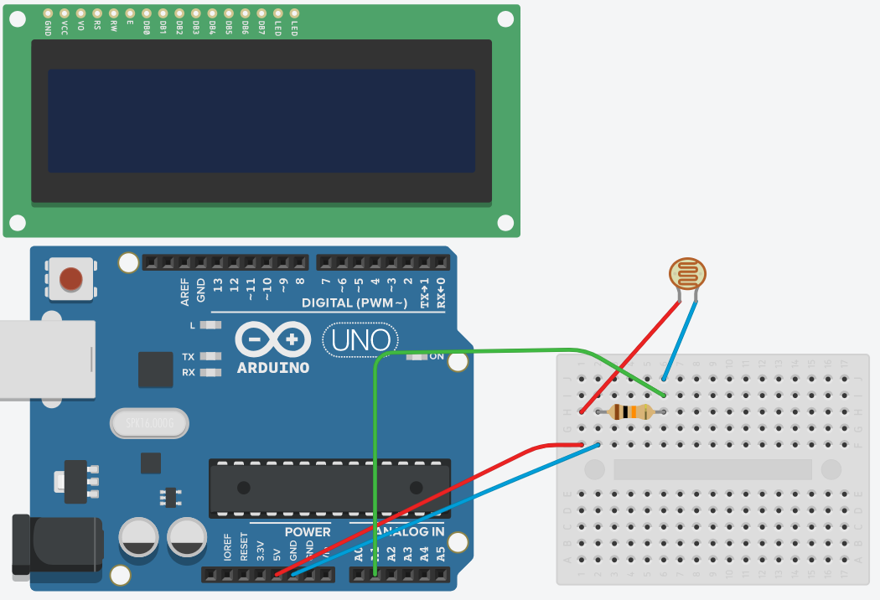
Activity 2 Light intensity النشاط 2 شدة الاضاءة
LDR Sensor

Slide 32
1- connect the Arduino with the USB
2- Open Arduino IDE
2- Press Open →LDR code 2
3- Press Upload!!
Studio56.qa

Slide 33
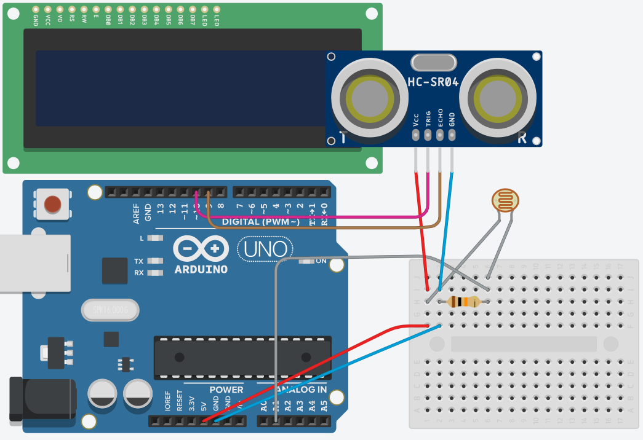
Activity 3 - distance & intensity
Arduino Ultrasonic
5V------------→VCC
GND-----------→GND
PIN 9 ---------→TRIG
PIN 10 --------→ECHO
النشاط 3 قياس المسافة والاضاءة

Slide 34
1- connect the Arduino with the USB
2- Open Arduino IDE
2- Press Open →Final code 3
3- Press Upload!!
Studio56.qa
Notes:
Arduino IDE is the same of other ordinary software's.
Button number 1 is to check if the Arduino code is true or false.
Button number 2 is to upload the Arduino code to the Arduino.
Button number 3 is to make a new file.
Button number 4 is to open Arduino code from the computer.
Button number 5 is to save the Arduino code to the computer.
Button number 6 is to open serial monitor.
Button number 7 is the tab of Arduino code.
Button number 8 is the workspace of the Arduino code.

Slide 35
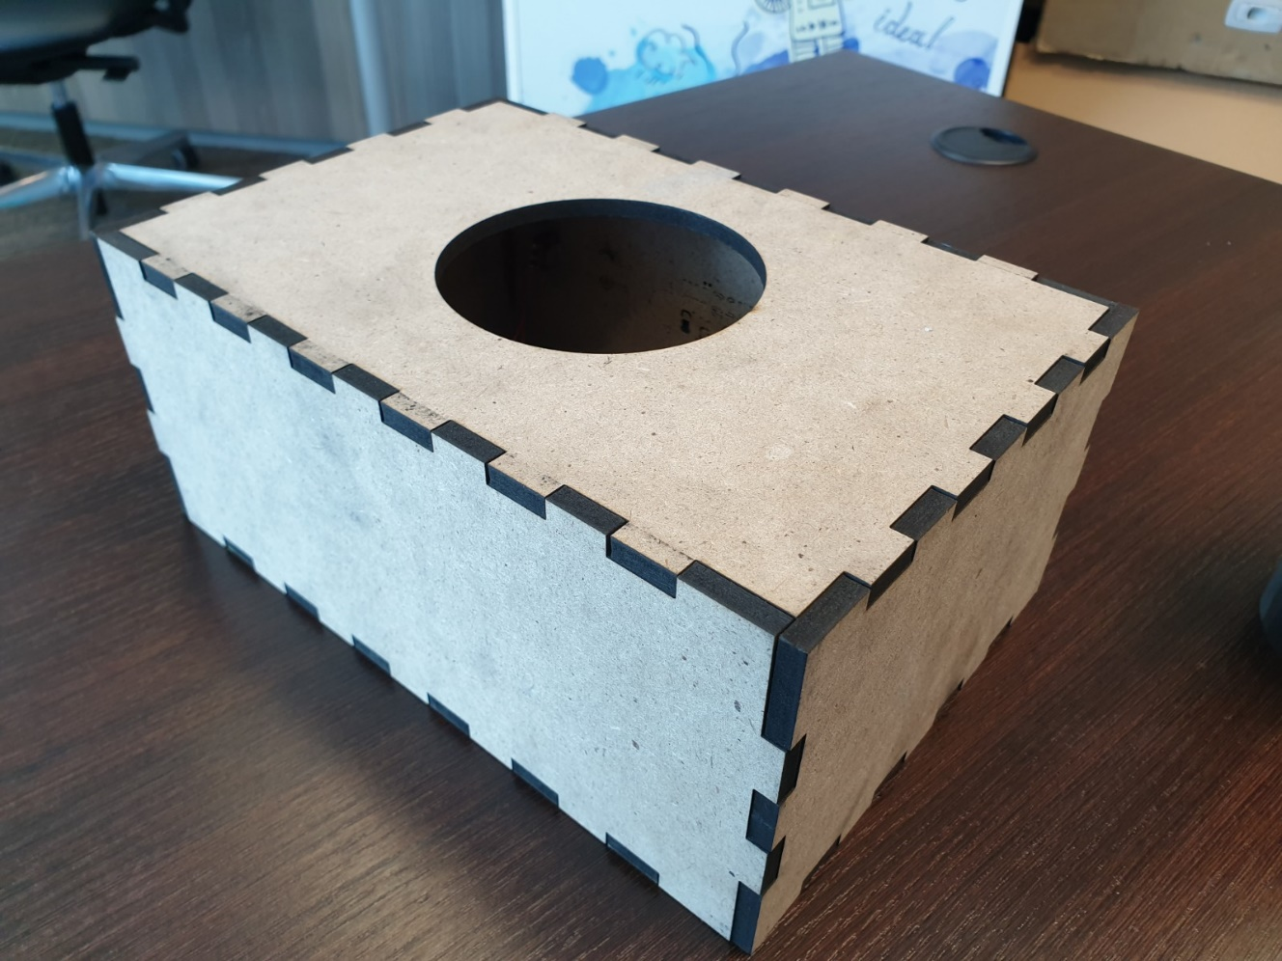
Assembly التجميع
نقوم بتجميع الصندوق ولصق الزوايا
Assemble the box and glue the corners
Studio56.qa

Slide 36
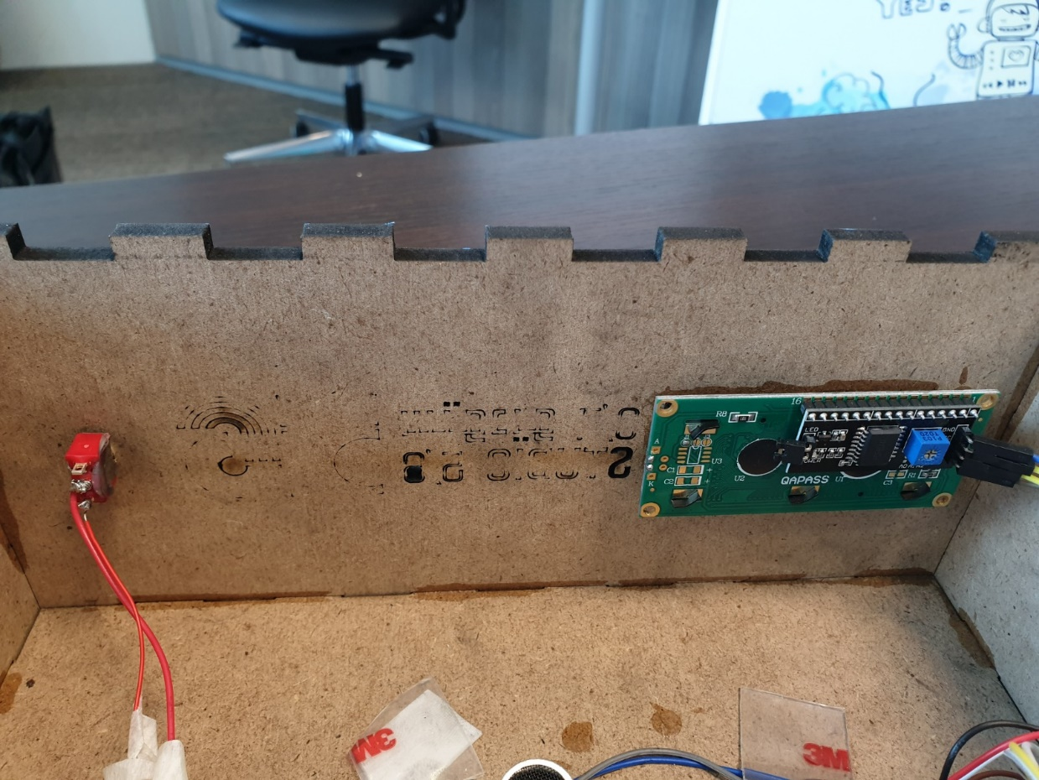
Assembly التجميع
نقوم بتثبيت الشاشة والمفتاح بالاماكن المخصصة باستخدام الاصق
Fix the screen and the switch with the glue

Slide 37
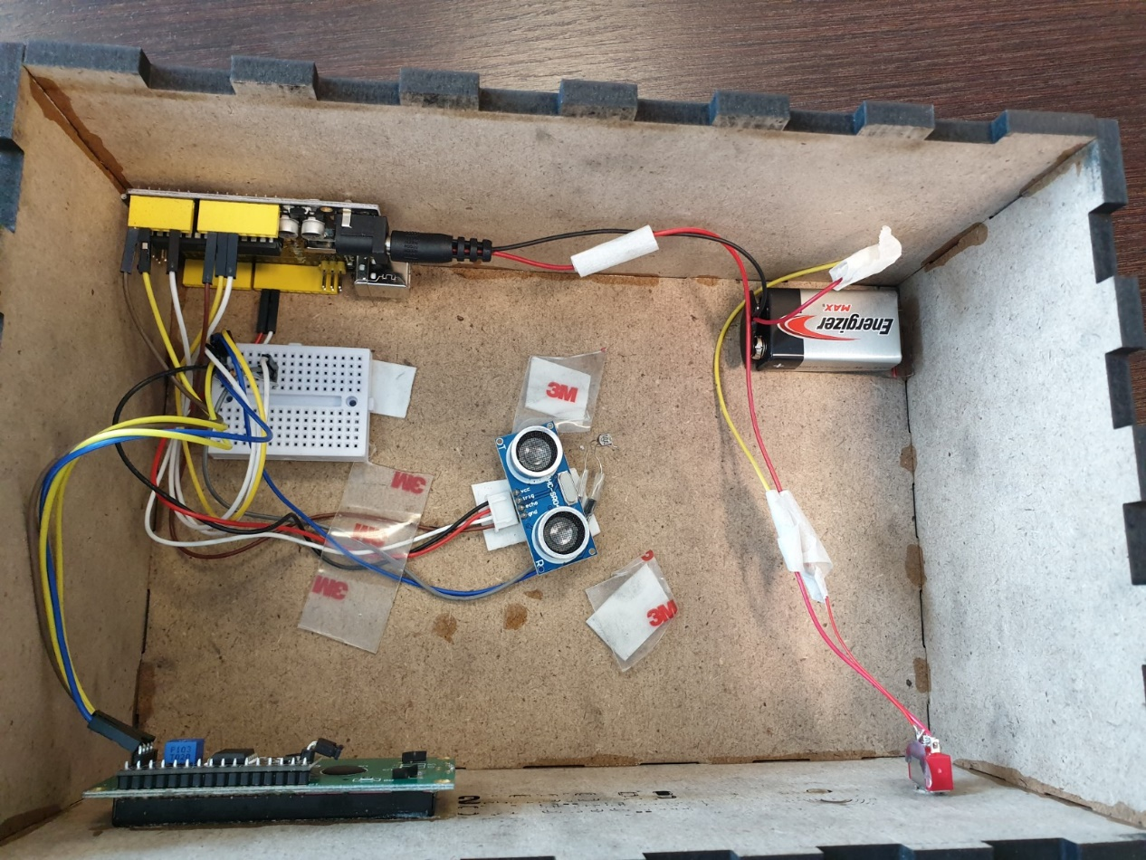
Connect all electronics devices and integrate the sensors in the middle of the box and measure the light intensity and distance.
قم بتوصيل جميع الأجهزة الإلكترونية ودمج المستشعر مناصف الصندوق وقياس شدة الضوء والمسافة.
Notes:
Test the prototype with a light source

Slide 38
measure the light intensity and distance.
قس شدة الضوء والمسافة.
Notes:
Test the prototype with a light source

Slide 39
THANKS
info@studio56.qa
Studio56.qa

