Slide 1


Light Up the National Day
Studio56.qa

Slide 2
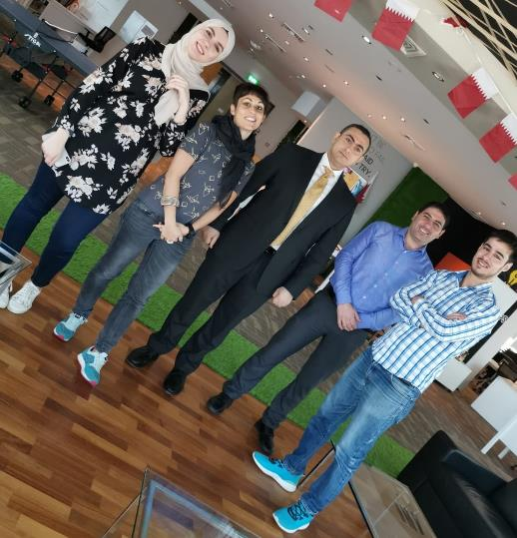
Our Team
I am Sarah Boussaa
Wasim
Ilaria
Moath
Feras
Maha
Aisha
Studio56.qa

Slide 3
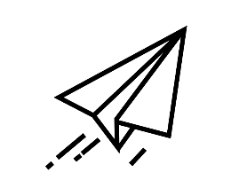
FLY WITH US!
You have 1 minute to make your own paper plane and write one word to Qatar!
Studio56.qa

Slide 4
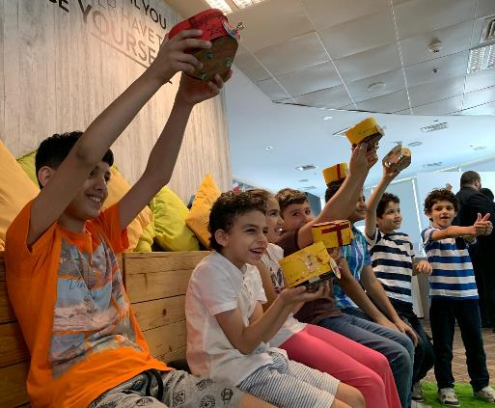
WHO ARE WE?
STUDIO 5\6 is a fabrication lab targeting kids from age 7 to 18.
_____
We will have Fablab with different machines and tools to use for creating active prototypes.
Studio56.qa

Slide 5
¿Where we can fabricate our objects?
FAB LAB
Fabrication Laboratory
Studio56.qa

Slide 6
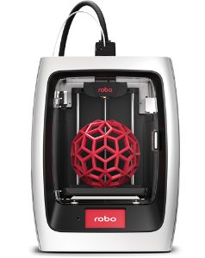
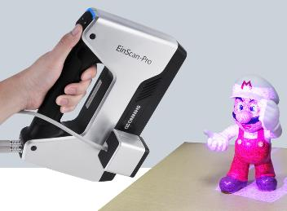
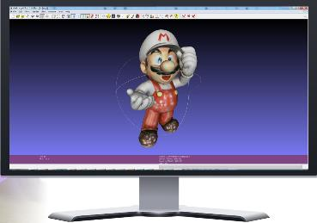
DIGITAL FABRICATION
It is the process of converting digital files on our computers to physical objects using different tools and machines.
3D scanning
Digital File
3D printing
Studio56.qa

Slide 7
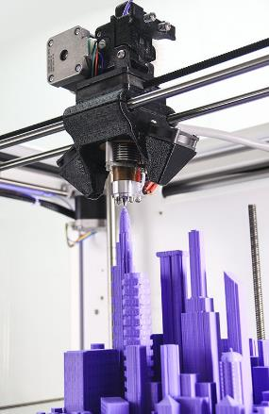
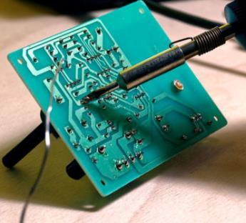
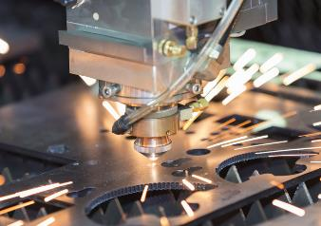
Machines and Tools that allow us to bring digital to the real-world are :
3D printing
Electronics and programming
Laser cutting
Studio56.qa

Slide 8
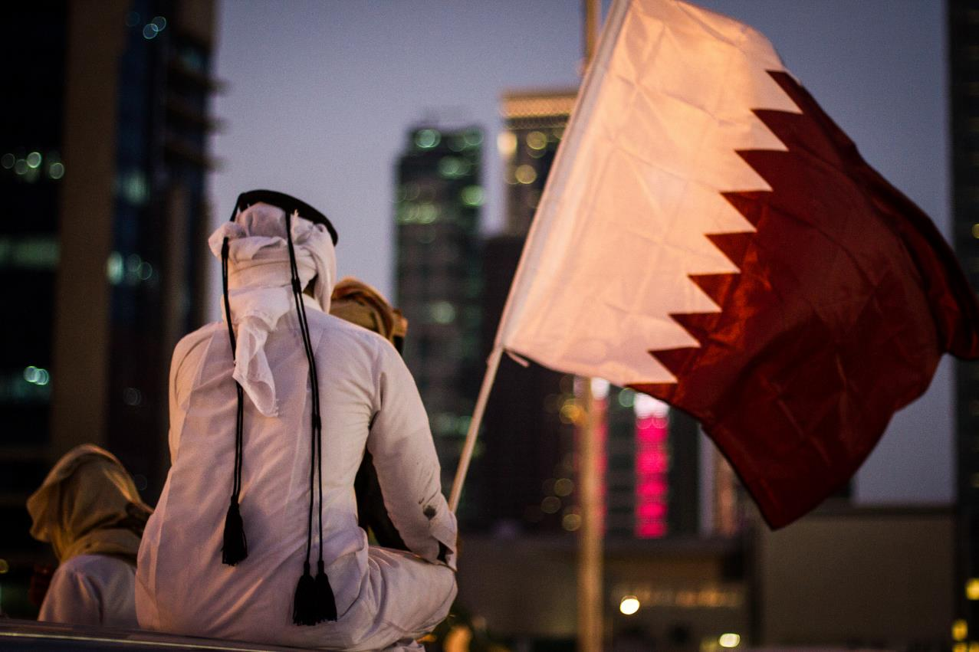
How we will be celebrating the National Day on 2030?
Studio56.qa

Slide 9
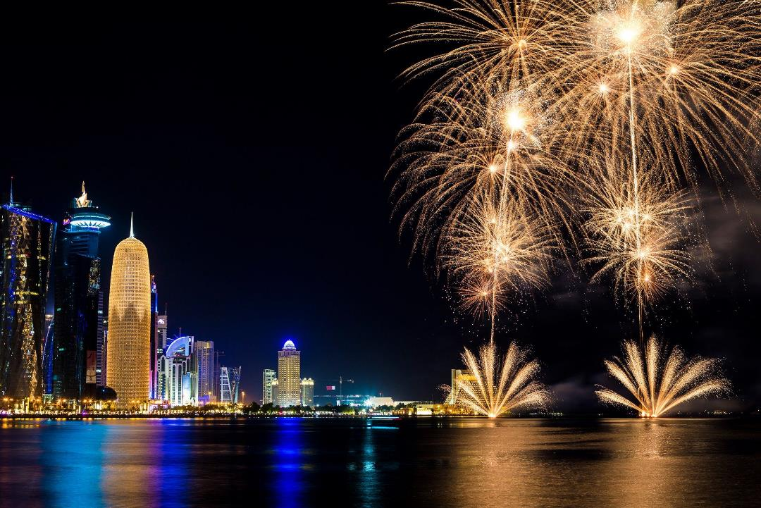
How
they
celebrate the National Day
in
Qatar ?

Slide 10
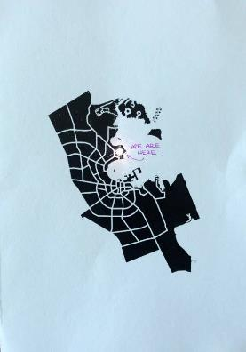
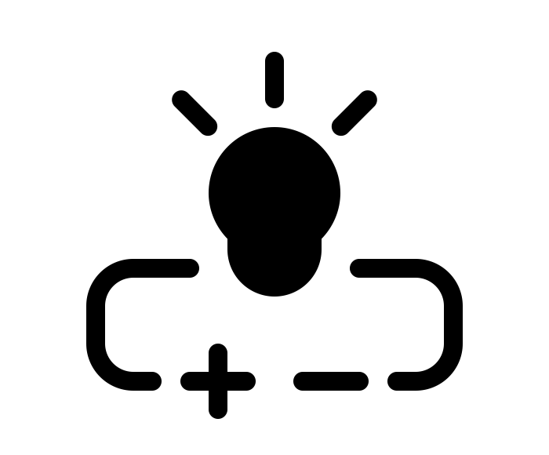
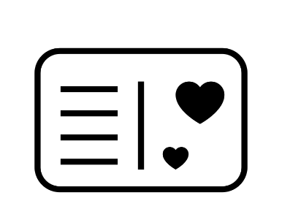
What will we do today?
Studio56.qa

Slide 11
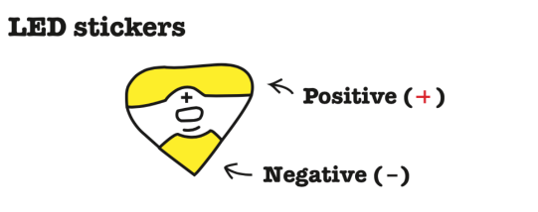
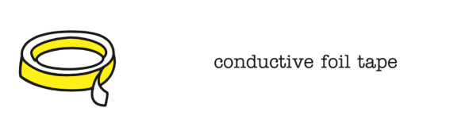
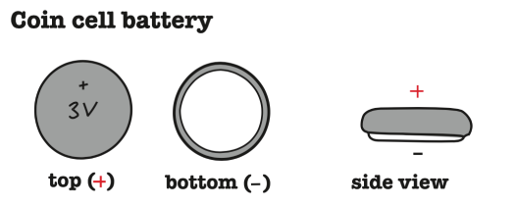
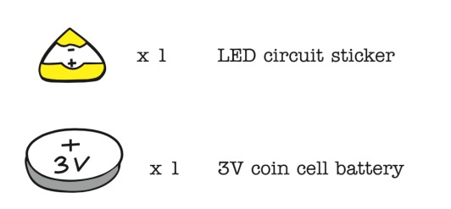
What are the components of the electric circuit ?

Slide 12



How does the electric circuit work?
ー
ー
＋
＋
ON
OFF
Studio56.qa

Slide 13
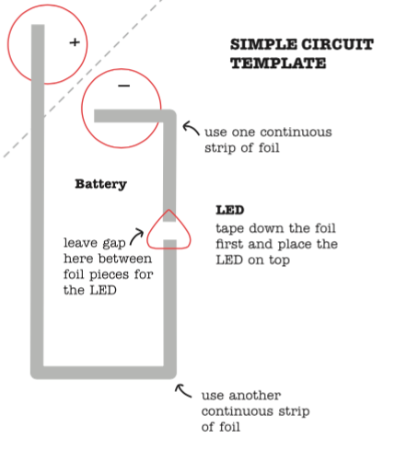
How are the components connected ?

Slide 14





LET’S MAKE IT!

Slide 15
THANKS
info@studio56.qa
Studio56.qa

