Slide 1
Traffic Light Online Workshop
Software Account Instructions
- The software that kids will work on it to build the prototype is called Tinkercad.
- Tinkercad is an online design platform.
Kids or parents need to build an account to be able to open the design page.
Follow bellow instructions to build account.
Start with this Link :
https://www.tinkercad.com/

Slide 3
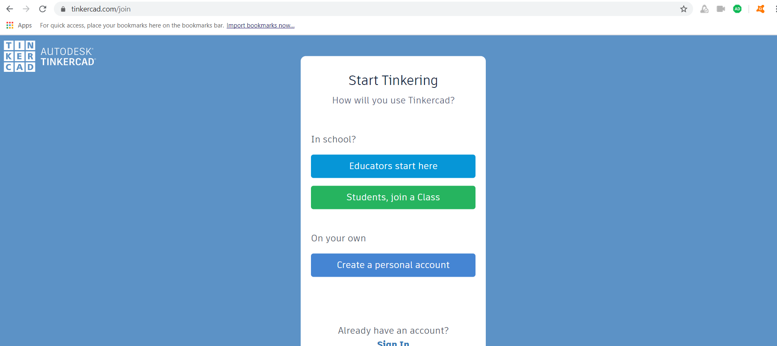

Slide 4
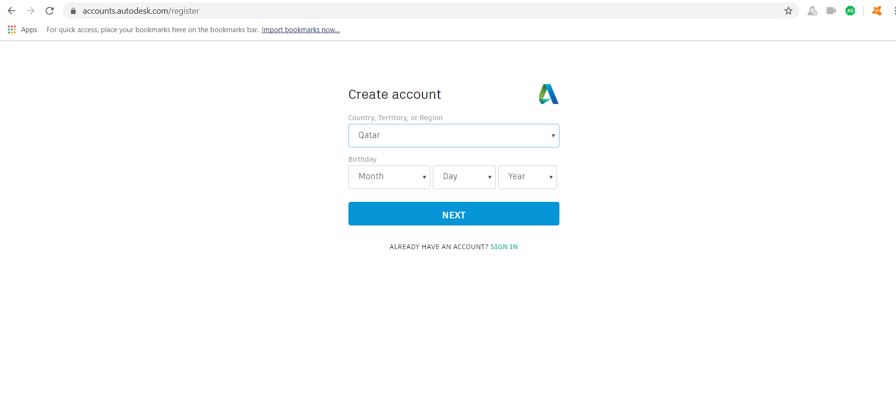
Age Above 18

Slide 5
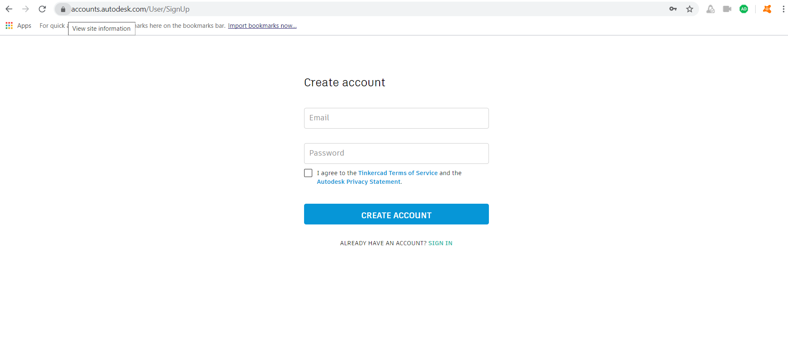

Slide 6
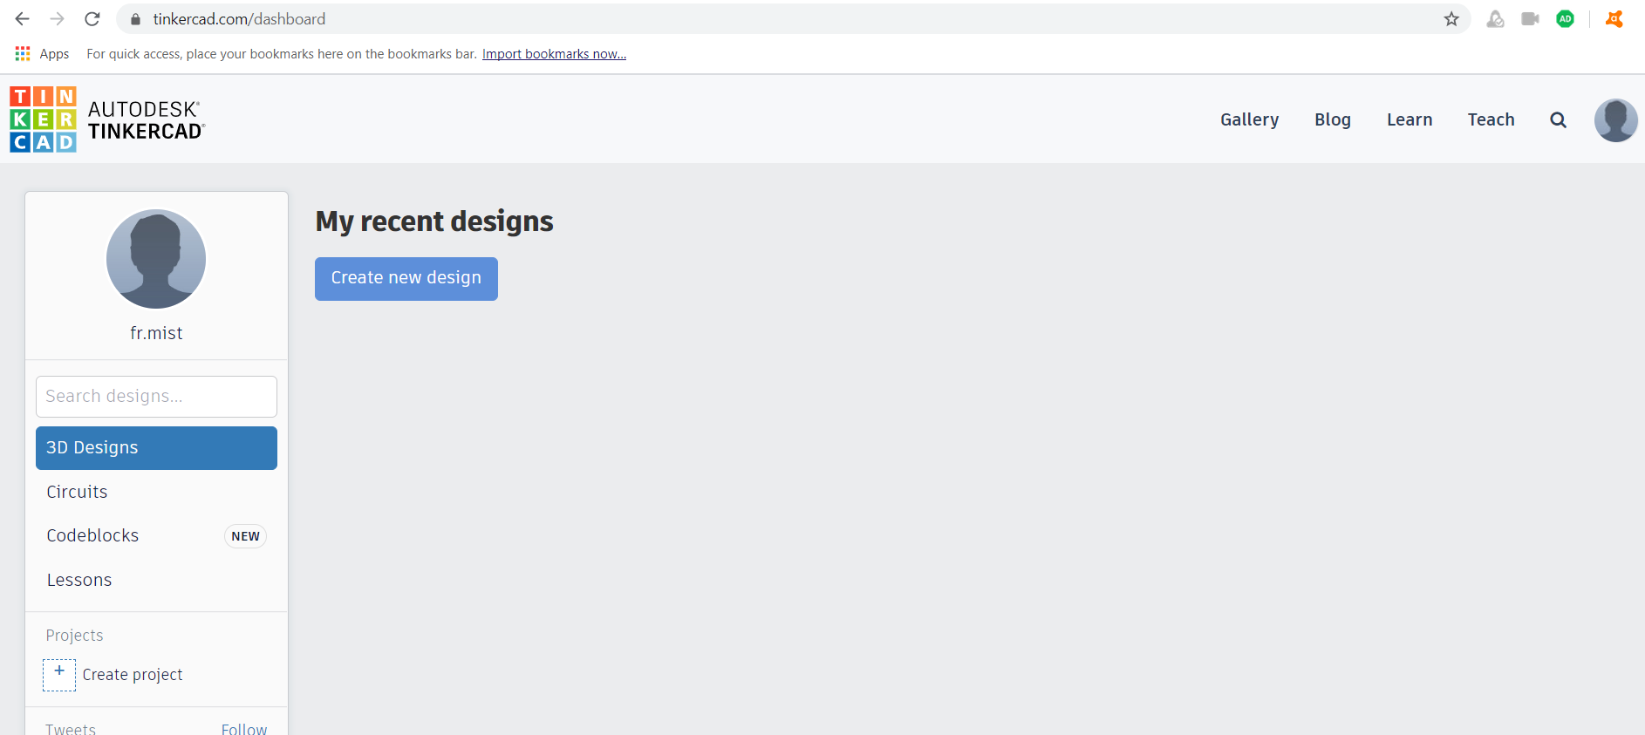
Final Page should be like following

