Slide 1

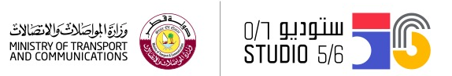
Build your Virtual Character
Studio56.qa

Slide 2
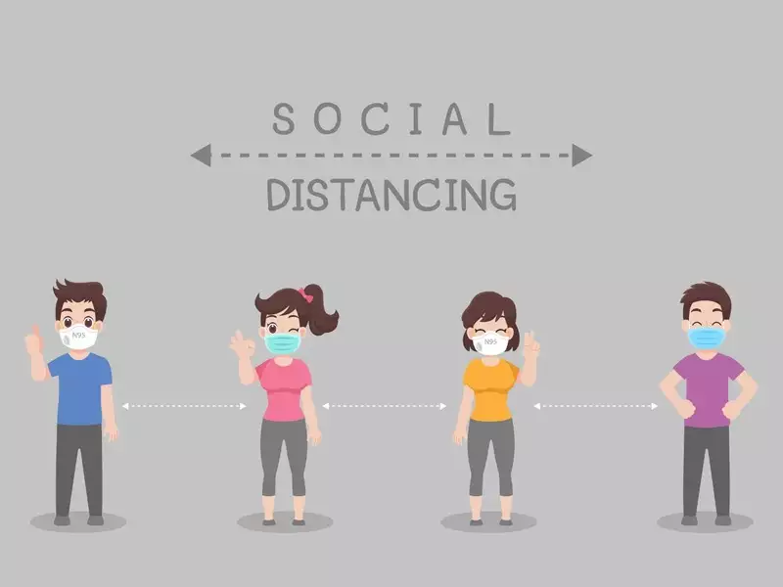
Talk to the World
Studio56.qa

Slide 3
Talk to the World
Studio56.qa

Slide 4
Talk to the World
Studio56.qa

Slide 5
Talk to the World
Studio56.qa

Slide 6
Talk to the World
Studio56.qa

Slide 7
Talk to the World
Studio56.qa

