Slide 1

Personal Image Classifier PIC
11-14
Studio56.qa
Notes:
Ask them if they have attended our workshops before.
Introduce Microsoft Teams.
Don’t forget to go through the presentation in just 10 minutes.

Slide 2
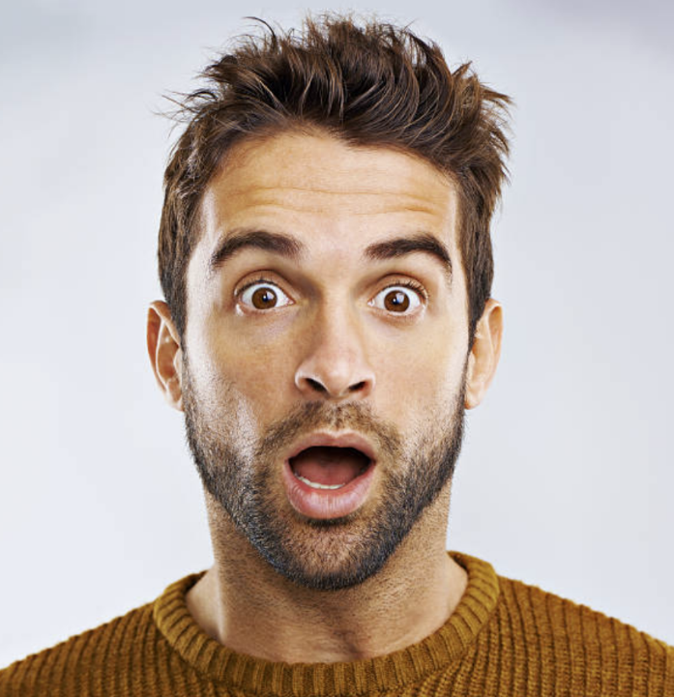

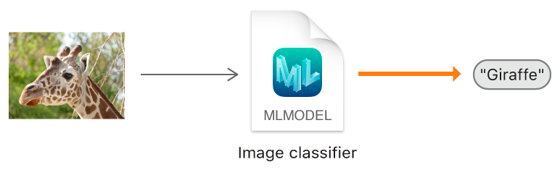
Image classification
Notes:
If I ask you to describe each picture in one word what would you say!!
You will probably say the 1st picture is for a surprised person and the 2nd picture is for a sad person
So, from our eyes we classified the emotions of those two pictures

Slide 3
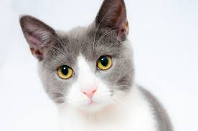

What is image classification?
Image classification is the process in which an image is matched to a specific word.
You do this all the time with your eyes and brain just looking around at the world!
CAT
Studio56.qa
Notes:
Can a computer recognize the photos and emotions like us?
Is this hard or easy for a machine?

Slide 4
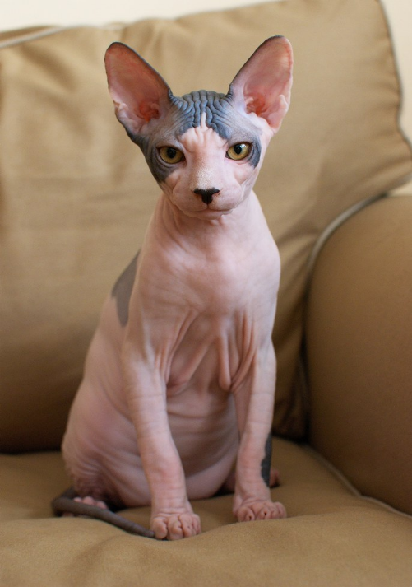
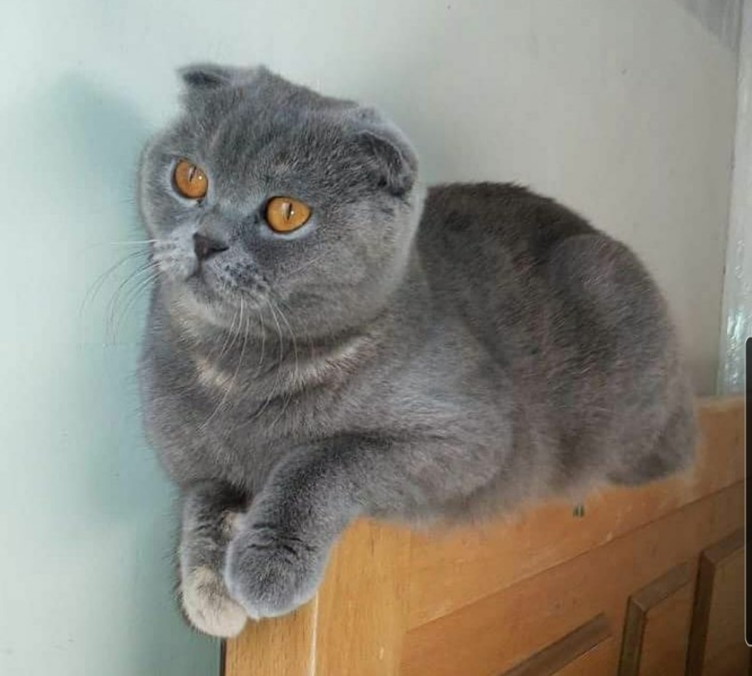
Why is this hard for machines?
Machines don’t have systems as complex as our brains.
We can see that these images are both cats, but they look so different it would be hard for a machine to figure out.
Studio56.qa

Slide 5
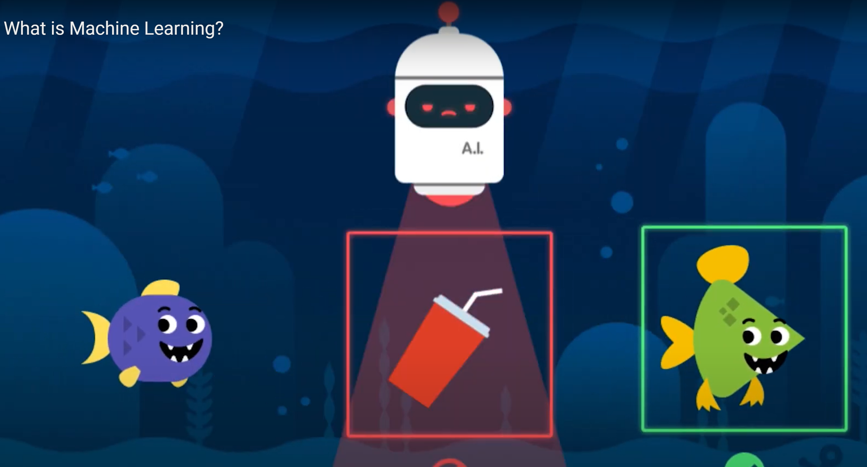
Notes:
Have you heard about machine learning?
What do you know about machine learning?
What do you understand from the picture?
the AI Robot is detecting trash and remove it to clean the ocean, but how does this Ai robot know how to differentiate between fish and trash??
we train the robot by showing him pictures of fish and pictures of trash, so the Ai robot learns from us how to separate between things without being programmed.
What Will happen if you give wrong training for the machine, for example showing it a purple fish and telling him this is a trash?
He will do the same mistake that you did and classify the fish as trash because the behavior of your Ai robot based in your bias

Slide 6
AI & Machine Learning (ML)
Machine learning is a subset of Artificial Intelligence, Let’s watch this video to learn more about it.
Studio56.qa

Slide 7
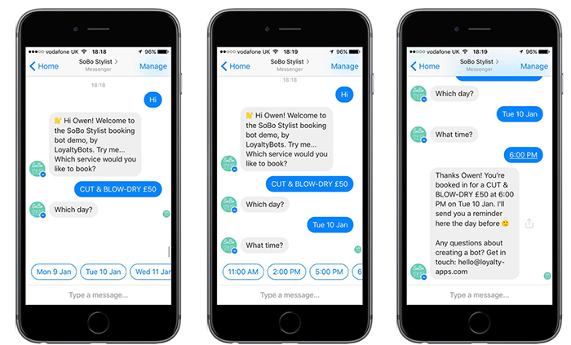
Where have you seen or experienced
artificial intelligence in your lives?
Studio56.qa
Notes:
Put some pictures for kids to recognize
Examples from the video include:
email filters
auto-complete text
video recommendation systems
voice recognition
translation apps
digital assistants
image recognition
Based on what you saw in the video, what is machine learning?
Machine learning the ability of a computer to or machine to recognize patterns and make decisions without being programmed.

Slide 8

Image Recognition using Machine Learning
Because there are so many parts of an image to consider, a machine needs to be able to learn, just like us, to correctly classify an image.
To do this it uses machine learning, a method that lets the machine learn from images.
Studio56.qa

Slide 9
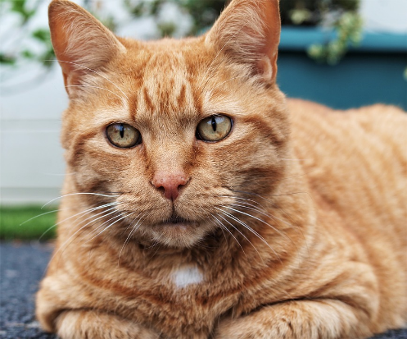
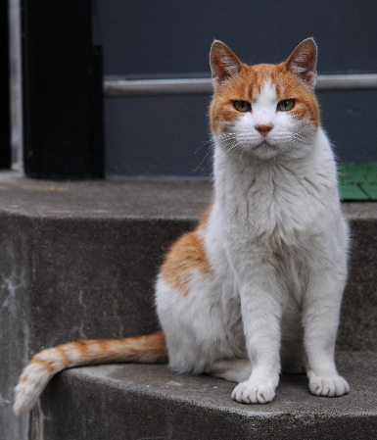
Testing and Training
To teach a machine to recognize images, you give it training examples first so it can learn what certain images are supposed to look like.
Then, you can give it testing examples to see if it is correct!
TRAINING
TESTING
“This is a cat. Learn to classify this as a cat.”
“Now, tell me what this image is.”
Studio56.qa
Notes:
Describe how to train a machine

Slide 10
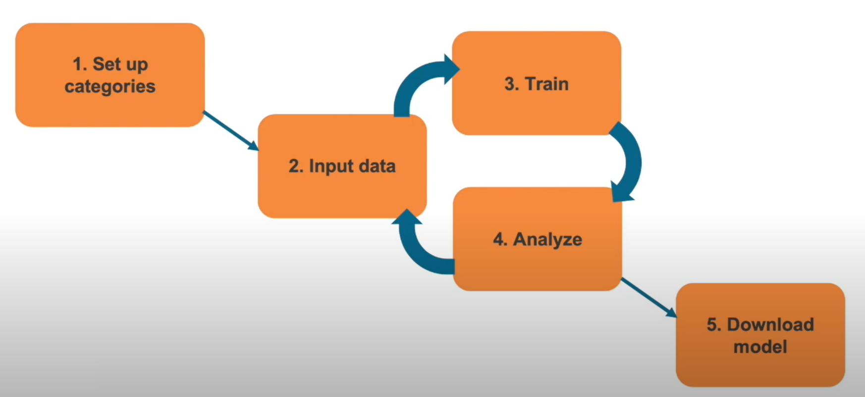
Personal image classifier Web Tool
Studio56.qa

Slide 11
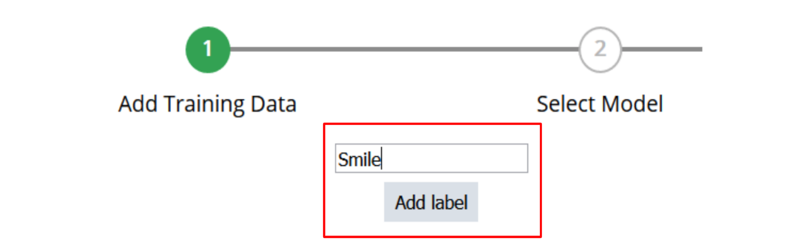
Training Steps
Define Labels
  Name your classes/labels (happy, sad, angry…)

Slide 12
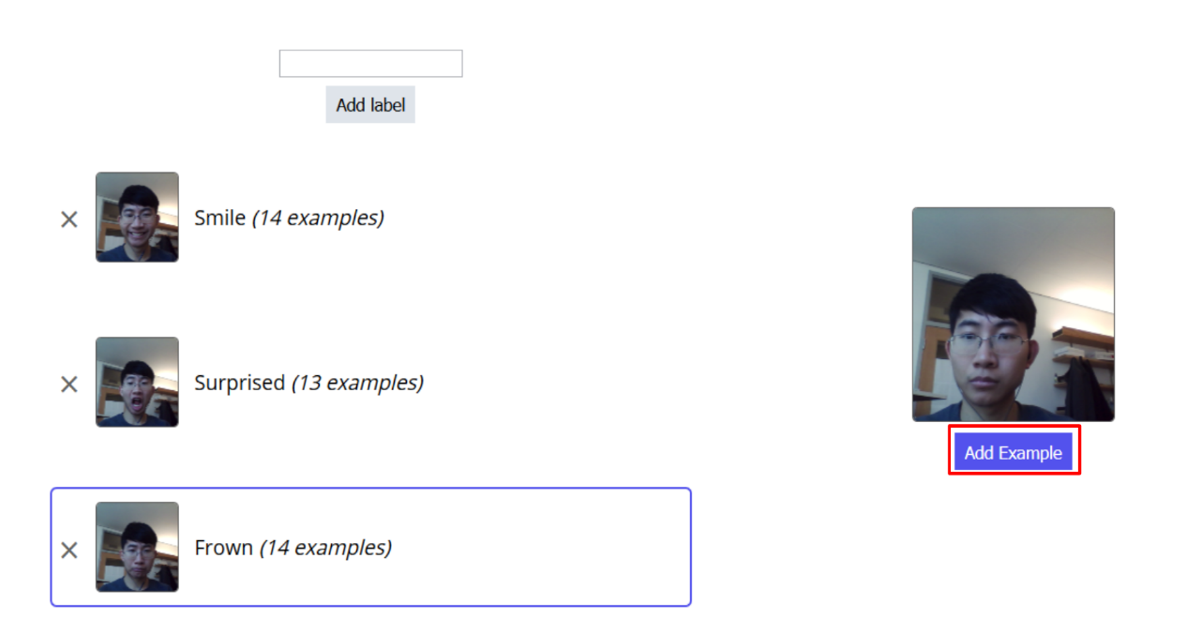
Training Steps
Add Training Data
  Take several pictures for each label, and/or upload images

Slide 13
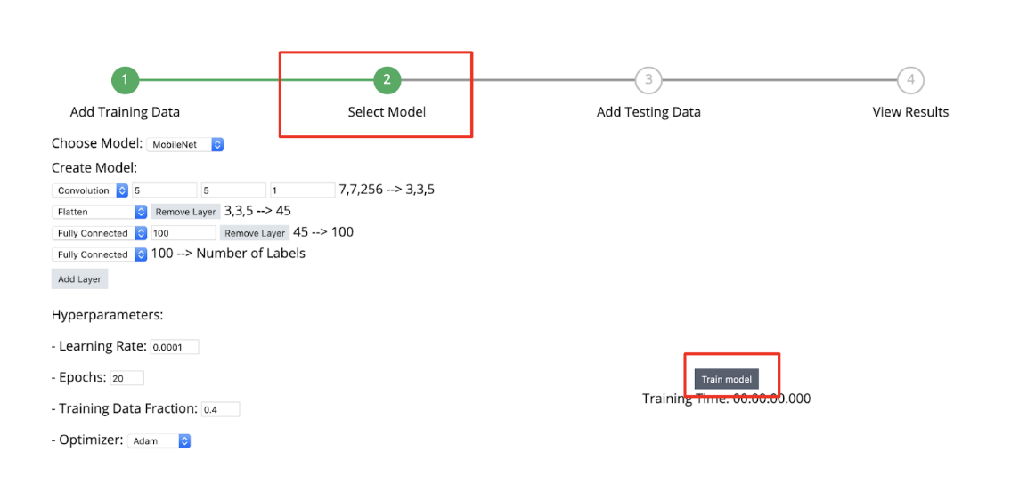
Training Steps
Select Model
  Can change parameters for model
  Best to use default values
  Press “Train model” button

Slide 14
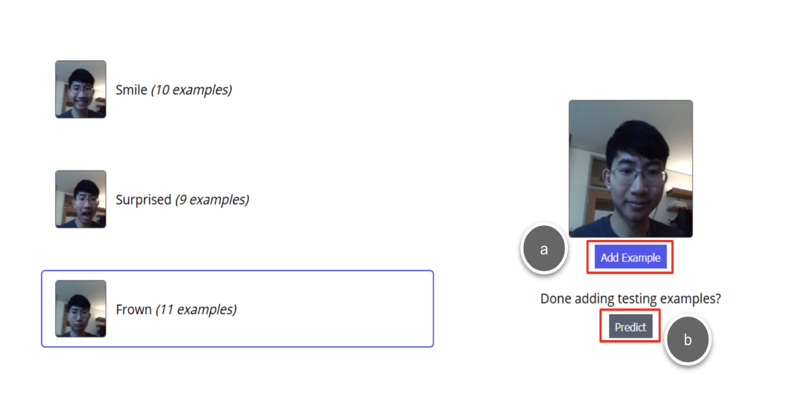
Training Steps
Add Testing Data
  Take several pictures (or upload) to test each label

Slide 15
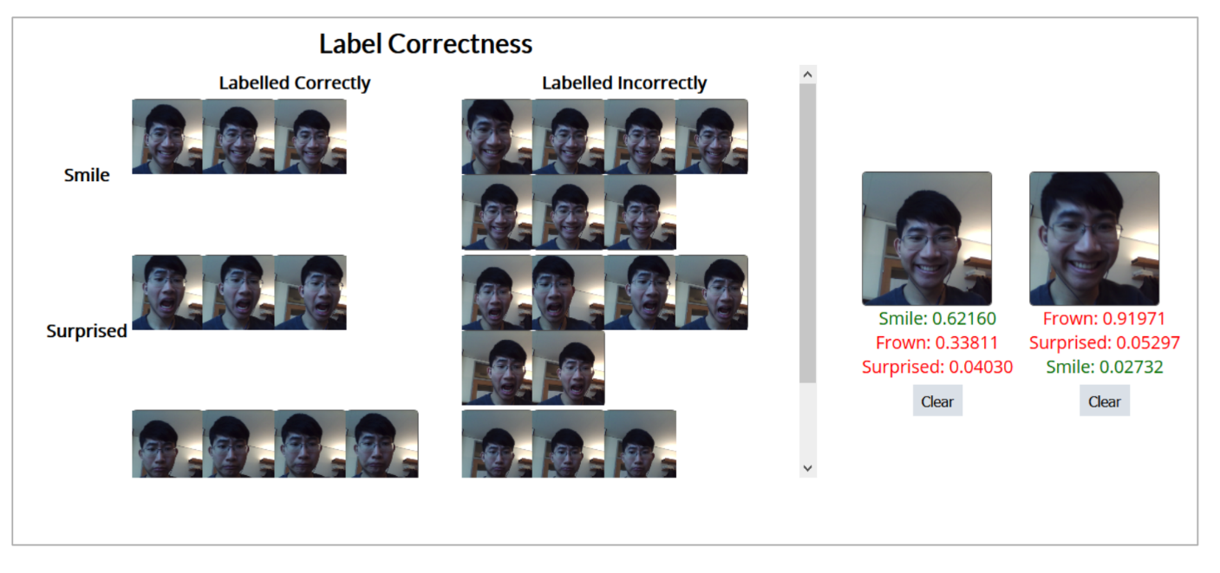
Training Steps
View Results
  Check which images were incorrectly labelled
  Compare images
  Go back and retrain more images based on results
Notes:
The link for the pictures.
https://studio56qatar-my.sharepoint.com/:f:/g/personal/moath_studio56_qa/EjrDx-w_k4VNk2v6UDfOOegBBP3Xa_ohnqY-SE5a5PabUQ?e=k0oWhg

Slide 16
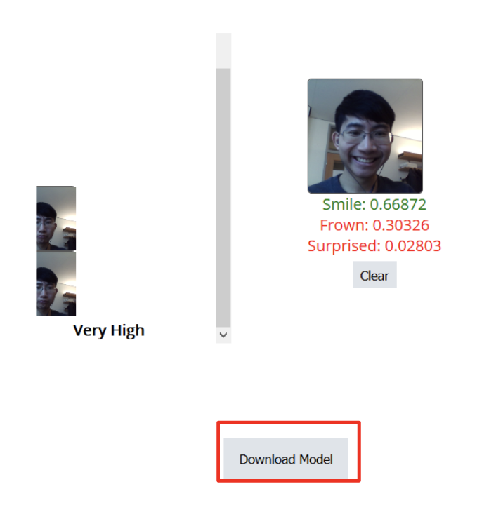
Download Model
  When satisfied with results, download the
  model to your computer

Slide 17
THANKS
info@studio56.qa
Studio56.qa
Notes:
WRAP UP الخاتمة

