Slide 1
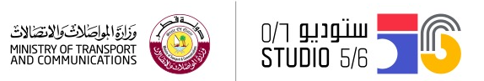
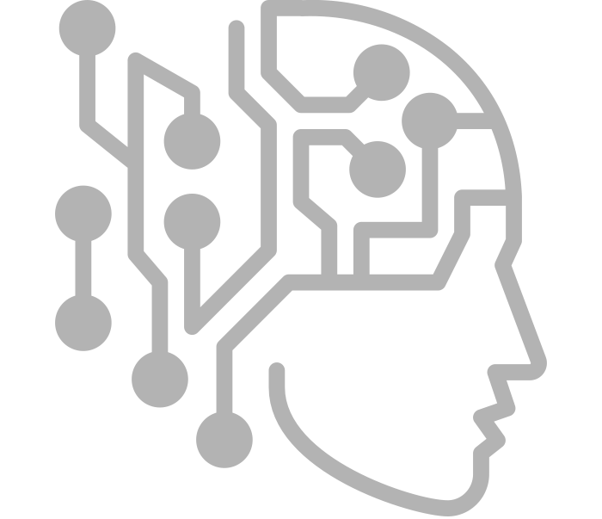
AI & Sound
Artificial Intelligence
الذكاء الاصطناعي و الصوت
الذكاء الاصطناعي
Studio56.qa

Slide 2
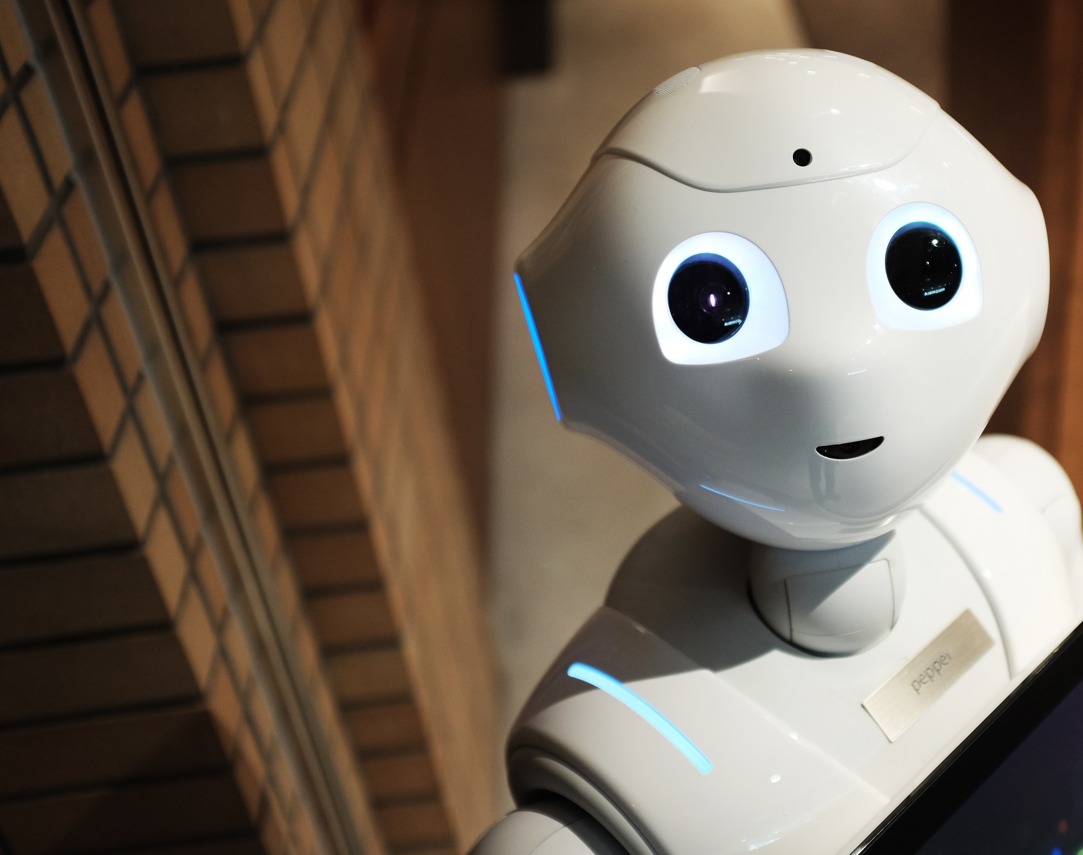
Artificial Intelligence. We hear this term more often these days, as machines around us are learning to become smarter and smarter every single day.
Studio 5/6 wanted the youth in Qatar to learn about this term and understand how it works. Therefore, in this workshop we will be using AI tool to teach the computer how to react to our movements. In result we will be able to play music as well.

Slide 3


Slide 4

Artificial Intelligence
الذكاء الاصطناعي
قدرة الحاسوب أو الآلة على التفكير والتعلم.
The ability of a computer program or a machine to think and learn.
Studio56.qa

Slide 5



How?
كيف؟
AI programming focuses on 3 steps
برمجة الذكاء الاصطناعي تتضمن 3 خطوات
Learning processes
عمليات التعلم
Reasoning processes
عمليات التحليل
Self-correction processes
عمليات تصحيح الذات
Studio56.qa
Notes:
Learning processes. acquiring data and creating rules for how to turn the data into actionable information. The rules, which are called algorithms, provide computing devices with step-by-step instructions for how to complete a specific task.
Reasoning processes. choosing the right algorithm to reach a desired outcome.
Self-correction processes. continually fine-tune algorithms and ensure they provide the most accurate results possible.

Slide 6
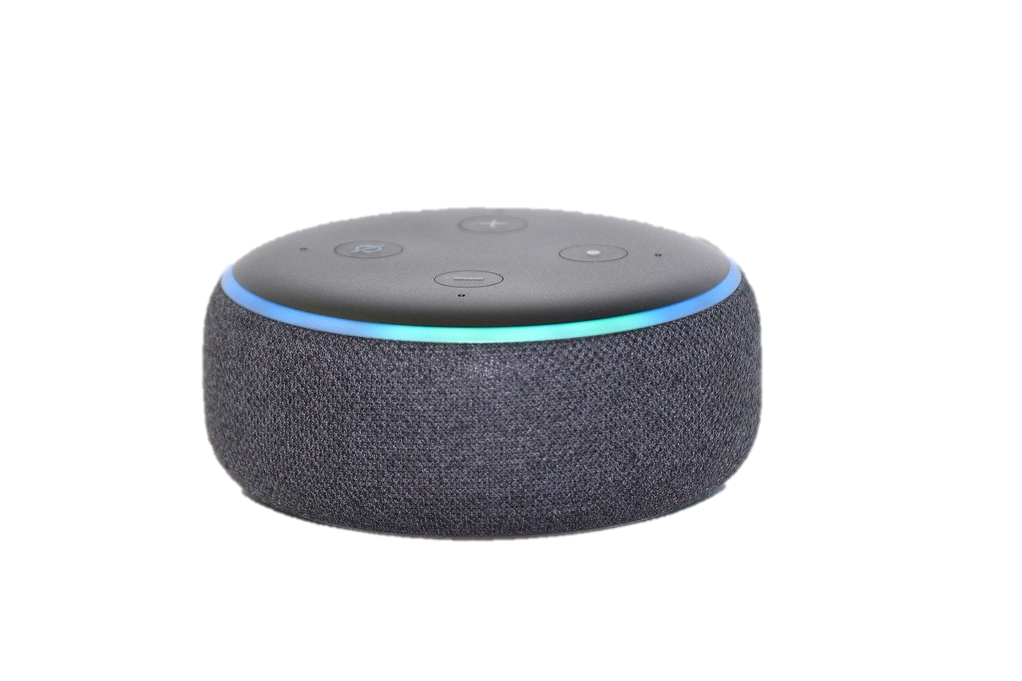

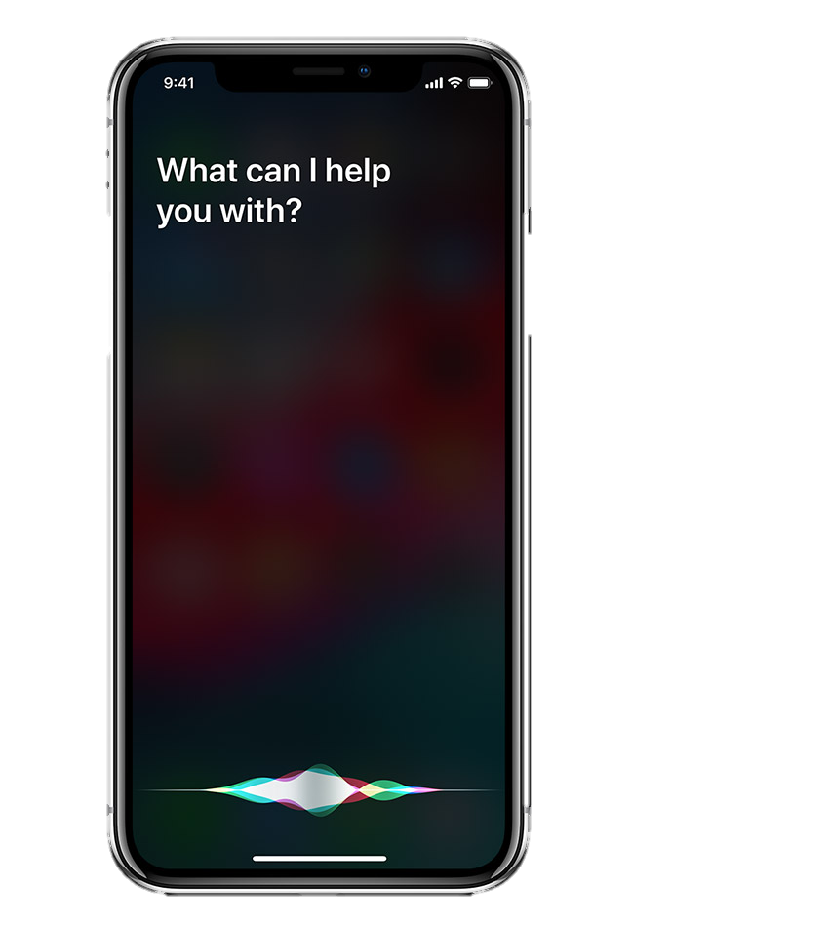
Examples?
أمثلة؟
Tesla
Alexa
Siri
Studio56.qa

Slide 7

ما هو البرنامج الذي سنقوم باستخدامه؟
What program we will be using?
Studio56.qa

Slide 8
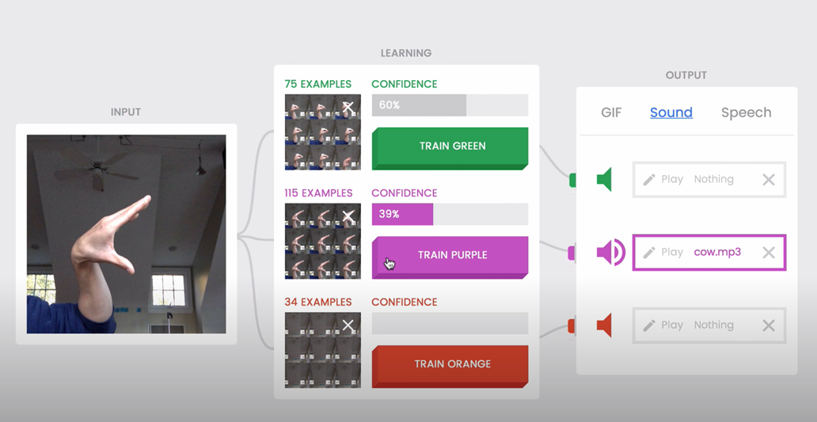
ما الذي سنقوم بتطويره اليوم؟
What we will develop today?
Studio56.qa

Slide 9
LET’S START!
info@studio56.qa
Studio56.qa

