Slide 1
Summer drop-in

Slide 2
AI and Sound
AGE GROUP: 7-10
DESCRIPTION:
The workshop will teach kids about AI and Machine learning. They will learn how we can train the machine (Laptop in this case) to respond to their input in the correct way and play a sound. They will use a tool called “Teachable Machine” for this workshop.
https://www.youtube.com/watch?v=LFHZtAasFXE&feature=youtu.be
Studio56.qa

Slide 3
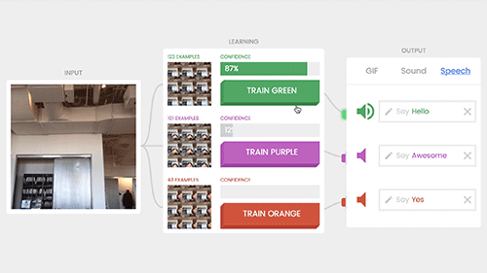
AI and Expression
AGE GROUP: 7-10
DESCRIPTION:
The workshop will teach kids about AI and Machine learning. They will learn how we can train the machine (Laptop in this case) to respond to their input in the correct way and read a specific text. They will use a tool called “Teachable Machine” for this workshop.
Studio56.qa

Slide 4
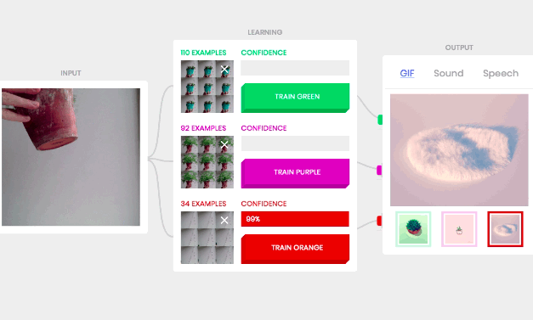
AI and GIFs
AGE GROUP: 7-10
DESCRIPTION:
The workshop will teach kids about AI and Machine learning. They will learn how we can train the machine (Laptop in this case) to respond to their input in the correct way and play a specific GIF. They will use a tool called “Teachable Machine” for this workshop.
Studio56.qa

