Slide 1
1. Co Spaces Account
Software Account Instructions
Start with this Link :
https://cospaces.io/edu/

Slide 2
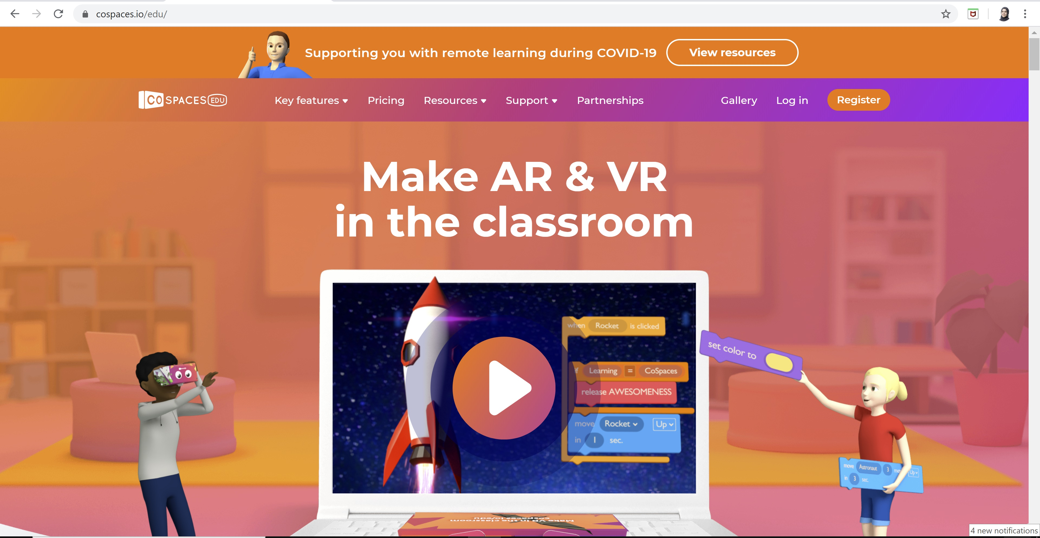

Slide 3
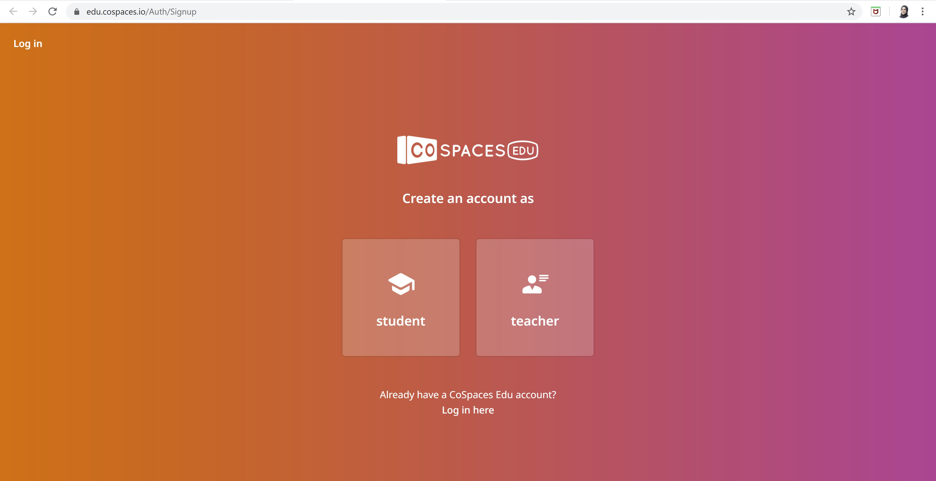

Slide 4
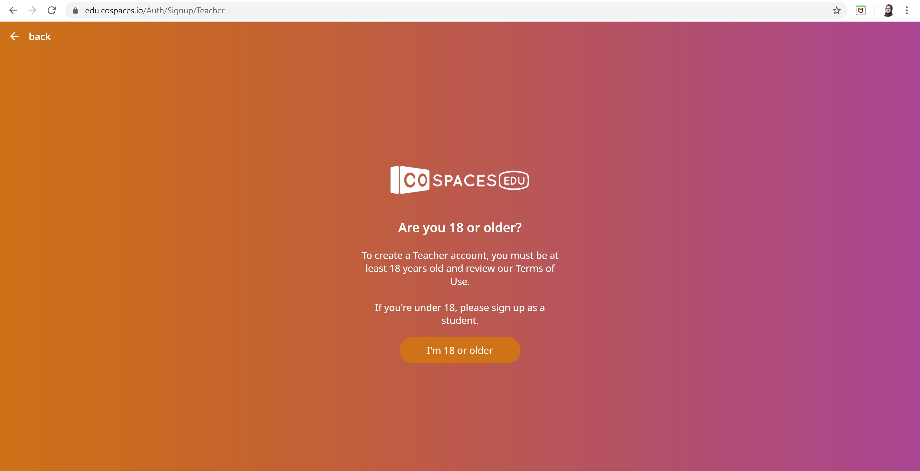

Slide 5
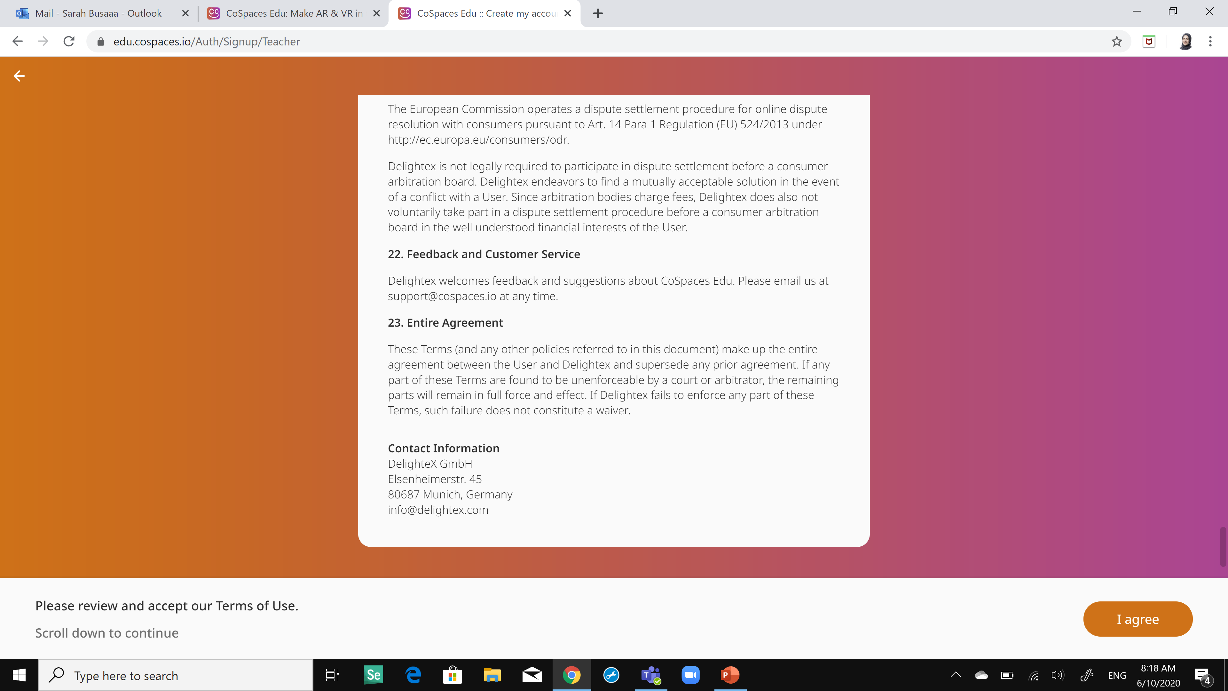

Slide 6
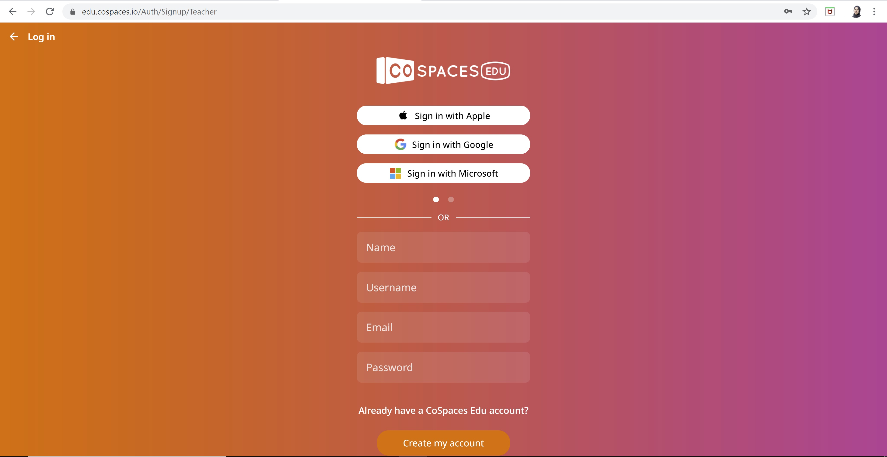
A confirmation email will be sent to this email

Slide 7
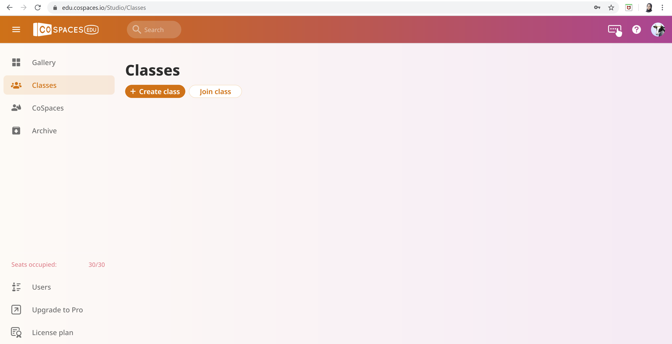
Final Page should be like following

Slide 8
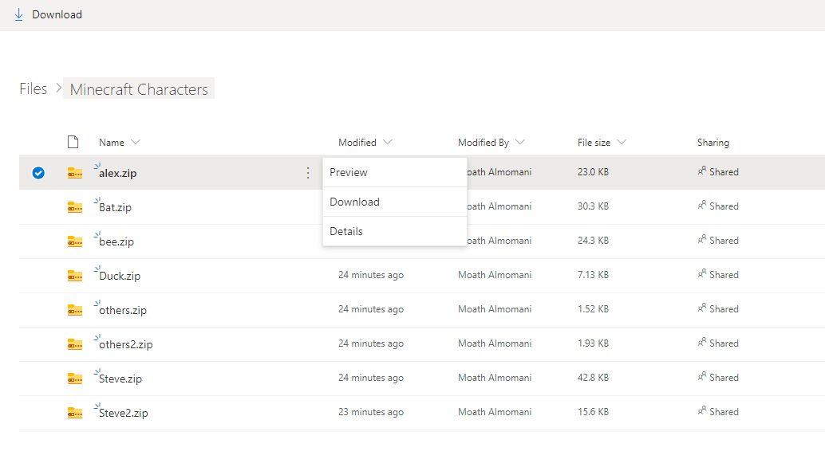
2. If you didn’t create your Minecraft characters you can download them from this link.
Just right click on the file and download it.

