Slide 1

Minecraft Coding Camp
7 -10
Studio56.qa
Notes:
Take the attendance
Have you attended workshops before?

Slide 2
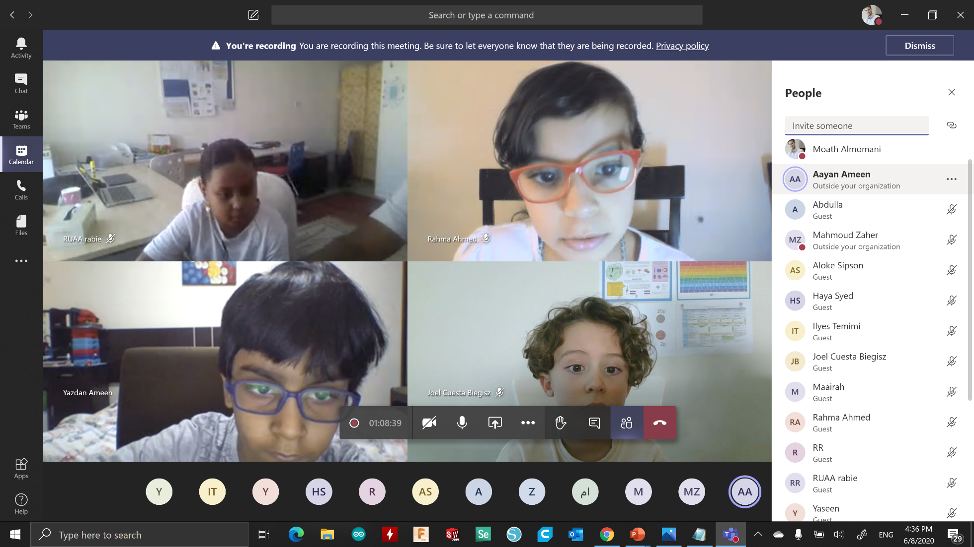
Microsoft Teams basics
1
2
3
Studio56.qa
Notes:
Introduce how to use Microsoft teams.

Slide 3
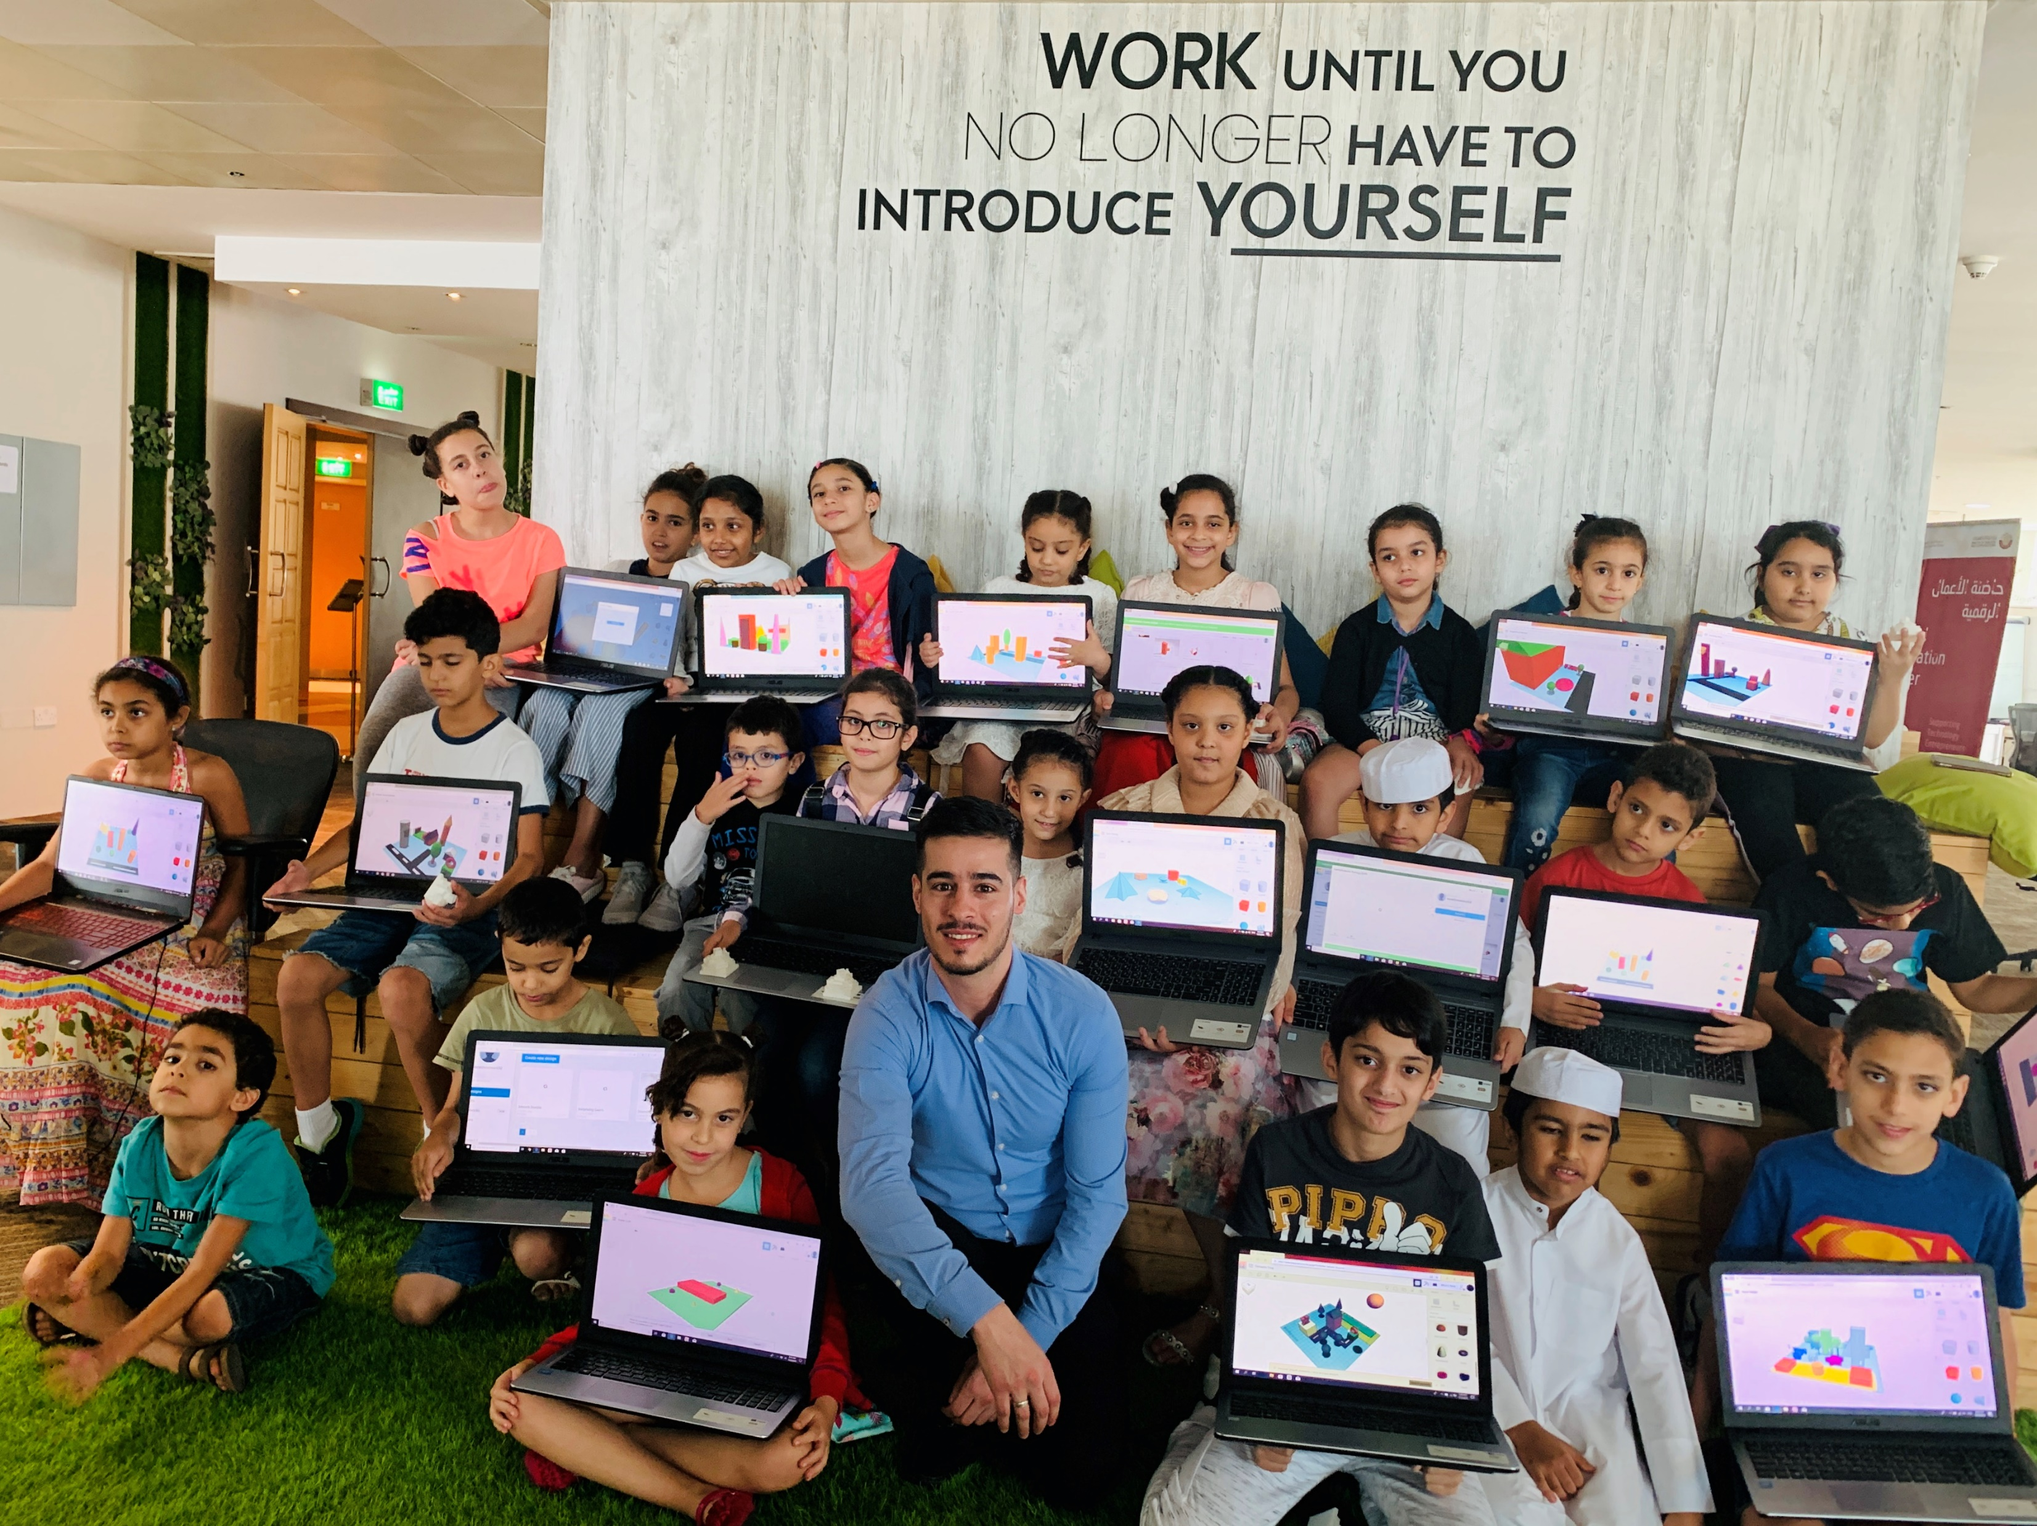

Who are we?
من نحن؟
Software Zone.
Technology Zone.
Creative Zone.
Notes:
Fab lab Studio 56 teaches youth about the necessary skills of this century such as digital fabrication, design and computer science.
Studio 56 has 3 main zones:

Slide 4
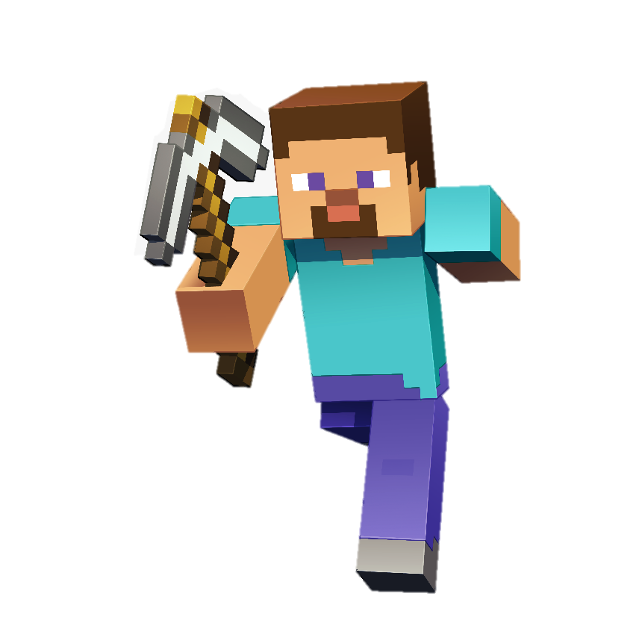
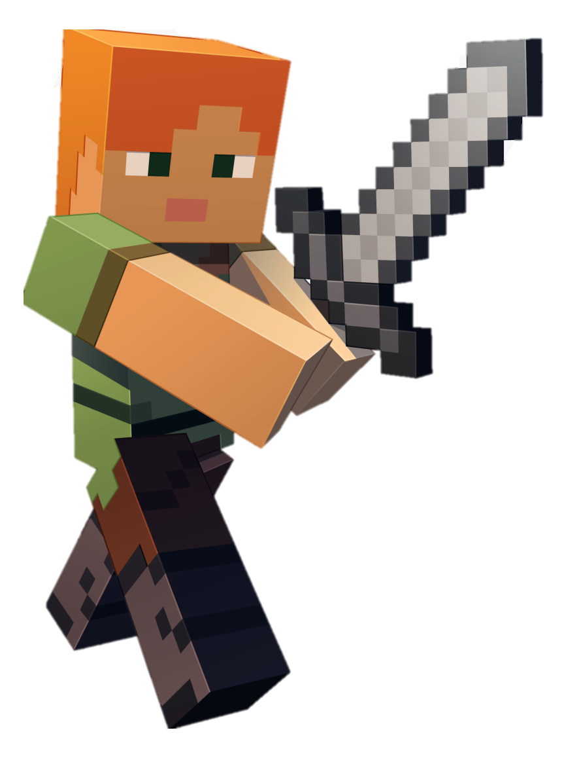
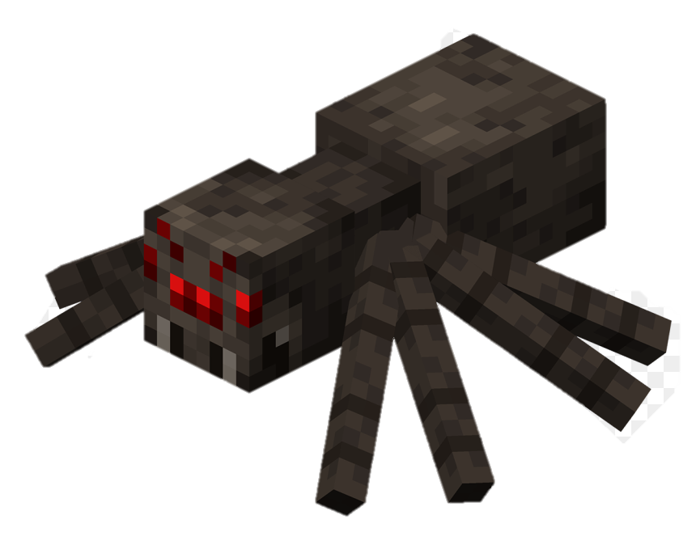
Today we are going to start our journey to explore Minecraft coding, this journey will be extended for 5 days, in each day we have a one-hour class to learn new skills.
On the last day you will be asked to conduct a final project in order to receive Studio 5/6 Certificate of completion.
ستبدأ اليوم رحلتنا لاستكشاف برمجة ماين كرافت وستمتد هذه الرحلة لمدة 5 أيام وفي كل يوم علينا حضور درس لساعة واحدة لتعلم مهارات جديدة.
في اليوم الأخير سيطلب منك عمل مشروع نهائي للحصول على شهادة إتمام من ستديو 56.
Studio56.qa
Notes:
Ice braking activity.
Have you played Minecraft before?

Slide 5
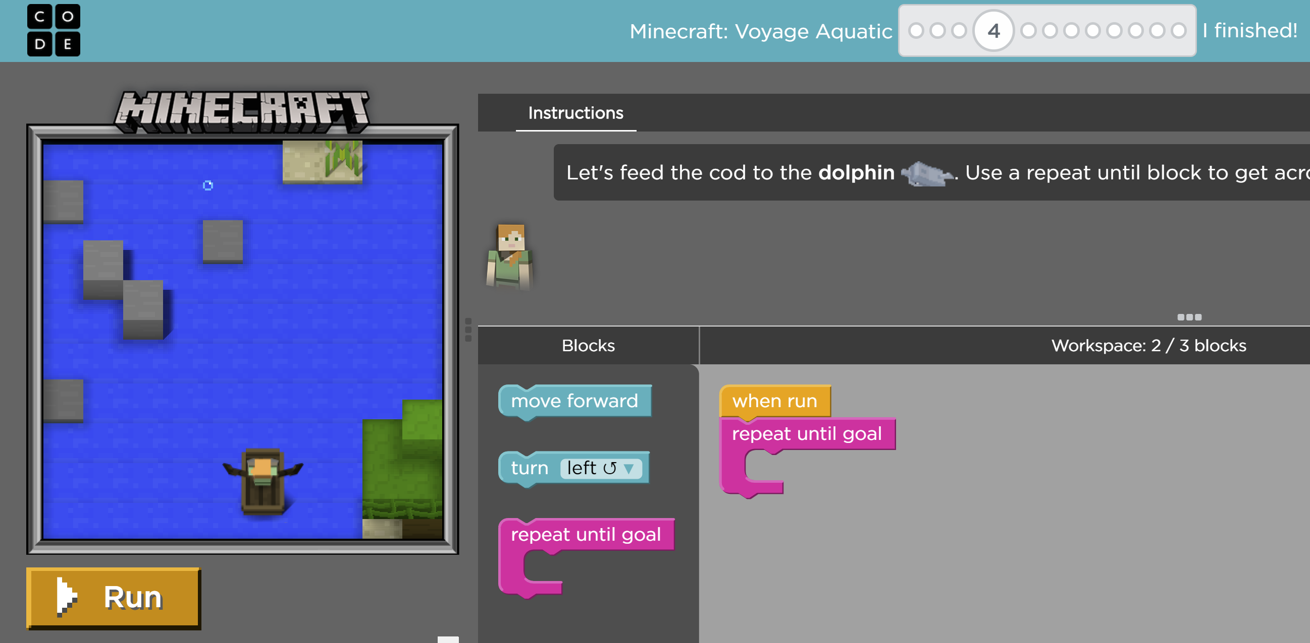
In Minecraft Voyage Aquatic you will have to go through a set of puzzles to complete the game.
في لعبة ماين كرافت، ستحتاج إلى المرور بمجموعة من الألغاز لإكمال اللعبة.
Studio56.qa
Notes:
In Minecraft today you are going to go through a set of puzzles to complete the game by using codes.
Have you heard about coding before??
Have experienced coding before??

Slide 6

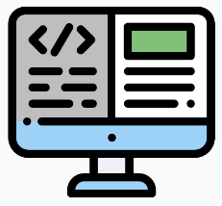
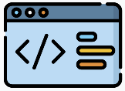
In computer science, “code” means a set of instructions that a computer can understand.
Studio56.qa
Notes:
In computer science, “code” means a set of instructions that a computer can understand, also there are some important vocabularies in computer science such as debugging and program.

Slide 7



Code, Debugging & Program
Code - to write code, or to write instructions for a computer.
Debugging - Finding and fixing problems in the instruction.
Program – instructions that has been coded into something that can be run by a machine.
Studio56.qa
Notes:
I said coding is to write instruction that a computed can understand but when you write something you may have some spelling errors, so you need to look for these errors and fix them and this is debugging in computer science - Finding and fixing problems in the instruction.
And we have the Program which is instructions that has been coded into something that can be run by a machine,,,,,, for example the games are programs also the mobile applications are programs

Slide 8
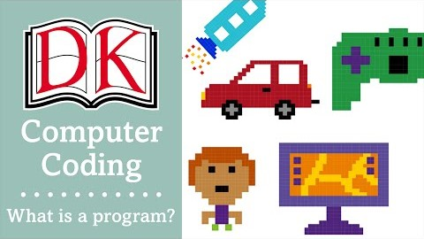
To know more about Coding lets watch this video
Studio56.qa
Notes:
To know more about programs lets watch this video.

Slide 9
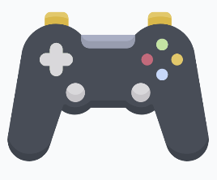

Where have you seen or experienced programs in your lives?
Studio56.qa
Notes:
What are the applications of coding?
Car program for self driving
Smart phone applications
Games
Machines like Coffee machines.

Slide 10
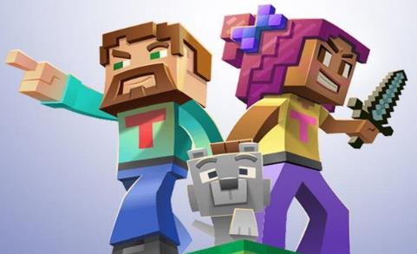
Let’s start Minecraft game and practice coding, programming and debugging.
Studio56.qa

Slide 11
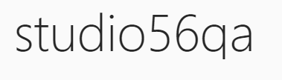
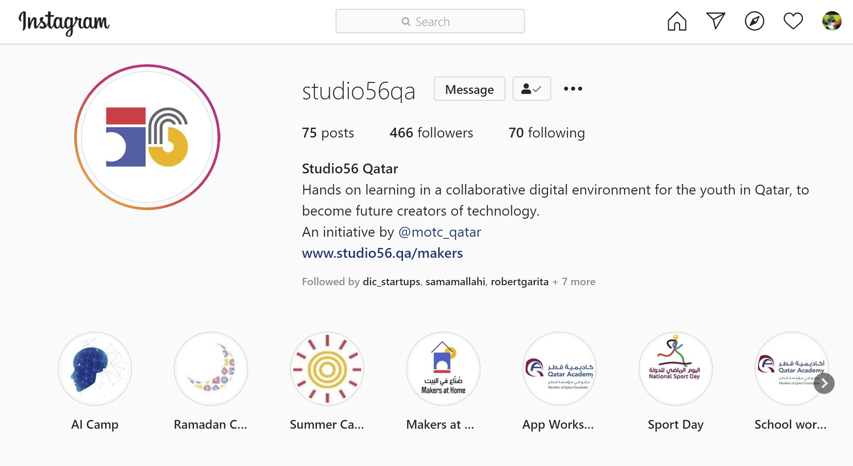
Studio56.qa
Notes:
Encourage participants to follow our studio56qa Instagram

Slide 12
THANKS
info@studio56.qa
Studio56.qa
Notes:
WRAP UP الخاتمة
Debrief استجواب
Ask students to reflect on the day’s activities. What did they learn about Programming? Debugging? How do they feel about computer science and code after spending one hour exploring?
Next Steps Let students know that if they enjoyed today’s activity, they have many options for continuing to code and learn. Encourage students to visit studio56.qa/media-center
tell students what’s coming next in your classroom.

