Slide 1

Minecraft Coding
7 -10
Studio56.qa
Notes:
Have you attended workshops before?
Introduce zoom instructions for participants.

Slide 2



In computer science, “coding” means writing a set of instructions that a computer can understand.
Studio56.qa

Slide 3



Code, Debugging & Program
Code - (v) to write code, or to write instructions for a computer.
Debugging - Finding and fixing problems in your algorithm or program.
Program - An algorithm that has been coded into something that
can be run by a machine.
Studio56.qa
Notes:
I said coding is to write instruction that a computed can understand but when you write something you may have some spelling errors, so you need to look for these errors and fix them and this is debugging in computer science - Finding and fixing problems in the instruction.
And we have the Program which is instructions that has been coded into something that can be run by a machine,,,,,, for example the games are programs also the mobile applications are programs

Slide 4
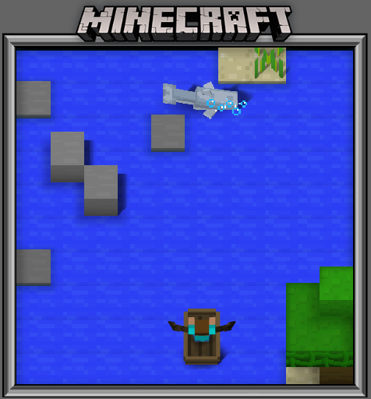
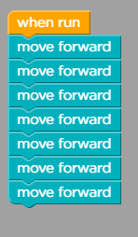
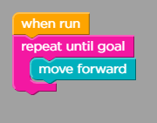
Some important codes we have experienced in our last lesson.
1- Repeat Command (loops).
Studio56.qa

Slide 5
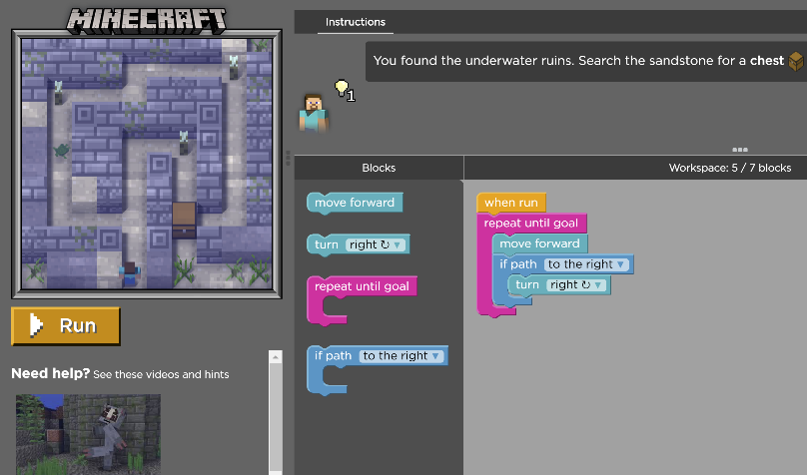
2- if statement Command.
If statements are conditionals. A conditional is an action that occurs if something specific happens.
Studio56.qa

Slide 6
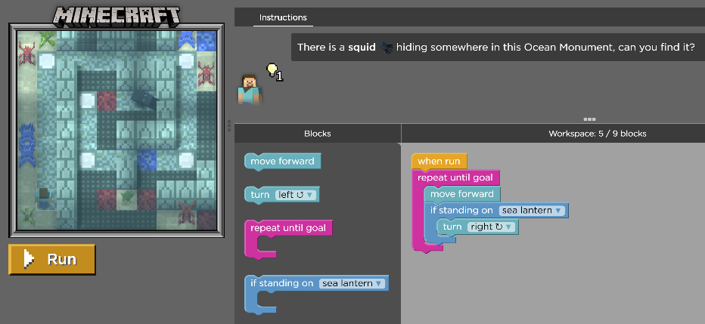
Who can explain the if statement?
Studio56.qa

Slide 7
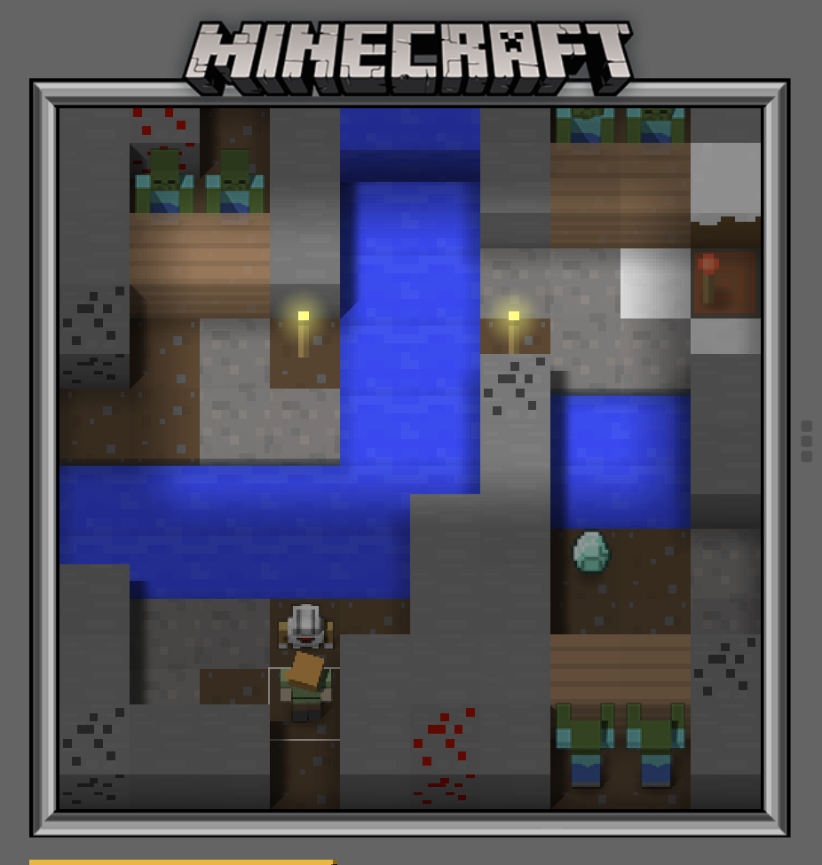
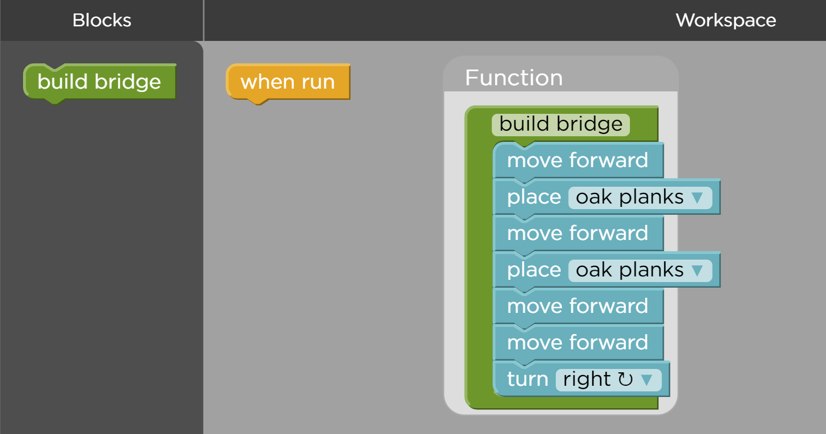
3- Functions
A function is a block of organized code that is used to perform a single related action.
Studio56.qa
Notes:
Give examples of functions

Slide 8
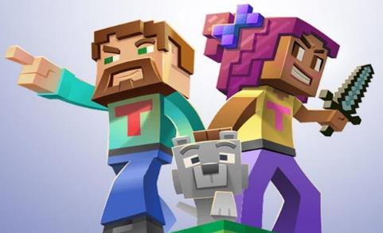
Let’s start Minecraft Hero’s Journey game and practice coding, programming and debugging.
Studio56.qa

Slide 9
THANKS
info@studio56.qa
Studio56.qa
Notes:
WRAP UP الخاتمة
Debrief استجواب
Ask students to reflect on the day’s activities. What did they learn about Programming? Debugging? How do they feel about computer science and code after spending one hour exploring?
Next Steps Let students know that if they enjoyed today’s activity, they have many options for continuing to code and learn. Encourage students to visit studio56.qa/media-center
tell students what’s coming next in your classroom.

