Slide 1

Minecraft characters
7 -10
Studio56.qa

Slide 2
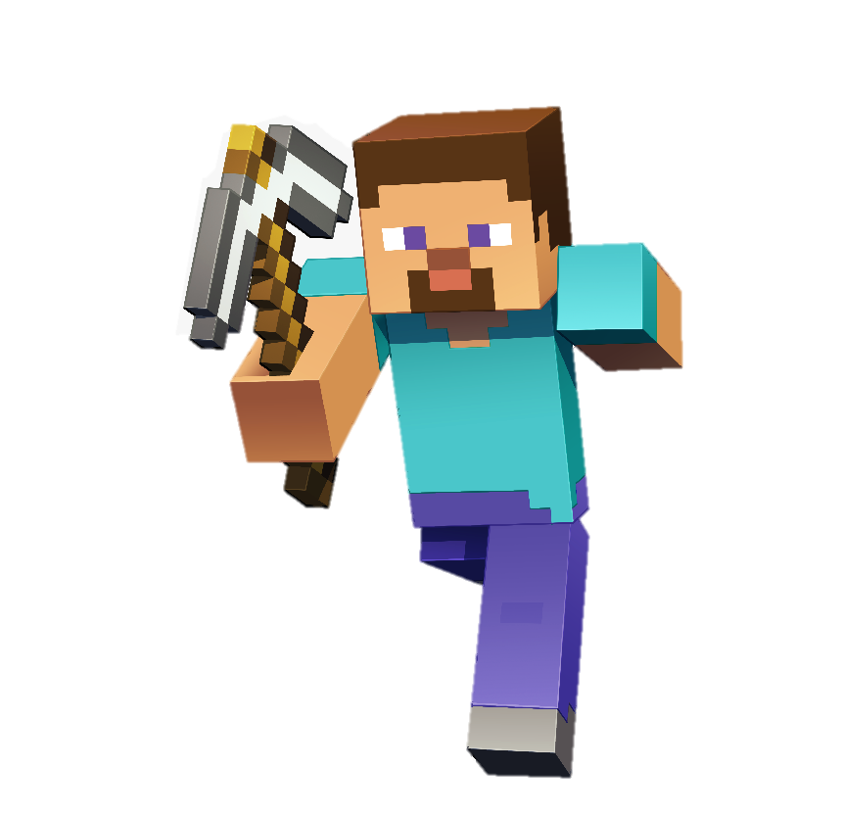
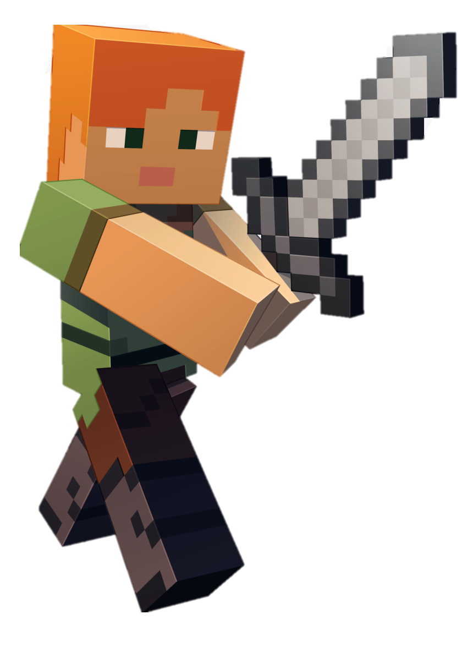
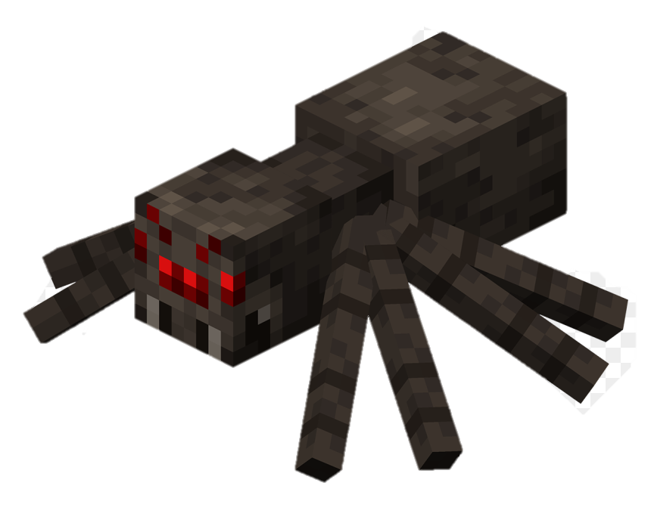
Today we have new experience to create and customize our favorite Minecraft characters.
So you can change the color of their hair, eyes, arms, and clothes in addition you will be able to change the position of any part.
Studio56.qa
Notes:
Ask participants what colors they would like to add on Steve?
What skin color is better Alex hair?

Slide 3
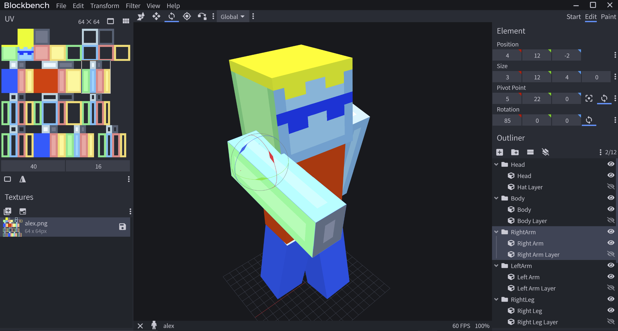
There is a new tool here today which will help you to build and customize Minecraft’s characters, and the name of this tool is Blockbench.
Blockbench is a modern model editor for creating custom 3D models for the Minecraft.
Studio56.qa
Notes:
Demonstrate to participants what we will customize today.

Slide 4
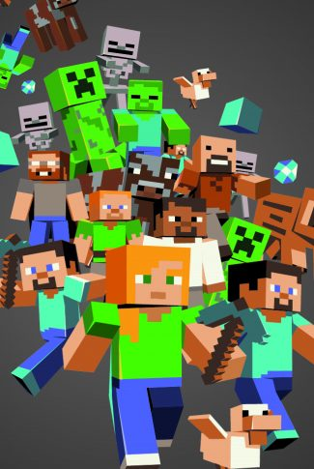
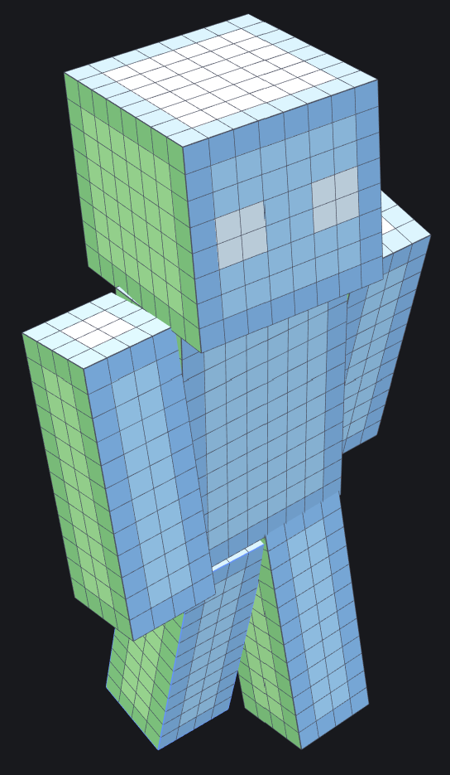
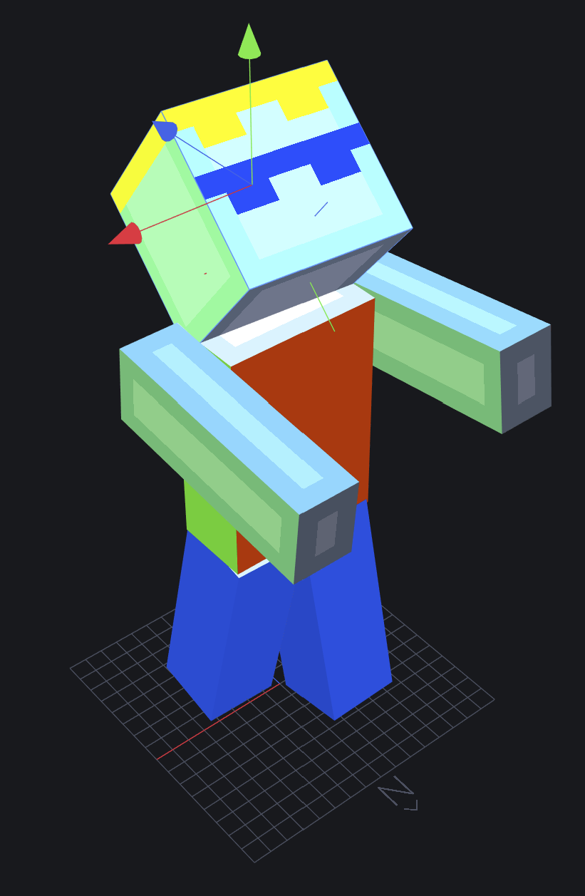
How to start with Blockbench
1
Select the character
2
Paint & Customize
3
Edit positions
Studio56.qa

Slide 5
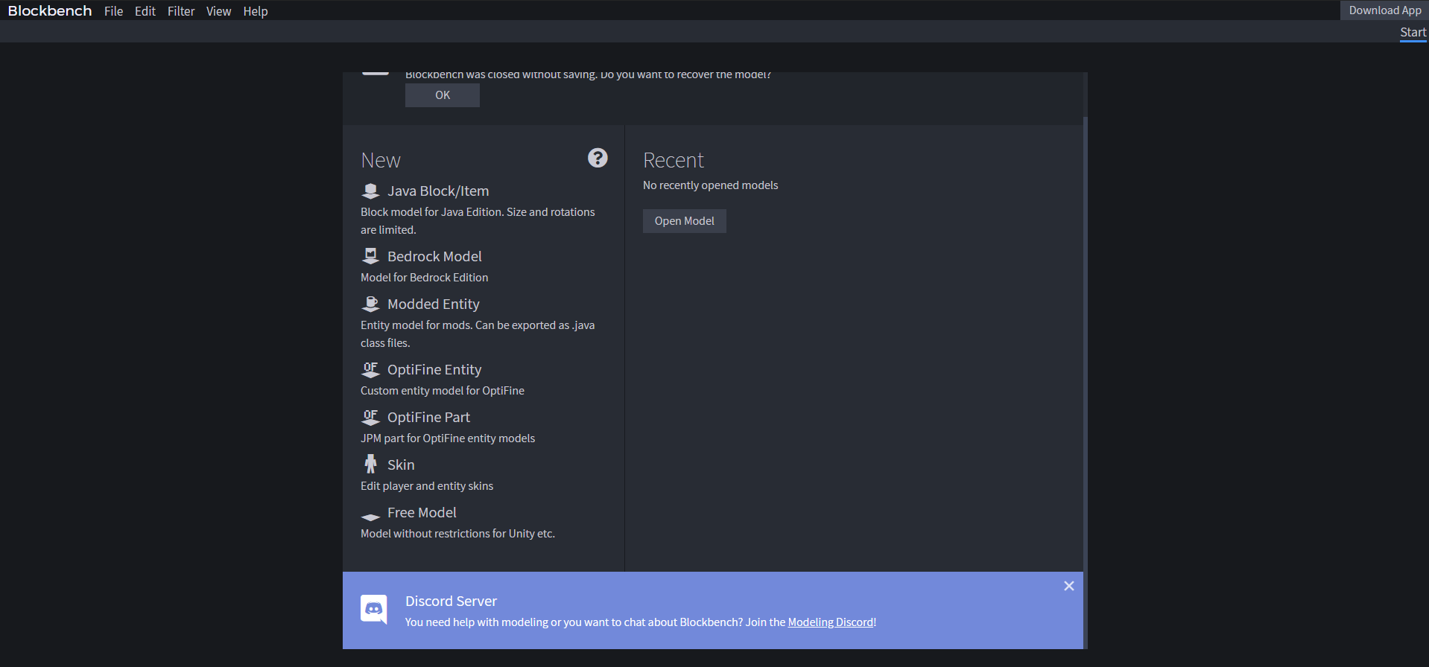
1- Choose Skin
Studio56.qa
Notes:
Demonstrate for the participants how to use the software
Choose character
Painting
Editing

Slide 6
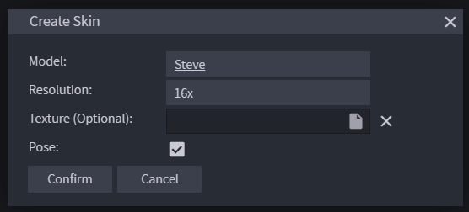
2- Select characters
Studio56.qa
Notes:
Demonstrate for the participants how to use the software
Choose character
Painting
Editing

Slide 7
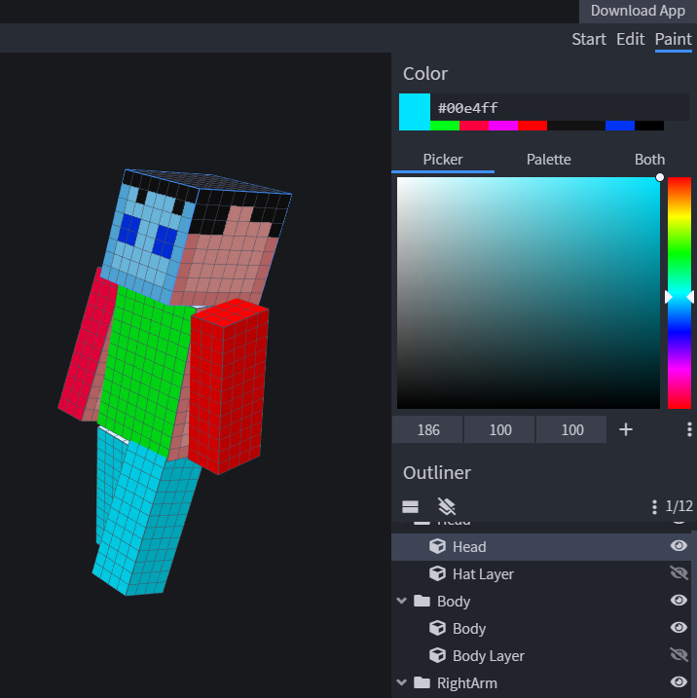
3- paint and customize the character
Studio56.qa
Notes:
Toggle skin layer

Slide 8
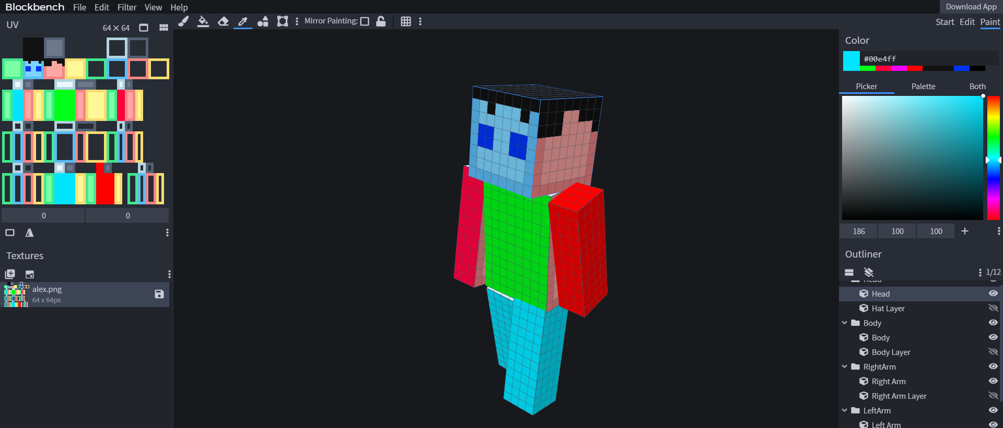
4- paint and customize the character
Studio56.qa
Notes:
Toggle skin layer

Slide 9
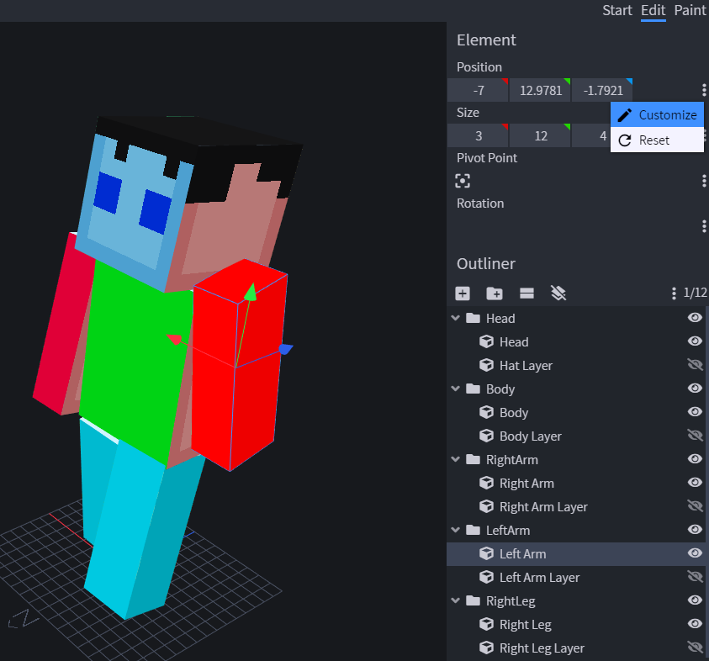
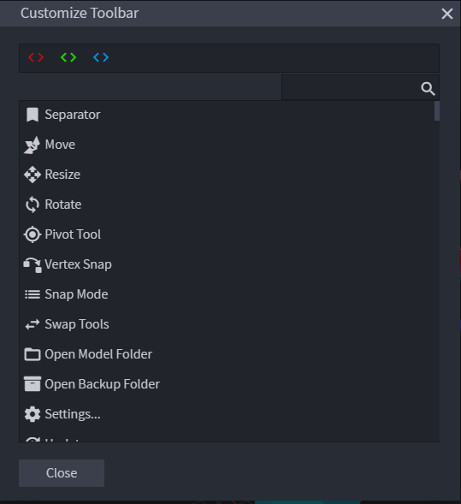
In edit you can change the positions
Studio56.qa
Notes:
Toggle skin layer

Slide 10
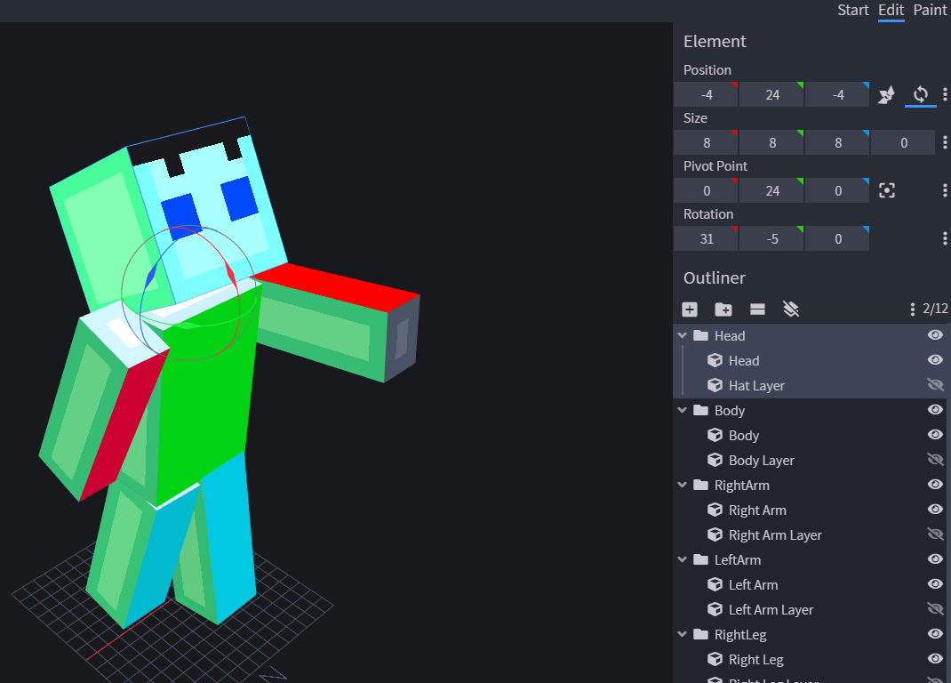
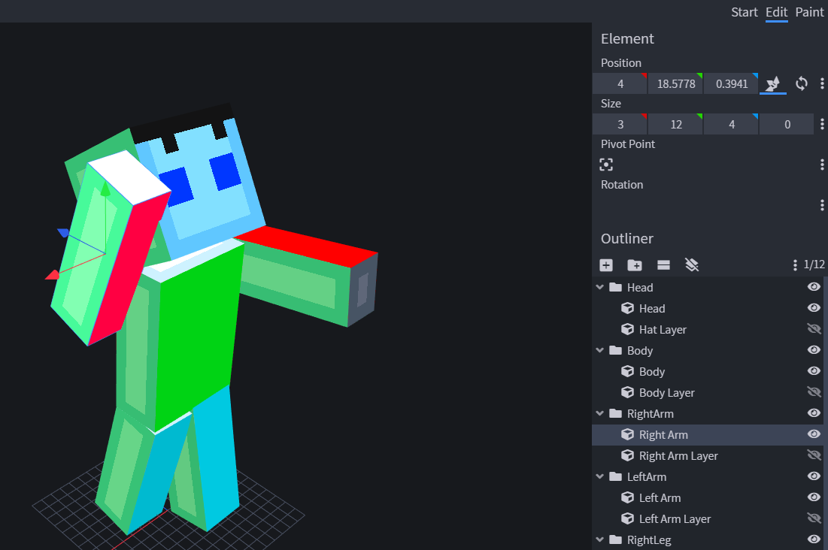
In edit you can change the positions
Studio56.qa
Notes:
Demonstrate for the participants how to use the software
Choose character
Painting
Editing

Slide 11
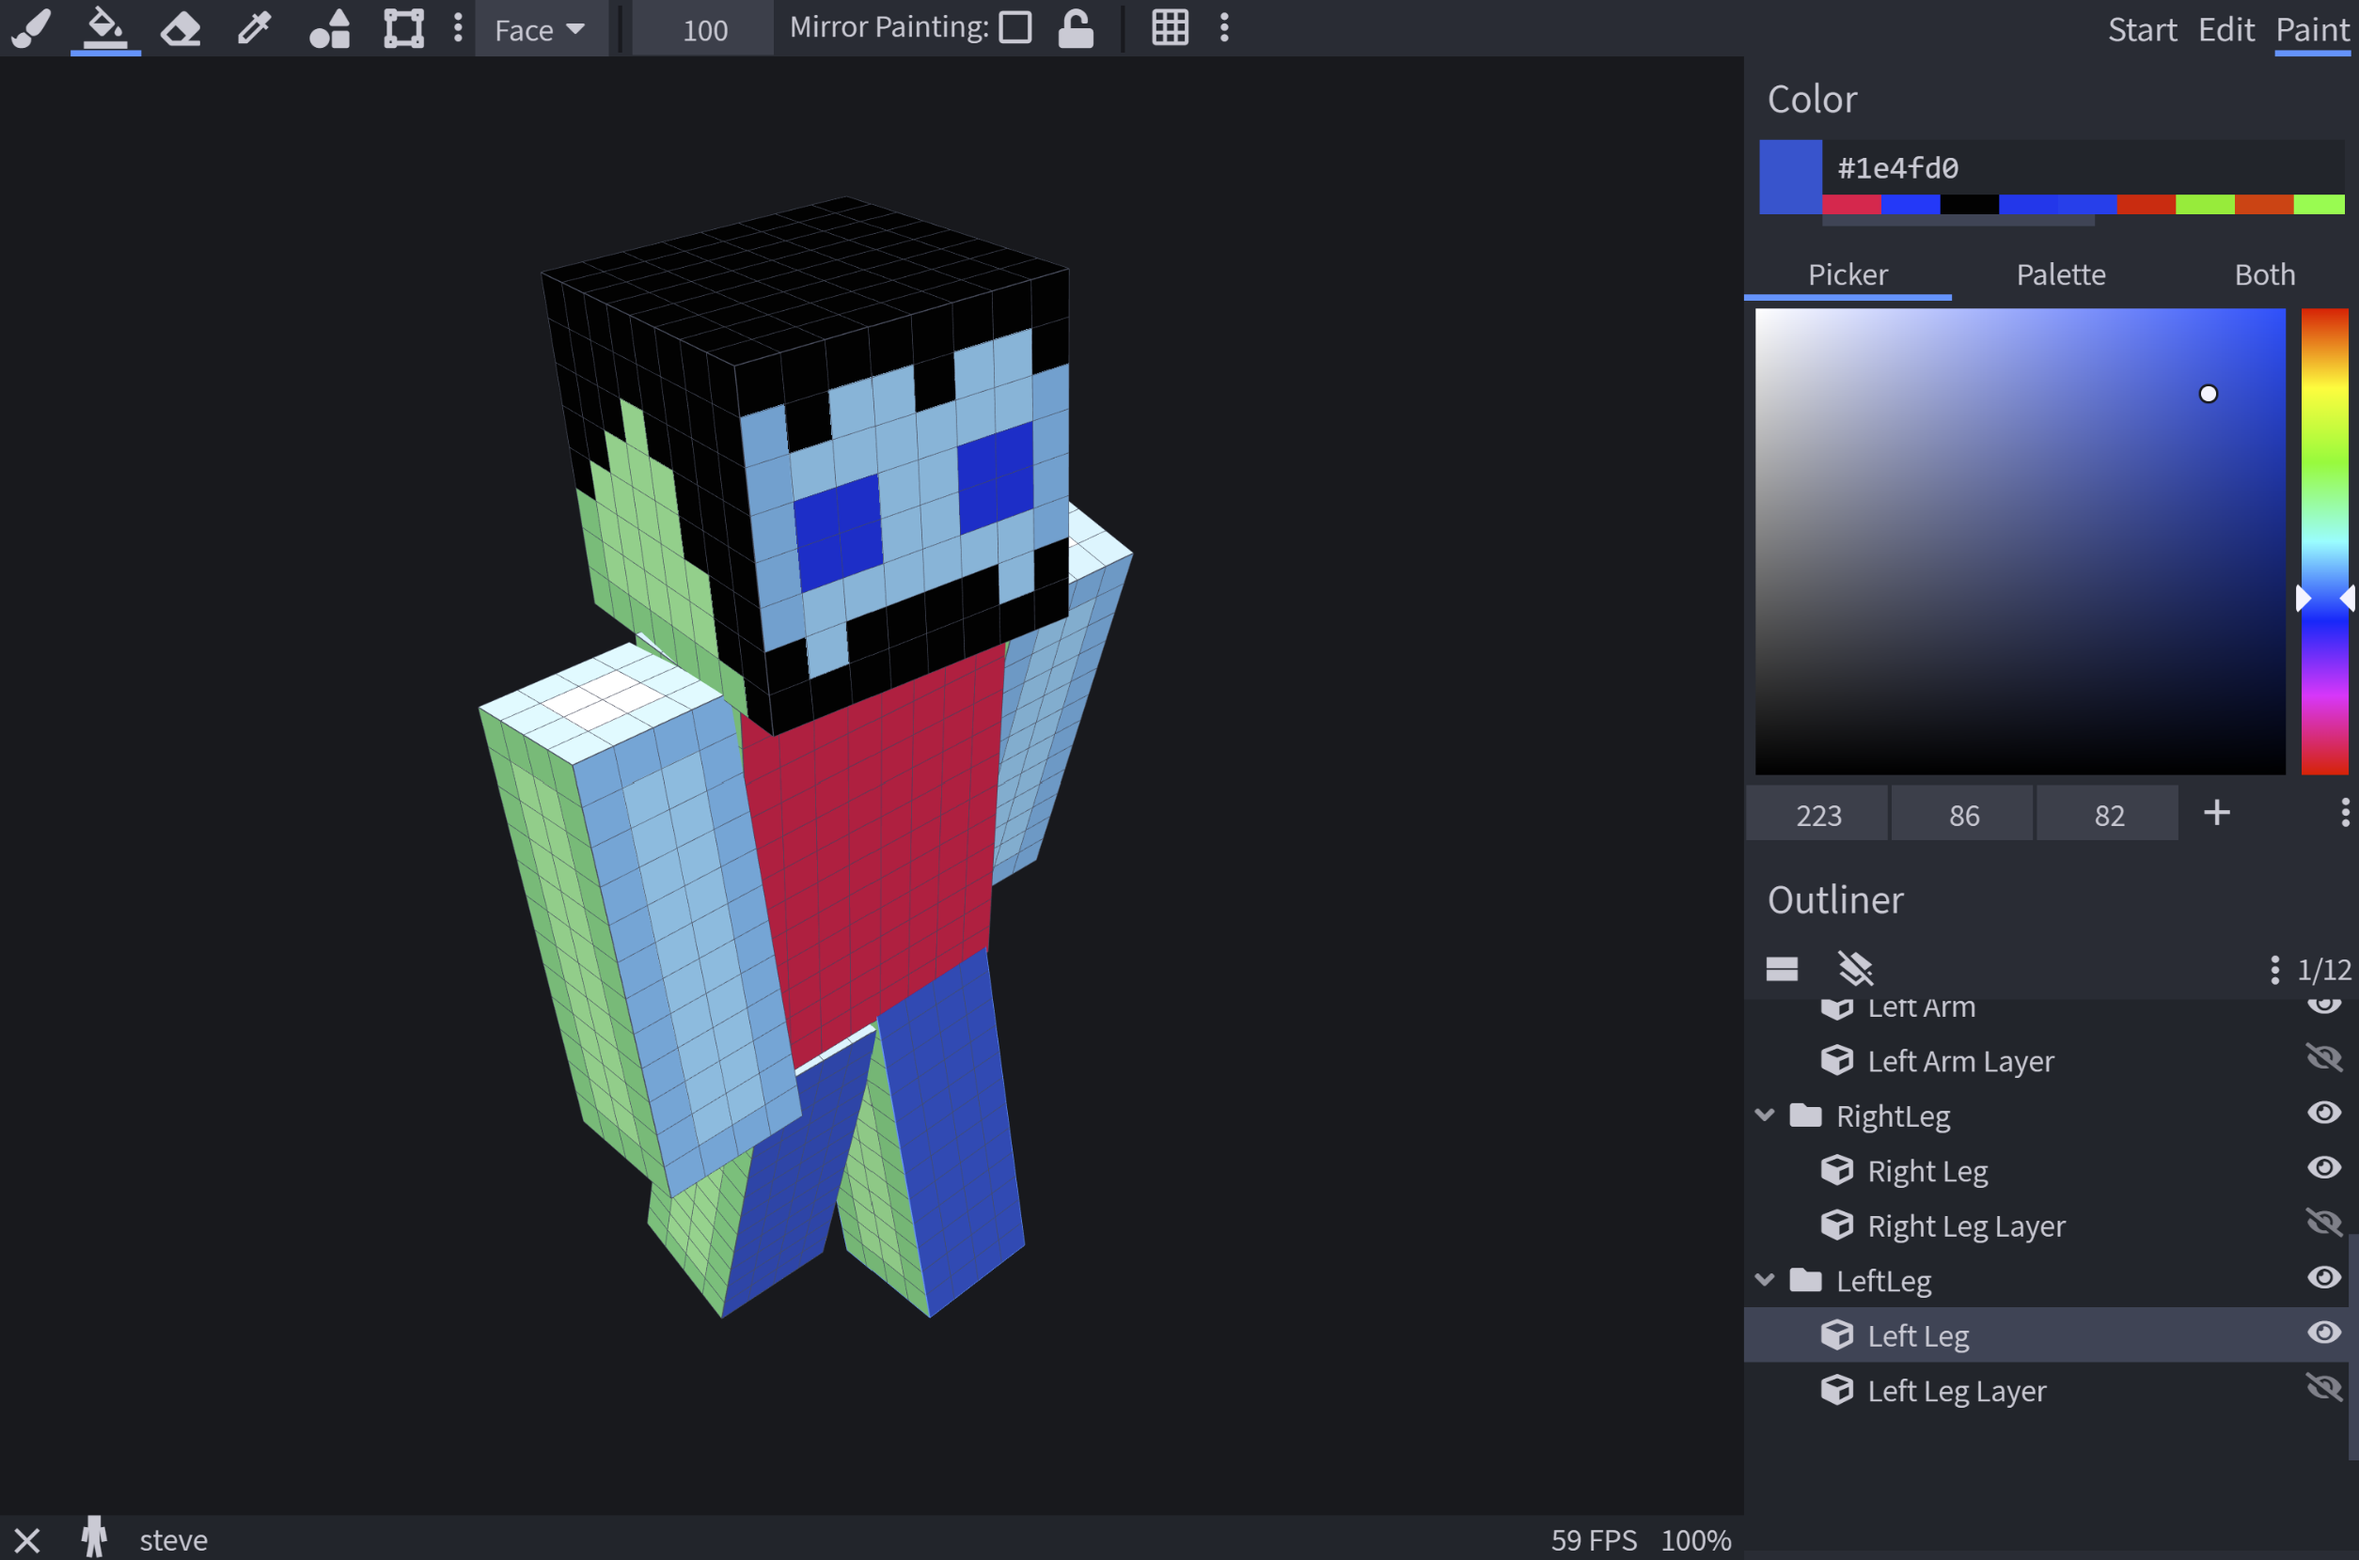
Let’s start creating and customizing
Studio56.qa

Slide 12
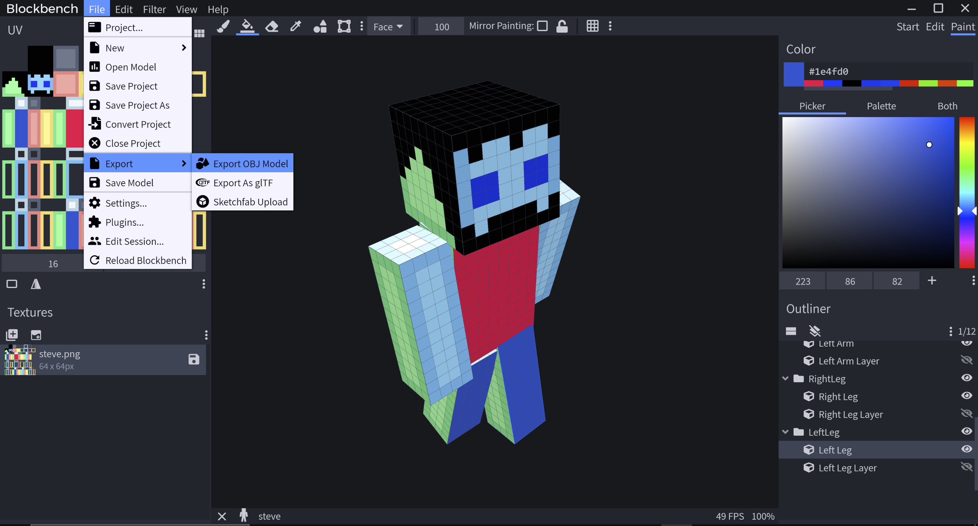
How to export the 3D model
Studio56.qa
Notes:
At the end tell participant how to export their models as OBJ file in order to use the in the next workshops.

Slide 13
THANKS
info@studio56.qa
Studio56.qa
Notes:
WRAP UP الخاتمة
Debrief استجواب
Ask students to reflect on the day’s activities. What did they learn about Programming? Debugging? How do they feel about computer science and code after spending one hour exploring?
Next Steps Let students know that if they enjoyed today’s activity, they have many options for continuing to code and learn. Encourage students to visit studio56.qa/media-center
tell students what’s coming next in your classroom.

