Slide 1

Create your own 3D Minecraft world
7 -10
Studio56.qa
Notes:
Talk about the final project ( what they will do)
Talk about the certificate and when they will receive it.
Last 10 minutes check the final projects.

Slide 2
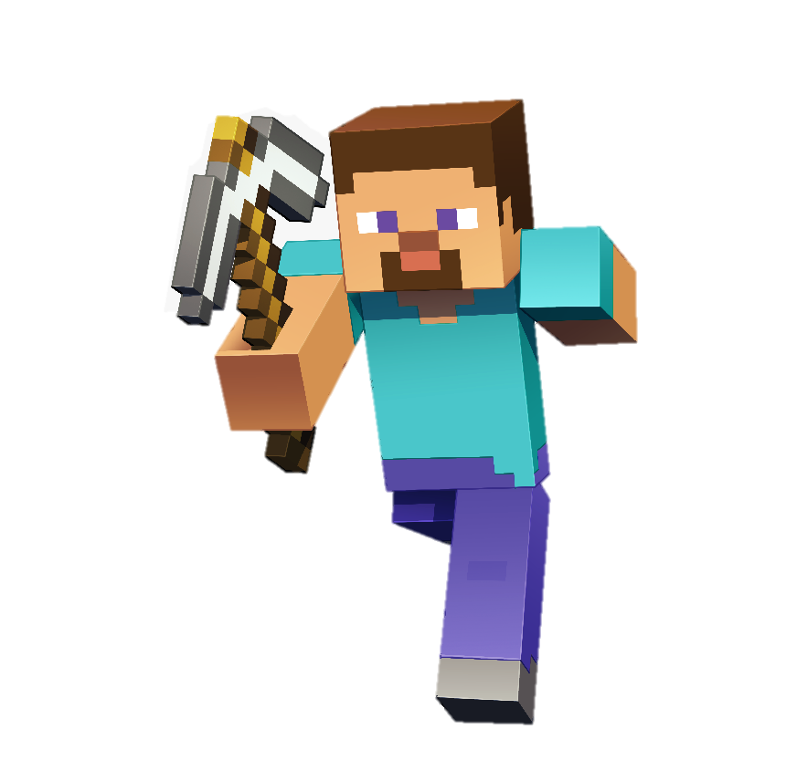
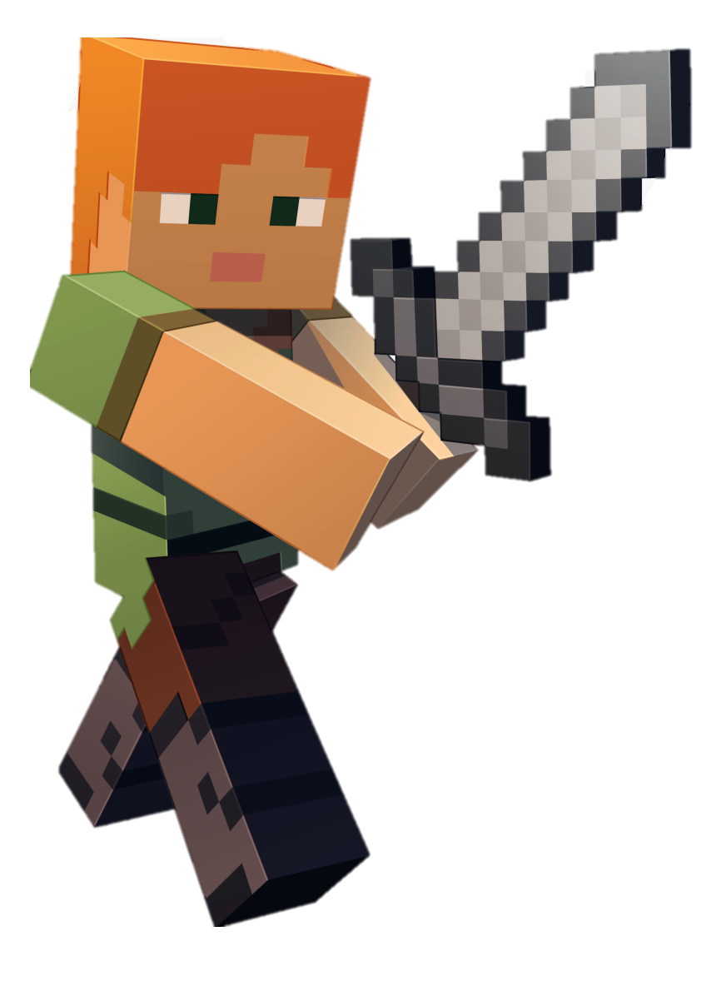
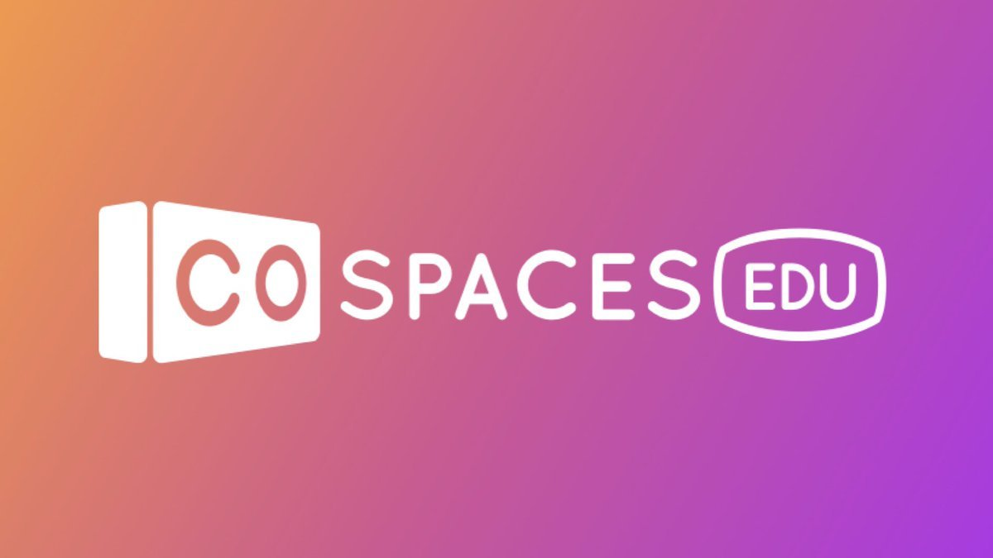
Today our last day in Minecraft coding journey, you will need to make your final project using CoSpaces in order to get your certificate.
In your final project you need to:
Create your own 3D Minecraft world.
Code your character.
Simulate the final code.
Studio56.qa
Notes:
Encourage participants and tell them about the certificate

Slide 3
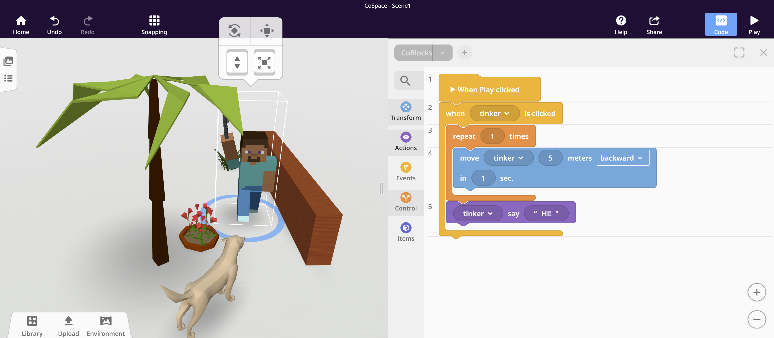
LET’S START!
Studio56.qa

Slide 4
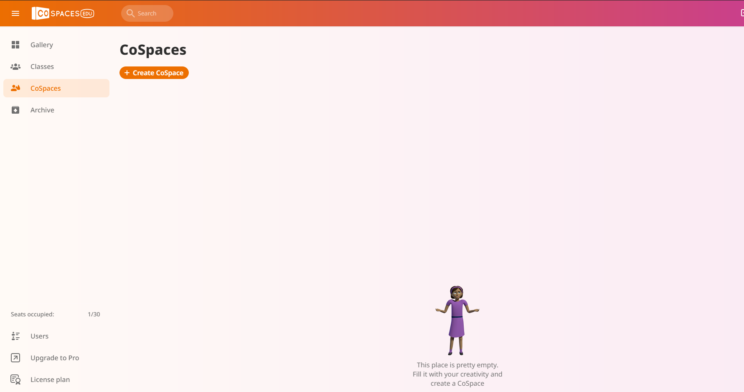
From CoSpaces select Create CoSpaces
Studio56.qa

Slide 5
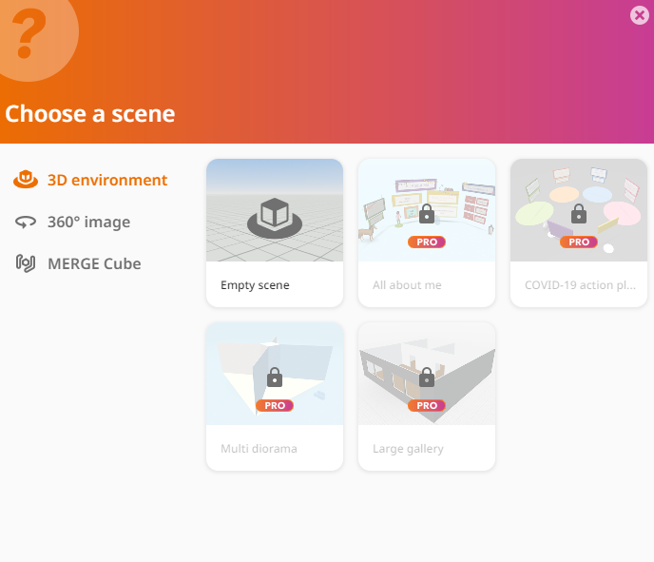
Choose empty scene
Studio56.qa

Slide 6
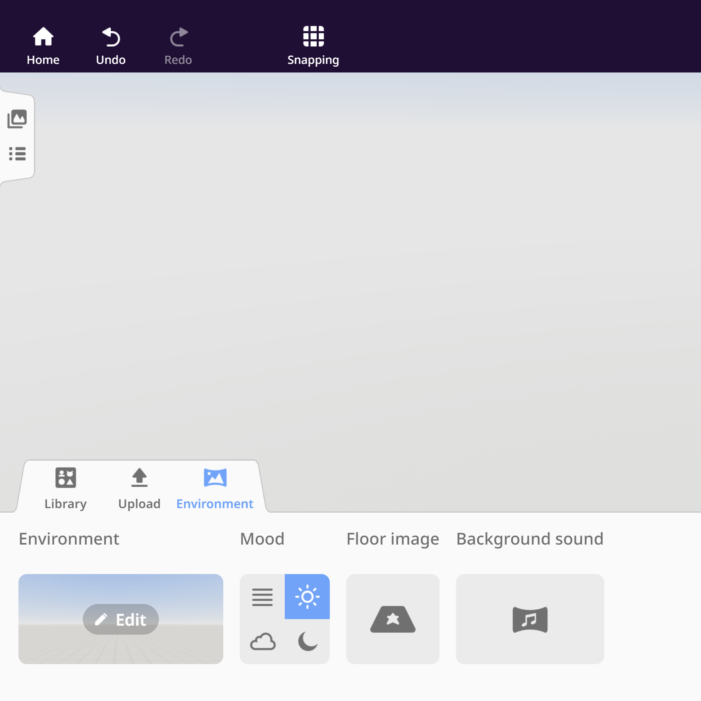
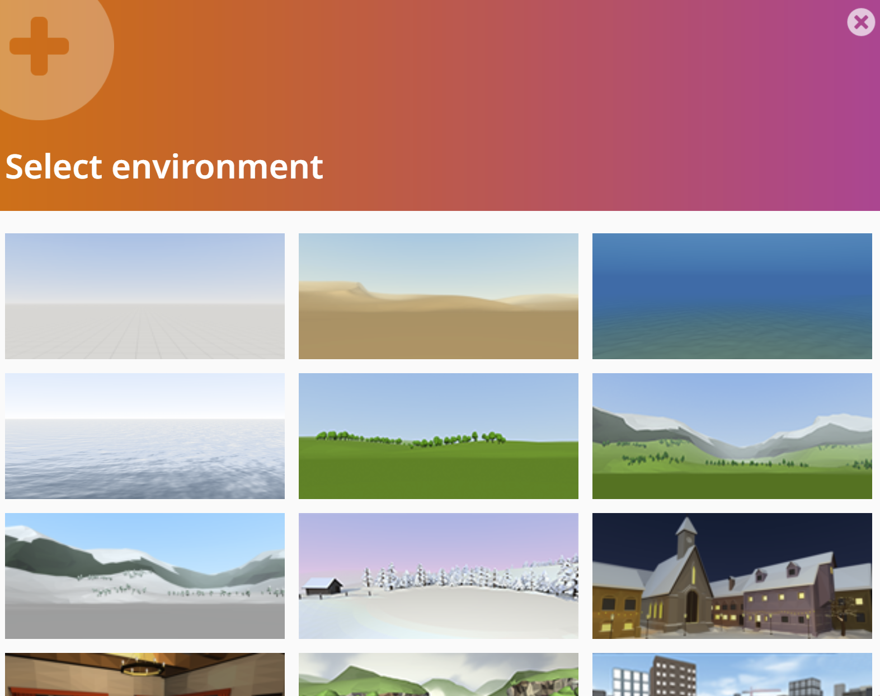
Start with the environment and choose the suitable one for you.
Studio56.qa

Slide 7
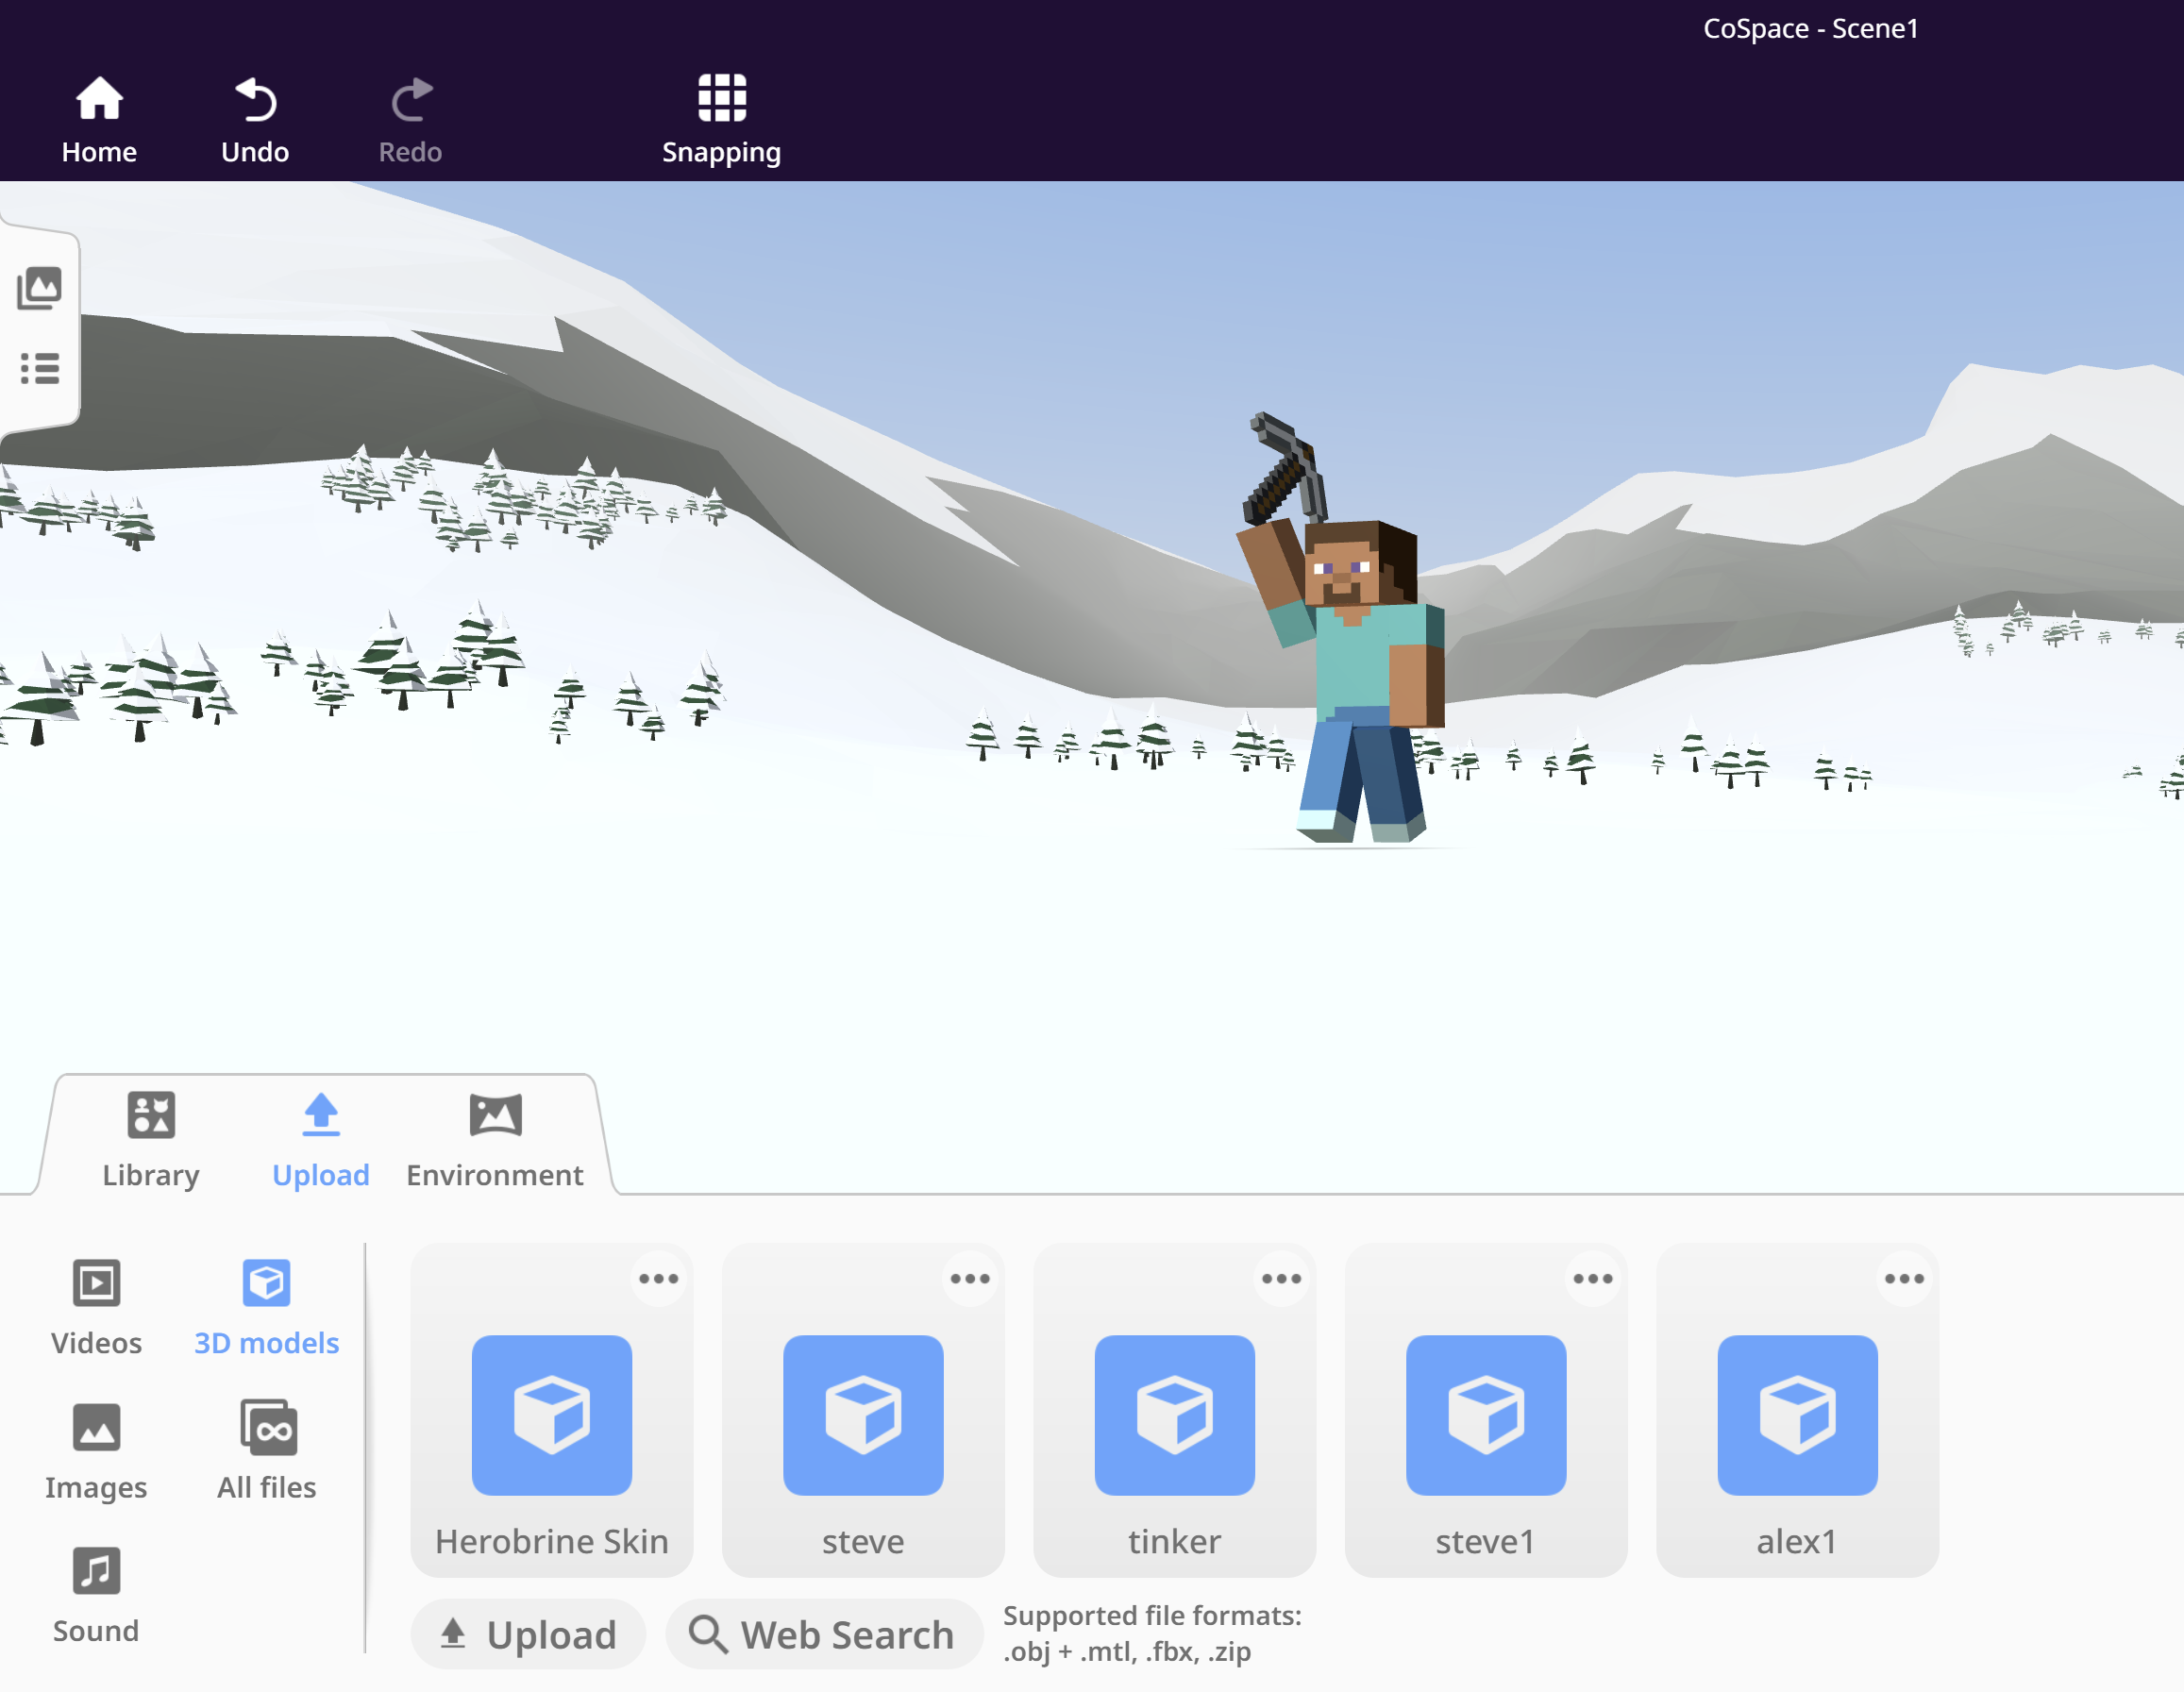
Upload Minecraft’s 3D models.
Studio56.qa

Slide 8
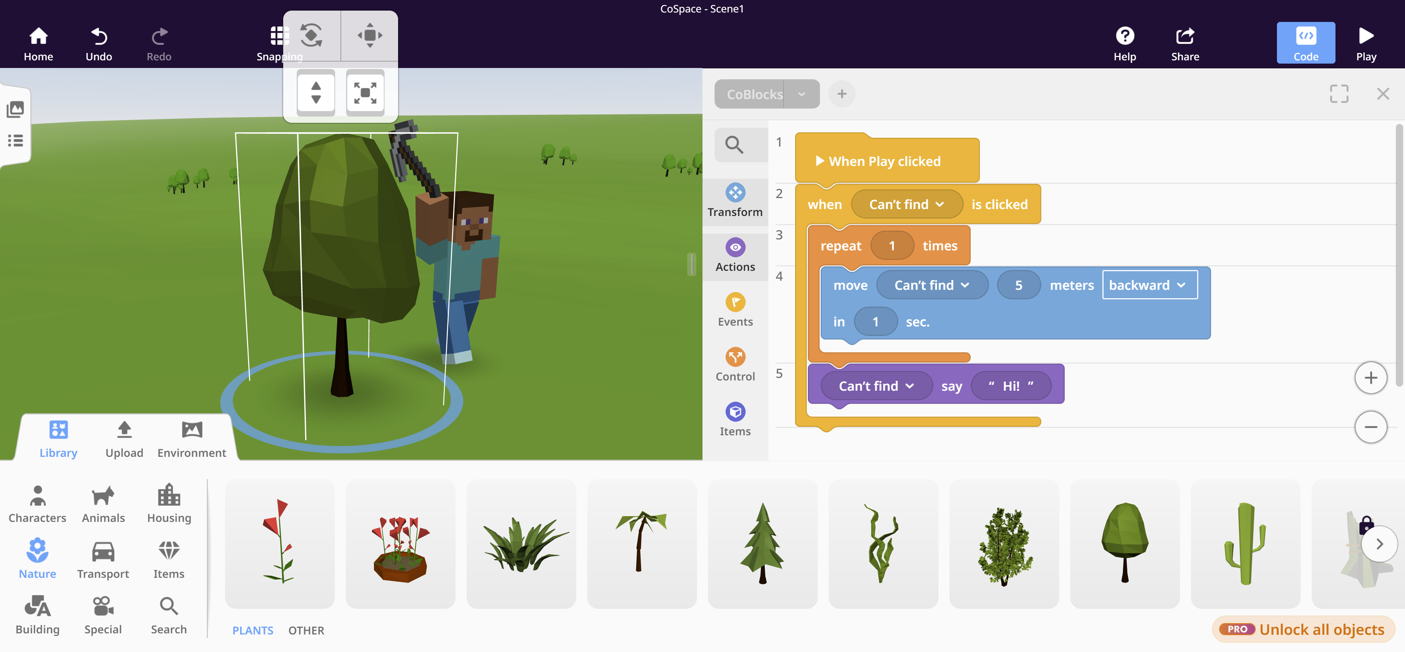
Upload 3D models and code your characters
Studio56.qa

Slide 9
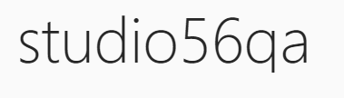
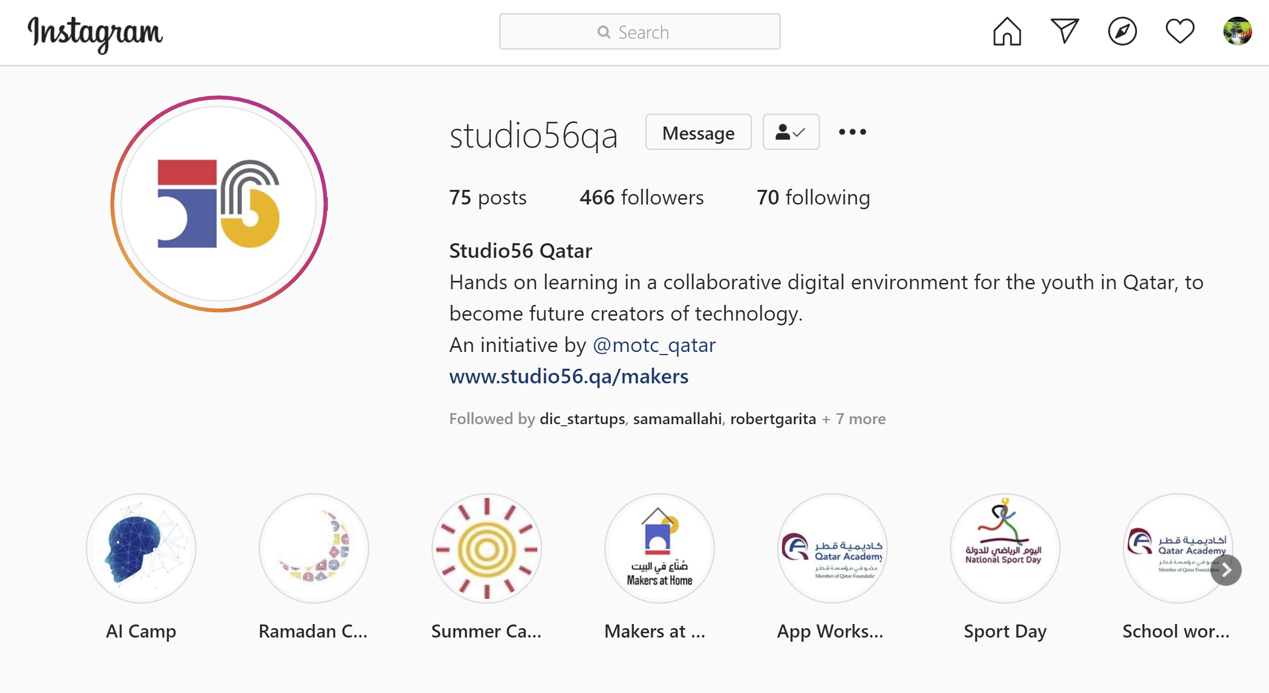
Studio56.qa
Notes:
Encourage participants to follow our studio56qa Instagram

Slide 10
THANKS
info@studio56.qa
Studio56.qa
Notes:
WRAP UP
Encourage students to visit our website and explore the workshops

