Slide 1
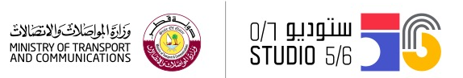
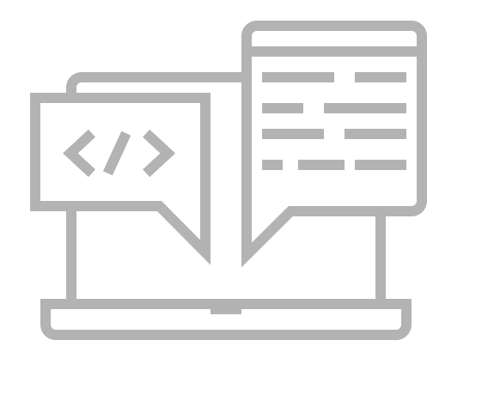
Create your own website
Studio56.qa

Slide 2
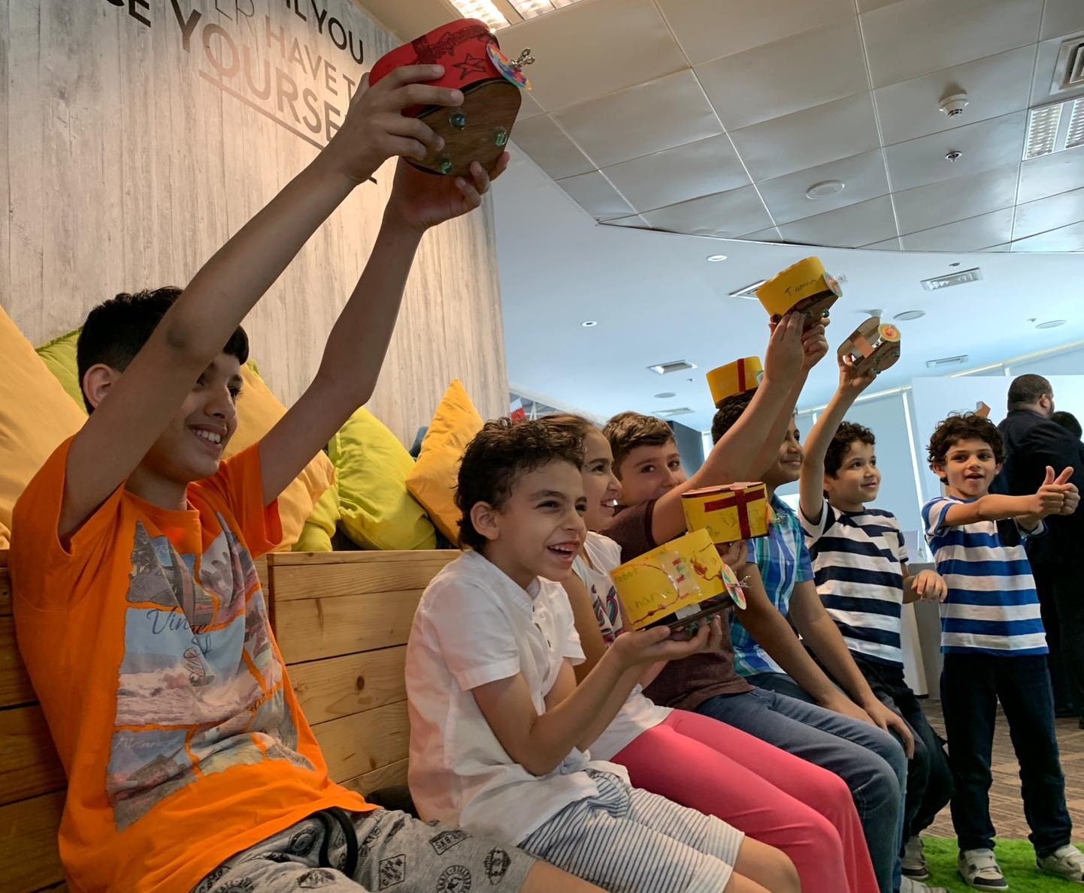
WHO ARE WE?
STUDIO 5\6 is a fabrication lab targeting kids from age 7 to 18.
_____
Our goals is to transform kids from consumers to creators, by empowering them to be technology makers.
_____
In Fablab there are different machines and tools to create active prototypes.
Studio56.qa

Slide 3

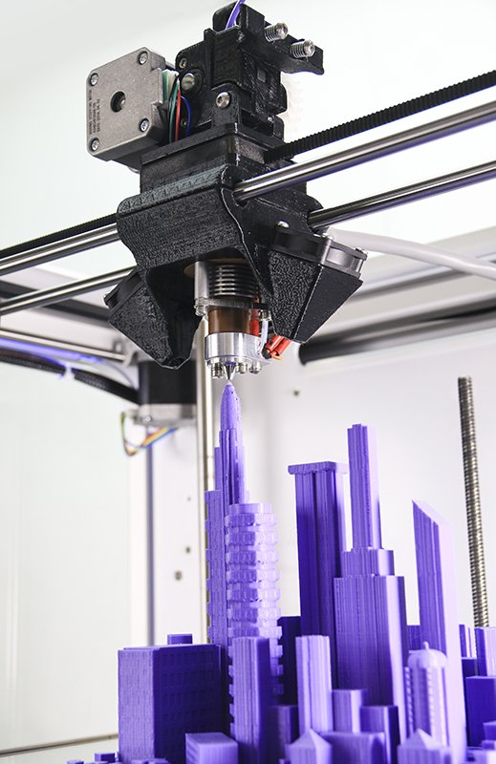

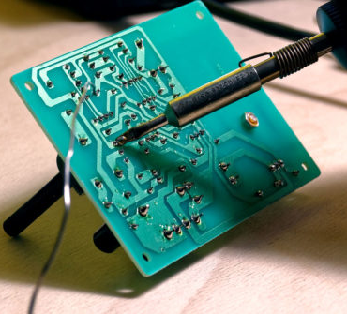
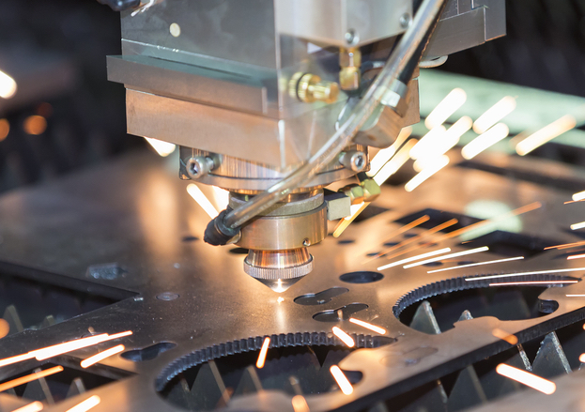
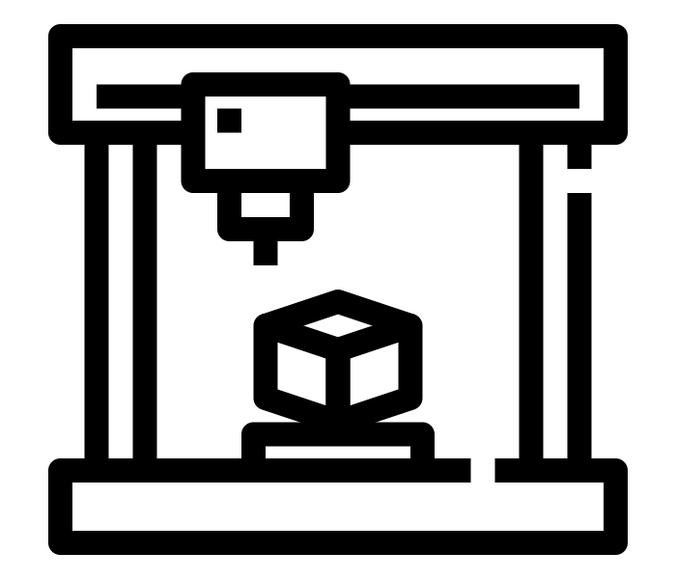
What is inside the FABLAB?
Tools & Machines
Zones
Creativity zone
3D printing
Electronics and programming
Software zone
Laser cutting
Technology zone

Slide 4
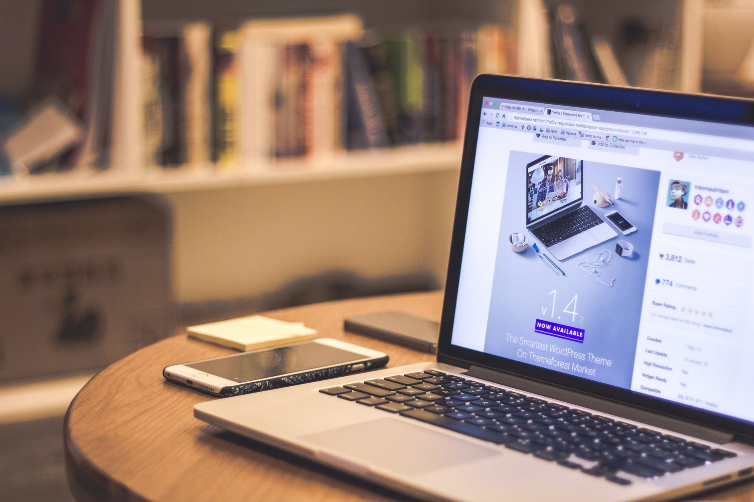
Your mission is to develop a website to represent the stadiums of
Qatar 2022 world cup
Studio56.qa

Slide 5
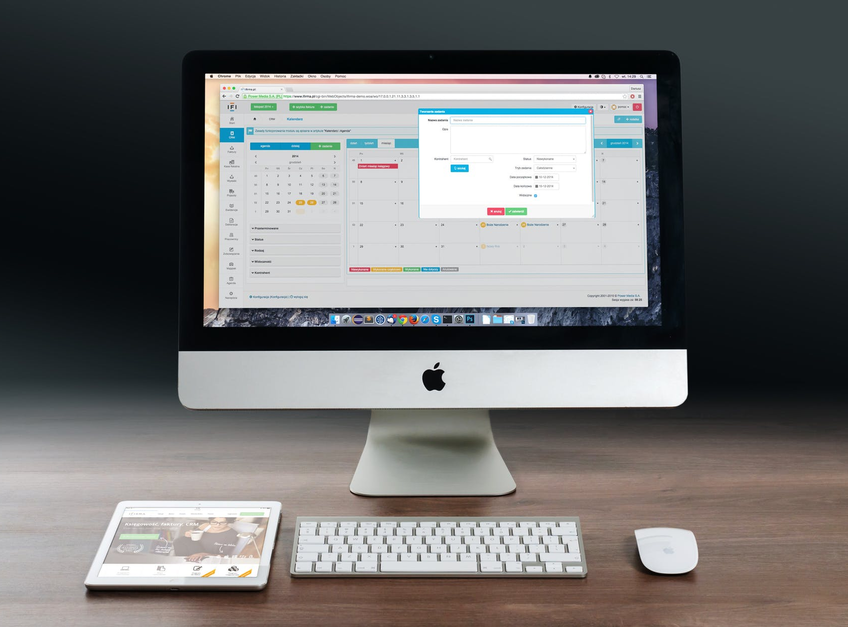
But first,
What is a WEBSITE?

Slide 6

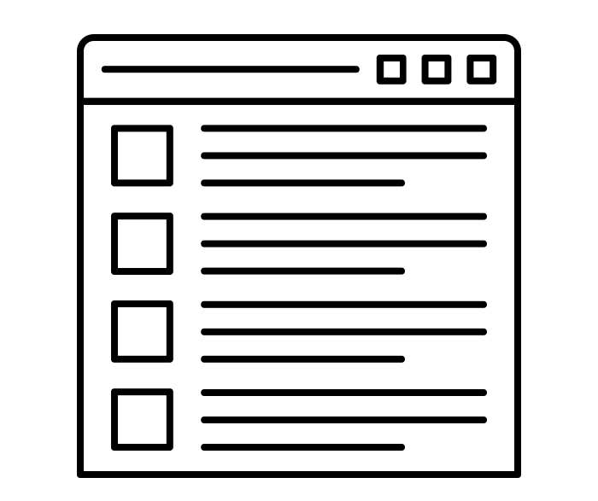
What is a Website?
A set of interconnected webpages, located on the same server, prepared and maintained as a collection of information by a person or a group.
Studio56.qa
Notes:
Explain that a server is a computer program or a device that provides functionality for other programs or devices.

Slide 7
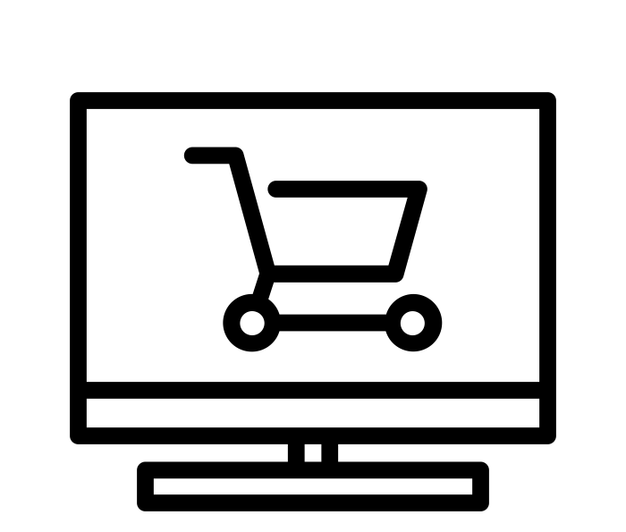
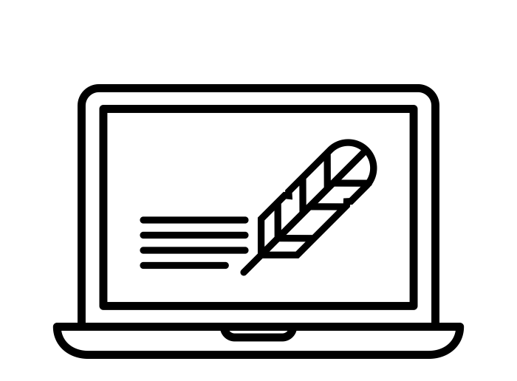


Types of Websites?
Shopping
Blog
Entertainment
Business
Notes:
These are some of the types, there are more.
Ask the students which website they use most frequently?

Slide 8
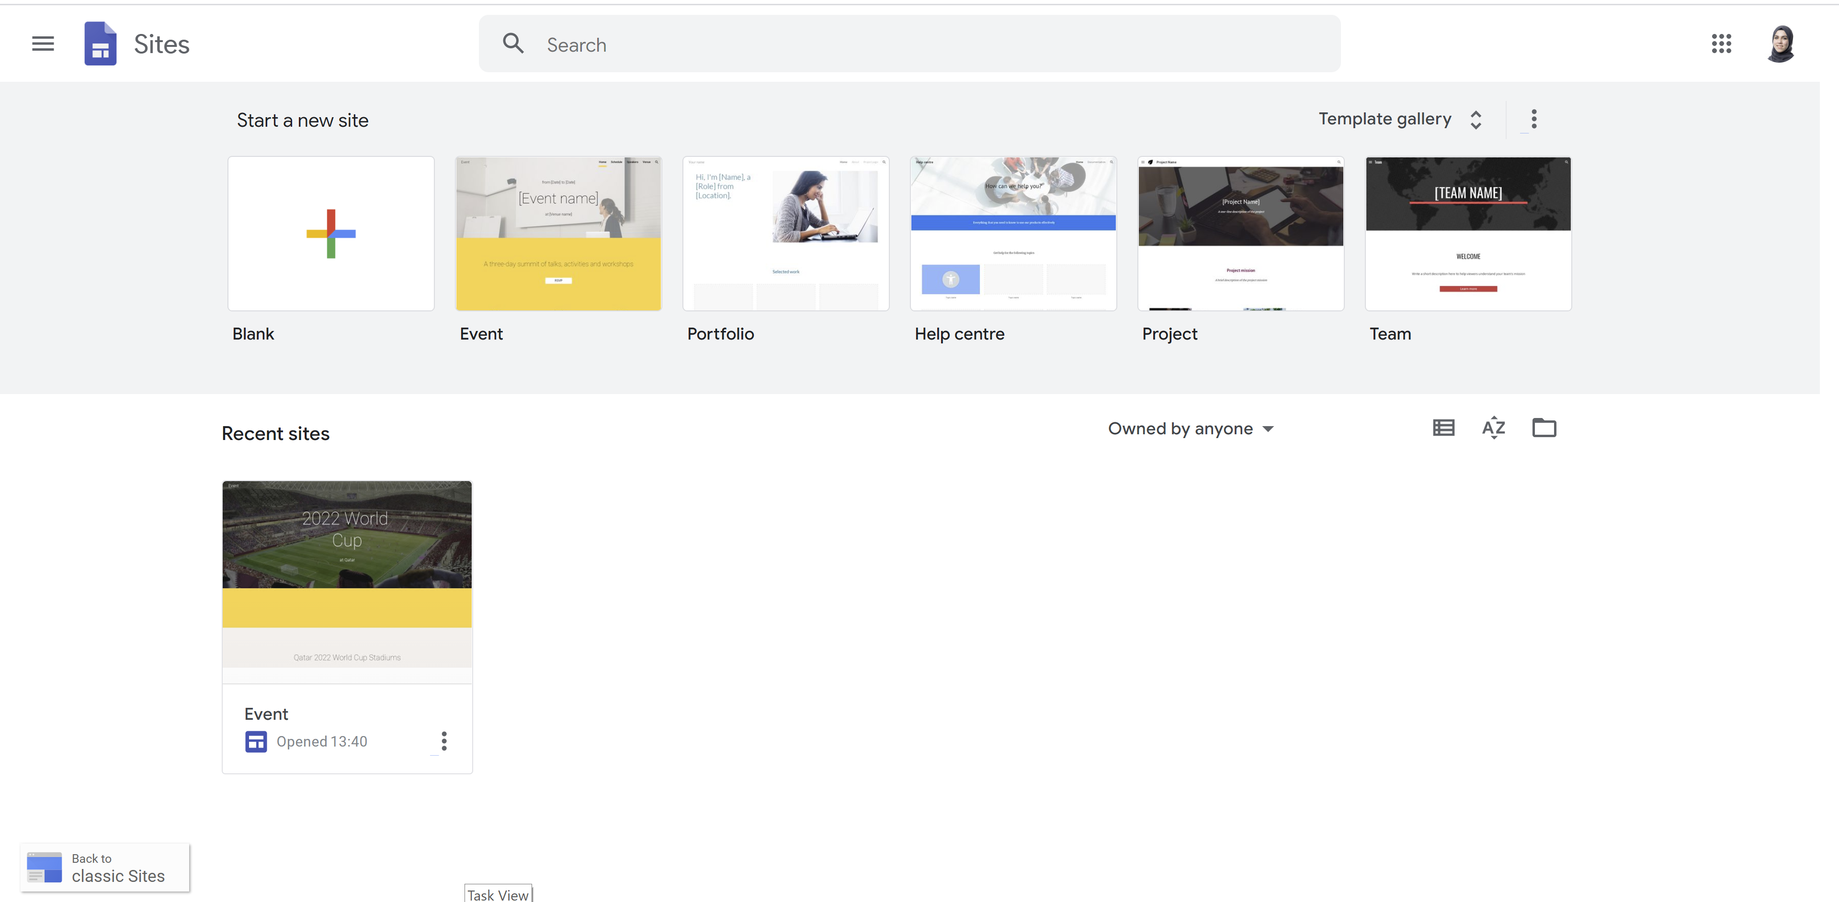
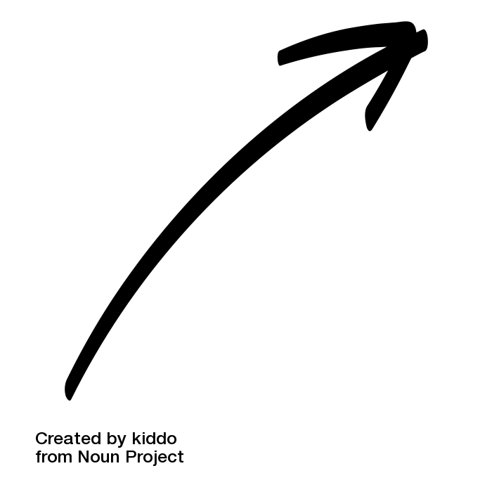
TODAY, WE WILL DESIGN OUR OWN WEBSITE!
Add pictures
Edit text size and font
Select layout
Edit hyperlinks
Notes:
Ask the kids if they built a website before?

Slide 9
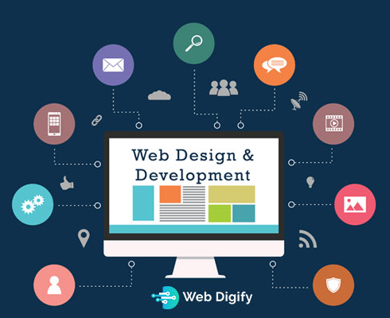
What is Web Design?
The process of deciding and choosing the appearance, layout, structure, and content of the website.
It also includes choosing the suitable color, font, images,and videos.

Slide 10


LET’S START!
We will be using the Google Sites online platform
Notes:
1- Select a template suitable to the topic.
2- Change the title of the first page.
3- Edit the menu to leave 3 pages only ( Home, History, General information).
4- In Home page: change the footer to have Studio56 or student preferred contact information.
5- In History page: Change title size and font + edit description text + add a picture.
6- In General Information page: change text size and font + edit description text + add a picture.
7- In Home page: Edit the hyperlinks of the buttons to refer to the right page.
8- Publish your website and save the link.

Slide 11
THANKS
info@studio56.qa
Studio56.qa

