Slide 1

3D Design in Fashion sector
11 -14
Studio56.qa
Notes:
Take the attendance
Have you attended workshops before?

Slide 2
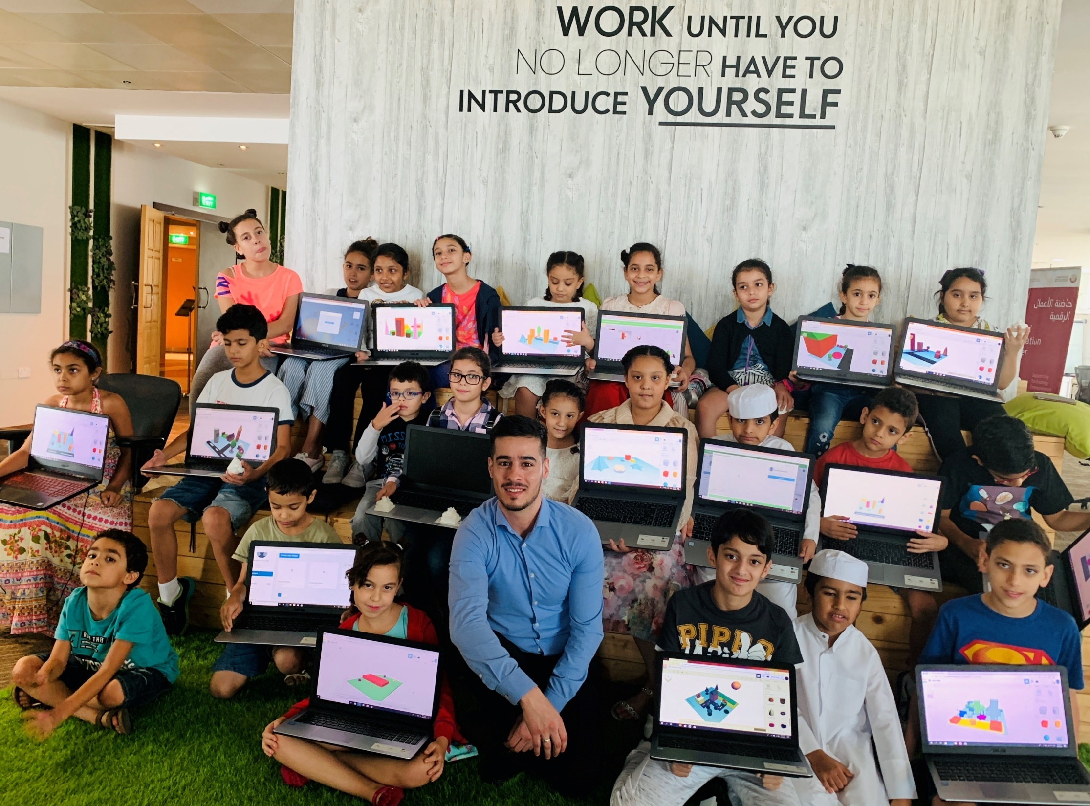

Who are we?
من نحن؟
Software Zone.
Technology Zone.
Creative Zone.
Notes:
Fab lab Studio 56 teaches youth about the necessary skills of this century such as digital fabrication, design and computer science.
Studio 56 has 3 main zones:

Slide 3
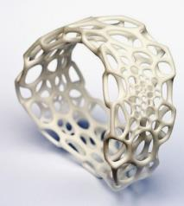
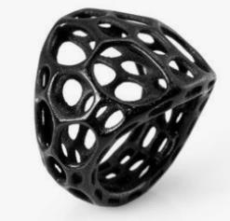
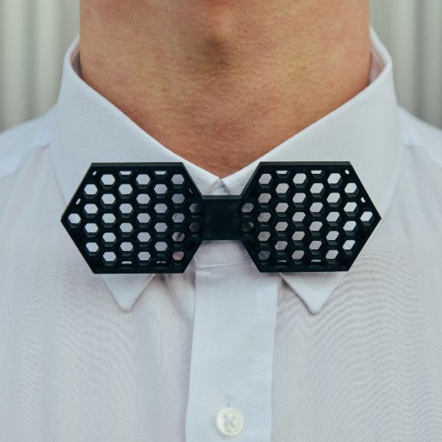
Ahmed is planning to enter a competition in fashion design, and he want to create unique and special fashion accessories by integrate modern 3d design with digital technology, so he is asking for your support to provide him with modern designs of fashion from your creative imagination.
يخطط أحمد للدخول في مسابقة في تصميم الأزياء ، ويريد إنشاء إكسسوارات أزياء فريدة ومميزة من خلال دمج التصميم ثلاثي الأبعاد الحديث مع التكنولوجيا الرقمية ، لذلك فهو يطلب دعمكم لتزويده بتصميمات عصرية للموضة من خيالك الإبداعي
Notes:
Ice braking activity.
Have you played Minecraft before?

Slide 4
Today we are going to start fashion tech camps to explore what technologies are used in fabricating fashion.
In this camp, you will need to attend 5 days during the week, each day you will have a one-hour class.
On the last day, you will be asked to conduct your final project.
سنبدأ اليوم مخيم تقنية الموضة لاستكشاف التقنيات المستخدمة في تصنيع الأزياء.
في هذا المعسكر ، سوف تحتاج إلى حضور 5 أيام خلال الأسبوع ، كل يوم سيكون لديك فصل لمدة ساعة واحدة.
في اليوم الأخير سيطلب منك عمل مشروعك النهائي.
Studio56.qa
Notes:
Ice braking activity.
Have you played Minecraft before?

Slide 5
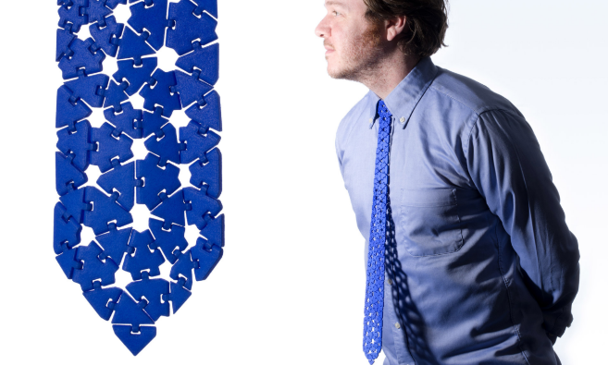
Those are some examples of digital manufactured fashion
هذه بعض الأمثلة على لأزياء التي تم تصنيعها رقميا
3D Printed tie
ربطة عنق
Studio56.qa

Slide 6
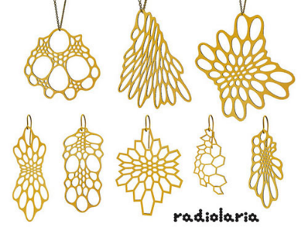
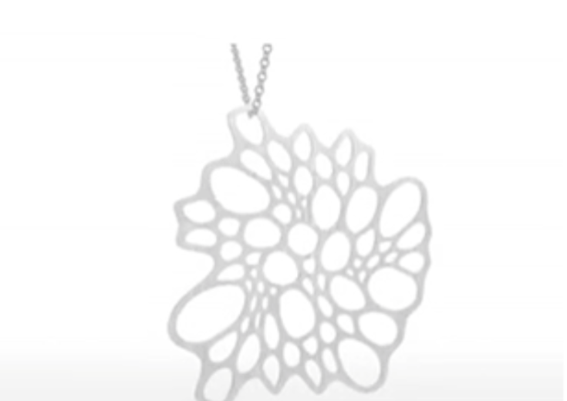
Those are some examples of digital manufactured fashion
هذه بعض الأمثلة على لأزياء التي تم تصنيعها رقميا
Radiolaria Design
3D Printed jewelry
تصميم راديولاريا
مجوهرات مطبوعة ثلاثية الأبعاد
Studio56.qa

Slide 7
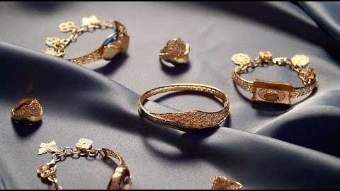
Let’s watch a video about digital manufacturing and fashion
لنشاهد مقطع فيديو عن التصنيع الرقمي والأزياء
Studio56.qa
Notes:
Laser cutting video
https://www.youtube.com/watch?v=KLTihO71h6o
The current video
https://www.youtube.com/watch?v=FalNsx2zULM

Slide 8
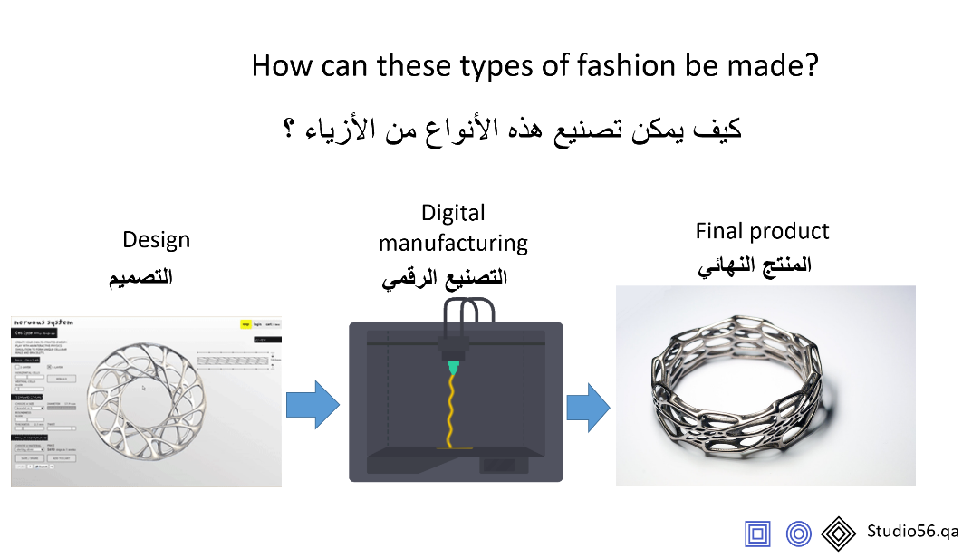
Notes:
Laser cutting video
https://www.youtube.com/watch?v=KLTihO71h6o
The current video
https://www.youtube.com/watch?v=FalNsx2zULM

Slide 9
التصميم
Design
يوجد الآن الكثير من برامج التصميم وكل منها مخصص لوظيفة معينة.
دعونا نستكشف بعض برامج التصميم و المخصصة للمجالات التالية:
هندسة العمارة
الطيران
الميكانيك
المنتجات
الألعاب
الأفلام
Now there are plenty of design software and each one is dedicated for a certain job.
Let’s explore some of design software that are dedicated for the following task:
Architecture
Aerospace
Mechanical design
Product design
Games
Movies
Studio56.qa
Notes:
Engage students in discussions, what is this machine ??
Have you heard about this machine before?
Have you seen it before?

Slide 10
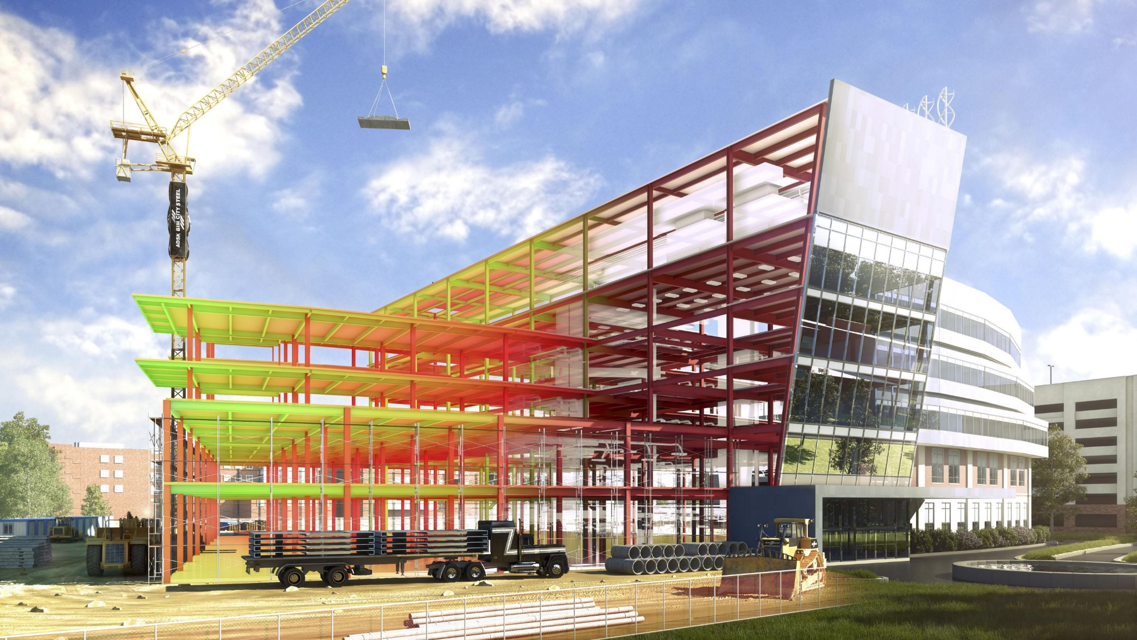
Revit Architecture
Studio56.qa
Notes:
Biem design

Slide 11
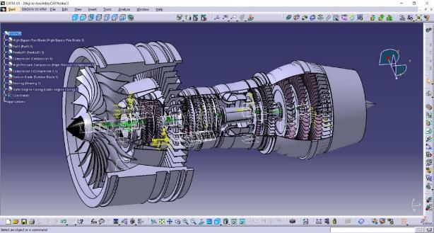
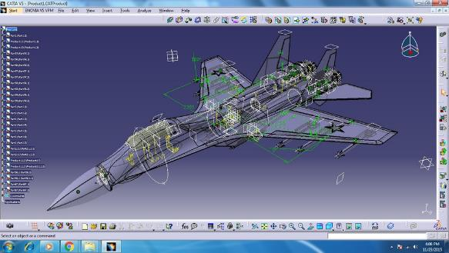
CATIA - Aero space
Studio56.qa
Notes:
SAY there are more design software such as semens nx

Slide 12
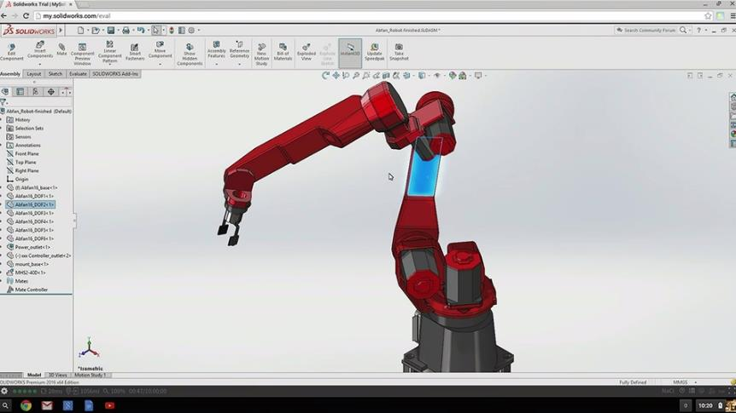
Solidworks - Mechanical
Studio56.qa

Slide 13
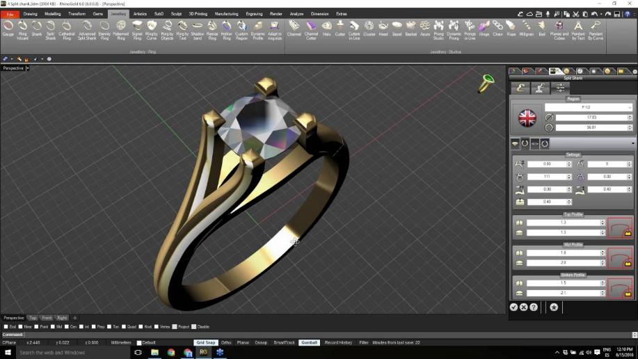
Rhino gold - jewelry
Studio56.qa
Notes:
https://www.youtube.com/watch?v=tWGLeJ-cS58

Slide 14
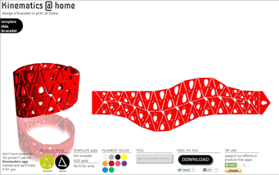
Nervous system – Fashions
Let’s Explore Nervo systems and fashion design
دعونا نستكشف أنظمة نيرفو و تصميم الأزياء
Studio56.qa
Notes:
After finish explaining nervo present to participant the parametric design

Slide 15
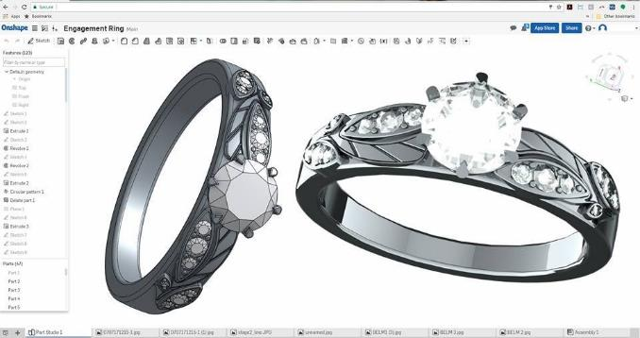
Product design – Onshape
Through this camp we will go through Onshape software and learn how to create 3D designs of fashion, jewelry and accessories.
خلال هذا المخيم ، سنتعرف على برنامج اون شيب ونتعلم كيفية إنشاء تصميمات ثلاثية الأبعاد للأزياء والمجوهرات والإكسسوارات.
Studio56.qa
Notes:
Explain Onshape and show the main interface :
Onshape is a computer-aided design software system, delivered over the Internet via a Software as a Service model.
Ask students to create accounts and help them

Slide 16
THANKS
info@studio56.qa
Studio56.qa
Notes:
WRAP UP الخاتمة
Debrief استجواب
Ask students to reflect on the day’s activities. What did they learn about Programming? Debugging? How do they feel about computer science and code after spending one hour exploring?
Next Steps Let students know that if they enjoyed today’s activity, they have many options for continuing to code and learn. Encourage students to visit studio56.qa/media-center
tell students what’s coming next in your classroom.

