Slide 1

Customized Fashion
11 -14
Studio56.qa
Notes:
Talk about the final project ( what they will do)
Talk about the certificate and when they will receive it.
Last 10 minutes check the final projects.

Slide 2
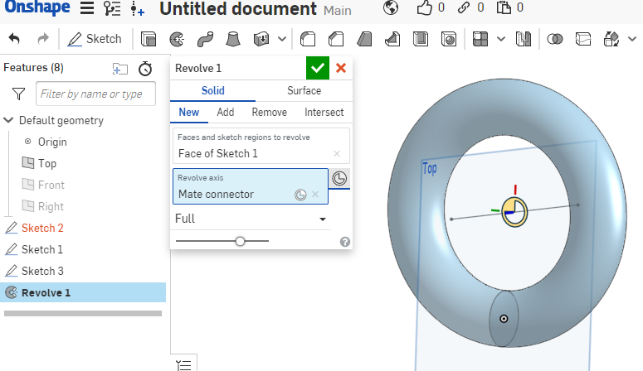
3D modeling tools:
أدوات التصميم الثلاثي الابعاد:
Revolve التدوير
Studio56.qa

Slide 3
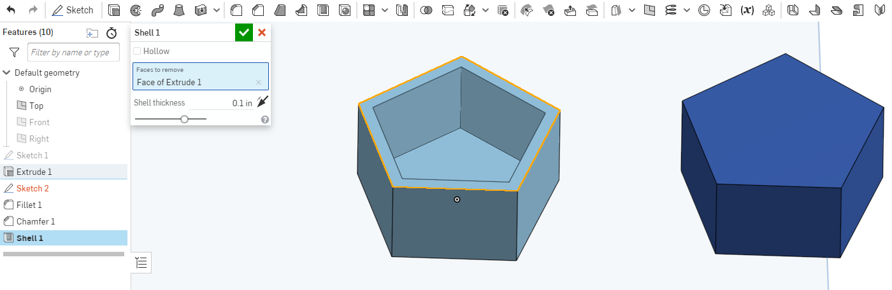
3D modeling tools:
أدوات التصميم الثلاثي الابعاد:
Shell الهيكل
Studio56.qa

Slide 4
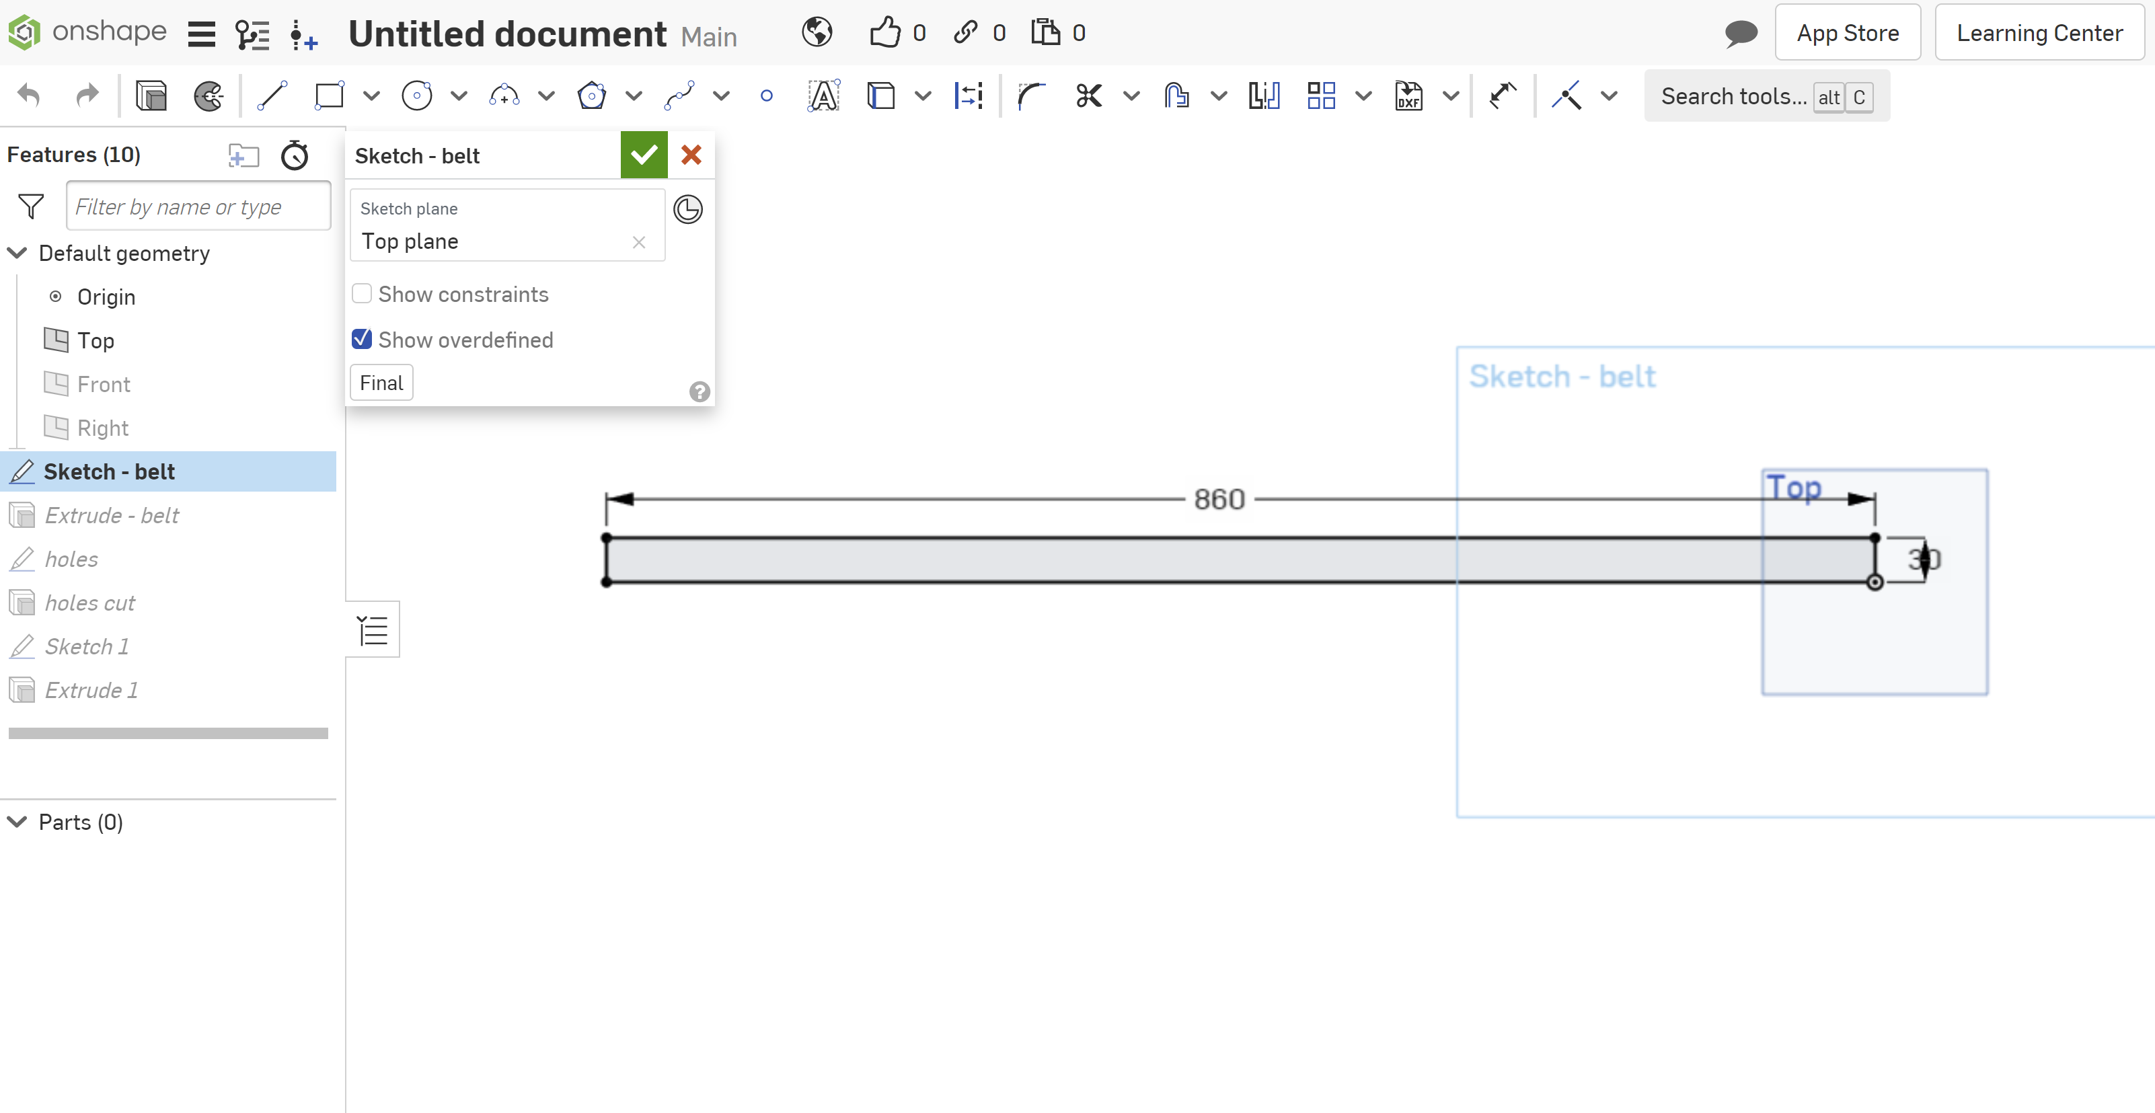
Let’s create a belt and start with a sketch
Studio56.qa

Slide 5
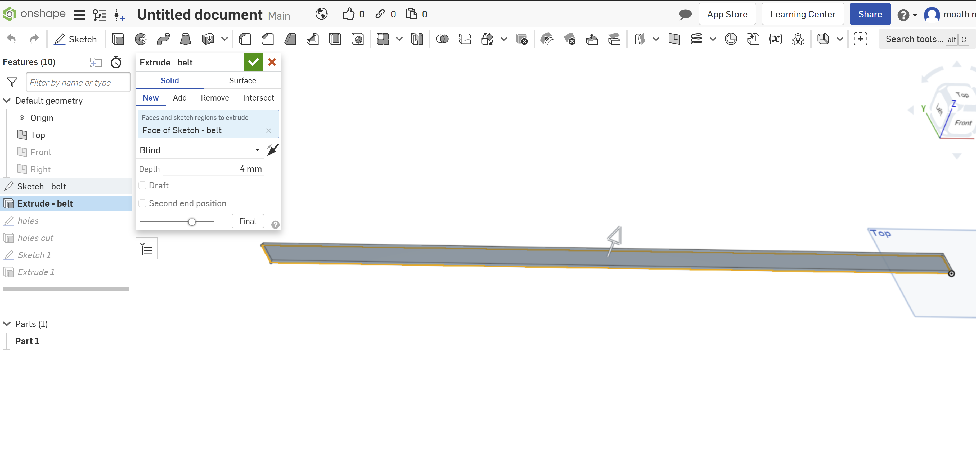
We perform extrude 4mm
Studio56.qa

Slide 6
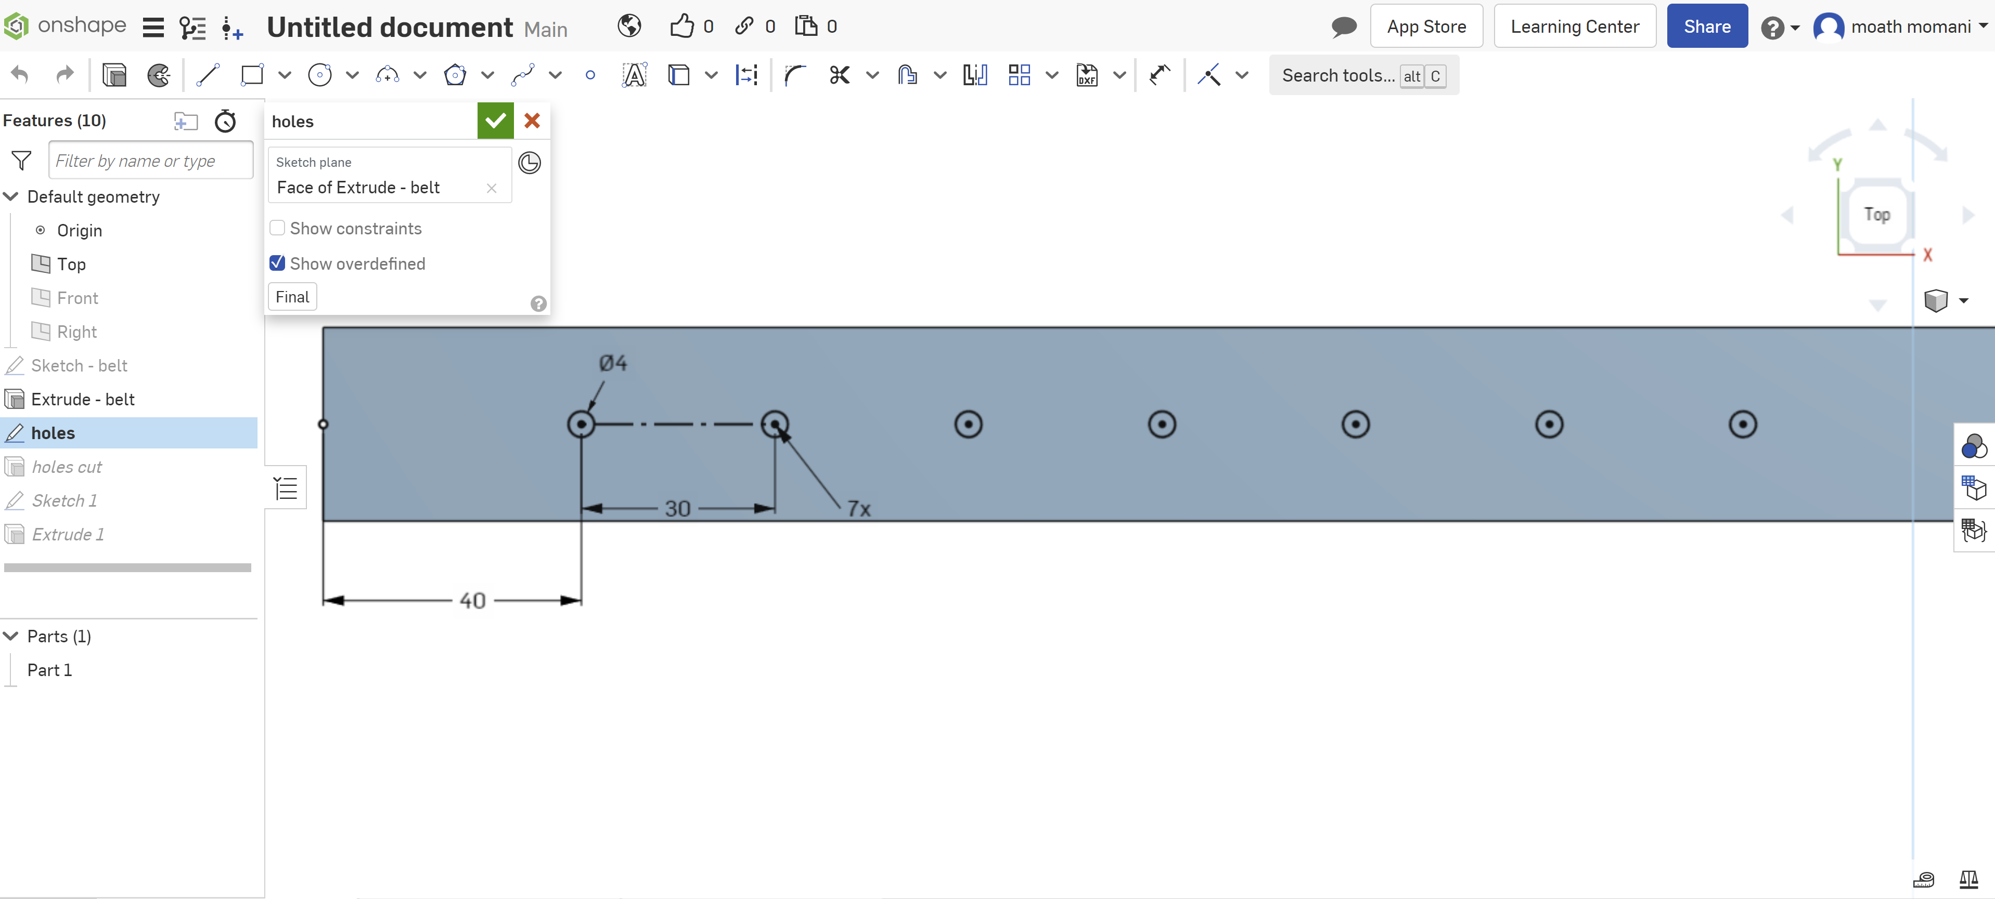
1- Create a new sketch and select circle.
2- Select Linear pattern to create 7 circles
Studio56.qa

Slide 7
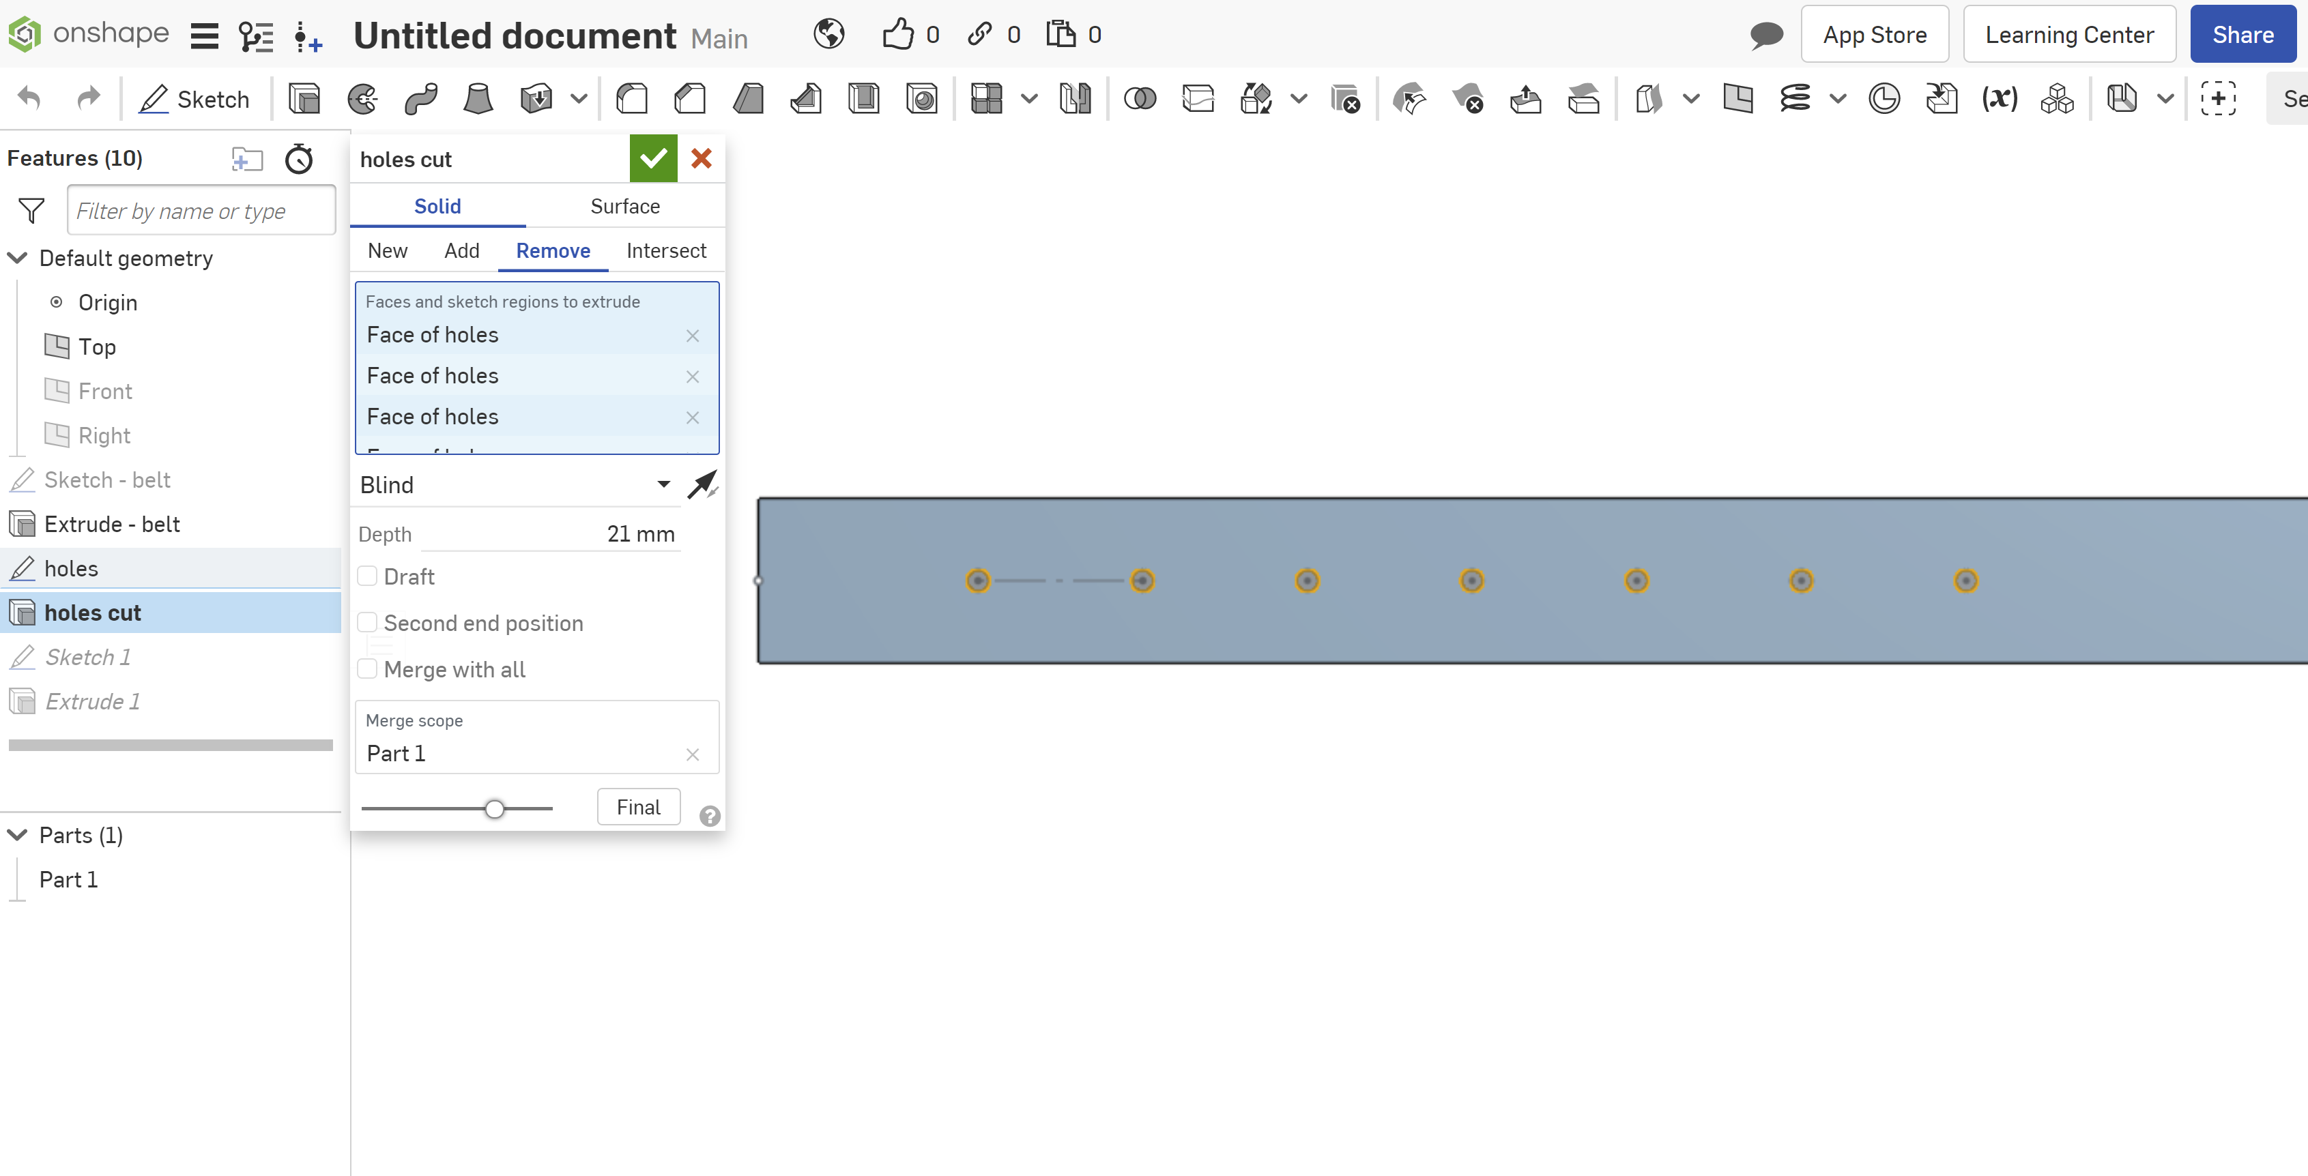
We perform extrude 4mm
Studio56.qa

Slide 8
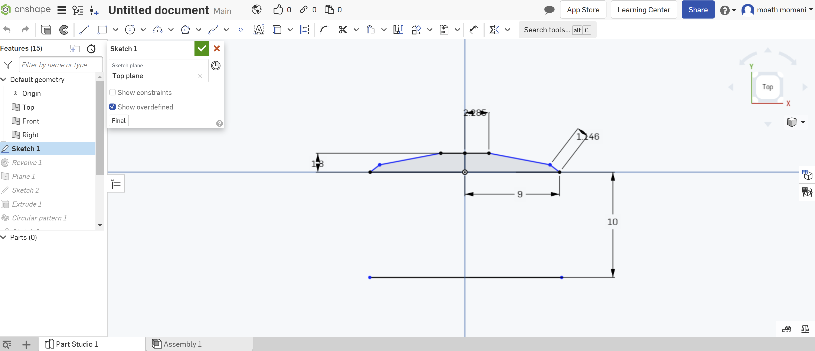
Let’s create a bracelet and start with a sketch
Studio56.qa

Slide 9
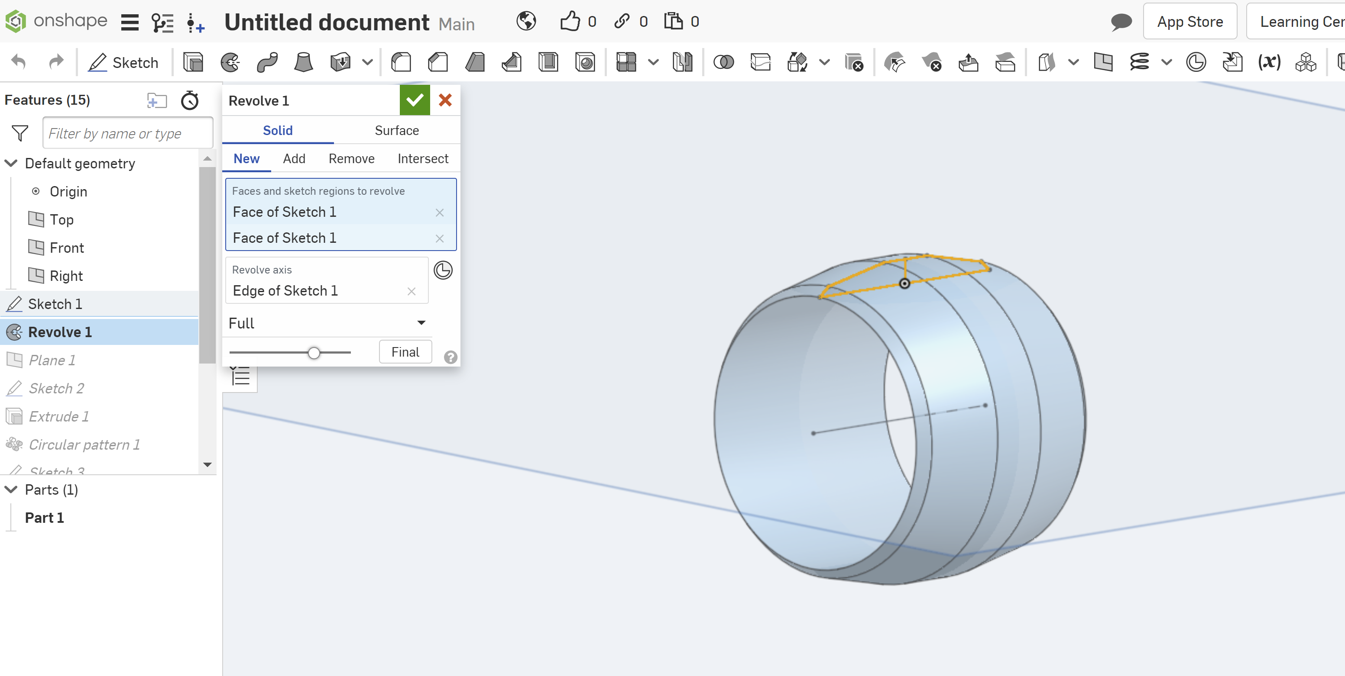
From 3D tools, select Revolve
Studio56.qa

Slide 10
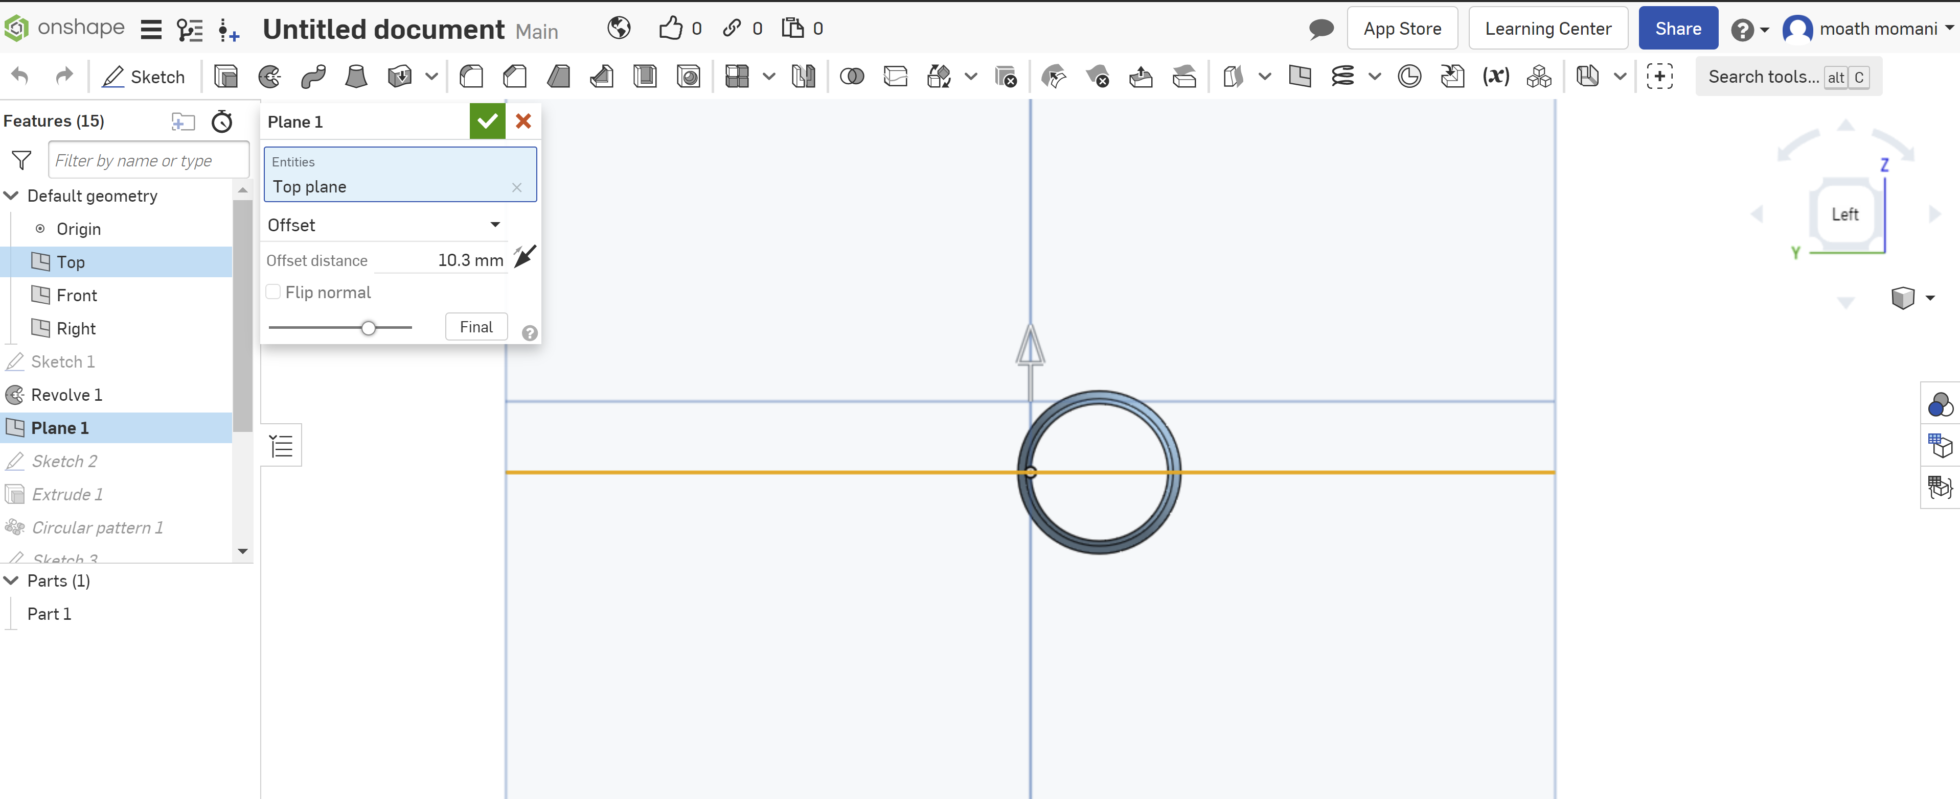
From 3D tools, select Revolve we need to create new plane to place a new sketch on it
Studio56.qa

Slide 11
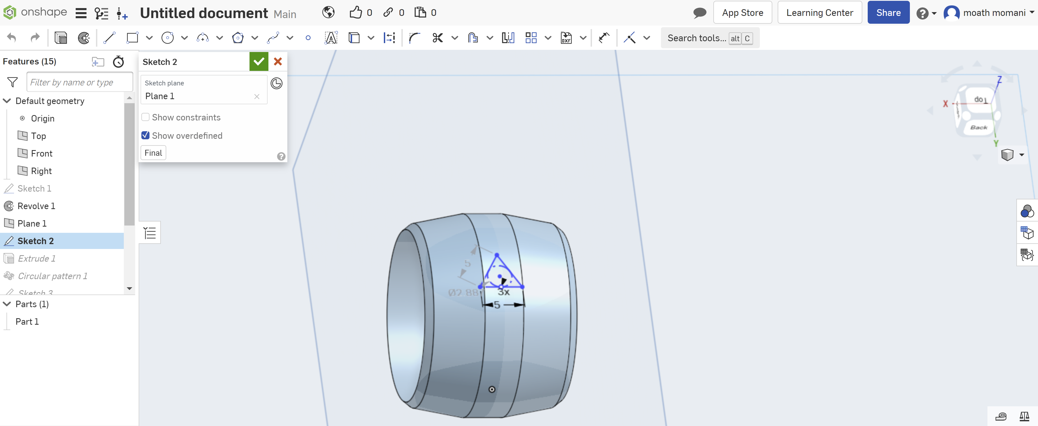
place a new sketch on it
Studio56.qa

Slide 12
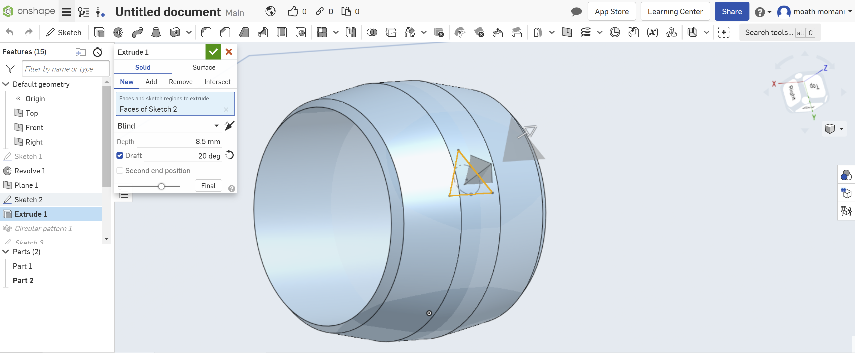
From 3D tools, select extrude and select new.
Studio56.qa

Slide 13
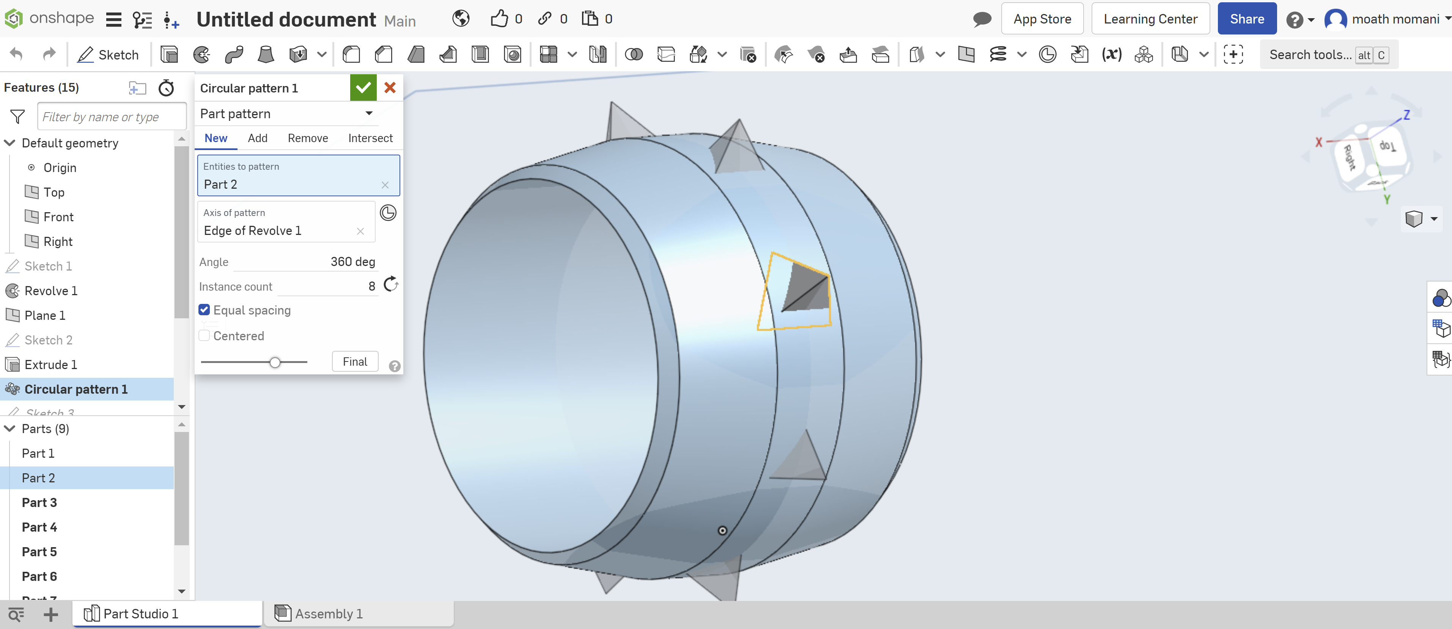
From 3D tools, select extrude and select new.
Studio56.qa

Slide 14
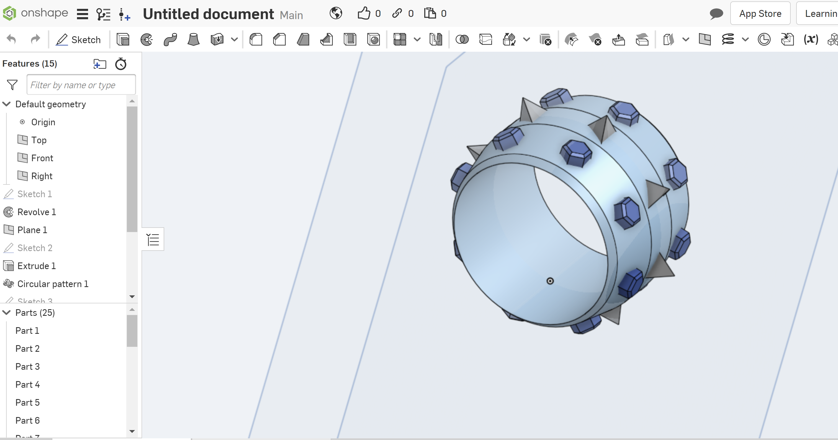
Studio56.qa

Slide 15
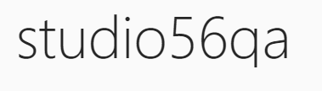
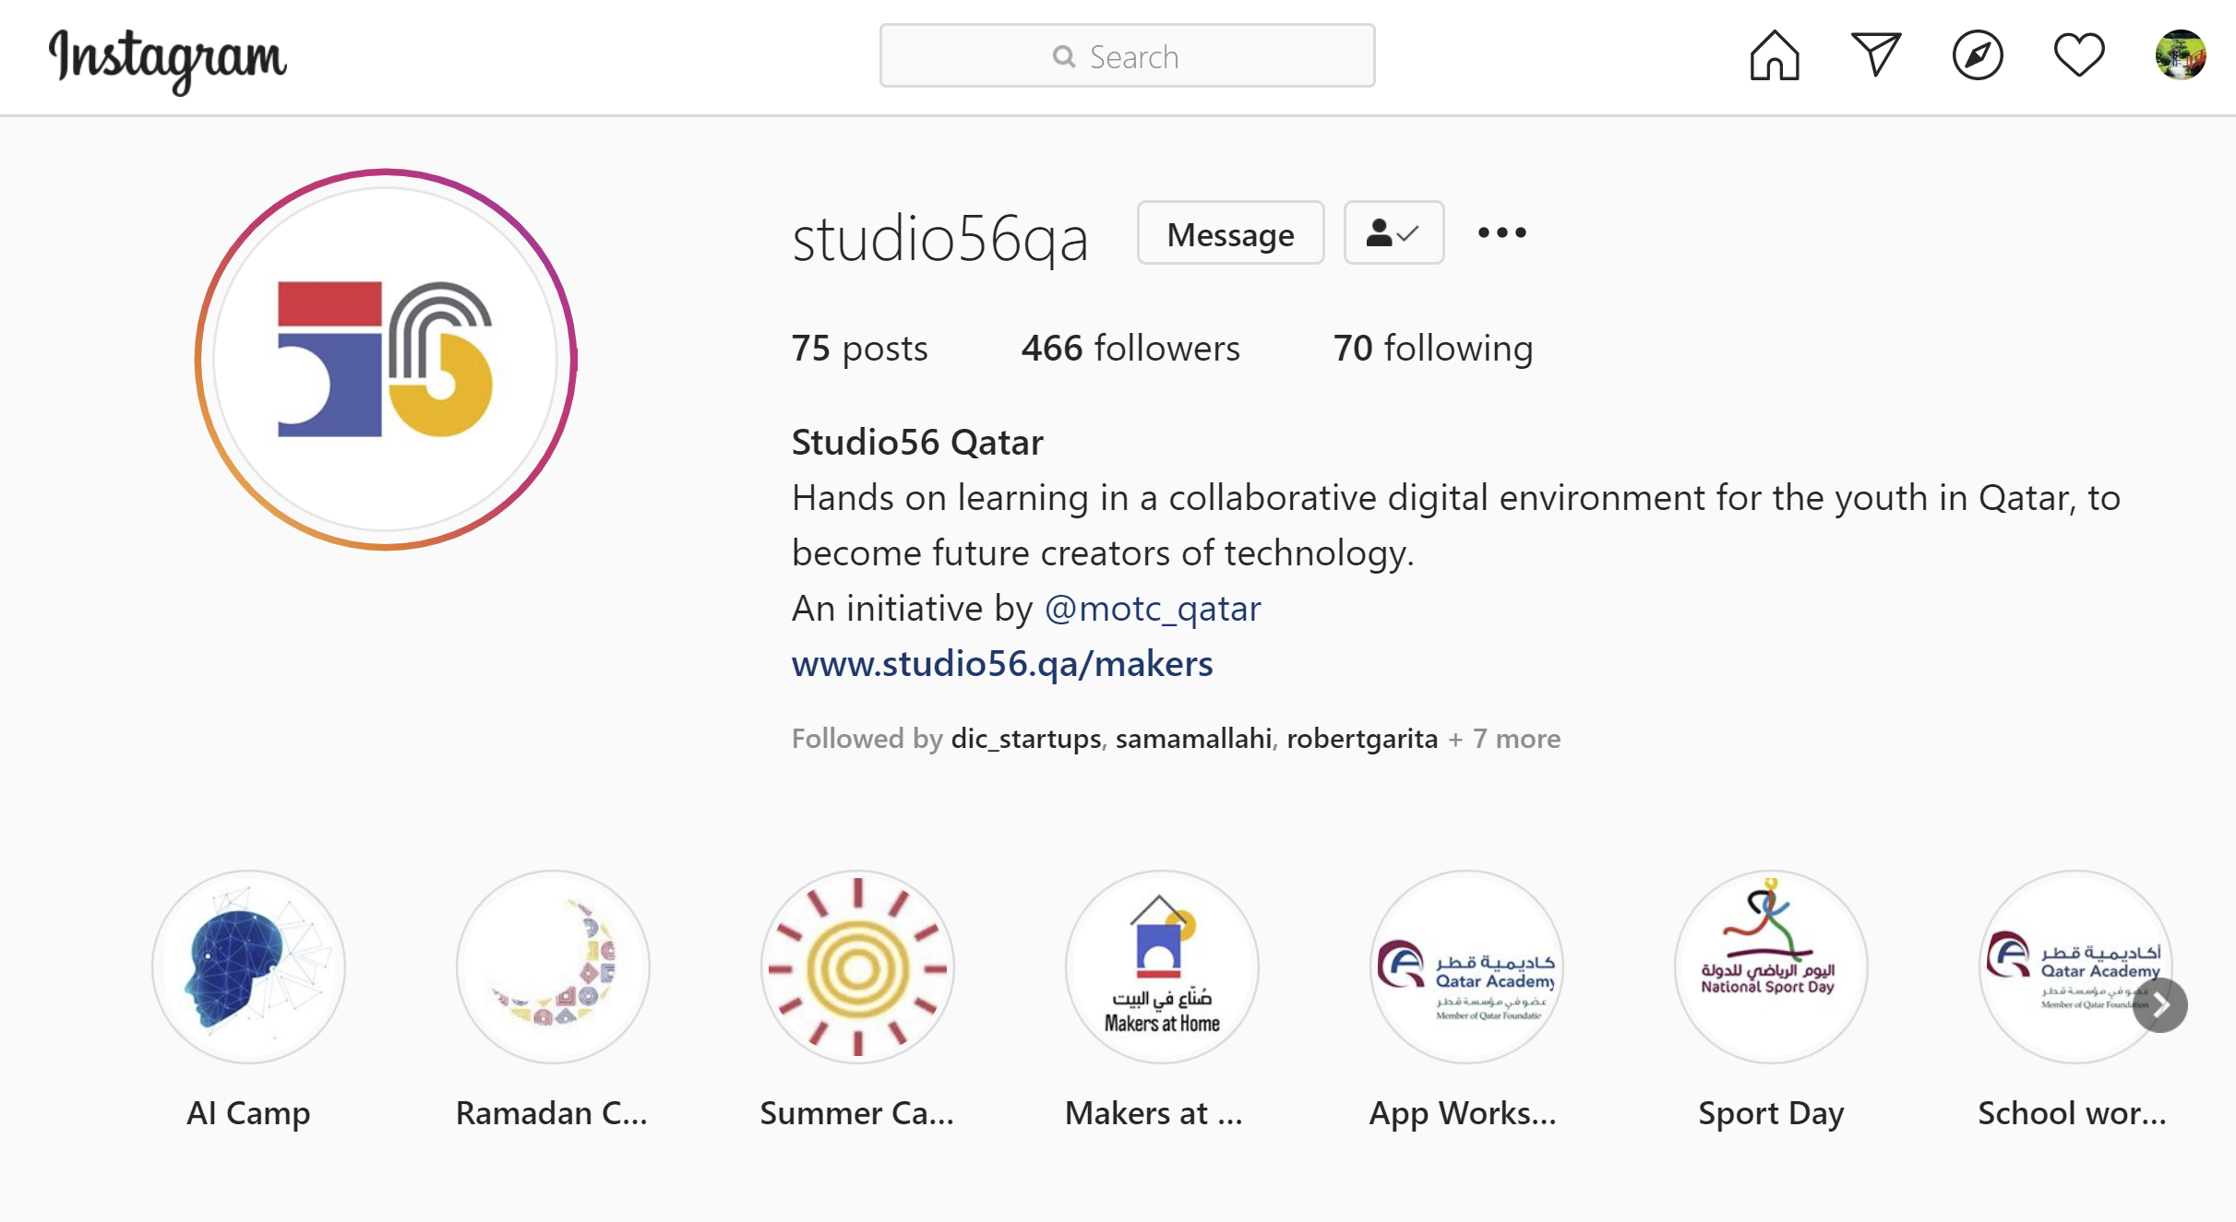
Studio56.qa
Notes:
Encourage participants to follow our studio56qa Instagram

Slide 16
THANKS
info@studio56.qa
Studio56.qa
Notes:
WRAP UP
Encourage students to visit our website and explore the workshops

