Slide 1

Virtual National Day
11-14
Studio56.qa
Notes:
Take the attendance
Have you attended workshops before?

Slide 2

How do you celebrate the national day?

Slide 3
Hamad wants to celebrate the national day in Qatar but due to his health situation he won’t be able to go out of his home, we need to help Hamad and celebrate the national day with him by creating a virtual world that simulate Qatar National Day.
يريد حمد الاحتفال باليوم الوطني في قطر ولكن بسبب وضعه الصحي لن يتمكن من الخروج من منزله ، نحتاج إلى مساعدة حمد والاحتفال باليوم الوطني معه من خلال إنشاء عالم افتراضي يحاكي يوم قطر الوطني.
Studio56.qa
Notes:
Ice braking activity.
Have you played Minecraft before?

Slide 4

VIRTUAL REALITY (VR)
It’s a computer-generated simulation in which a person can interact within an artificial three-dimensional environment using electronic devices, such as special goggles with a screen or gloves fitted with sensors.
Virtual Reality can be used in different fields such as science, medicine, sport, education and many others.
Studio56.qa

Slide 5
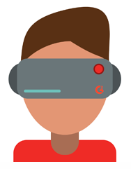
Types of Virtual Reality - VR
There are three main types of virtual reality used today to transform the world around us, including non-immersive, semi-immersive, and fully-immersive simulations.
أنواع الواقع الافتراضي - VR
هناك ثلاثة أنواع رئيسية من الواقع الافتراضي المستخدمة اليوم لتغيير العالم من حولنا، بما في ذلك المحاكاة غير الغامرة ، وشبه الغامرة ، والواقعية بالكامل.
To get a better understanding of how the technology is used, let’s break down the different types of VR and see examples of each.
للحصول على فهم أفضل لكيفية استخدام التكنولوجيا ، دعنا نقسم الأنواع المختلفة من VR ونرى أمثلة لكل منها.
Types of Virtual Reality - VR
Fully-Immersive
Simi-Immersive
Non-Immersive
أنواع الواقع الافتراضي - VR
غامرة بالكامل
شبه غامرة
غير غامرة
Studio56.qa

Slide 6
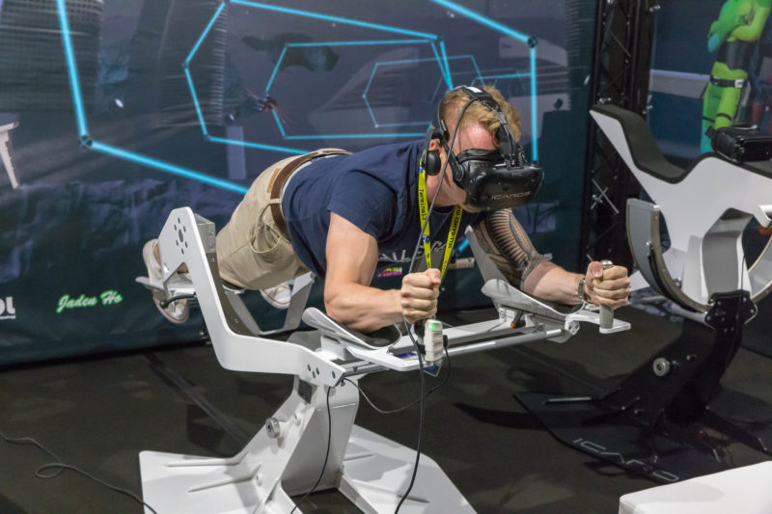
Training - flight simulator - Fully-Immersive
التدريب – محاكاة الطيران - غامرة بالكامل
Studio56.qa
Notes:
a fully-immersive experience – complete with head-mounted displays, headphones, gloves, and maybe a treadmill or some kind of suspension apparatus.

Slide 7

EDUCATION - Immersive
التعليم - غامرة بالكامل
Studio56.qa

Slide 8
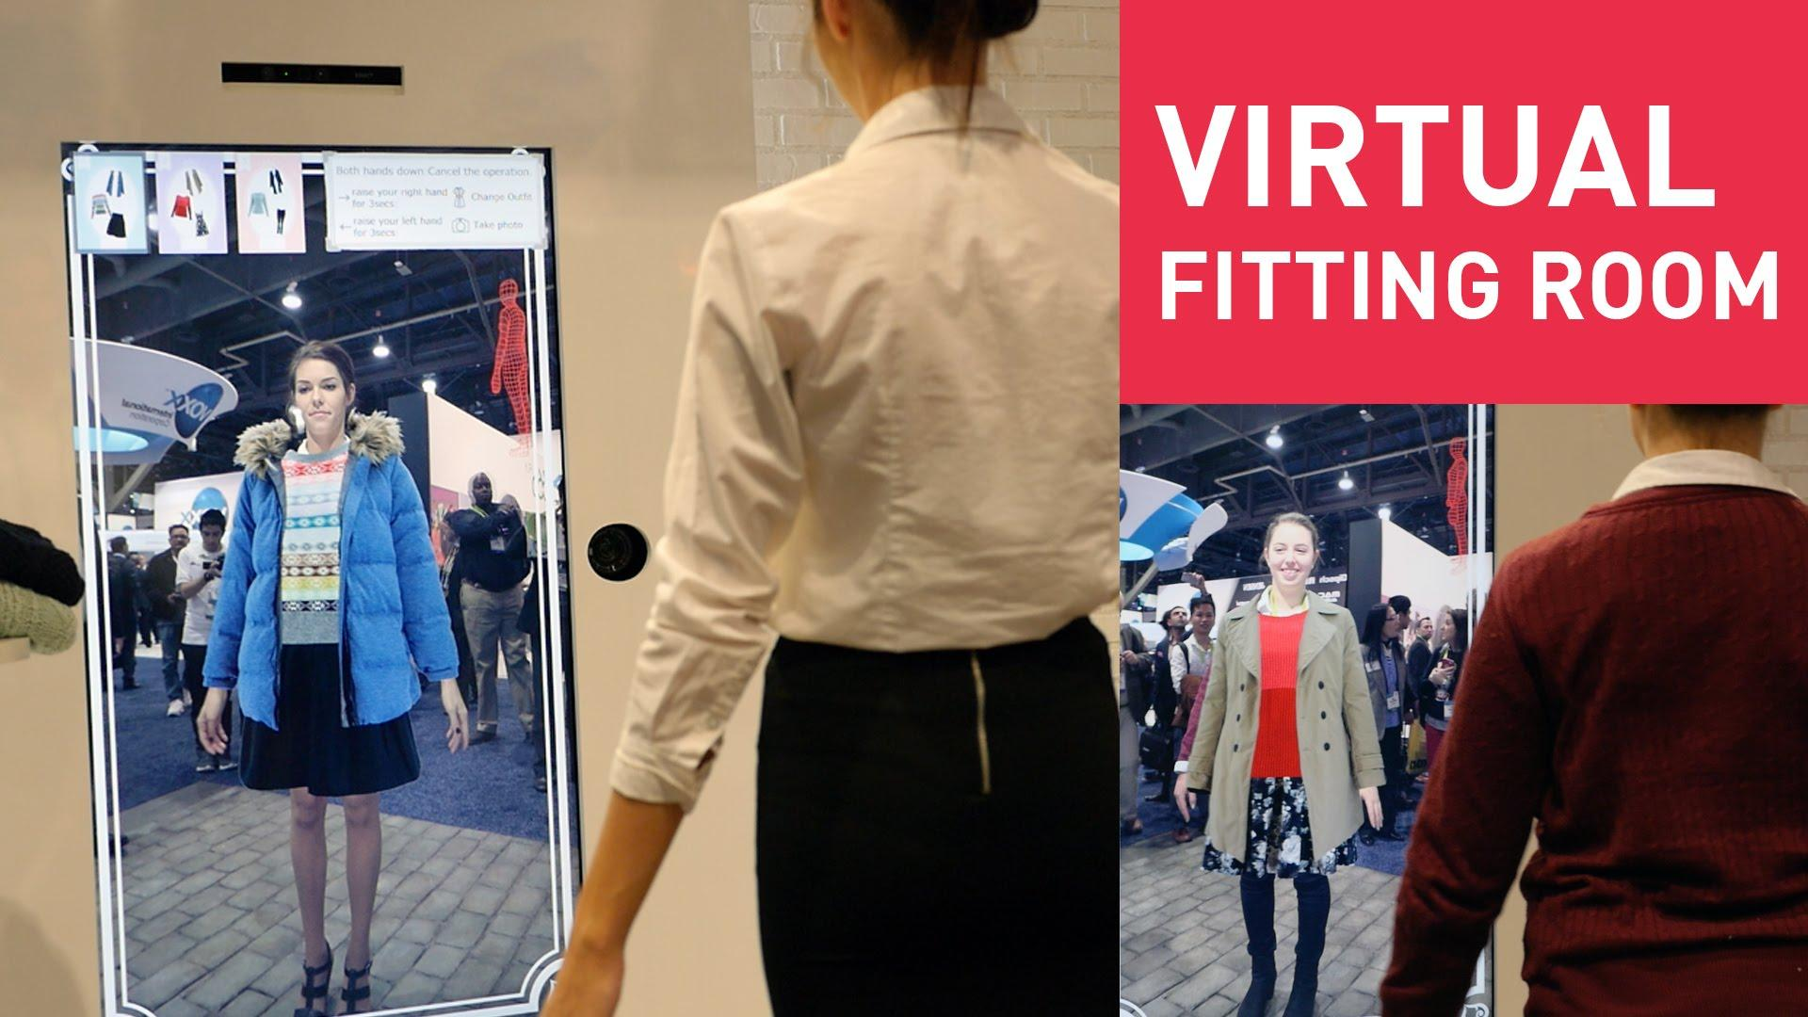
Fashion – Sime-Immersive
الأزياء- شبه غامرة
Studio56.qa
Notes:
Semi-immersive experiences provide users with a partially virtual environment to interact with. In this example, the instruments in front of the girl are real and the windows are screens displaying virtual content.
It’s important to keep in mind that semi-immersive VR simulations still give users the perception of being in a different reality.

Slide 9
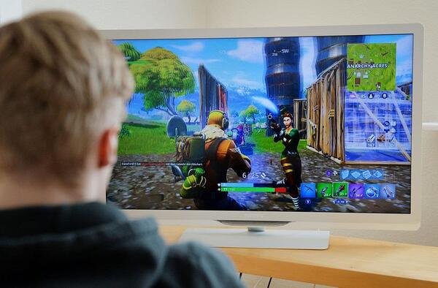
GAMING - Non-immersive
الألعاب – غير غامرة
Studio56.qa
Notes:
Non-immersive simulations are often forgotten as an actual type of VR, because it’s very common in our everyday lives.
The average video game is technically considered a non-immersive virtual reality experience. Think about it, you’re sitting in a physical space, interacting with a virtual one.

Slide 10
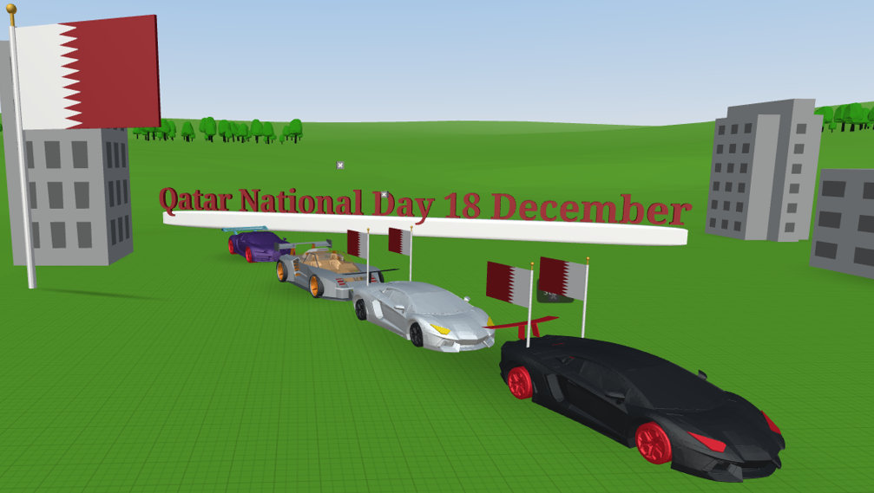
What we will do today?
ماذا سنفعل اليوم؟
Studio56.qa
Notes:
Today we will build a non immersive VR world to create a simulated environment of the national day in Qatar.

Slide 11
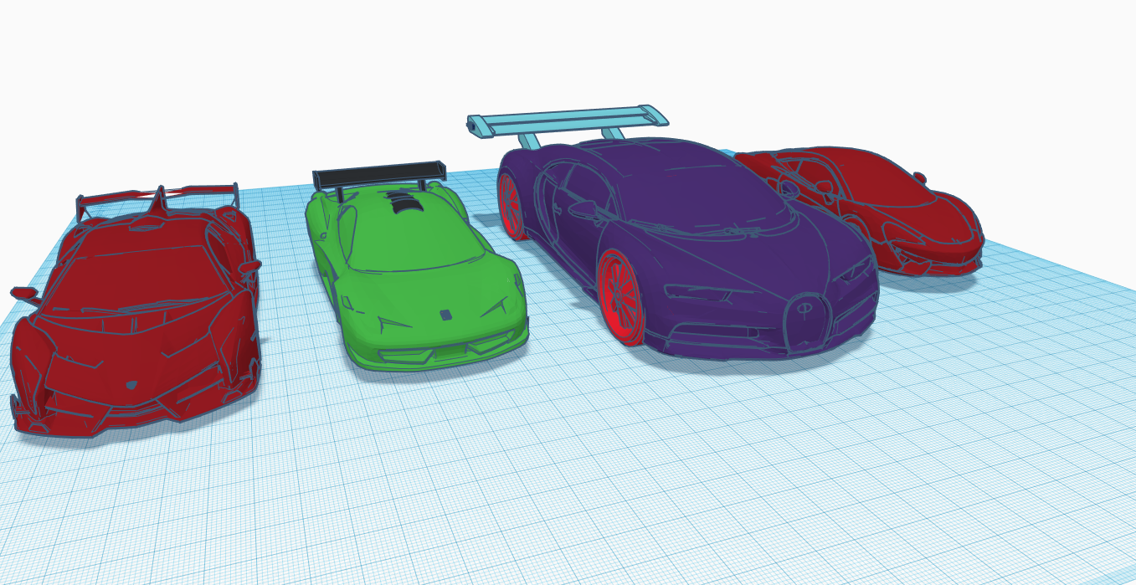
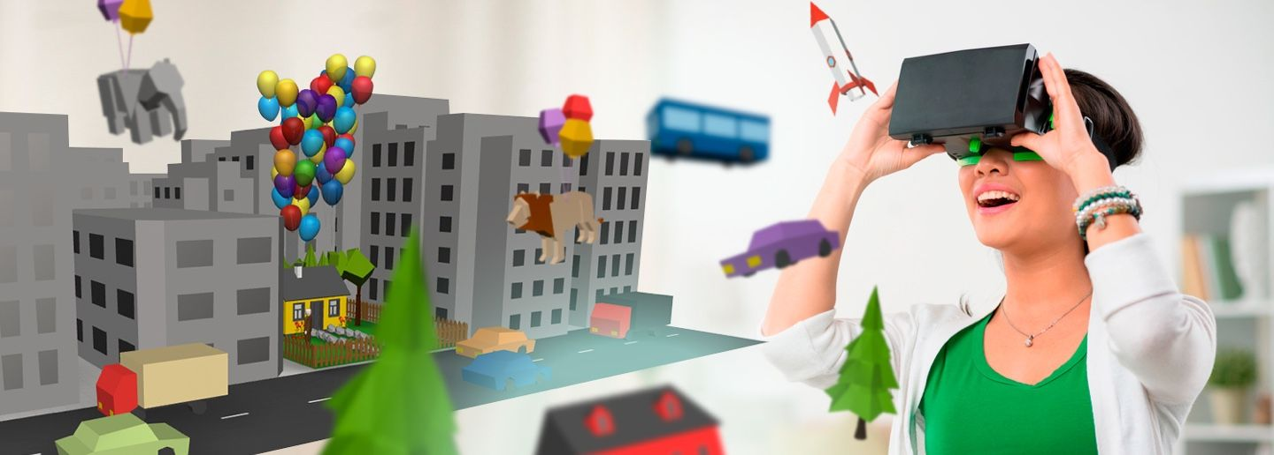
HOW IT WORKS
آلية عمل الواقع الإفتراضي
التصميم
بناء الإعدادات(برنامج كوسبيسز)
Design
Settings(CoSpaces)
Studio56.qa

Slide 12
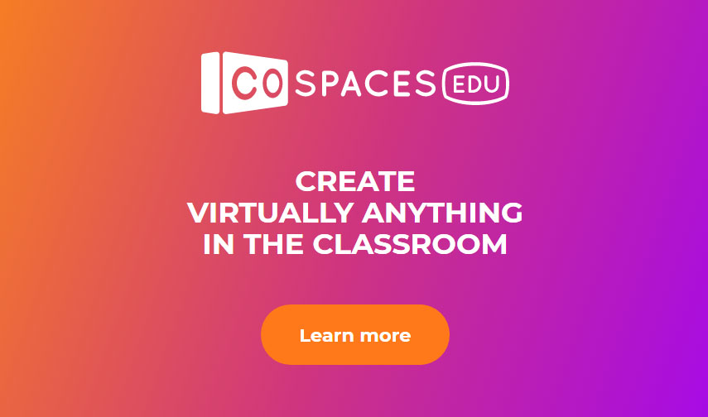
We have a new tool today that will help us to build our 3D virtual game.
CoSpaces is a web-based application that allows us to create and engage with interactive 3D content using visual programming language.
لدينا أداة جديدة اليوم ستساعدنا في بناء لعبتنا الافتراضية ثلاثية الأبعاد.
كوسبيسس هو تطبيق قائم على الويب يسمح لنا بإنشاء محتوى تفاعلي ثلاثي الأبعاد والتفاعل معه باستخدام لغة البرمجة المرئية.
Studio56.qa

Slide 13


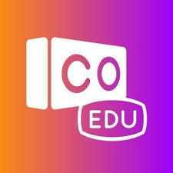
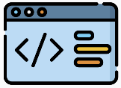
BLOCK CODING
In computer science, “code” means a set of instructions that a computer can understand.
Studio56.qa
Notes:
In computer science, “code” means a set of instructions that a computer can understand, also there are some important vocabularies in computer science such as debugging and program.

Slide 14
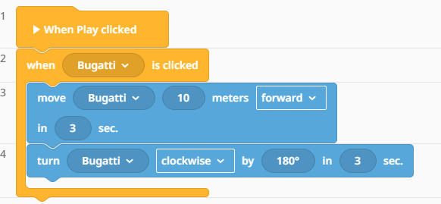
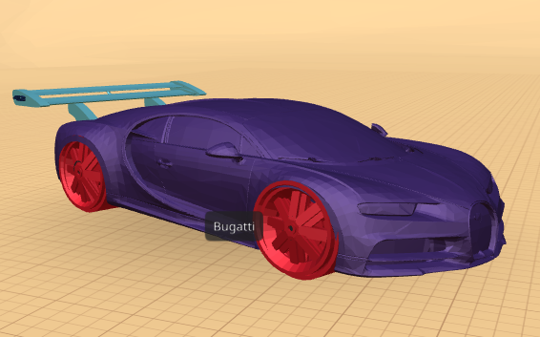
What type of codes will be used ?
BLOCK CODS
Studio56.qa
Notes:
In computer science, “code” means a set of instructions that a computer can understand, also there are some important vocabularies in computer science such as debugging and program.

Slide 15
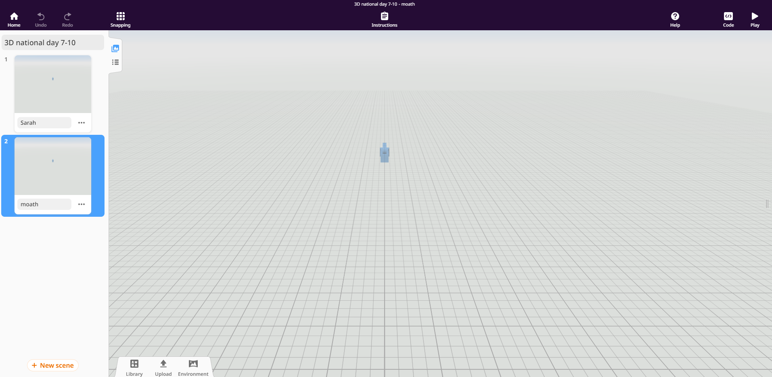
Open a new scene and put your real name.
Studio56.qa

Slide 16
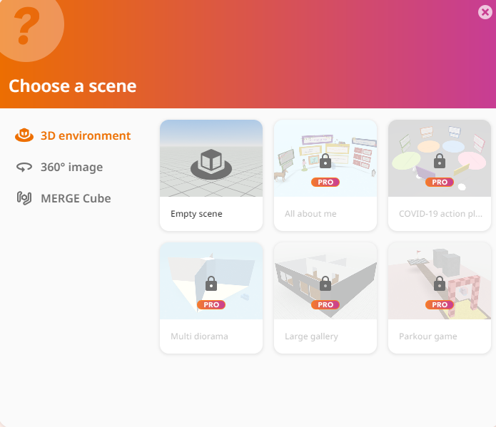
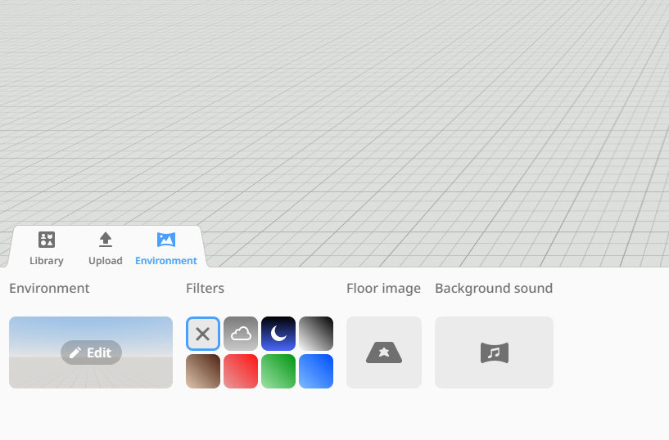
Click on Edit and chose you favorite 360 picture
Studio56.qa

Slide 17
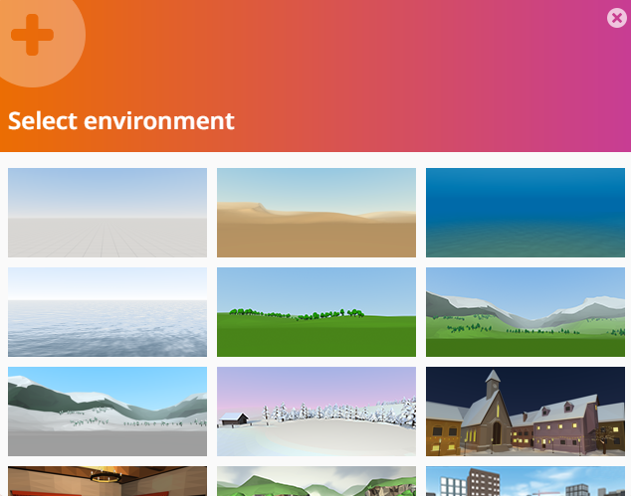
Click on Edit and chose you favorite 360 picture
Studio56.qa

Slide 18
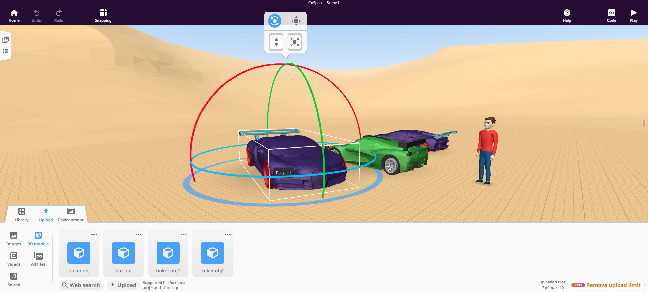
There are many options in upload menu you can use, for example 3D models enable you to add just 3d models such as the cars as shown.

Slide 19
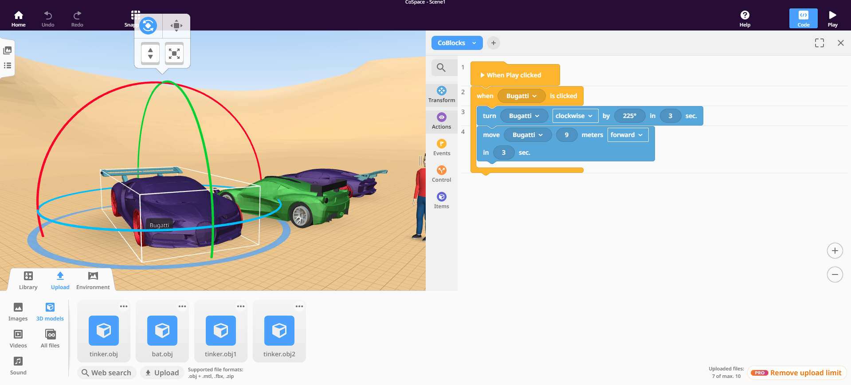
Final step to control and let the Bugatti move, so we need to write a program and play the scene.
1
2
Studio56.qa

Slide 20
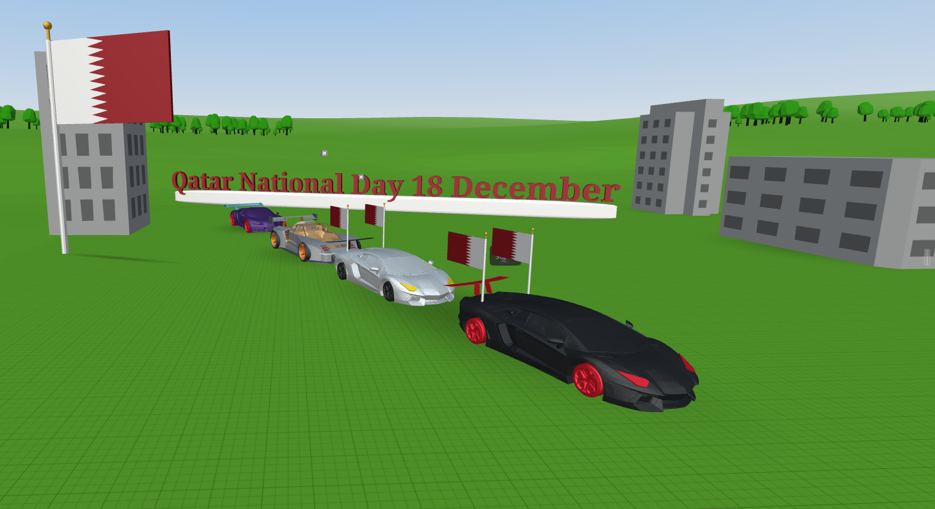
Studio56.qa

Slide 21
THANKS
info@studio56.qa
Studio56.qa

