Slide 1

3D National Day
7-10
Studio56.qa
Notes:
Take the attendance
Have you attended workshops before?

Slide 2
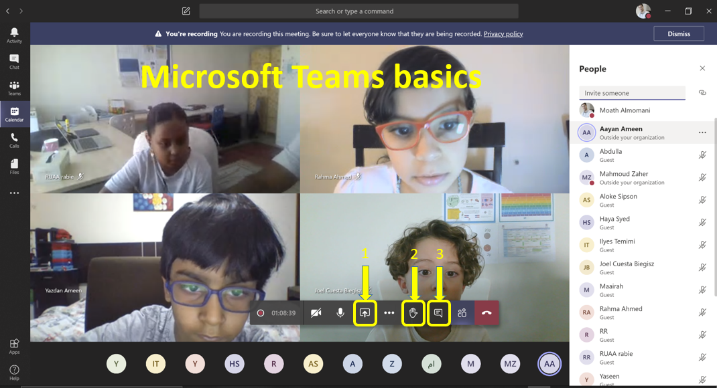
Studio56.qa
Notes:
Introduce how to use Microsoft teams.

Slide 3
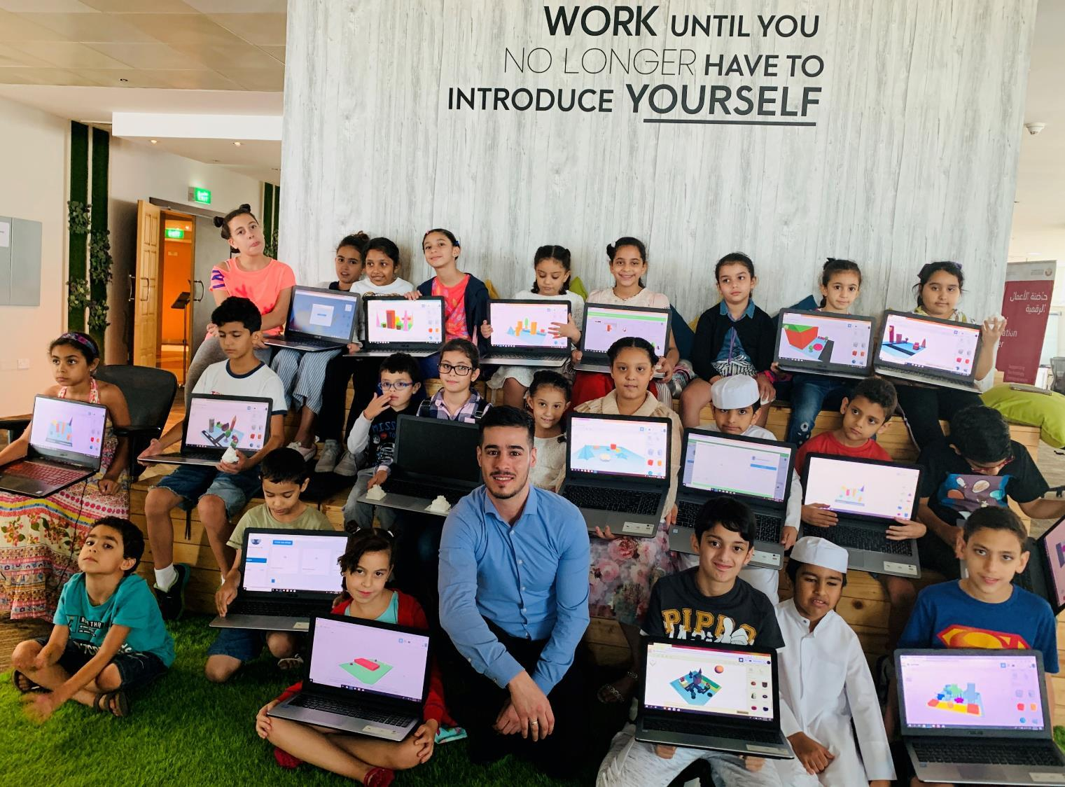

Who are we?
من نحن؟
Software Zone.
Technology Zone.
Creative Zone.
Notes:
Fab lab Studio 56 teaches youth about the necessary skills of this century such as digital fabrication, design and computer science.
Studio 56 has 3 main zones:

Slide 4

Qatar National Day is a national commemoration of Qatar's unification in 1878. It’s celebrated annually on 18 December.
Notes:
The celebration of National Day comes on the eighteenth of December of every year, which is the date of the late Sheikh Jassim bin Muhammad Al Thani the founder of modern Qatar, assuming power in the country in 1878.
ويأتي الاحتفال باليوم الوطني في الثامن عشر من ديسمبر من كل عام ، وهو تاريخ تولي المغفور له الشيخ جاسم بن محمد آل ثاني ، مؤسس دولة قطر الحديثة ، السلطة في البلاد عام 1878

Slide 5
Hamad wants to celebrate the national day in Qatar but due to his health situation he won’t be able to go out of his home, we need to help Hamad and celebrate the national day with him by creating a virtual world that simulate Qatar National Day.
يريد حمد الاحتفال باليوم الوطني في قطر ولكن بسبب وضعه الصحي لن يتمكن من الخروج من منزله ، نحتاج إلى مساعدة حمد والاحتفال باليوم الوطني معه من خلال إنشاء عالم افتراضي يحاكي يوم قطر الوطني.
Studio56.qa
Notes:
Ice braking activity.
Have you played Minecraft before?

Slide 6
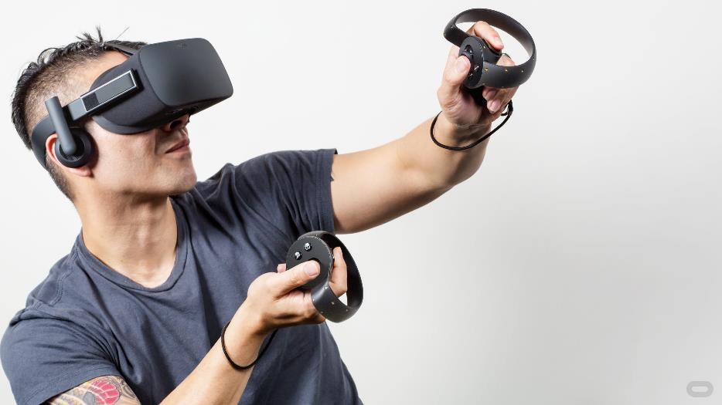
VIRTUAL REALITY (VR)
It’s a computer-generated simulation in which a person can interact within an artificial 3D environment using electronic devices, such as special goggles with a screen or gloves fitted with sensors.
Virtual Reality can be used in different fields such as science, medicine, sport, education and many others.
Studio56.qa

Slide 7
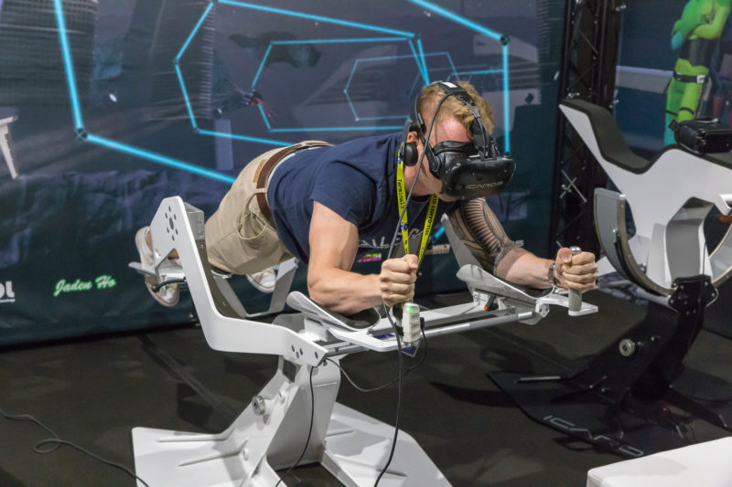
Training - flight simulator
التدريب – محاكاة الطيران -
Studio56.qa
Notes:
a fully-immersive experience – complete with head-mounted displays, headphones, gloves, and maybe a treadmill or some kind of suspension apparatus.

Slide 8

Education
التعليم
Studio56.qa

Slide 9
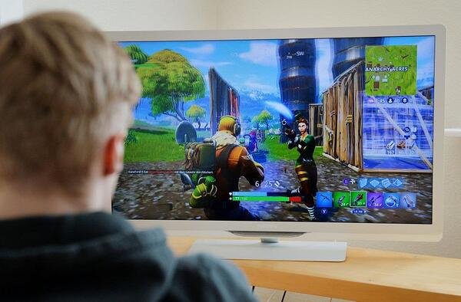
الألعاب
GAMING
Studio56.qa
Notes:
Games are often forgotten as an actual type of VR, because it’s very common in our everyday lives.
The average video game is technically considered a virtual reality experience. Think about it, you’re sitting in a physical space, interacting with a virtual one.

Slide 10
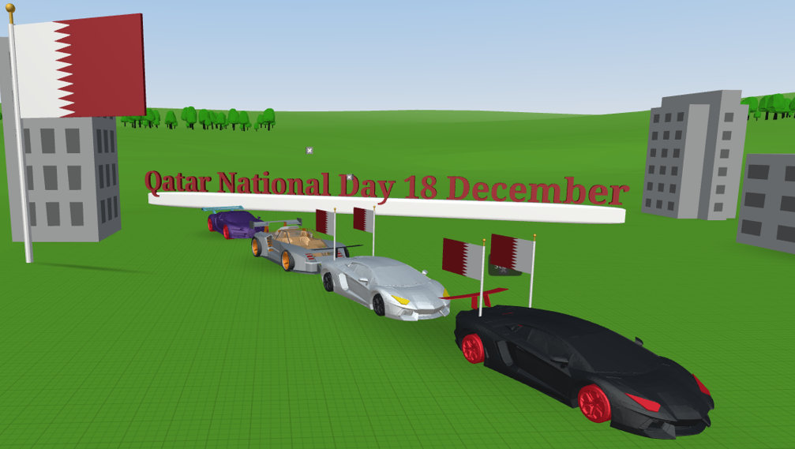
What we will do today?
ماذا سنفعل اليوم؟
Studio56.qa
Notes:
Today we will build a VR world of a simulated environment to celebrate the national day in Qatar.

Slide 11
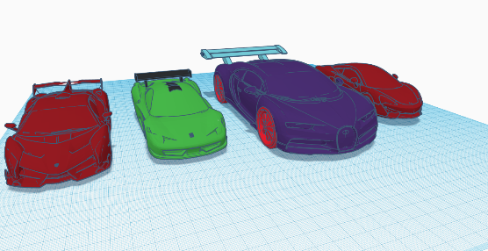
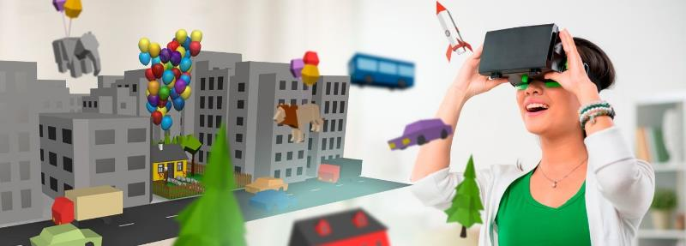
HOW IT WORKS
آلية عمل الواقع الإفتراضي
التصميم
بناء الإعدادات(برنامج كوسبيسز)
Design
Settings(CoSpaces)
Studio56.qa

Slide 12
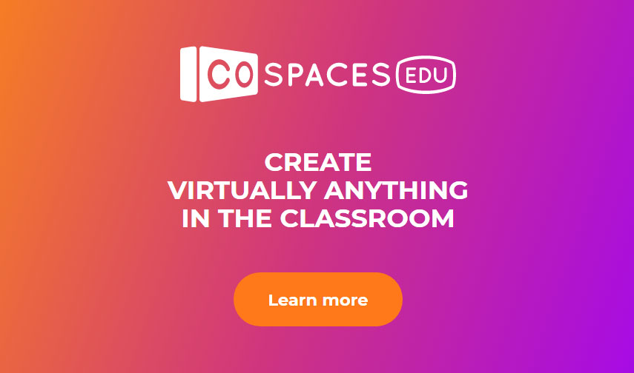
We have a new tool today that will help us to build our 3D virtual game.
CoSpaces is a web-based application that allows us to create and engage with interactive 3D content using visual programming language.
لدينا أداة جديدة اليوم ستساعدنا في بناء لعبتنا الافتراضية ثلاثية الأبعاد.
كوسبيسس هو تطبيق قائم على الويب يسمح لنا بإنشاء محتوى تفاعلي ثلاثي الأبعاد والتفاعل معه باستخدام لغة البرمجة المرئية.
Studio56.qa

Slide 13
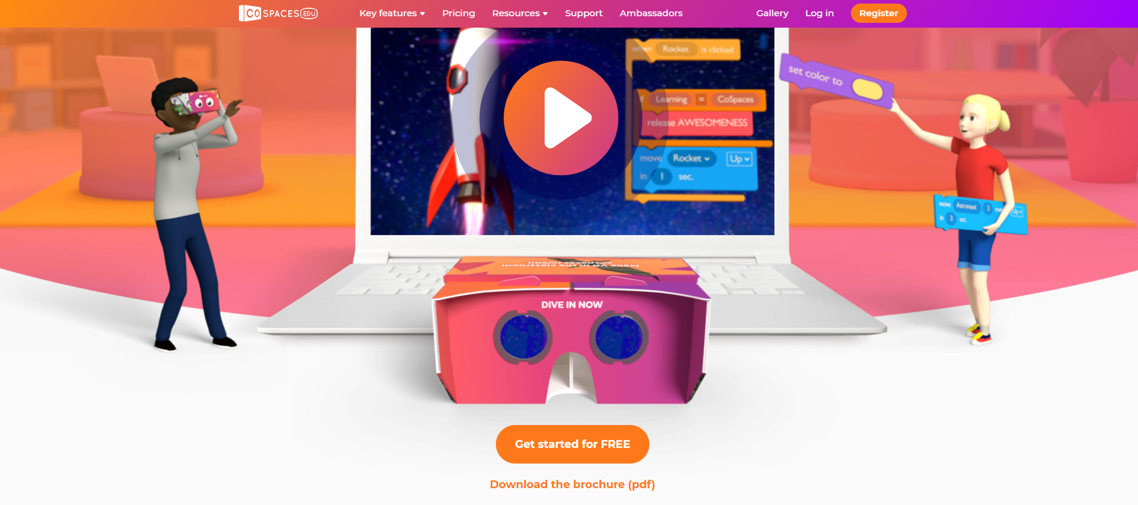
From CoSpaces select get started for free
Studio56.qa

Slide 14

Choose student account
Studio56.qa

Slide 15

Enter the class code: 2 X K K X

Slide 16

Fill your information

Slide 17
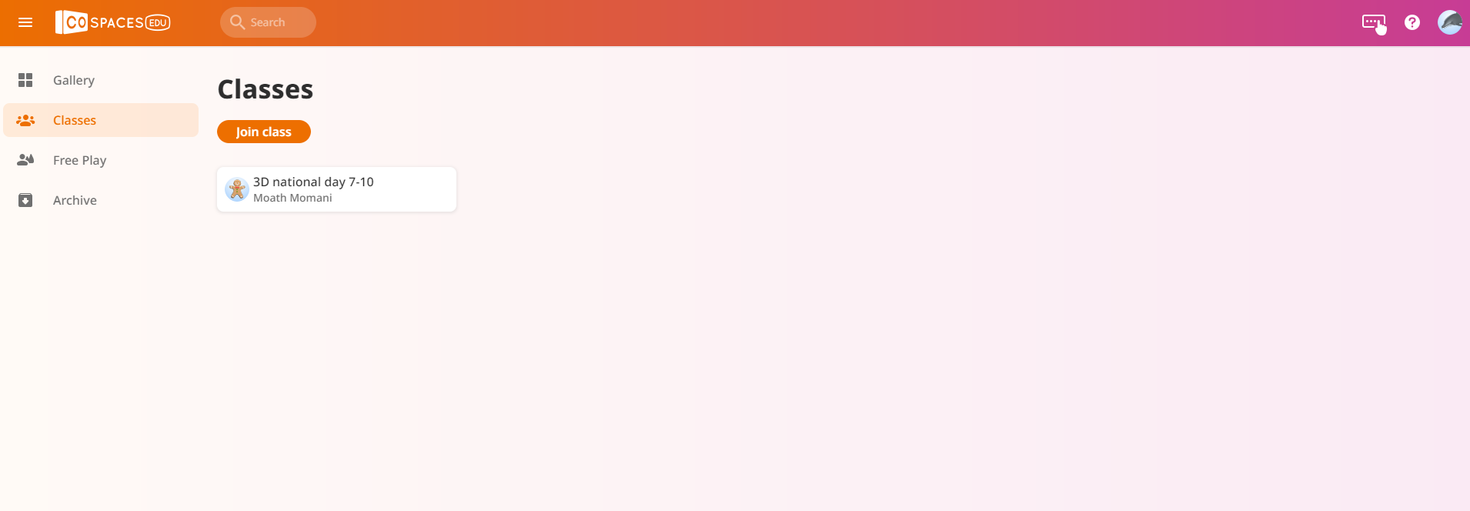
After you filled your information, rise you hand and aske the instructor to add you.
Open the 3D National Day Class.
Studio56.qa

Slide 18
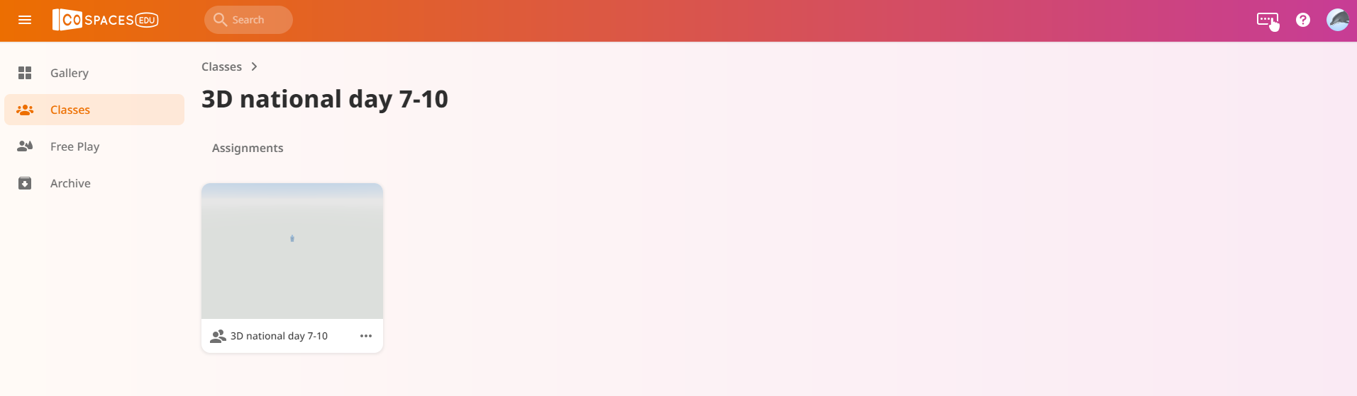
Open the assignment - 3D National Day 7-10.
Studio56.qa

Slide 19
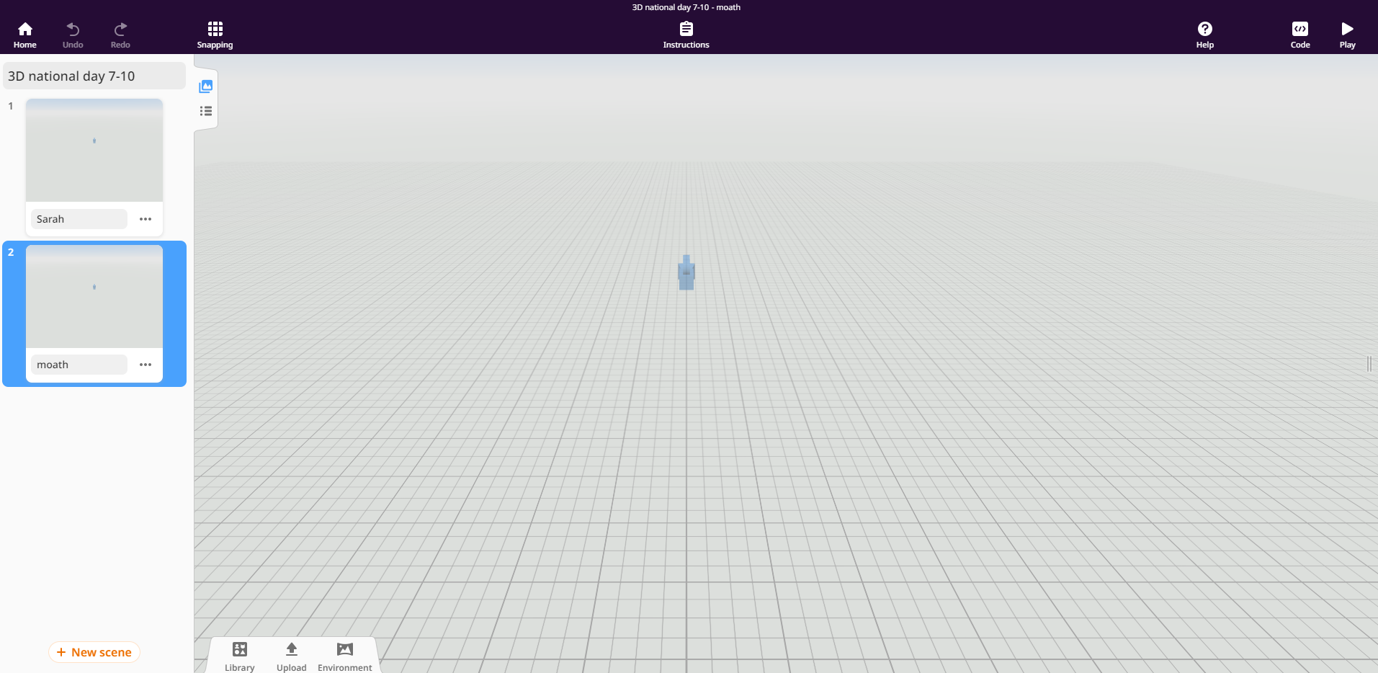
Open a new scene and put your real name.
Studio56.qa

Slide 20
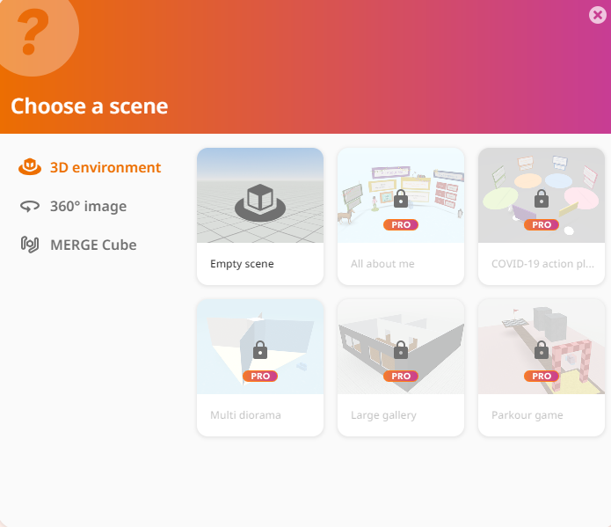
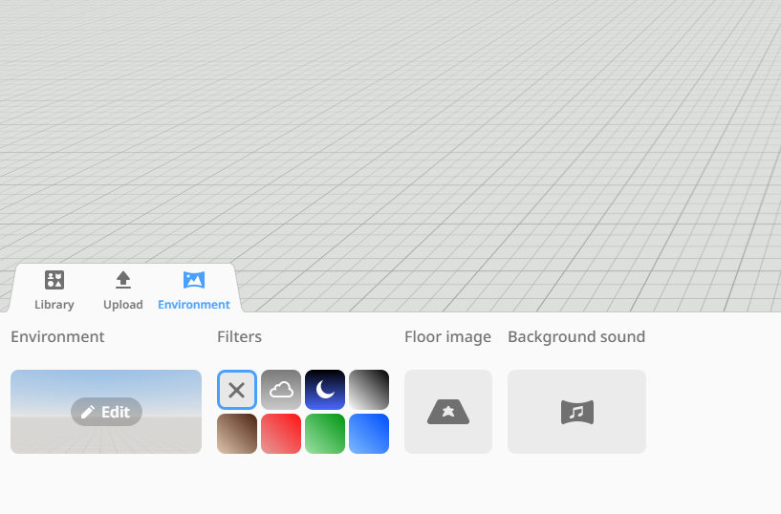
Click on Edit and chose you favorite 360 picture
Studio56.qa

Slide 21
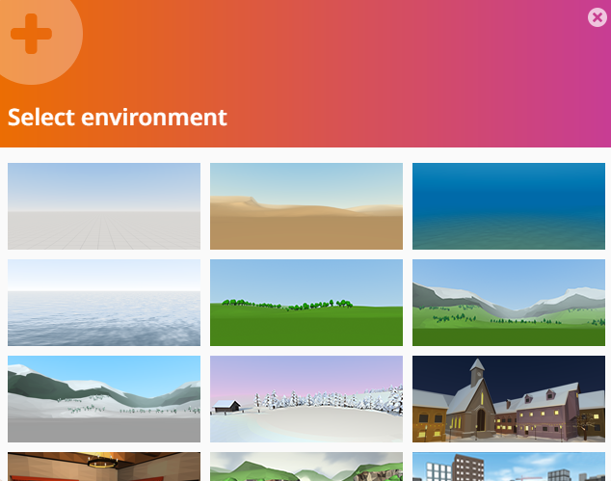
Click on Edit and chose you favorite 360 picture
Studio56.qa

Slide 22
Click on 3D environment and select empty scene
Studio56.qa

Slide 23
Click on Edit and chose you favorite environment
Studio56.qa

Slide 24
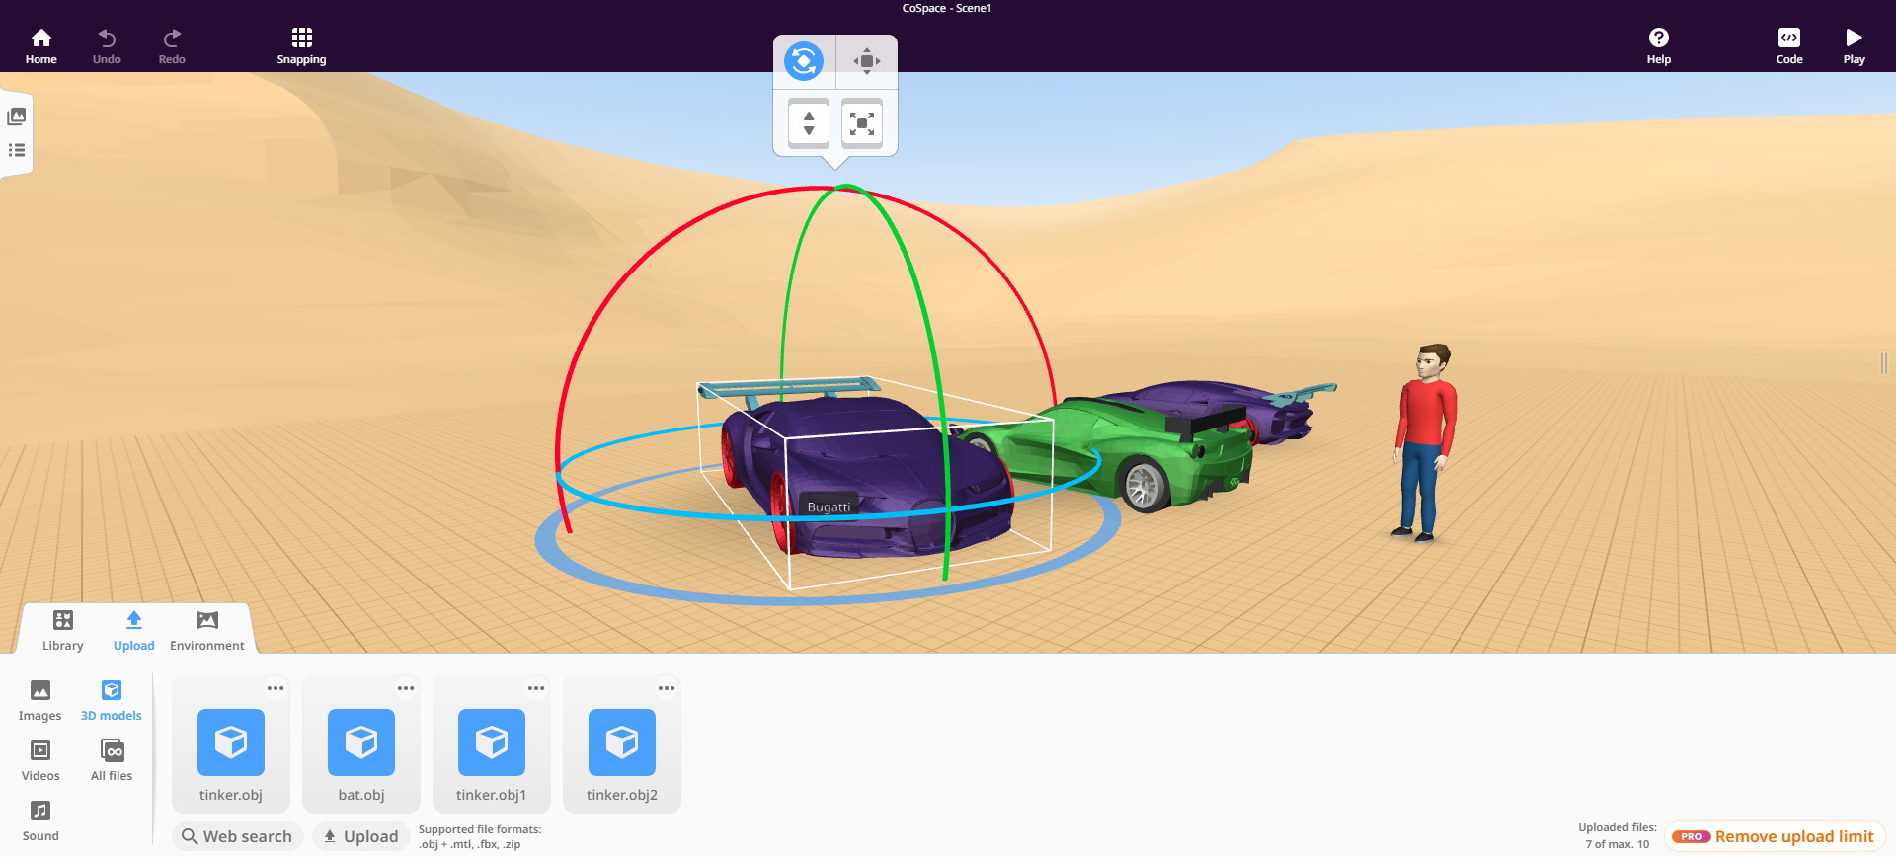
There are many options in upload menu you can use, for example 3D models enable you to add just 3d models such as the cars as shown.

Slide 25
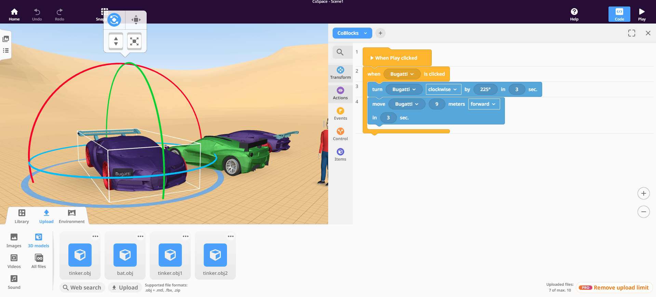
Final step to control and let the Bugatti move, so we need to write a program and play the scene.
1
2
Studio56.qa

Slide 26
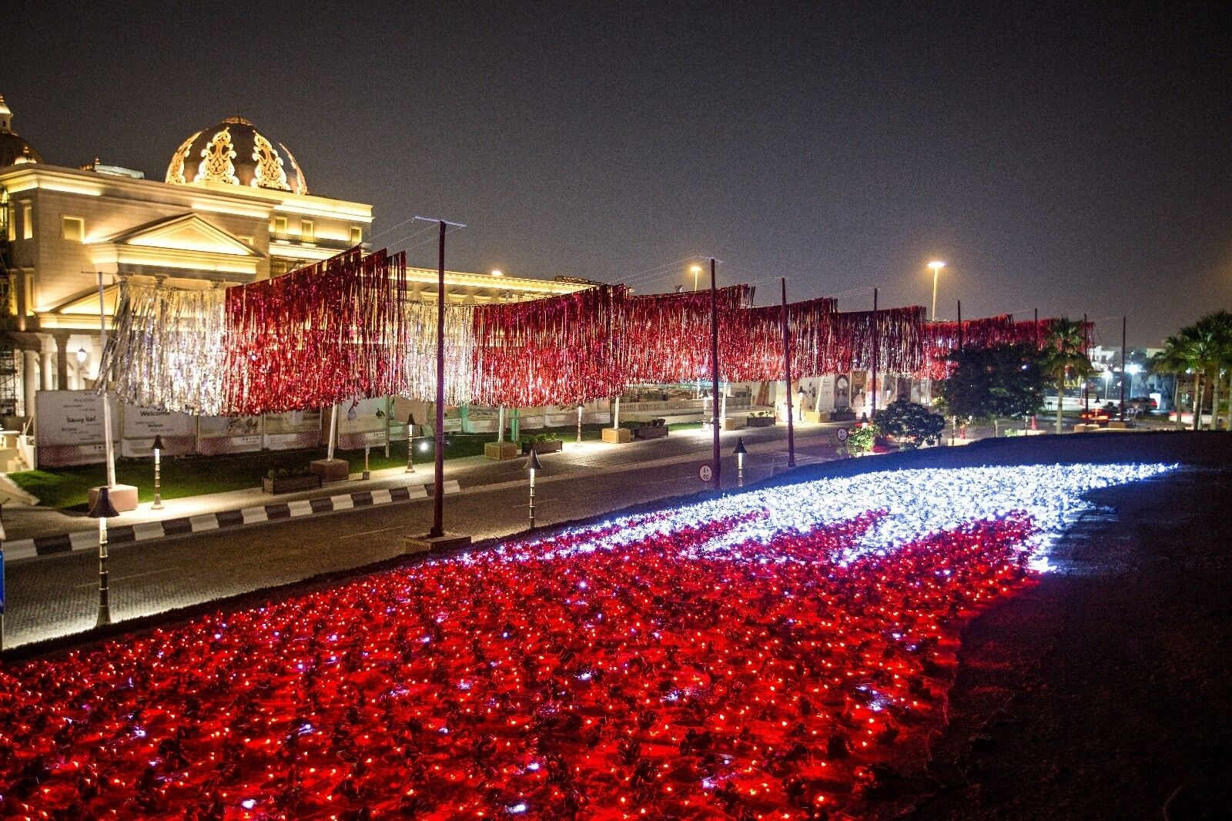
NATIOANL DAY CELEBRATION
DON’T FORGET TO JOIN US IN THE CELEBTATION
ON DECEMBER 17TH
*PRIZES WILL BE GIVEN RANDOMLY FOR THE ATTENDEES*
Studio56.qa

Slide 27
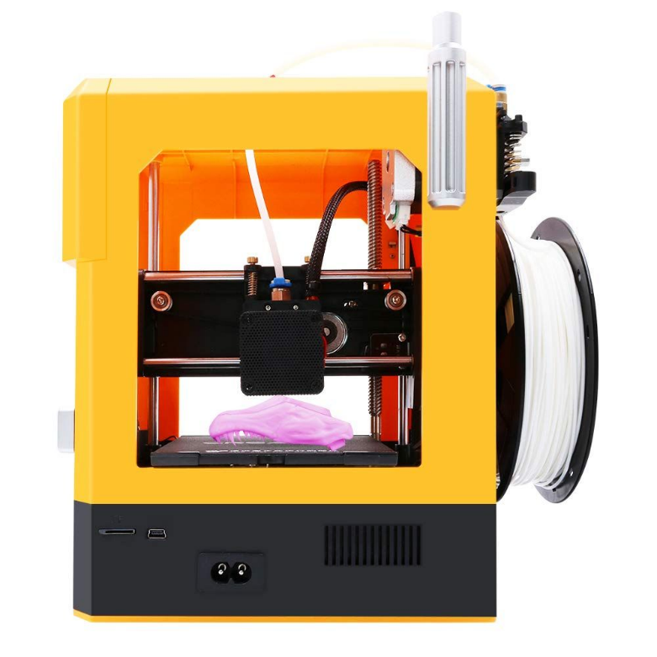

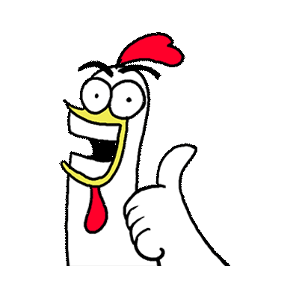
DON’T MISS THE CHANCE OF WINNING
MINI 3D PRINTER!

Slide 28
THANKS
info@studio56.qa
Studio56.qa

