Slide 1

Animate Fashion show
Video making & Animation
عروض الأزياء الافتراضية
تصميم وتطوير الفيديوهات
Studio56.qa

Slide 2
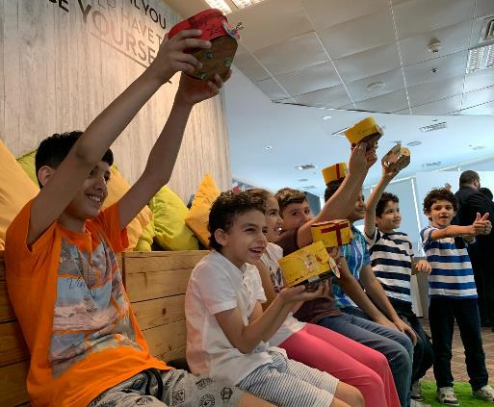
WHO ARE WE? من نحن؟
ستوديو 5\6 هو مختبر تصنيع للأطفال الذين يتراوح أعمارهم بين عمر 7 و 18.
STUDIO 5\6 is a fabrication lab targeting kids from age 7 to 18.
_____
سوف يحتوي مخبر التصنيع على آلات ومعدات مختلفة لتصنيع مختلف النماذج المبدئية المبتكرة.
We will have Fablab with different machines and tools to use for creating active prototypes.
Studio56.qa
Notes:
Explain what we do in Studio5/6 and the age group we target.

Slide 3
أين يمكننا تصنيع أشيائنا الخاصة؟
¿Where we can fabricate our objects?
FAB LAB
Fabrication Laboratory
التصنيع مختبر
Studio56.qa
Notes:
Explain what is a FabLab and where the word come from.

Slide 4
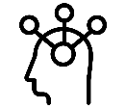
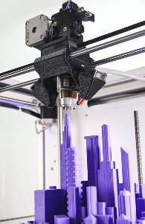

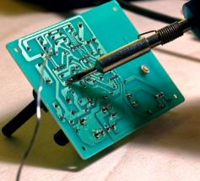
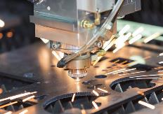

What is inside the FABLAB?
ماذا نجد داخل مختبر التصنيع؟
Tools & Machines
آلات وأدوات
Zones
مناطق
Creativity zone
منطقة الابداع
3D printing
الطباعة ثلاثية الأبعاد
Electronics and programming
الإلكترونيات والبرمجة
Software zone
منطقة البرمجة
Laser cutting
القص بالليزر
Technology zone
منطقة التكنولوجيا

Slide 5
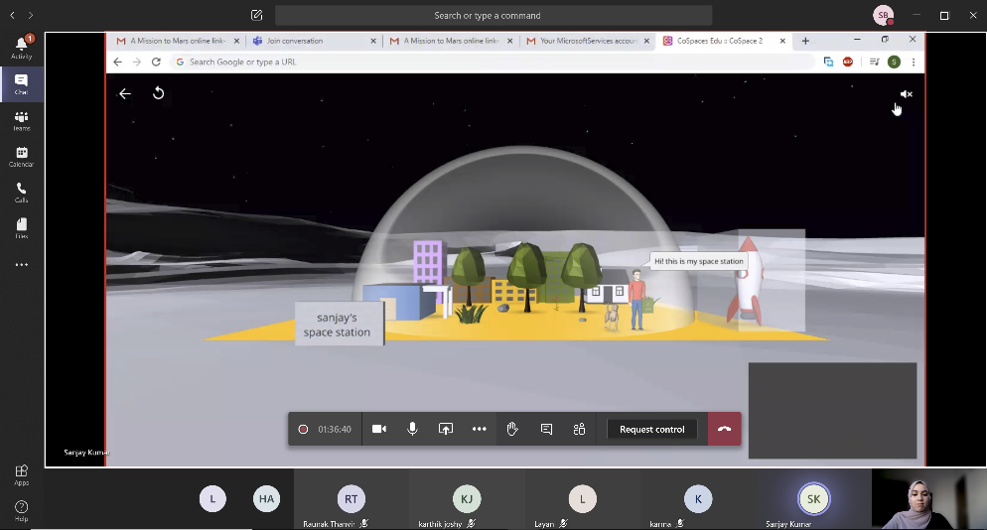
Teams Interface
واجهة برنامج Teams
Studio56.qa
Notes:
Explain what is a FabLab and where the word come from.

Slide 6
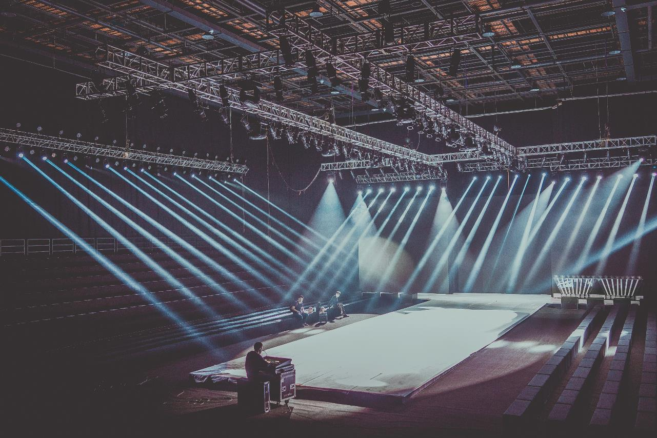
Khalifa is a Qatari fashion designer, who is very passionate about his field. He is preparing for a fashion show in Qatar to showcase his latest collection. However, he wants to promote for his fashion show by having an animation video simulating his fashion show. Therefore, he needs your help in creating a short animation video, simulating the fashion show day in a funny and attractive way.
Studio56.qa
Notes:
The client letter: explain to the participants the problem we have and ask them to suggest solutions to solve it.

Slide 7

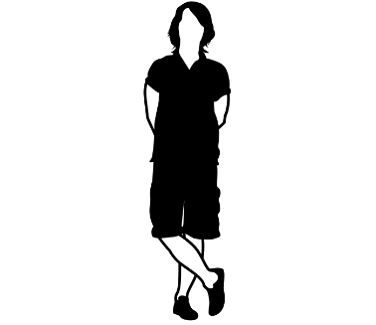
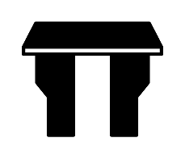
What is Fashion? ماهي الموضة؟
Fashion is the general style of dress or behavior at any given time, constantly changing to adapt with time change. We can find fashion in furniture, automobiles, clothing and other objects.
الموضة هي النمط العام للباس أو السلوك في أي وقت ، وتتغير باستمرار للتكيف مع تغير الوقت. يمكننا أن نجد الموضة في الأثاث والسيارات والملابس والأشياء الأخرى.
Studio56.qa
Notes:
Explain what are mobile applications and how they work.

Slide 8
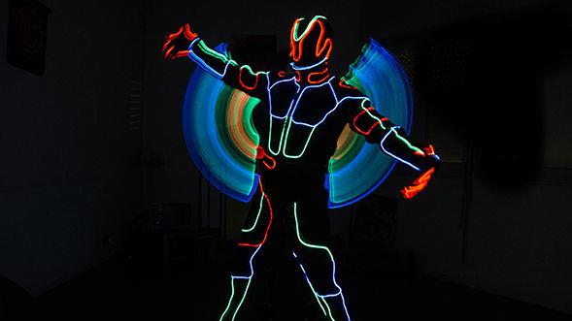
DIGITAL
FASHION

Slide 9
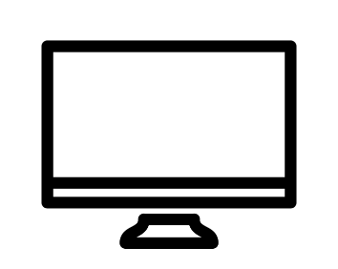
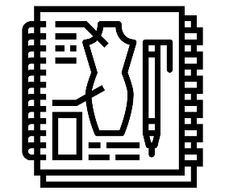
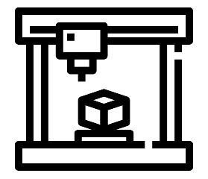
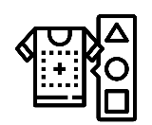
Digital Fashion الموضة الرقمية
Fashion
الموضة
Computer
الكمبيوتر
Digital Fabrication
التصنيع الرقمي
Studio56.qa

Slide 10
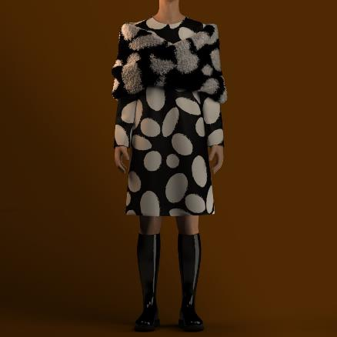
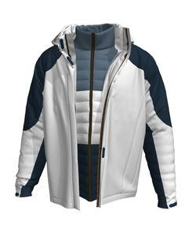
Fashion Design Softwares
Clo
DC Suite
Valentina
Blender
Tailornova
Edraw max
Studio56.qa
Notes:
Explain what is a FabLab and where the word come from.

Slide 11
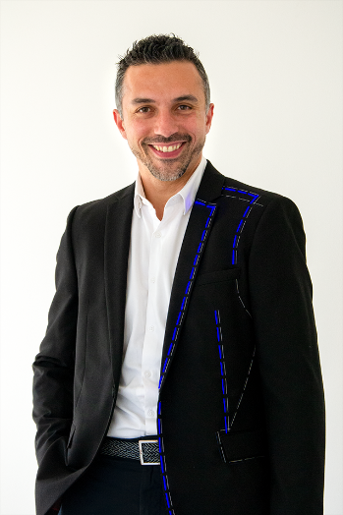
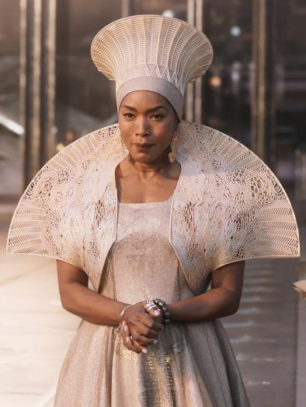
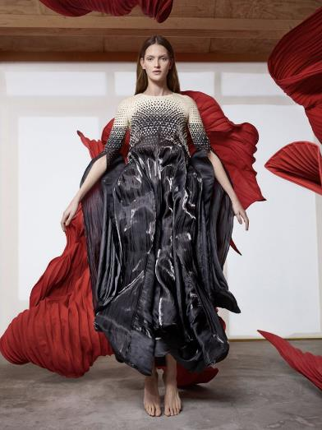
Examples
أمثلة
Studio56.qa

Slide 12
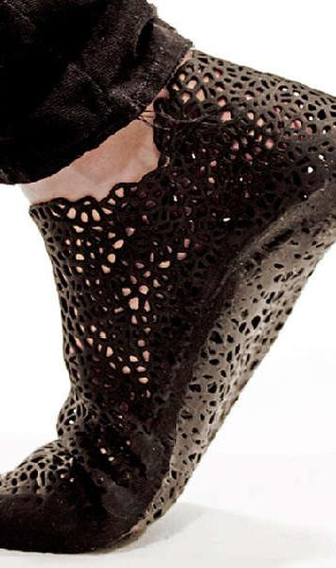
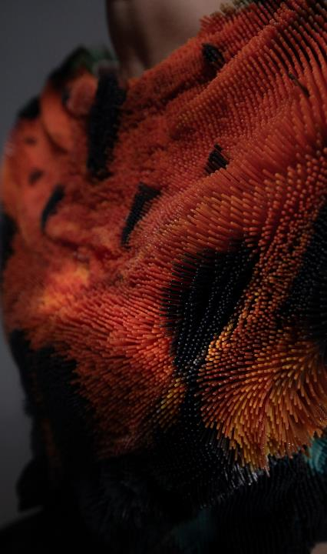
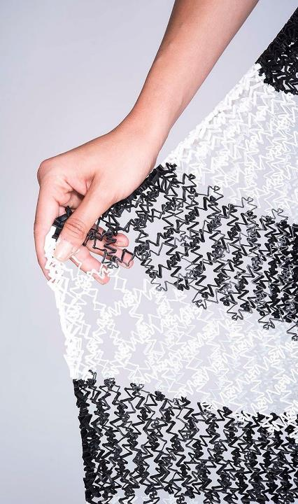

Slide 13
Day 1
Intro to Animaker
Studio56.qa

Slide 14
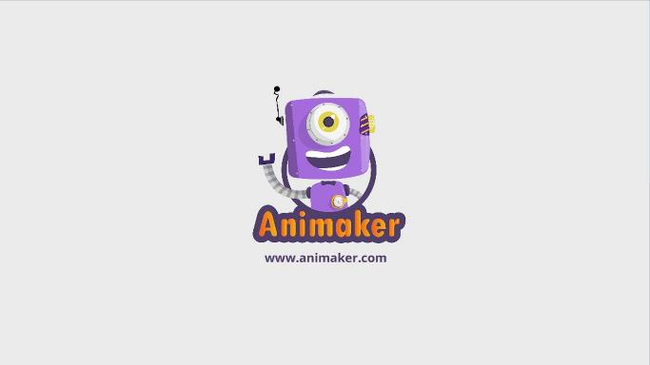
ما هو البرنامج الذي سنقوم باستخدامه اليوم؟
What program we will be using TODAY?
Studio56.qa
Notes:
Explain the program that we will be using today to make our application.

Slide 15
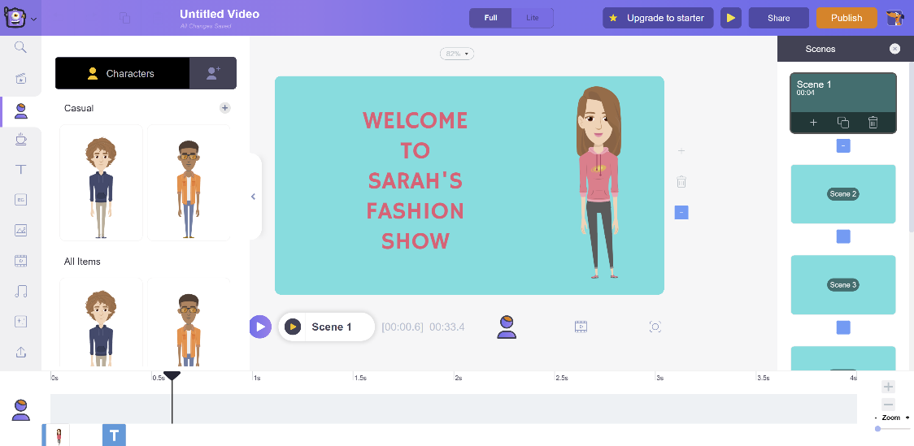
Animaker
https://www.animaker.com/
Studio56.qa
Notes:
Explain what is a FabLab and where the word come from.

Slide 16
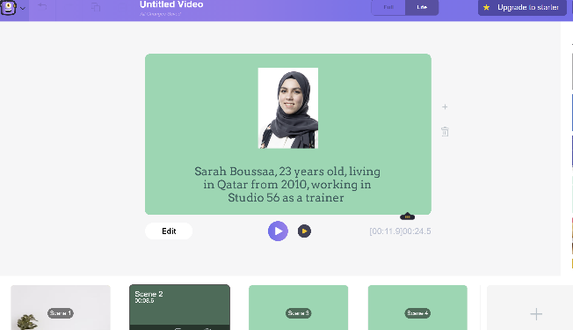
ما الذي سنقوم بتطويره اليوم؟
What we will develop TODAY?
A simple video about yourself for practice
فيديو بسيط عن نفسك بغرض التدريب
Studio56.qa
Notes:
Explain that we will build a mobile application game that contains different pictures and buttons.

Slide 17
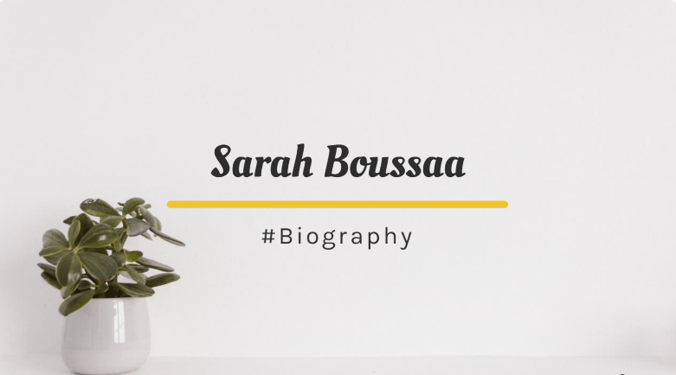
Scene 1
1- Title.
2- Background.
3- Transition effects.
Studio56.qa
Notes:
Explain what is a FabLab and where the word come from.

Slide 18
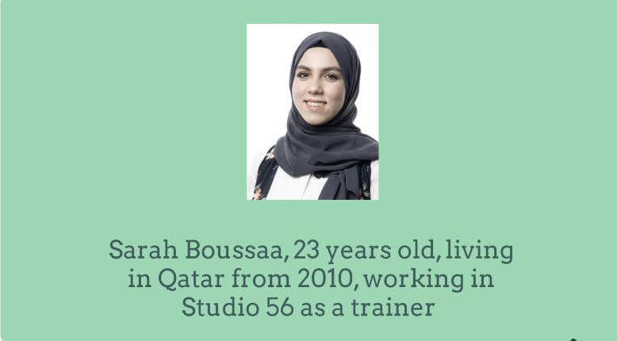
Scene 2
1- Image.
2- Text.
3- Background.
4- Transition effects.
Studio56.qa
Notes:
Explain what is a FabLab and where the word come from.

Slide 19
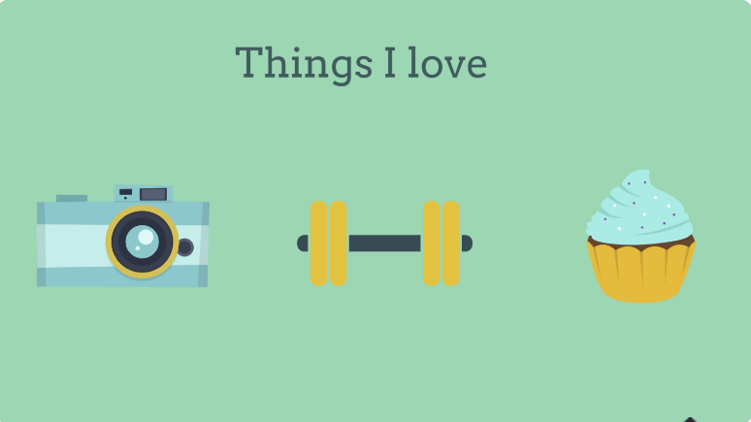
Scene 3
1- Title.
2- Properties.
3- Background.
4- Transition effects.
Studio56.qa
Notes:
Explain what is a FabLab and where the word come from.

Slide 20
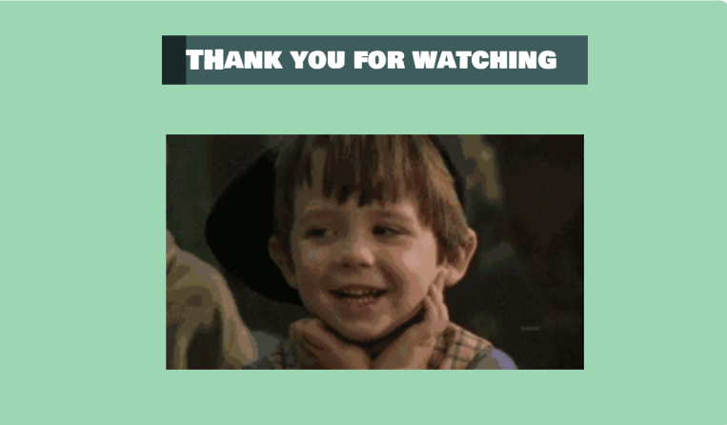
Scene 4
1- Title.
2- GIF.
3- Background.
4- Transition effects.
Studio56.qa
Notes:
Explain what is a FabLab and where the word come from.

Slide 21
Day 2
Design the Scenes #1
Studio56.qa

Slide 22
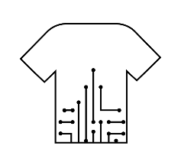
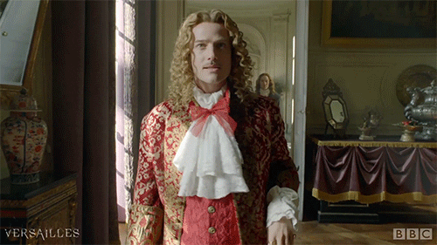

BRAIN STORMING
*Unique Tech-designed outfit*
Studio56.qa

Slide 23
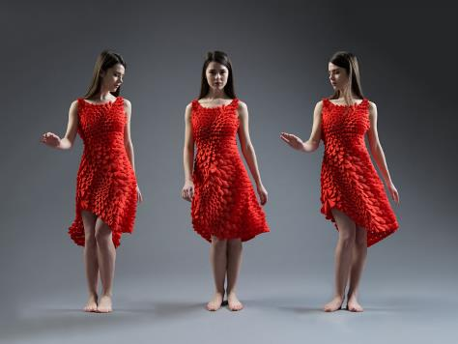
https://www.youtube.com/watch?v=tnDJAchJKzs
  4D PRINTED DRESS

Slide 24
ما هو البرنامج الذي سنقوم باستخدامه اليوم؟
What program we will be using TODAY?
Studio56.qa
Notes:
Explain the program that we will be using today to make our application.

Slide 25
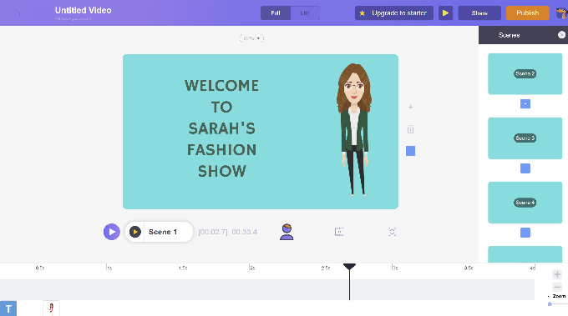
ما الذي سنقوم بتطويره اليوم؟
What we will develop TODAY?
Design the first and second scenes
تصميم المشهدين الأول و الثاني
Studio56.qa
Notes:
Explain that we will build a mobile application game that contains different pictures and buttons.

Slide 26
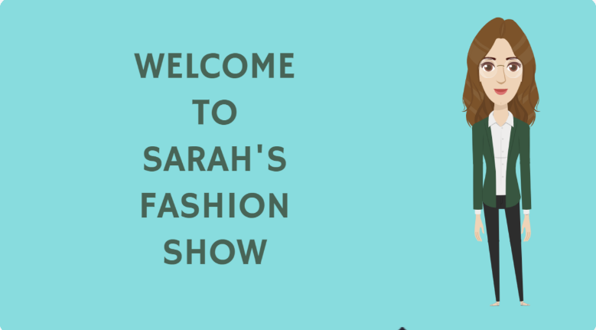
Scene 1
1- Title.
2- Character.
3- Background.
4- Transition effects.
Studio56.qa
Notes:
Explain what is a FabLab and where the word come from.

Slide 27
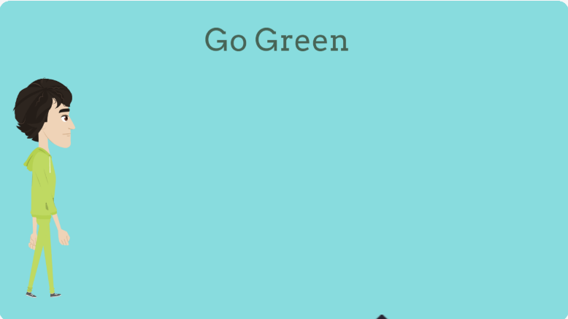
Scene 2
1- Title
2- Model Character1.
3- Walking animation.
4- Background.
5- Transition effects.
Studio56.qa
Notes:
Explain what is a FabLab and where the word come from.

Slide 28
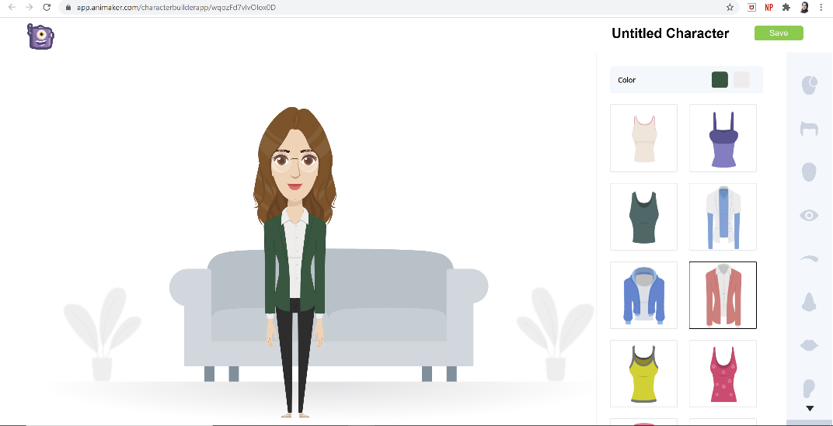
Customize your characters
Studio56.qa
Notes:
Explain what is a FabLab and where the word come from.

Slide 29
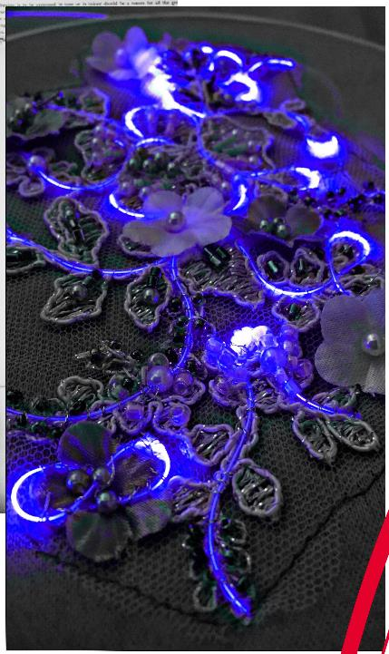
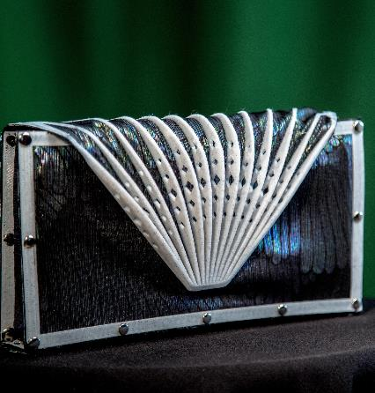
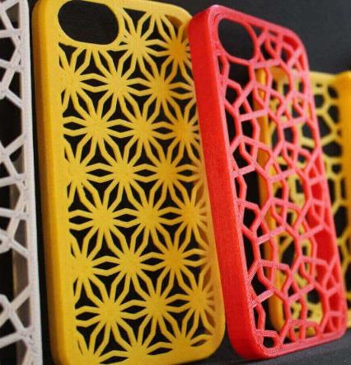
TECHNOLOGY THEME

