Slide 1
Day 3
Design the Scenes #2
Studio56.qa

Slide 2



Why make videos?
لماذا نصنع الفيديوهات؟
Blending images and sounds can give the viewers a boost of emotions, based on the purpose of the video.
يمكن أن يمنح مزيج الصور والأصوات المشاهدين دفعة من المشاعر، بناءً على الغرض من الفيديو.
Notes:
Explain what is a FabLab and where the word come from.

Slide 3
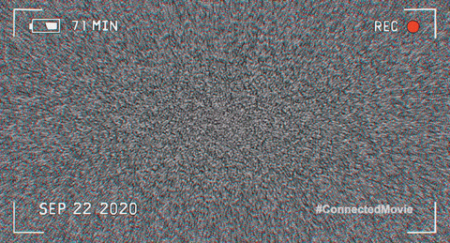
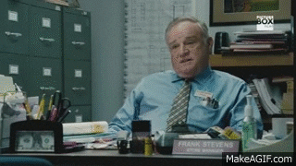
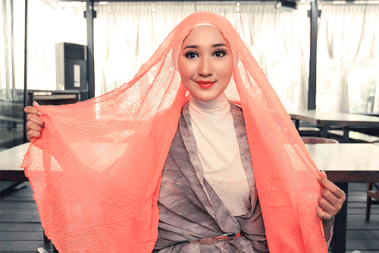
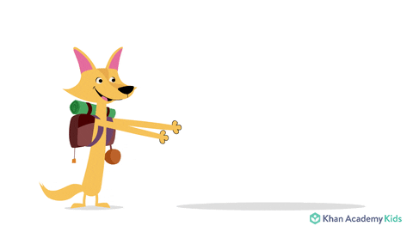
Types of videos?
أنواع الفيديوهات
Vlog
Interview
Tutorial
Educational
Notes:
These are some of the types, there are more.
Ask the students which website they use most frequently?

Slide 4
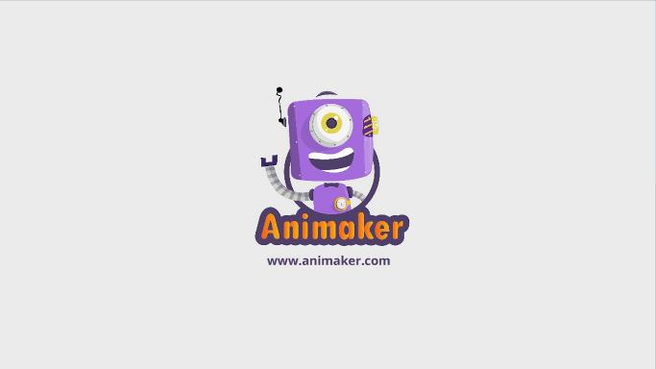
ما هو البرنامج الذي سنقوم باستخدامه اليوم؟
What program we will be using TODAY?
Studio56.qa
Notes:
Explain the program that we will be using today to make our application.

Slide 5
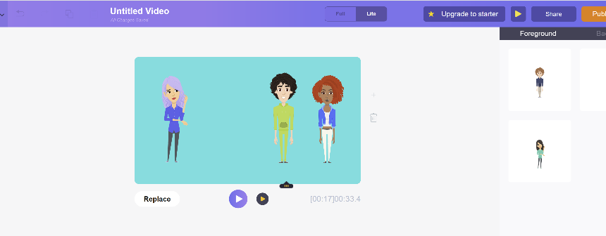
ما الذي سنقوم بتطويره اليوم؟
What we will develop TODAY?
Design the third and fourth scenes
تصميم المشهدين الثالث و الرابع
Studio56.qa
Notes:
Explain that we will build a mobile application game that contains different pictures and buttons.

Slide 6
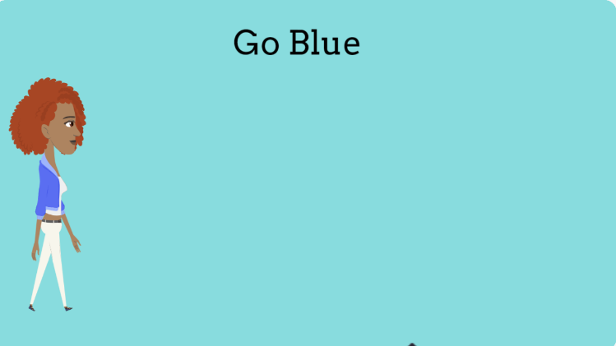
Scene 3
1- Title
2- Model Character2.
3- Walking animation.
4- Background.
5- Transition effects.
Studio56.qa
Notes:
Explain what is a FabLab and where the word come from.

Slide 7
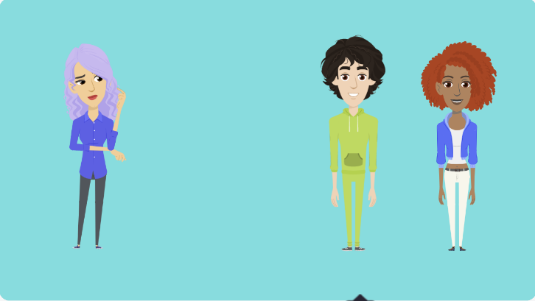
Scene 4
1- Jury Character.
2- Model Characters.
3- Animation.
4- Background.
5- Transition effects.
Studio56.qa
Notes:
Explain what is a FabLab and where the word come from.

Slide 8
Day 4
Design the scenes #3
Studio56.qa

Slide 9
What is Animation?
ماهو التحريك؟
https://www.youtube.com/watch?v=dGGU4rAkShE

Slide 10
ما هو البرنامج الذي سنقوم باستخدامه اليوم؟
What program we will be using TODAY?
Studio56.qa
Notes:
Explain the program that we will be using today to make our application.

Slide 11
ما الذي سنقوم بتطويره اليوم؟
What we will develop TODAY?
Design the fifth and sixth scenes
تصميم المشهدين الخامس و السادس
Studio56.qa
Notes:
Explain that we will build a mobile application game that contains different pictures and buttons.

Slide 12
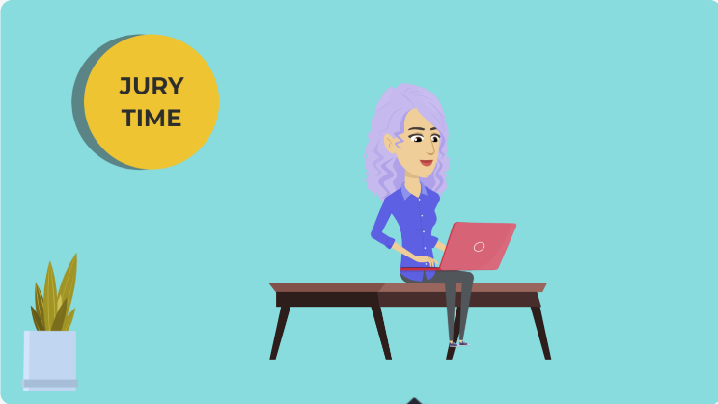
Scene 5
1- Title
2- Judge Character.
3- Sitting animation.
4- Background.
5- Transition effects.
Studio56.qa
Notes:
Explain what is a FabLab and where the word come from.

Slide 13
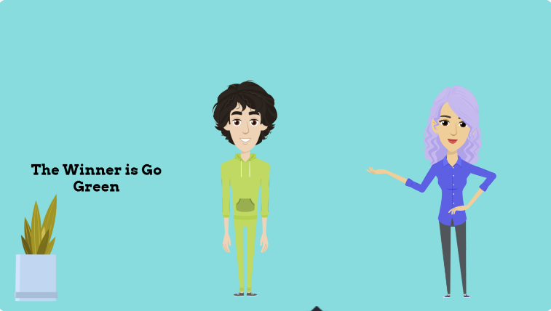
Scene 6
1- Jury Character.
2- Model Characters.
3- Animation.
4- Text/voice.
4- Background.
5- Transition effects.
Studio56.qa
Notes:
Explain what is a FabLab and where the word come from.

Slide 14
Day 5
Test and Share the app
Studio56.qa

Slide 15
ما هو البرنامج الذي سنقوم باستخدامه اليوم؟
What program we will be using TODAY?
Studio56.qa
Notes:
Explain the program that we will be using today to make our application.

Slide 16
ما الذي سنقوم بتطويره اليوم؟
What we will develop TODAY?
Add sound and transition effects
إضافة الصوت وخصائص الانتقال
Studio56.qa
Notes:
Explain that we will build a mobile application game that contains different pictures and buttons.

Slide 17
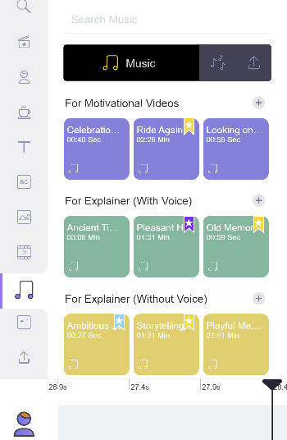
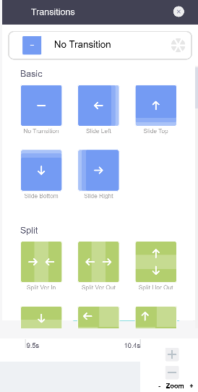

  SOUND
  TRANSITION EFFECTS
Studio56.qa

Slide 18


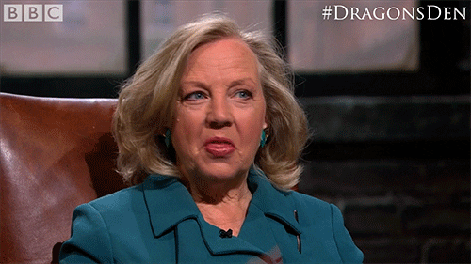
POP-UP CHALLENGE
  MAKE A VIDEO FROM SCRATCH
Studio56.qa

Slide 19

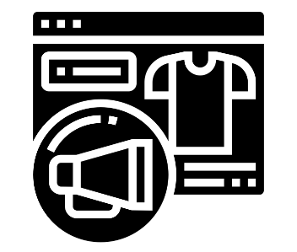
IDEAS أفكار
Storytelling - fashion designer
Product – promoting

Slide 20

Thanks
@studio56qa
Studio56.qa

