Slide 1

CREATE A NEW AVATAR FRIEND
Age 7-10
تخصيص النماذج
Studio56.qa
Notes:
Take the attendance
Have you attended workshops before?

Slide 2
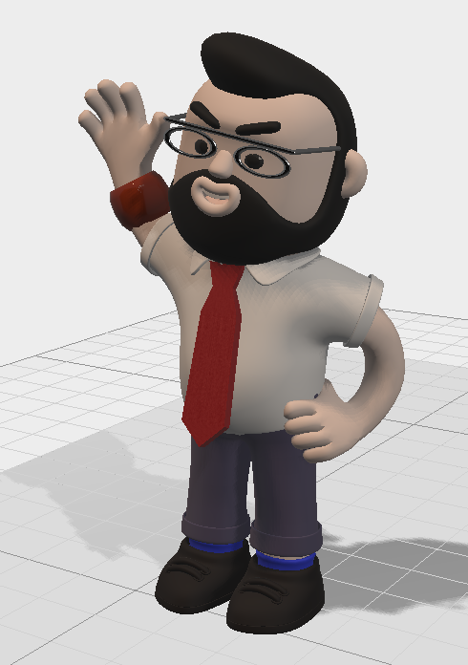
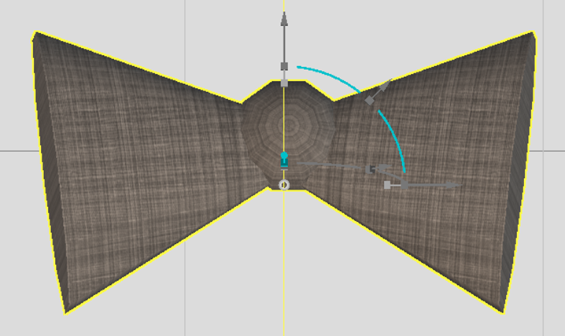
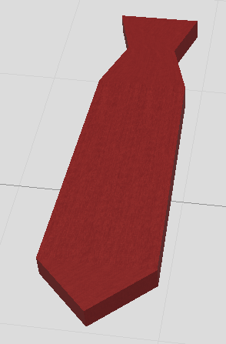
Today is the final project and you will need to design a new 3D models related to fashion and customize their texture.
import new 3d accessories and modify them in edit mode.
The new fashion accessories should be designed with different colors, textures, and patterns.
Decorate your avatar with the new fashion.
Studio56.qa

Slide 3
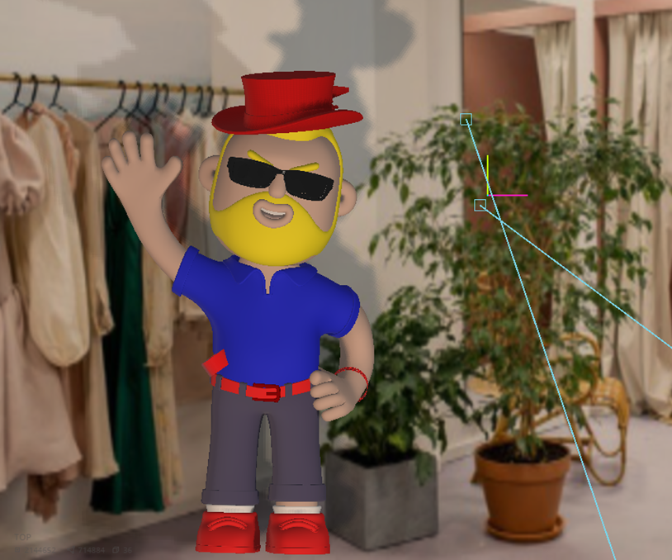
Today is the final project and you will need to design a new 3D models related to fashion and customize their texture.
import new 3d accessories and modify them in edit mode.
The new fashion accessories should be designed with different colors, textures, and patterns.
Decorate your avatar with the new fashion.
https://free3d.com/
https://www.cgtrader.com/free-3d-models
Studio56.qa

Slide 4
THANKS
info@studio56.qa
Studio56.qa
Notes:
WRAP UP الخاتمة
Debrief استجواب
Ask students to reflect on the day’s activities. What did they learn about Programming? Debugging? How do they feel about computer science and code after spending one hour exploring?
Next Steps Let students know that if they enjoyed today’s activity, they have many options for continuing to code and learn. Encourage students to visit studio56.qa/media-center
tell students what’s coming next in your classroom.

