Slide 1

Sport tech Camp – 3D Design and Scanning
11 -14
Studio56.qa
Notes:
Take the attendance
Have you attended workshops before?

Slide 2
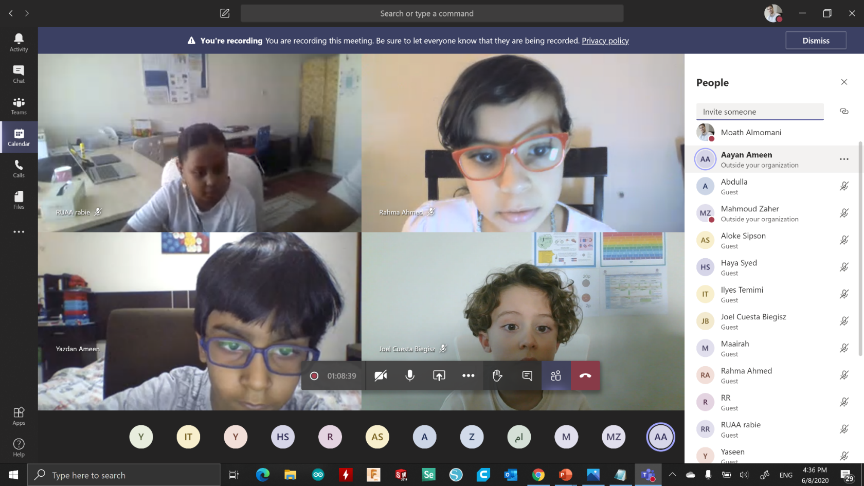
Microsoft Teams basics
1
2
3
Studio56.qa
Notes:
Introduce how to use Microsoft teams.

Slide 3
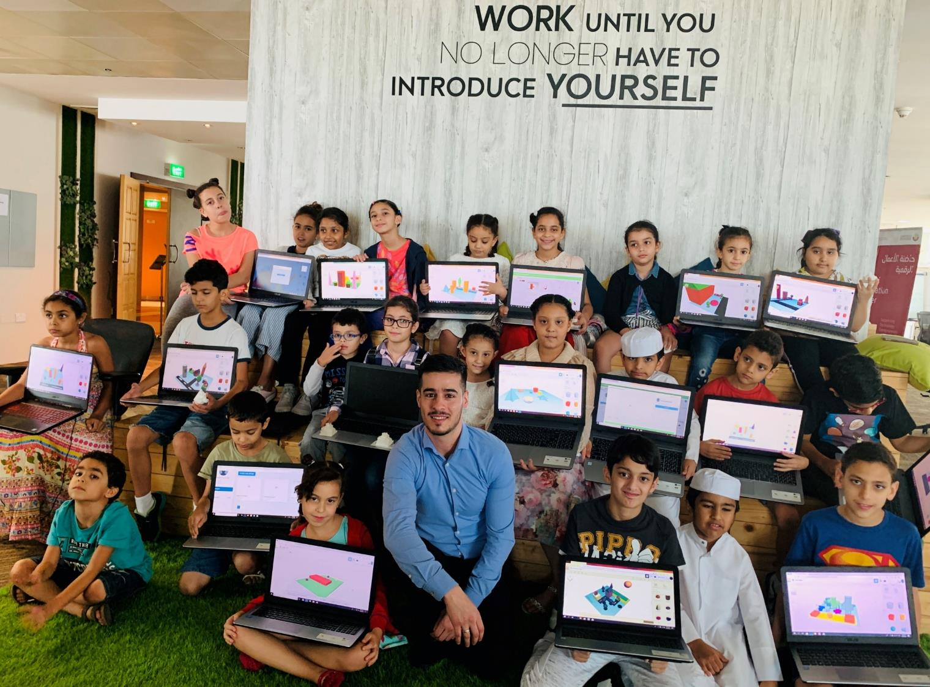

Who are we?
من نحن؟
Software Zone.
Technology Zone.
Creative Zone.
Notes:
Fab lab Studio 56 teaches youth about the necessary skills of this century such as digital fabrication, design and computer science.
Studio 56 has 3 main zones:

Slide 4
Today we are going to start sport tech camp to explore 3D scanning, 3d design, and what technologies are used in digital manufacturing.
In this camp, you will need to attend 5 days during the week, each day you will have a one-hour class, and on the last day, you will be asked to conduct a final project.
سنبدأ اليوم مخيم تكنولوجيا الرياضة لاستكشاف المسح الثلاثي الابعاد و التصميم الثلاثي الابعاد و التقنيات المستخدمة في التصنيع الرقمي.
في هذا المخيم، سوف تحتاج إلى حضور 5 أيام خلال الأسبوع، كل يوم سيكون لديك درس لمدة ساعة واحدة وفي اليوم الأخير سيطلب منك عمل مشروع نهائي.
Studio56.qa

Slide 5

Saleh is a Boling player looking to be the best and win the title of the champion.
Saleh doesn’t feel comfortable with the bowling ball size, so he is asking for you're help to customize one that fits with his hand and its related pins so he can win and be the champion.
صالح لاعب بولينج يتطلع ليكون الأفضل ويفوز بلقب البطل.
لا يشعر صالح بالراحة مع حجم كرة البولينج، لذلك يطلب منك المساعدة في تخصيص واحدة تناسب يده والدبابيس المرتبطة بها حتى يتمكن من الفوز ويكون البطل.
Studio56.qa
Notes:
How to know what is the best bats size for Fahed grip?
We should measure the size of Fahed hands.
What are technologies available to take the measurements of something?
say about the paper scanner with is a 2D scanner
Have you heard about 3D scanning?
Introduce the 3D scanner >> it can scan any 3D object like human body or hands, So the best choice to take a detailed measurements of any 3D object is 3D scanning.

Slide 6
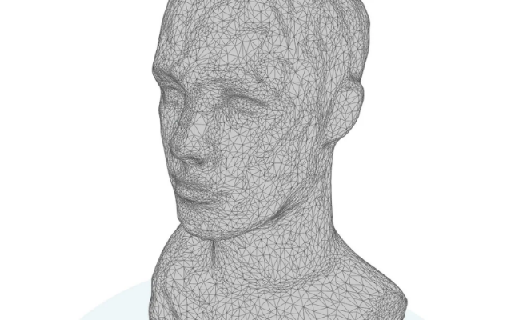

3D Scanning
المسح الثلاثي الابعاد
3D scanning is a technology for creating 3D models of real-world objects.
How it works?
A 3D scanner takes multiple snapshots of an object. The shots are then fused into a 3D model, which you can rotate and view from different angles on your computer.
المسح ثلاثي الأبعاد هو تقنية لإنشاء نماذج ثلاثية الأبعاد لمجسمات العالم الحقيقي.
كيف تعمل؟
الماسح الضوئي ثلاثي الأبعاد يأخذ لقطات متعددة لمجسم ما. يتم بعد ذلك دمج اللقطات في نموذج ثلاثي الأبعاد يمكنك تدويره وعرضه من زوايا مختلفة على جهاز الكمبيوتر الخاص بك.
Studio56.qa
Notes:
In this class, you'll learn everything you need to know to use your camera to take objects from the world around you and turn them into 3D models on your computer! I'll introduce you to the basic concepts of 3D scanning and teach you an easily accessible method of reality capture called photogrammetry. Then I'll show you how to use a great program called Qlone that will magically reconstruct your photos into 3D models in the cloud. Last you'll learn how to repair and edit your models to turn them into functional objects for all kinds of uses.

Slide 7



Type of 3D scanners
أنواع الماسحات الثلاثية الابعاد
There are various types of 3D scanning technologies, such as laser, light, and Photogrammetry 3D scanning such as Kinect in Xbox.
هناك أنواع كثيرة من تقنيات المسح ثلاثي الأبعاد ، مثل الليزر والضوء والمسح التصويري ثلاثي الأبعاد مثل Kinect في Xbox
Studio56.qa
Notes:
https://www.youtube.com/watch?v=tap6NbuGeeg

Slide 8
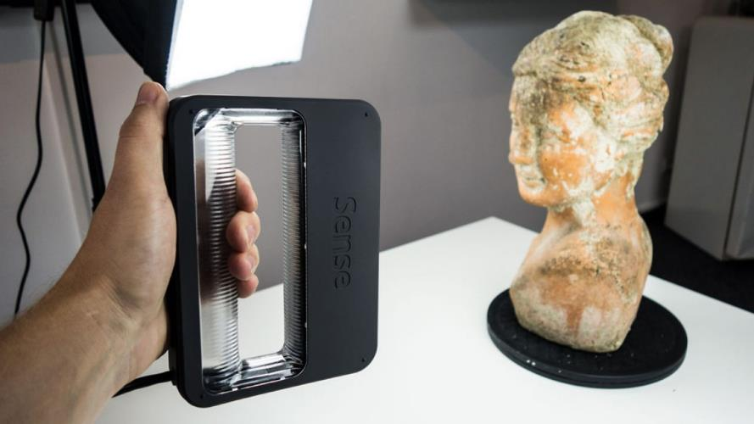
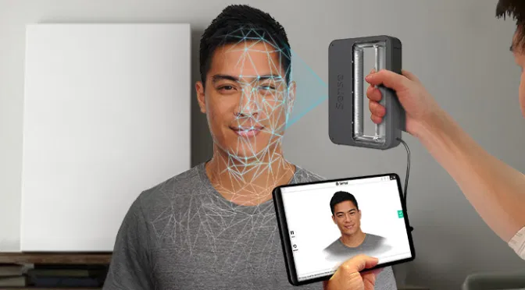
Photogrammetry Scanning
المسح التصويري
photogrammetry is an incredibly useful technology in various fields. The technology takes multiple images, taken at different positions, and triangulates points in these images to figure out the location of them in a three-dimensional space.
يعد المسح التصويري تقنية مفيدة بشكل لا يصدق في مختلف المجالات. تلتقط التقنية صورًا متعددة تم التقاطها في مواقع مختلفة، ومن ثم تقوم بتثليث النقاط في هذه الصور لمعرفة موقعها في مساحة ثلاثية الأبعاد.
Studio56.qa
Notes:
https://www.youtube.com/watch?v=aTLC4qfOHio
3D Systems iSense 3D scanner
Qlone scanner
Photogrammetry: useful for scanning people, animals, etc.
Photogrammetry
Stemming from photography, photogrammetry is an incredibly useful technology in various fields. The technology takes multiple images, taken at different positions, and triangulates points in these images to figure out the location of them in a three-dimensional space.

Slide 9
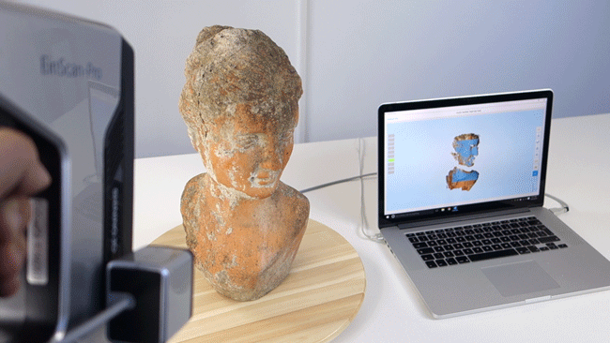
structured light scanning
المسح بالضوء المنظم
Is a 3D scanning technology that uses a single light source that projects multiple lines on the object, all of which are tracked simultaneously by a camera or multiple cameras. This is in contrast to a laser scanner, which emits multiple laser dots on the object one after the other.
هو تقنية مسح ضوئي ثلاثية الأبعاد تستخدم مصدر ضوء واحد يعرض خطوطًا متعددة على الكائن ، يتم تتبعها جميعًا في وقت واحد بواسطة كاميرا أو عدة كاميرات. هذا على عكس ماسح الليزر ، الذي ينبعث منه نقاط ليزر متعددة على الجسم واحدة تلو الأخرى.
Studio56.qa
Notes:
structured light 3d scanning - provides extremely precise measurements for small objects.
This 3D Scanner uses Kinect technology to create 3D models
The device features an "RGB camera, depth sensor, which provide full-body 3D motion capture and.
Applications:
Facial recognition system works by projecting more than 30,000 infrared dots onto a face and producing a 3D facial map.
https://www.youtube.com/watch?v=mSLIEZ_Yg4s

Slide 10
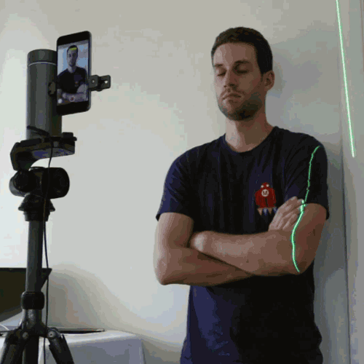
Laser scanning
المسح الضوئي بالليزر
The most accurate 3D scanning technology is laser scanning. It’s similar to the structured light scanners, by casting a laser beam upon the object being scanned, then a camera can record where the beam and object intersect.
تقنية المسح الضوئي ثلاثية الأبعاد الأكثر دقة هي المسح بالليزر إنه مشابه للماسحات الضوئية المنظمة، من خلال إرسال شعاع ليزر على المجسم الذي يتم مسحه ضوئيًا، ثم يمكن للكاميرا تسجيل مكان تقاطع الشعاع و المجسم.
Studio56.qa
Notes:
Perhaps the most accurate 3D scanning technology, also known to as triangulation
https://www.youtube.com/watch?v=J_SIro1TLBQ

Slide 11
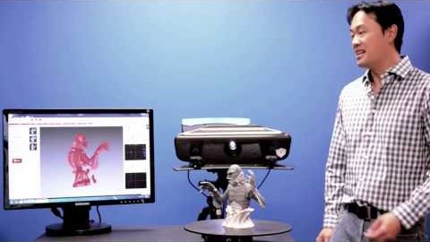
Numerous scans have to be conducted from different positions and then combined until the mesh can be 100% complete. Computer programs automatically combine all the scans to form a complete mesh.
يجب إجراء العديد من عمليات المسح من مواضع مختلفة ثم دمجها حتى تكتمل شبكة التصميم بنسبة 100٪.
تجمع برامج الكمبيوتر تلقائيًا جميع عمليات المسح لتشكيل هذه الشبكة الكاملة.
Notes:
https://www.youtube.com/watch?v=0P4zTtDLJv8&t=76s

Slide 12
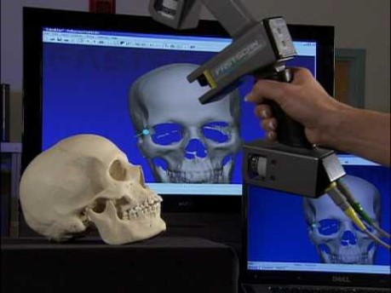
Laser scanning
المسح الضوئي بالليزر
Studio56.qa
Notes:
https://www.youtube.com/watch?v=SyzgBycPxyw
Play the video from min 3
Mention the hexagon - Romer

Slide 13
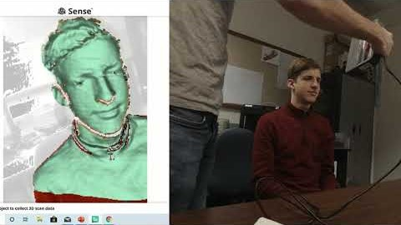
The video below shows us the 3D scanning process so you can get a deeper understanding of it.
يوضح الفيديو ادناه عملية المسح ثلاثي الأبعاد حتى تتمكن من الحصول على فهم أعمق لها.
Notes:
https://www.youtube.com/watch?v=dtjazI18KpA&t=179s
Start from 2:20

Slide 14
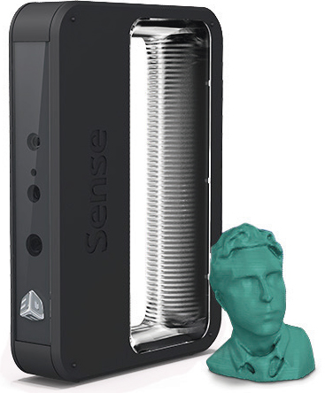
Let's start learning how to create 3D scan using Sense 3D
لنبدأ في تعلم كيفية إنشاء مسح ثلاثي الأبعاد باستخدام Sense 3D
Studio56.qa

Slide 15
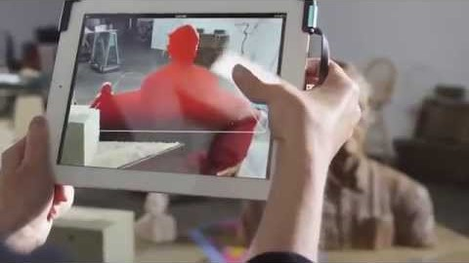
المسح التصويري
Photogrammetry Scanning
Studio56.qa
Notes:
https://www.youtube.com/watch?v=G0614Y6kYI8
3D Systems iSense 3D scanner
A photogrammetry scanner, 3D Systems iSense, is a quite capable scanner for its class. It’s very simple to operate, as a user simply opens up the application, selects the item to be scanned and conducts the scan. However, the technology is only compatible with iOS systems, which means scans will not be compatible with other systems such as Android and Windows.

Slide 16
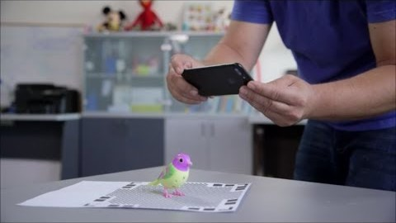
المسح التصويري
Photogrammetry Scanning
Studio56.qa
Notes:
https://www.youtube.com/watch?v=aTLC4qfOHio
Qlone scanner
Photogrammetry: useful for scanning people, animals, etc.

Slide 17

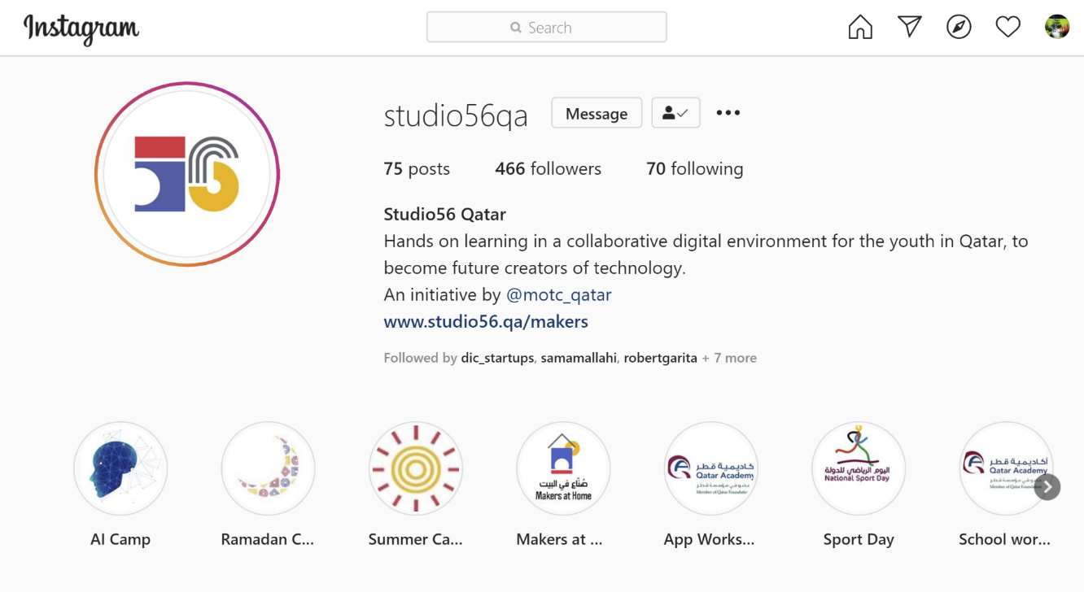
Studio56.qa
Notes:
Encourage participants to follow our studio56qa Instagram

Slide 18
THANKS
info@studio56.qa
Studio56.qa
Notes:
WRAP UP الخاتمة
Debrief استجواب
Ask students to reflect on the day’s activities. What did they learn about Programming? Debugging? How do they feel about computer science and code after spending one hour exploring?
Next Steps Let students know that if they enjoyed today’s activity, they have many options for continuing to code and learn. Encourage students to visit studio56.qa/media-center
tell students what’s coming next in your classroom.

