Slide 1

Gabgha Digital Show
Video making & Animation
عرض الغبقة الافتراضي
صناعة الفيديوهات والتحريك
Studio56.qa

Slide 2
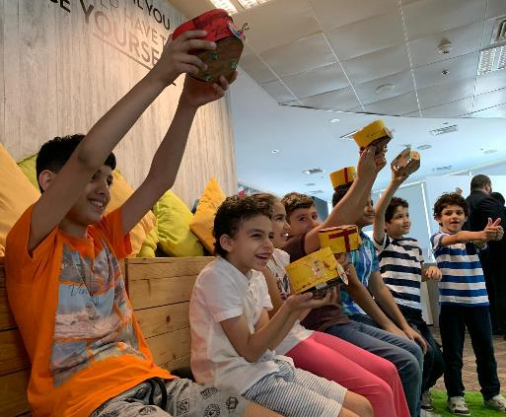
WHO ARE WE? من نحن؟
ستوديو 5\6 هو مختبر تصنيع للأطفال الذين يتراوح أعمارهم بين عمر 7 و 18.
STUDIO 5\6 is a fabrication lab targeting kids from age 7 to 18.
_____
سوف يحتوي مخبر التصنيع على آلات ومعدات مختلفة لتصنيع مختلف النماذج المبدئية المبتكرة.
We will have Fablab with different machines and tools to use for creating active prototypes.
Studio56.qa
Notes:
Explain what we do in Studio5/6 and the age group we target.

Slide 3
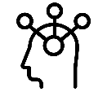
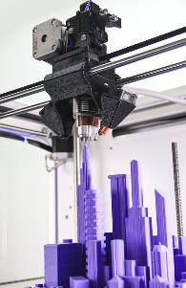

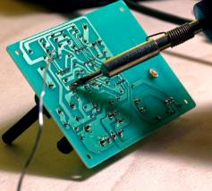
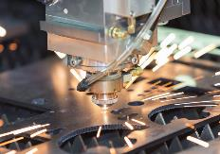

What is inside the FABLAB?
ماذا نجد داخل مختبر التصنيع؟
Tools & Machines
آلات وأدوات
Zones
مناطق
Creativity zone
منطقة الابداع
3D printing
الطباعة ثلاثية الأبعاد
Electronics and programming
الإلكترونيات والبرمجة
Software zone
منطقة البرمجة
Laser cutting
القص بالليزر
Technology zone
منطقة التكنولوجيا

Slide 4
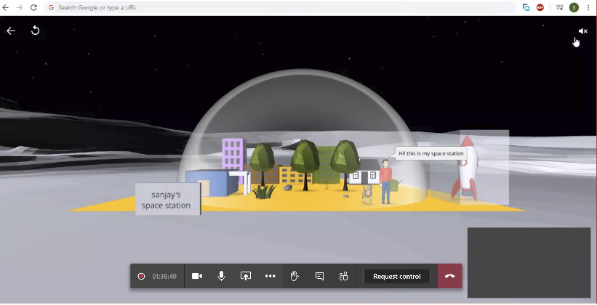
Teams Interface
Chat
Raise hand
Attendees
Video
Screen Sharing
Microphone
Studio56.qa
Notes:
Explain what is a FabLab and where the word come from.

Slide 5
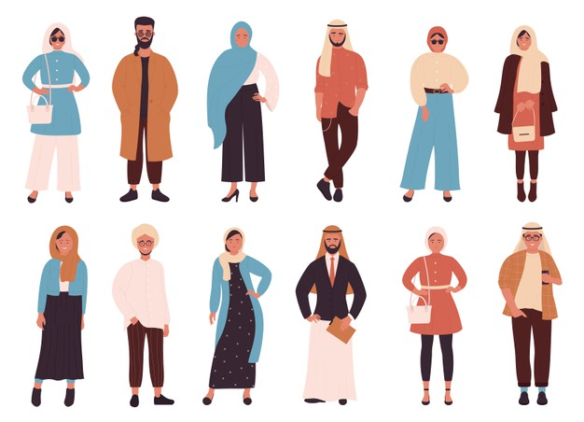
Gabgha, is a type of gathering event that takes place at the nights of the blessed month of Ramadhan. In this event, friends gather in one house, after they are done with Salat Al Taraweh and enjoy an evening filled with food and fun activities.
We want to have a fashion show of traditional Qatari clothes in one of these events, as a fun activity. However, we need a video that simulates this fashion show. Please help us in this workshop to create a video that contains a character, animation, and sound.
Studio56.qa
Studio56.qa
Notes:
The client letter: explain to the participants the problem we have and ask them to suggest solutions to solve it.

Slide 6
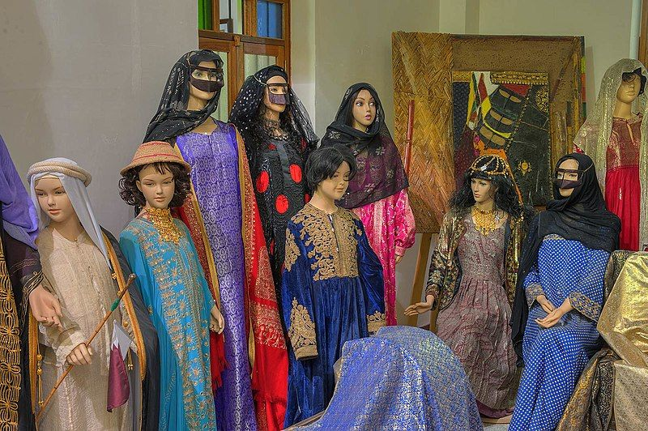
QATARI
TRADITIONAL
CUTOMES
Studio56.qa

Slide 7

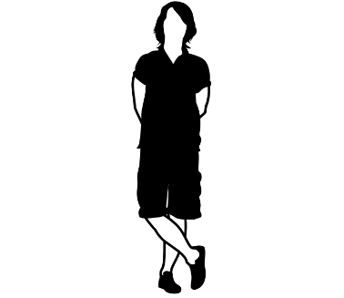
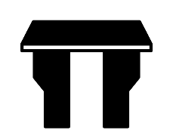
What is Fashion? ماهي الموضة؟
Fashion is the general style of dress or behavior at any given time, constantly changing to adapt with time change. We can find fashion in furniture, automobiles, clothing and other objects.
الموضة هي النمط العام للباس أو السلوك في أي وقت ، وتتغير باستمرار للتكيف مع تغير الوقت. يمكننا أن نجد الموضة في الأثاث والسيارات والملابس والأشياء الأخرى.
Studio56.qa
Notes:
Explain what are mobile applications and how they work.

Slide 8
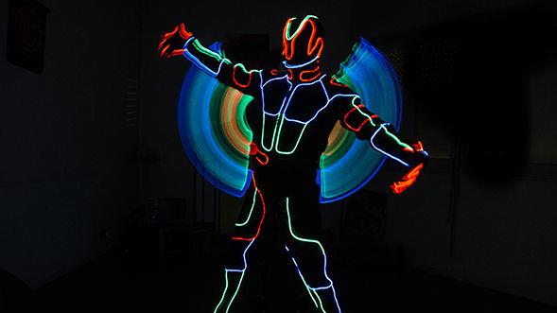
DIGITAL
FASHION

Slide 9
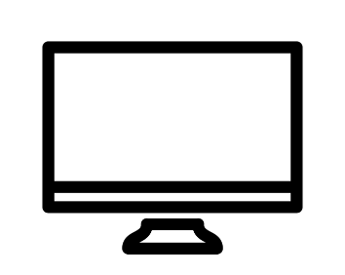
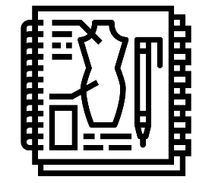
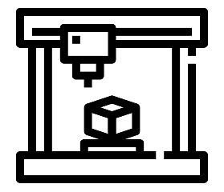
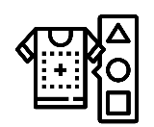
Digital Fashion الموضة الرقمية
Fashion
الموضة
Computer
الكمبيوتر
Digital Fabrication
التصنيع الرقمي
Studio56.qa

Slide 10
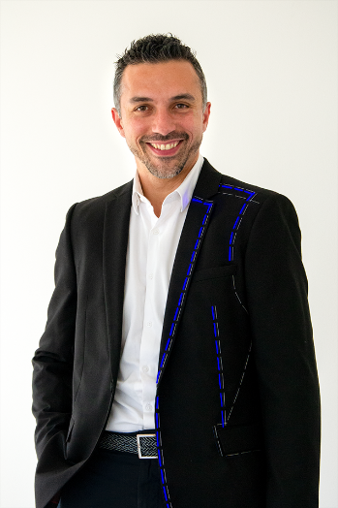
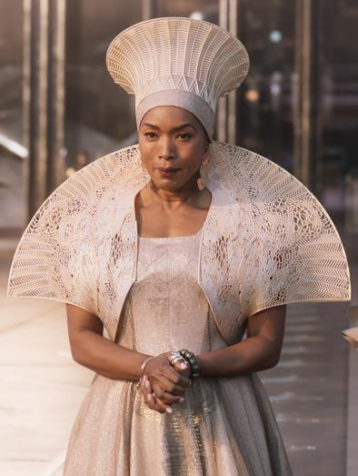
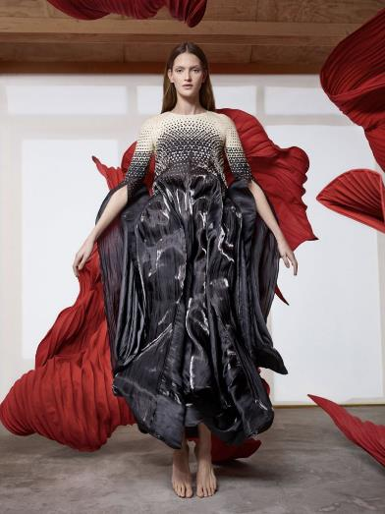
Examples
أمثلة
Studio56.qa

Slide 11
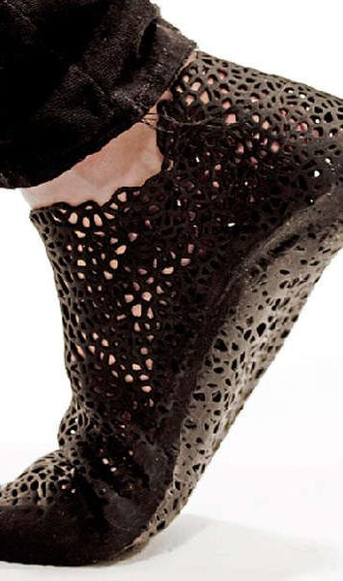
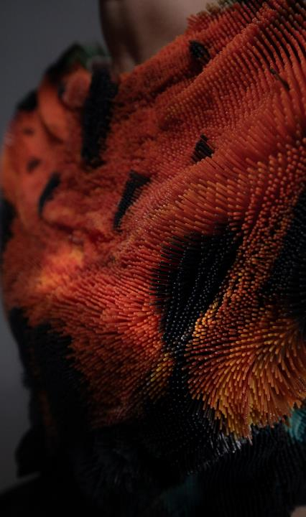
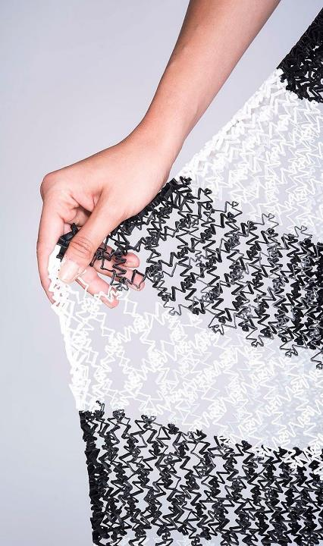

Slide 12
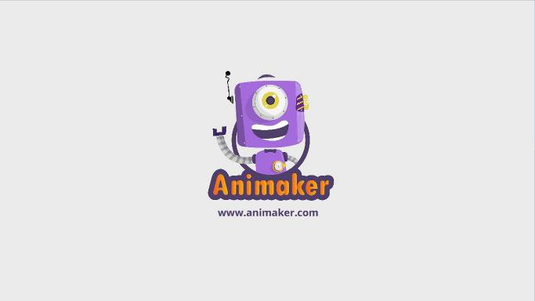
ما هو البرنامج الذي سنقوم باستخدامه اليوم؟
What program we will be using TODAY?
Studio56.qa
Notes:
Explain the program that we will be using today to make our application.

Slide 13
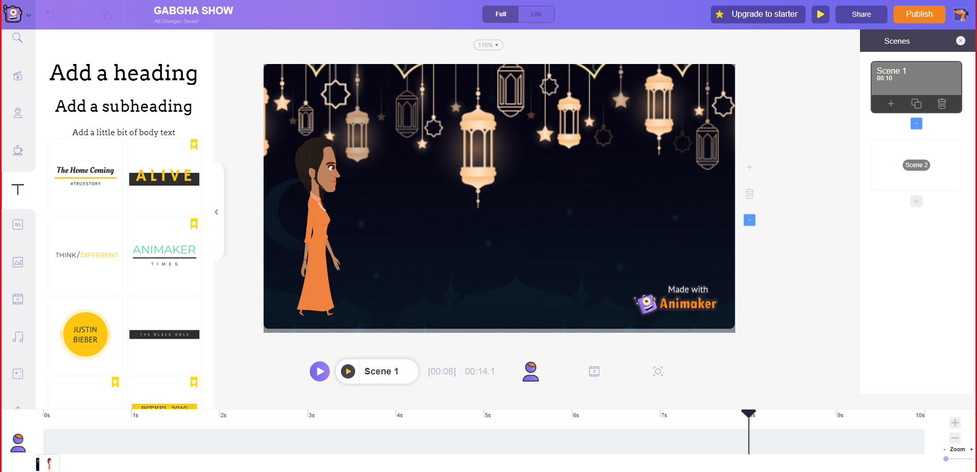
Animaker
https://www.animaker.com/
Studio56.qa
Notes:
Explain what is a FabLab and where the word come from.

Slide 14
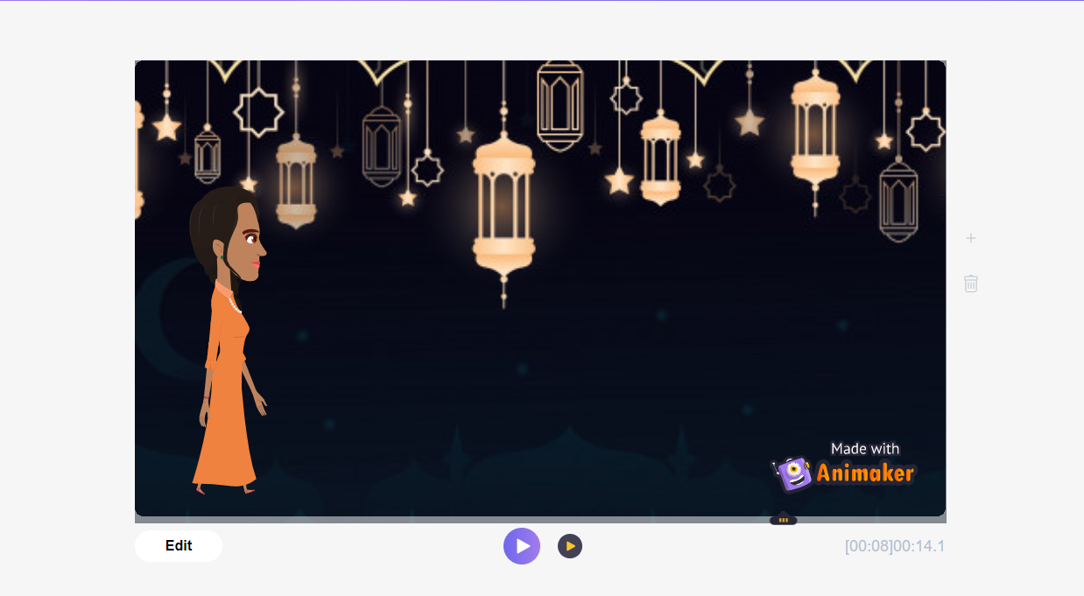
ما الذي سنقوم بتطويره اليوم؟
What we will develop TODAY?
A digital fashion show simulation video
فيديو محاكاة لعرض الأزياء الافتراضي
Studio56.qa
Notes:
Explain that we will build a mobile application game that contains different pictures and buttons.

Slide 15
Scene 1
1- Background
2- Model Character
3- Walking animation
Studio56.qa
Notes:
Explain what is a FabLab and where the word come from.

Slide 16
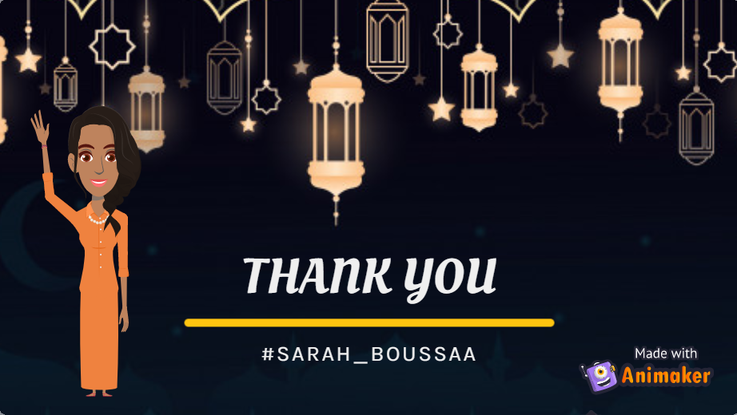
Scene 2
1- Background
2- Model Character
3- Waving animation
Studio56.qa
Notes:
Explain what is a FabLab and where the word come from.

Slide 17
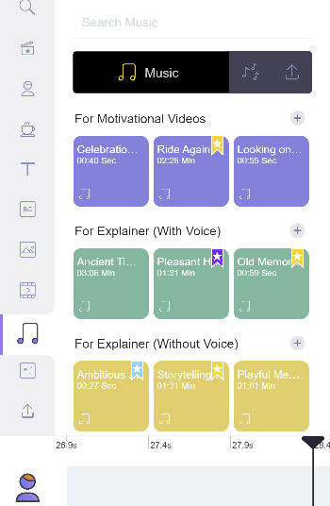
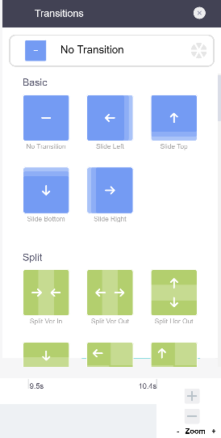

  SOUND
  TRANSITION EFFECTS
Studio56.qa

Slide 18

Thanks
@studio56qa
Studio56.qa

