Slide 1

3D Gold Accessories
إكسسوارات ذهبية ثلاثية الأبعاد
11 -14
Studio56.qa
Notes:
Take the attendance
Have you attended workshops before?

Slide 2
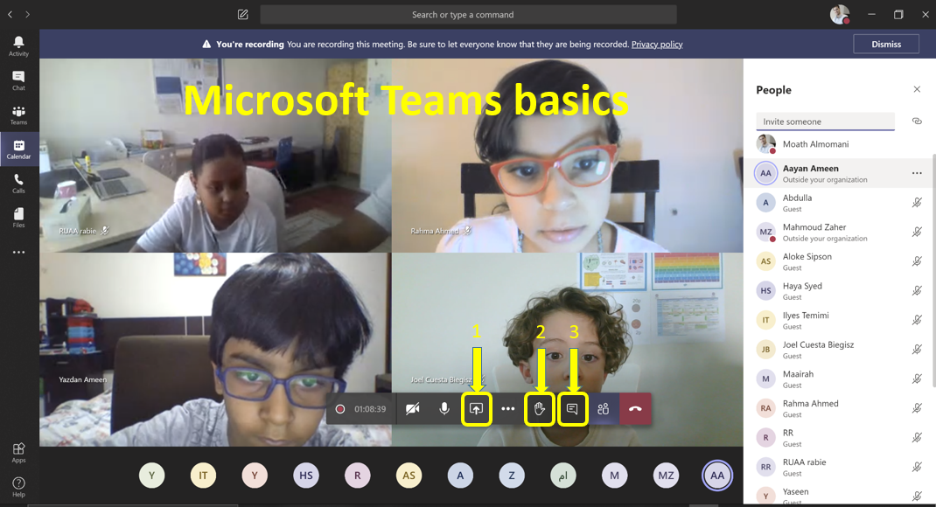
Microsoft Teams basics
1
2
3
Studio56.qa
Notes:
Introduce how to use Microsoft teams.

Slide 3
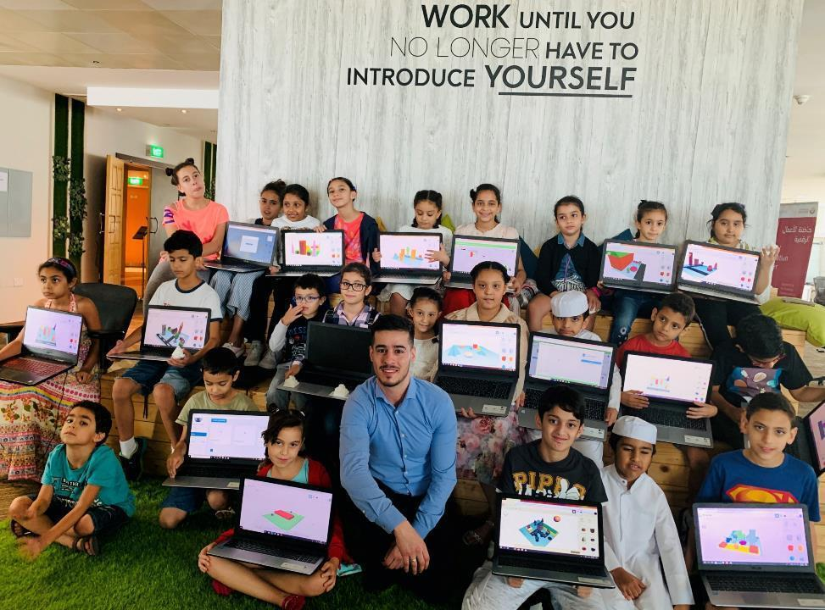
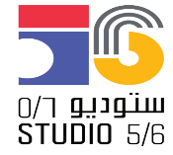
Who are we?
من نحن؟
Software Zone.
Technology Zone.
Creative Zone.
Notes:
Fab lab Studio 56 teaches youth about the necessary skills of this century such as digital fabrication, design and computer science.
Studio 56 has 3 main zones:

Slide 4
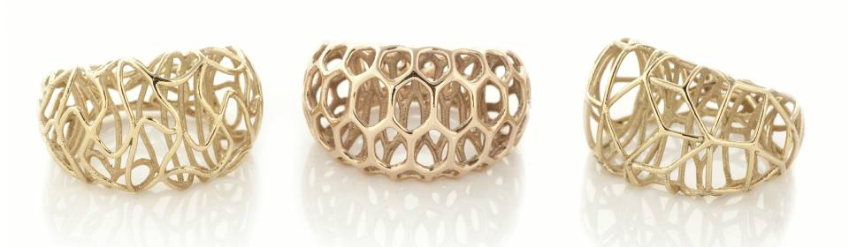
Fatima is planning to enter a competition in Gold accessory design, and she wants to create unique and special accessories by integrating modern 3d design with digital technology, so she is asking for your support to provide her with modern and innovative designs of gold accessory from your creative imagination.
تخطط فاطمة للدخول في مسابقة في تصميم الإكسسوار الذهبي ، ويريد إنشاء إكسسوارات فريدة ومميزة من خلال دمج التصميم ثلاثي الأبعاد الحديث مع التكنولوجيا الرقمية ، لذا فهو يطلب دعمكم لتزويده بتصميمات حديثة ومبتكرة للإكسسوار الذهبي منكم. الخيال الإبداعي.
Studio56.qa
Notes:
Ice braking activity.
Have you played Minecraft before?

Slide 5
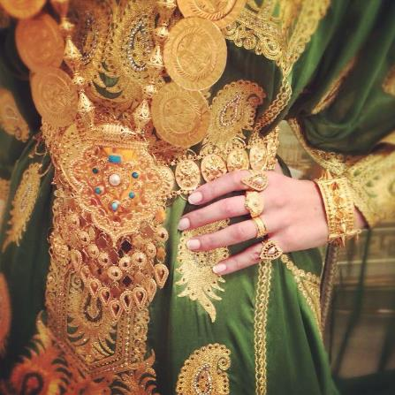
Gold has a very important value in Qatari society as women wear it more frequently during Ramadan gathering, therefore learn about 3D design and are its importance in relating to modern gold accessories manufacturing.
الذهب له قيمة مهمة للغاية في المجتمع القطري حيث ترتديه النساء بشكل متكرر خلال التجمعات الرمضانية ، لذلك تعرف على التصميم ثلاثي الأبعاد وأهميته فيما يتعلق بتصنيع الإكسسوارات الذهبية الحديثة.
Studio56.qa
Notes:
Ice braking activity.
Have you played Minecraft before?

Slide 6
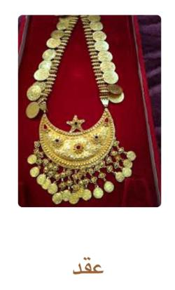
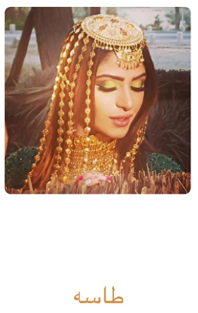
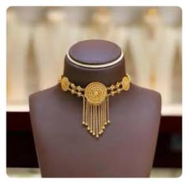
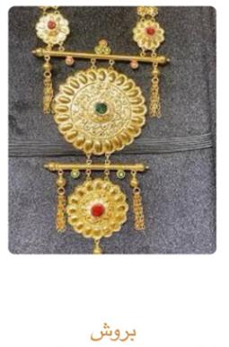

These are some pictures of jewelry from the Qatari heritage, which is distinguished by being made of gold and pearls.
هذه بعض الصور للحلي من التراث القطري و يتميز بانه يصنع من الذهب و اللؤلؤ.
Necklace
Baroush
Tasa
Mzanat
Studio56.qa
Notes:
Ice braking activity.
Have you played Minecraft before?

Slide 7
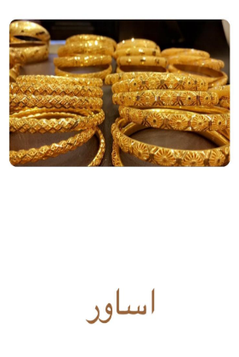
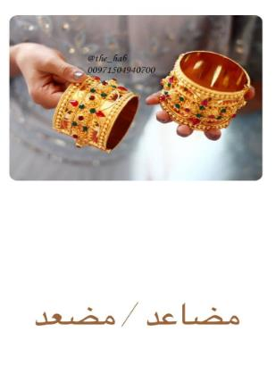
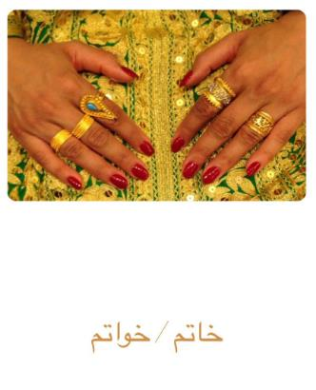
These are some pictures of jewelry from the Qatari heritage, which is distinguished by being made of gold and pearls.
هذه بعض الصور للحلي من التراث القطري و يتميز بانه يصنع من الذهب و اللؤلؤ.
Bracelets
Bracelets
Rings
Studio56.qa
Notes:
Ice braking activity.
Have you played Minecraft before?

Slide 8
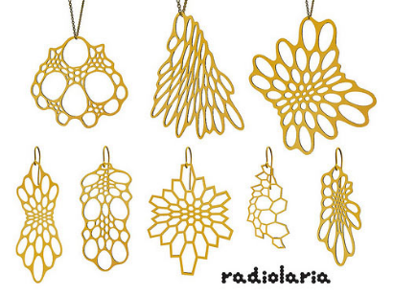
Those are some examples of digital manufactured accessories
هذه بعض الأمثلة على الاكسسوارات التي تم تصنيعها رقميا
Radiolaria Design
3D Printed jewelry
تصميم راديولاريا
مجوهرات مطبوعة ثلاثية الأبعاد
Studio56.qa

Slide 9
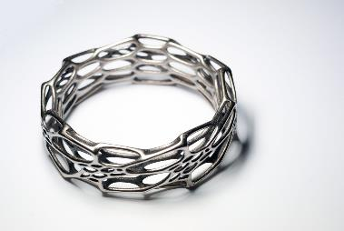
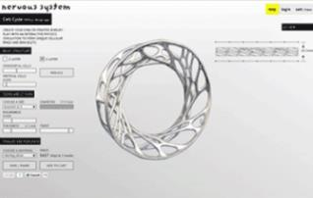
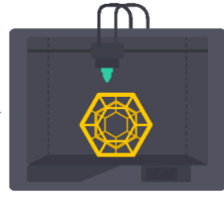
How can these types of fashion be made?
كيف يمكن تصنيع هذه الأنواع من الأزياء ؟
Digital manufacturing
Design
Final product
التصميم
المنتج النهائي
التصنيع الرقمي
Studio56.qa
Notes:
Say that the first step in the digital manufacturing process is the design

Slide 10
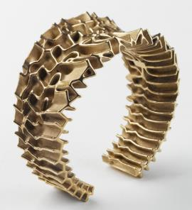
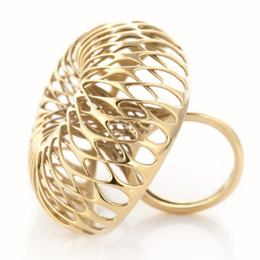
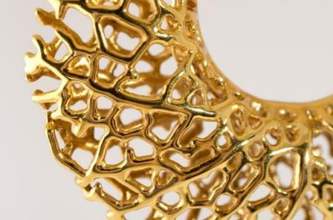
Those are some examples of 3D printed gold accessories
هذه بعض الأمثلة على لأزياء التي تم تصنيعها رقميا
Studio56.qa
Notes:
Laser cutting video
https://www.youtube.com/watch?v=KLTihO71h6o
The current video
https://www.youtube.com/watch?v=FalNsx2zULM

Slide 11
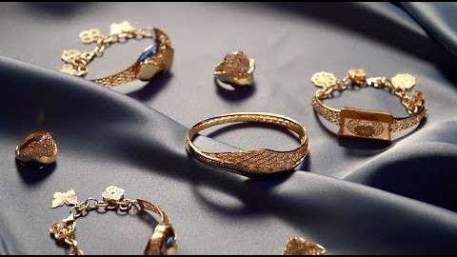
Let’s watch a video about digital manufacturing and fashion
لنشاهد مقطع فيديو عن التصنيع الرقمي والأزياء
Studio56.qa
Notes:
Laser cutting video
https://www.youtube.com/watch?v=KLTihO71h6o
The current video
https://www.youtube.com/watch?v=FalNsx2zULM

Slide 12
التصميم
Design
يوجد الآن الكثير من برامج التصميم وكل منها مخصص لوظيفة معينة.
دعونا نستكشف بعض برامج التصميم و المخصصة للمجالات التالية:
هندسة العمارة
الطيران
الميكانيك
المنتجات
الألعاب
الأفلام
Now there are plenty of design software and each one is dedicated for a certain job.
Let’s explore some of design software that are dedicated for the following task:
Architecture
Aerospace
Mechanical design
Product design
Games
Movies
Studio56.qa
Notes:
Engage students in discussions, what is this machine ??
Have you heard about this machine before?
Have you seen it before?

Slide 13
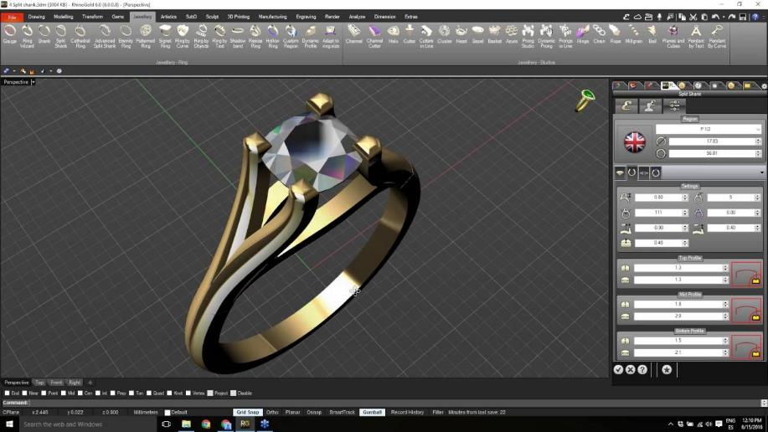
Rhino gold - jewelry
Studio56.qa
Notes:
https://www.youtube.com/watch?v=tWGLeJ-cS58

Slide 14
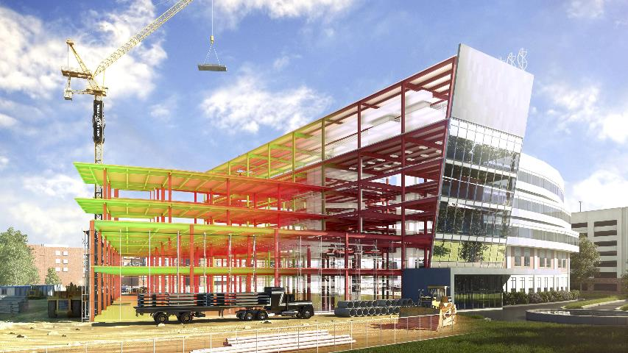
Revit Architecture
Studio56.qa
Notes:
Biem design

Slide 15
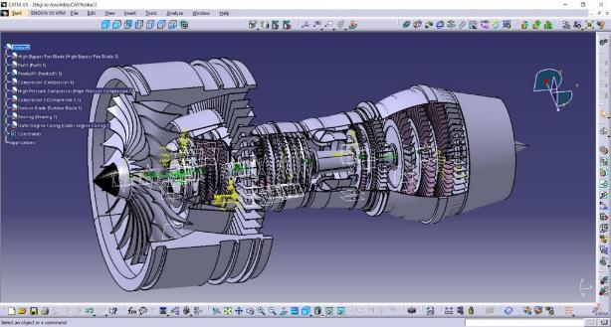
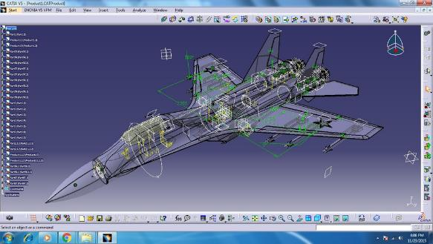
CATIA - Aero space
Studio56.qa
Notes:
SAY there are more design software such as semens nx

Slide 16
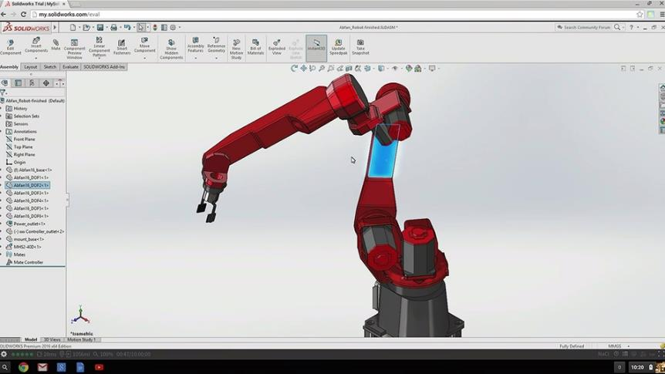
Solidworks - Mechanical
Studio56.qa

Slide 17
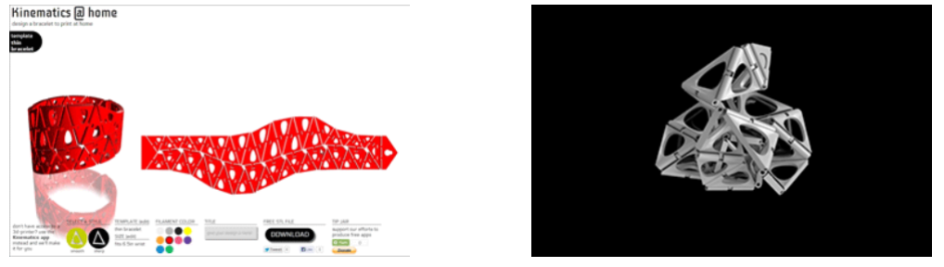
Nervous system – Fashions
Let’s Explore Nervo systems and fashion design
دعونا نستكشف أنظمة نيرفو و تصميم الأزياء
Studio56.qa
Notes:
After finish explaining nervo present to participant the parametric design

Slide 18
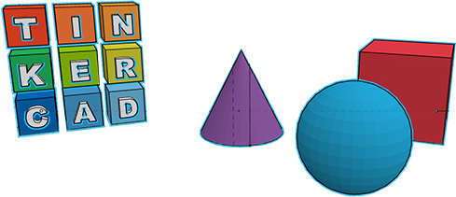
TINKERCAD
Today we are going to use an online tool which will help us to create 3D objects.
سنستخدم اليوم أداة عبر الإنترنت ستساعدنا في إنشاء تصاميم ثلاثية الأبعاد.
Studio56.qa
Notes:
Ask Participants
What kind of design software have you experiences before?
Have you used Tinkercad before?
Introduced Tinkercad

Slide 19
Getting started with Tinkercad
UI: How to start a new project, Camera control, zoom in and out, and objects menu.
Basic objects, how to interact, rotate, and scale.
How to group and cut objects.
واجهة المستخدم: كيفية بدء مشروع جديد ، والتحكم في الكاميرا ، والتكبير والتصغير ، وقائمة الاشكال.
الاشكال الأساسية ، وكيفية التفاعل ، والتدوير ، والقياس.
كيفية تجميع وقطع الأشياء.
Studio56.qa

Slide 20
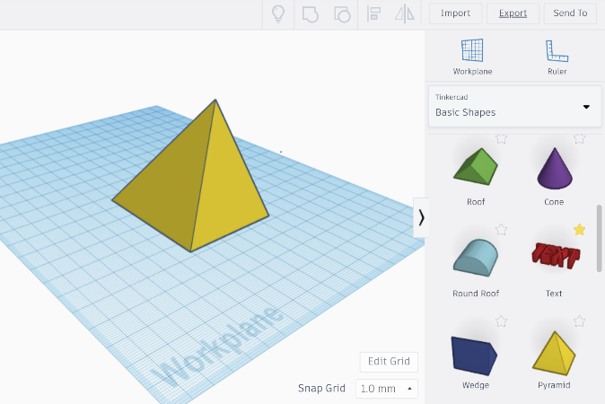
Objects can be moved by click and drag objects.
يمكن نقل الكائنات عن طريق النقر واسحب الكائنات.
Studio56.qa

Slide 21
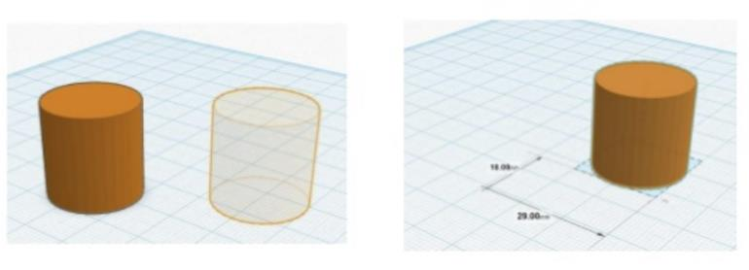
Objects can be moved by click and drag objects.
Moving Objects تحريك المجسمات
يمكن نقل المجسمات عن طريق النقر والسحب.
Studio56.qa

Slide 22
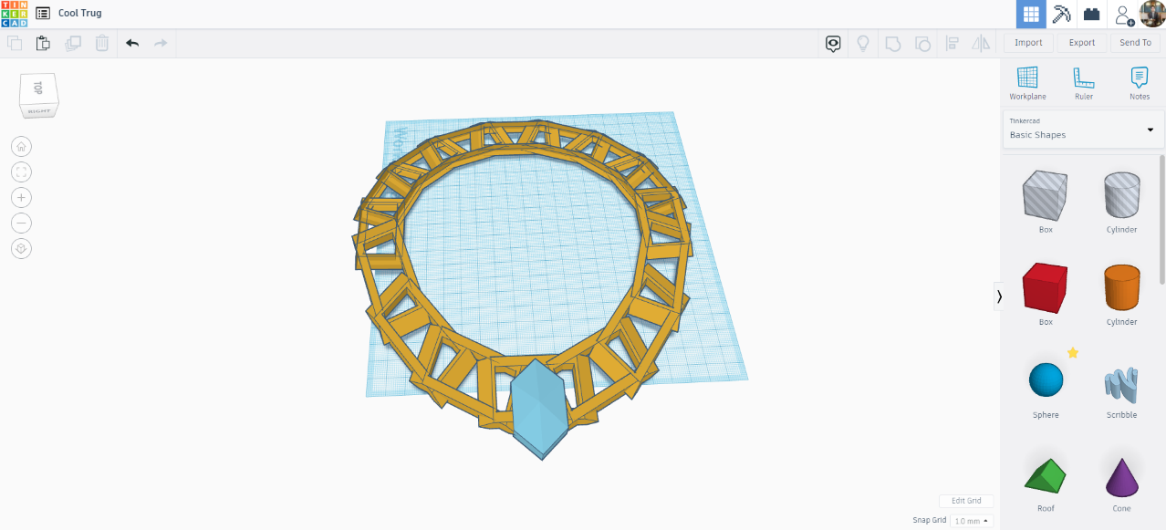
Accessory and general design – Tinkercad
Studio56.qa
Notes:
Explain Onshape and show the main interface :
Onshape is a computer-aided design software system, delivered over the Internet via a Software as a Service model.
Ask students to create accounts and help them

Slide 23
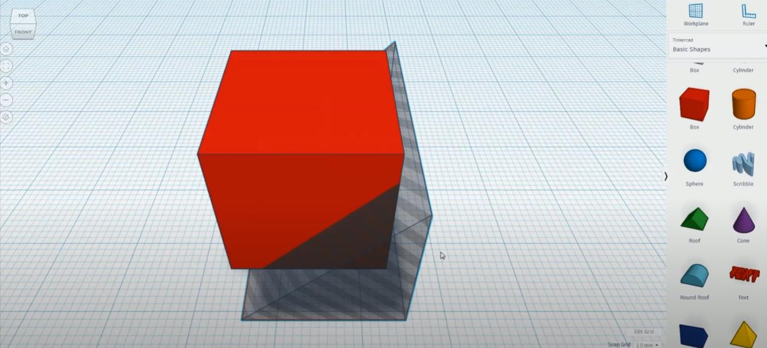
Objects can be moved by click and drag objects.
From the cube we will make the parts of the necklace
من شكل المكعب سوف نصمم أجزاء العقد
Studio56.qa

Slide 24
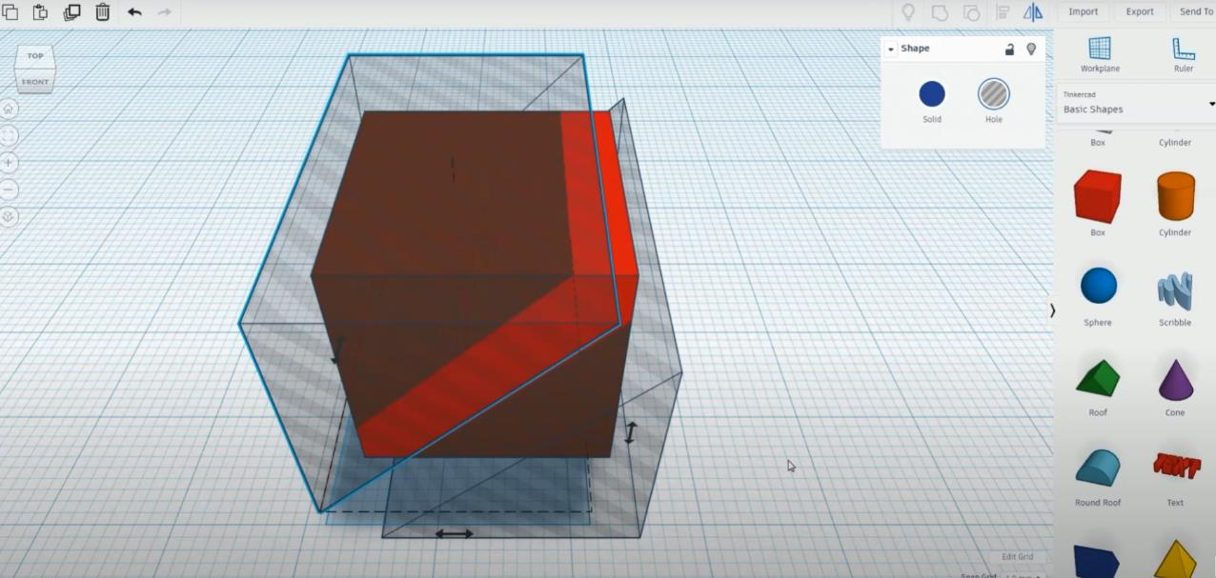
Objects can be moved by click and drag objects.
Duplicate and mirror the hole shape to cut the shaded area and get the piece that we need
قم بتكرار شكل الثقب وعكسه لقص المنطقة المظللة والحصول على القطعة التي نحتاجها
Studio56.qa

Slide 25
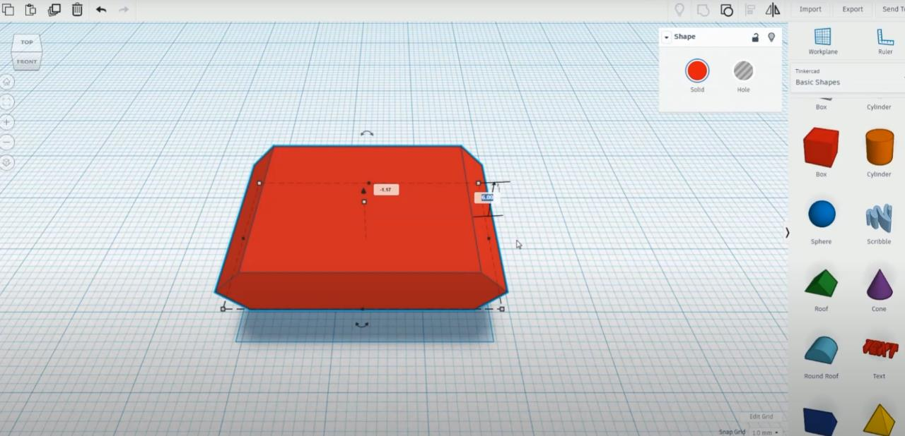
Objects can be moved by click and drag objects.
Rotate the part and make it flat
قم بتدوير الجزء وجعله مسطحًا
Studio56.qa

Slide 26
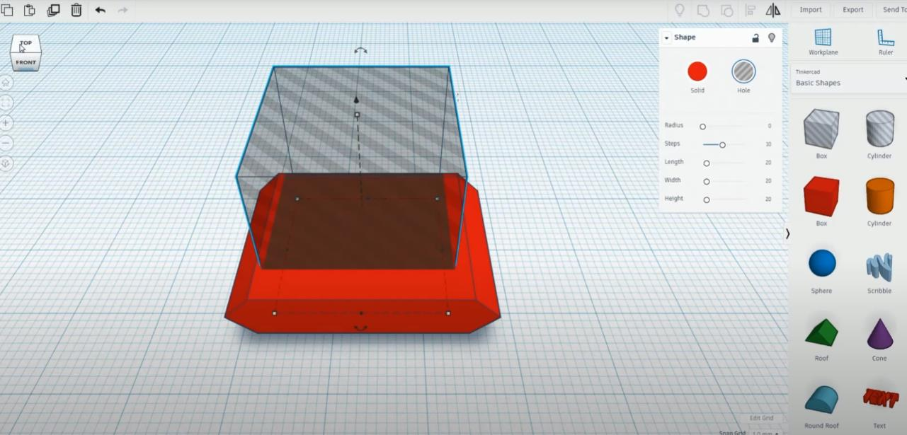
Objects can be moved by click and drag objects.
Select the hole shape to cut the shaded area and get the piece that we need
حدد شكل الفتحة لقص المنطقة المظللة والحصول على القطعة التي نحتاجها
Studio56.qa

Slide 27
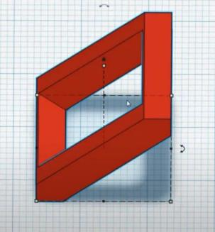
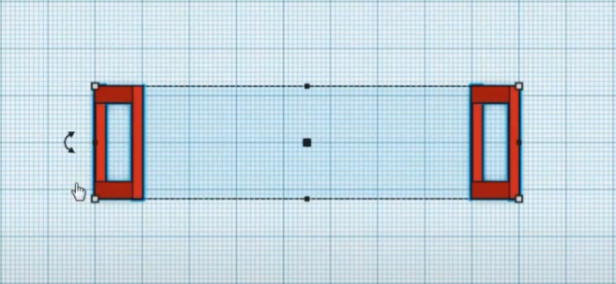
After you get the desired part, we will need another copy.
You can use the duplicate button
بعد أن تحصل على الجزء المطلوب ، سنحتاج إلى نسخة أخرى.
يمكنك استخدام زر التكرار
Studio56.qa

Slide 28
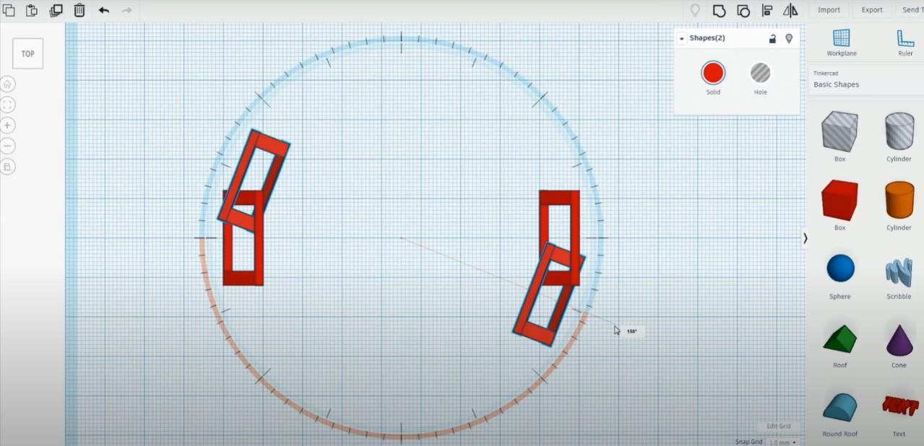
Duplicate the two parts and make a little rotation
قم بتكرار الجزأين وقم بإجراء القليل من الدوران
Studio56.qa

Slide 29
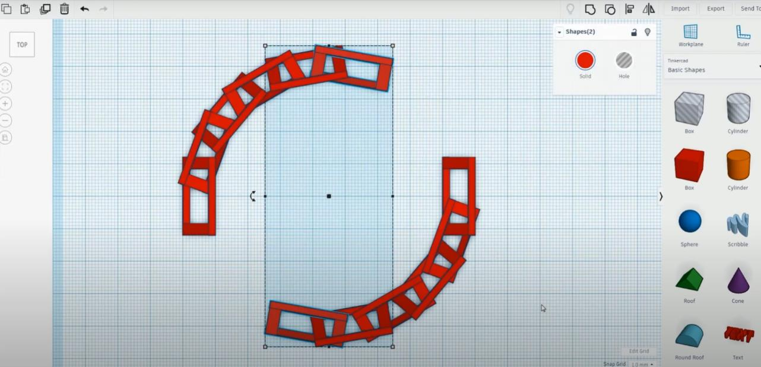
Duplicate Again and again until you complete the circle
كرر مرارًا وتكرارًا حتى تكمل الدائرة
Studio56.qa

Slide 30
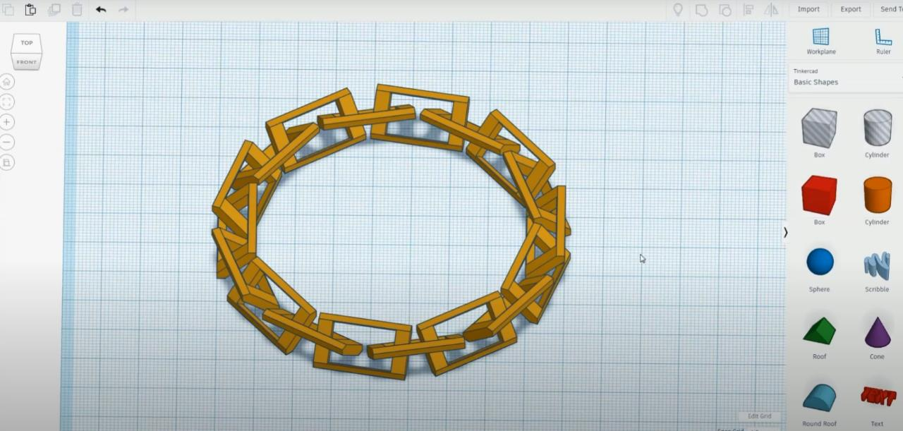
Change the color to gold
تغيير اللون إلى الذهبي
Studio56.qa

Slide 31
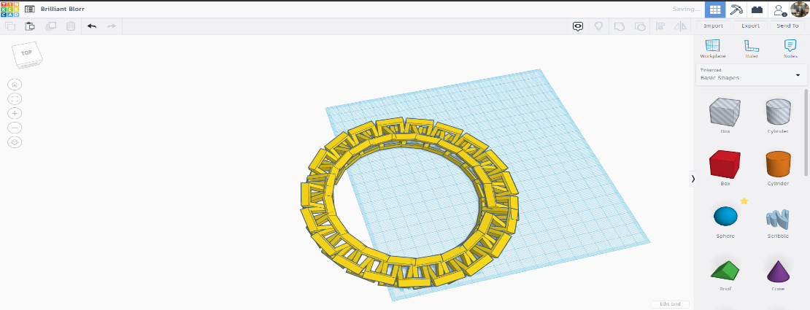
Studio56.qa
Notes:
Explain Onshape and show the main interface :
Onshape is a computer-aided design software system, delivered over the Internet via a Software as a Service model.
Ask students to create accounts and help them

Slide 32
Accessory and general design – Tinkercad
Studio56.qa
Notes:
Explain Onshape and show the main interface :
Onshape is a computer-aided design software system, delivered over the Internet via a Software as a Service model.
Ask students to create accounts and help them

Slide 33
THANKS
info@studio56.qa
Studio56.qa
Notes:
WRAP UP الخاتمة
Debrief استجواب
Ask students to reflect on the day’s activities. What did they learn about Programming? Debugging? How do they feel about computer science and code after spending one hour exploring?
Next Steps Let students know that if they enjoyed today’s activity, they have many options for continuing to code and learn. Encourage students to visit studio56.qa/media-center
tell students what’s coming next in your classroom.

