Slide 1
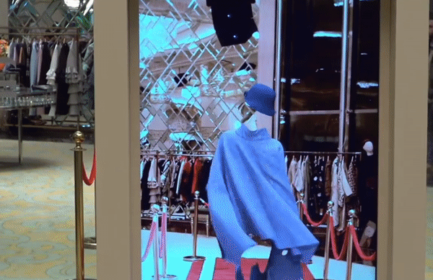
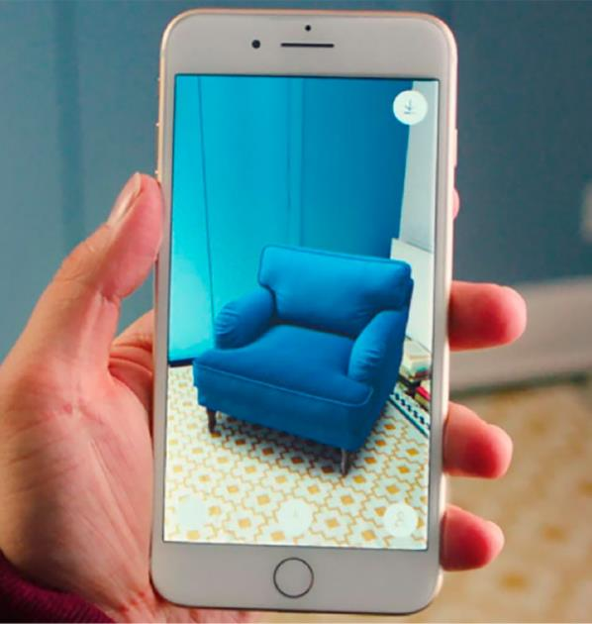
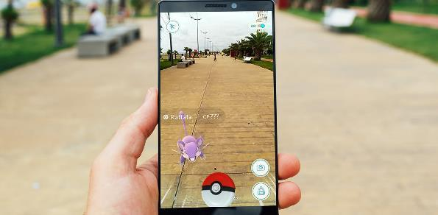

AR
Studio56.qa

Slide 2
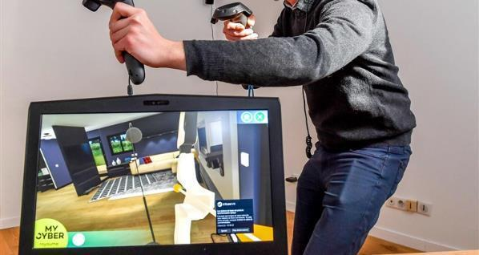
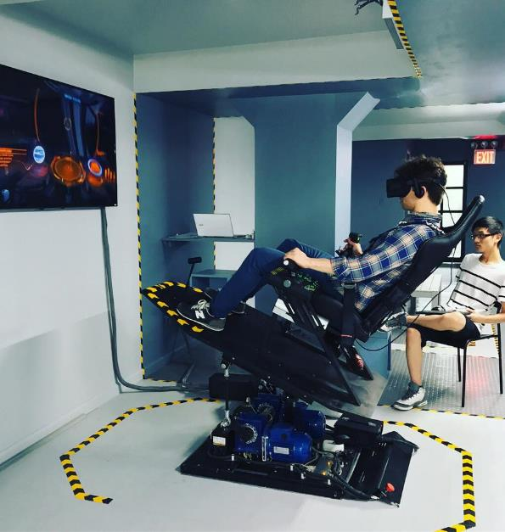

VR
Studio56.qa

Slide 3

ما هو البرنامج الذي سنقوم باستخدامه اليوم؟
What program we will be using TODAY?
Unity is a cross-platform game engine developed by Unity Technologies.
Make real-time 3D projects for Games, Animation, Film, Automotive, Transportation, Architecture, Engineering, Manufacturing & Construction.
Studio56.qa
Notes:
Explain the program that we will be using today to make our application.

Slide 4
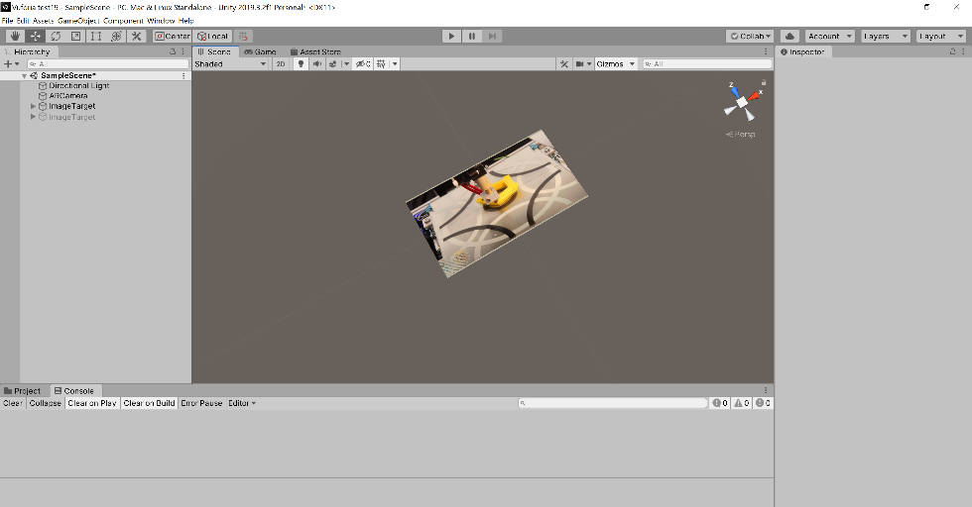
Let's add another Target image on Unity
لنقم باضافة صورة الهدف في Unity
Studio56.qa

Slide 5

Create your video
اصنع الفيديو الخاص بك
https://clideo.com/video-maker
OR look for one!
أو ابحث عن فيديو!
Studio56.qa

Slide 6
Day 4
Embed in clothes and connect
Studio56.qa

Slide 7

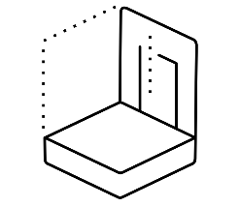

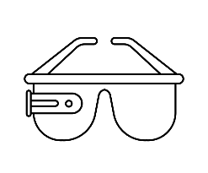
Uses of Unity 3D
استخدامات برنامج Unity
Animation
الرسوم المتحركة
Architecture
العمارة
Game Development
تطوير الألعاب الالكترونية
Interactive Experiences
التجارب التفاعلية
Studio56.qa

Slide 8




AR softwares
برامج تطوير الواقع المعزز
AR Kit
AR Core
HP Reveal
Zapworks
Studio56.qa

Slide 9



PRINT
Print your target images and attach them to your clothing items
اطبع صورك المستهدفة وأرفقها بقطع ملابسك
ATTACH
Studio56.qa

Slide 10
ما هو البرنامج الذي سنقوم باستخدامه اليوم؟
What program we will be using TODAY?
Unity is a cross-platform game engine developed by Unity Technologies.
Make real-time 3D projects for Games, Animation, Film, Automotive, Transportation, Architecture, Engineering, Manufacturing & Construction.
Studio56.qa
Notes:
Explain the program that we will be using today to make our application.

Slide 11
Day 5
Test and Share the program
Studio56.qa

Slide 12
How AR is used in Fashion?
Studio56.qa

Slide 13
AR in Sephora
https://www.youtube.com/watch?v=5qpuym4-JDE
Studio56.qa

Slide 14
AR in Zara
https://www.youtube.com/watch?v=PTiT-Y4y7AI
Studio56.qa

Slide 15
AR in Ikea
https://www.youtube.com/watch?v=UudV1VdFtuQ
Studio56.qa

Slide 16
AR in Nike
https://www.youtube.com/watch?v=QBrskBwURMk
Studio56.qa

Slide 17
AR in Timberland
https://www.youtube.com/watch?v=5TZmQPdhpak
Studio56.qa

Slide 18

BRAINSTORMING
**Further improvements**
Studio56.qa

Slide 19

Thanks
@studio56qa
Studio56.qa

