Slide 1

Al Sabha 3D SCANNING CAMP – INTRO OF 3D SCANNING AND MODELING​
المسح ثلاثي الابعاد للمسبحة- مقدمة للمسح ثلاثي الأبعاد والنمذجة
7 -10
Studio56.qa
Notes:
Take the attendance
Have you attended workshops before?

Slide 2
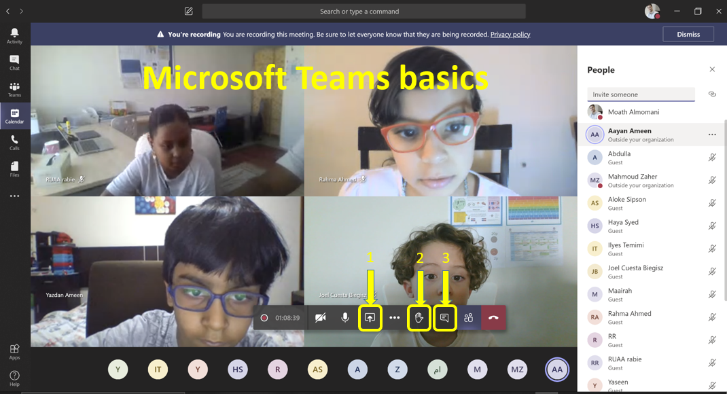
Studio56.qa
Notes:
Introduce how to use Microsoft teams.

Slide 3
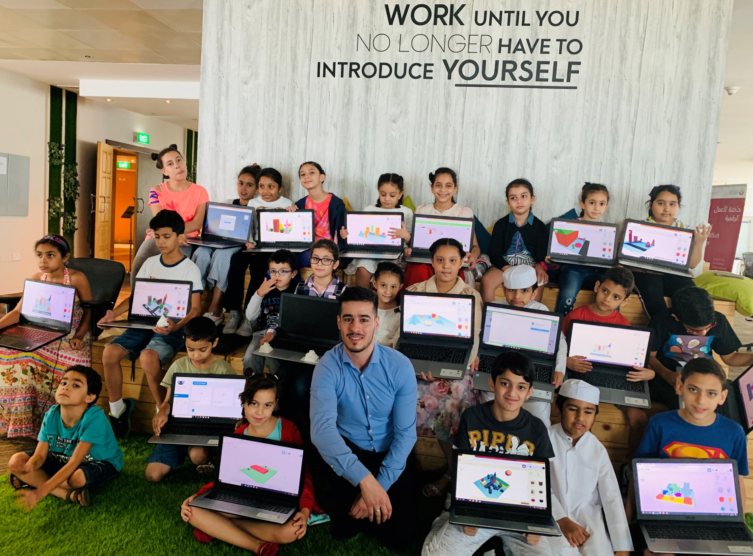

Who are we?
من نحن؟
Software Zone.
Technology Zone.
Creative Zone.
Notes:
Fab lab Studio 56 teaches youth about the necessary skills of this century such as digital fabrication, design and computer science.
Studio 56 has 3 main zones:

Slide 4
This week we are going to start the Islamic Accessories and technology camp, You will need to attend 5 days during the week, each day you will have a one-hour class to learn about 3D scanning, 3D design, and 3D printing technology.
On the last day, you will be asked to conduct your final digital project using the knowledge and skills you learned.
سنبدأ هذا الأسبوع مخيم الملحقات الإسلامية والتكنولوجيا، سوف تحتاج إلى حضور 5 أيام خلال هذا الأسبوع، في كل يوم سيكون لديك درس مدته ساعة واحدة للتعلم على المسح الضوئي ثلاثي الأبعاد والتصميم ثلاثي الأبعاد وتكنولوجيا الطباعة ثلاثية الأبعاد.
في اليوم الأخير، سيُطلب منك إجراء مشروعك الرقمي النهائي باستخدام المعرفة والمهارات التي تعلمتها.
Studio56.qa
Notes:
Ice braking activity.
Have you played Minecraft before?

Slide 5
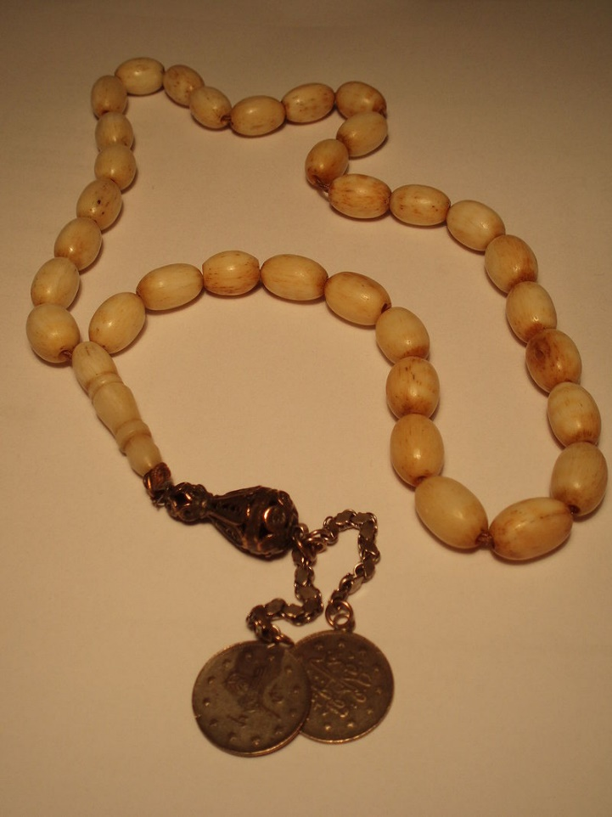
Al Sabha has a long history and represents for Muslims a purpose of religiosity and remembrance, and sometimes for dignity and prestige. Therefore, Hamad wants to present a new Sabha to his mother as a gift in place of her old damaged rosary, Unfortunately, Hamad did not find any Sabha similar to that, so he is asking for your help in making a new customized replica one to his mother.
السبحة لها تاريخ طويل و تمثل للمسلمين غرضا للتدين و الذكر، وأحياناً للوقار والوجاهة.
لذلك حمد يريد ان يقدم سبحة جديدة لوالدته كهدية عوضا عن مسبحتها القديمة التالفة
لكن لسوء الحظ حمد لم يجد اي مسبحة مشابه لذلك هو يطلب مساعدتكم لصنع واحدة جديدة و مخصصة طبق الأصل لامه.
Studio56.qa
Notes:
.

Slide 6

In other religion like Christianity, they use the same thing such as the Rosary and they believe it purifies souls, washing away sin, and supplies us with what is needed to pay all your debts to God.
في ديانات أخرى مثل المسيحية ، يستخدمون نفس الشيء مثل المسبحة الوردية ويعتقدون أنها تطهر الأرواح وتزيل الخطيئة وتزودنا بما نحتاجه لدفع جميع ديوننا لله.
Studio56.qa
Notes:
.

Slide 7

3D Scanning
المسح الثلاثي الابعاد
3D scanning is a technology for creating 3D models of real-world objects.
How it works?
A 3D scanner takes multiple snapshots of an object. The shots are then fused into a 3D model, which you can rotate and view from different angles on your computer.
المسح ثلاثي الأبعاد هو تقنية لإنشاء نماذج ثلاثية الأبعاد لمجسمات العالم الحقيقي.
كيف تعمل؟
الماسح الضوئي ثلاثي الأبعاد يأخذ لقطات متعددة لمجسم ما. يتم بعد ذلك دمج اللقطات في نموذج ثلاثي الأبعاد يمكنك تدويره وعرضه من زوايا مختلفة على جهاز الكمبيوتر الخاص بك.
Studio56.qa
Notes:
In this class, you'll learn everything you need to know to use your camera to take objects from the world around you and turn them into 3D models on your computer! I'll introduce you to the basic concepts of 3D scanning, and teach you an easily accessible method of reality capture called photogrammetry. Then I'll show you how to use a great program called ReCap Photo that will magically reconstruct your photos into 3D models in the cloud. Last you'll learn how to repair and edit your models to turn them into functional objects for all kinds of uses.

Slide 8
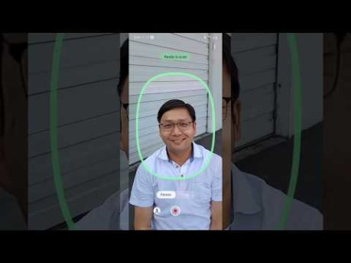
The video below shows the 3D scanning process.
يوضح الفيديو ادناه عملية المسح ثلاثي الأبعاد.
Studio56.qa
Notes:
https://www.youtube.com/watch?v=HjPiaIYoEK4

Slide 9



Type of 3D scanners
أنواع الماسحات الثلاثية الابعاد
There are various types of 3D scanning technologies, such as laser, light, and Photogrammetry 3D scanning such as Kinect in Xbox.
هناك أنواع كثيرة من تقنيات المسح ثلاثي الأبعاد ، مثل الليزر والضوء والمسح التصويري ثلاثي الأبعاد مثل Kinect في Xbox
Studio56.qa
Notes:
https://www.youtube.com/watch?v=tap6NbuGeeg

Slide 10
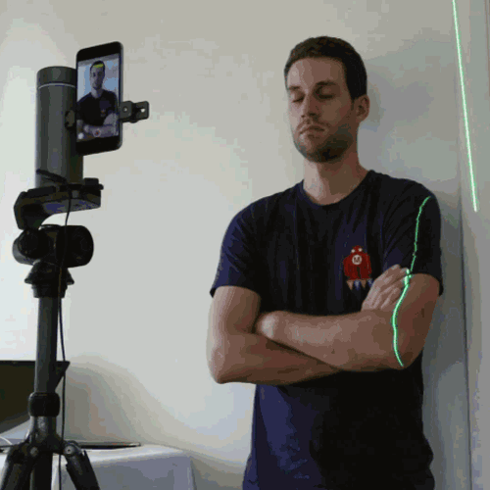
المسح الضوئي بالليزر
Laser scanning
Studio56.qa
Notes:
Perhaps the most accurate 3D scanning technology, also known to as triangulation
https://www.youtube.com/watch?v=J_SIro1TLBQ

Slide 11
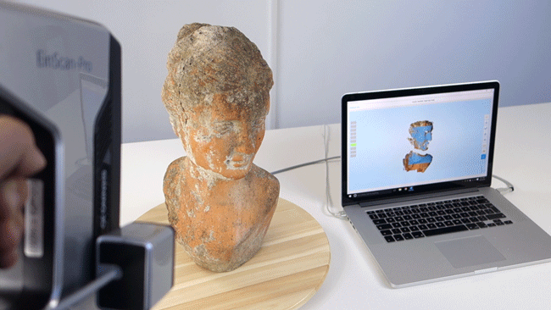
المسح بالضوء المنظم
structured light scanning
Studio56.qa
Notes:
structured light 3d scanning - provides extremely precise measurements for small objects and those of delicacy.
https://www.youtube.com/watch?v=0P4zTtDLJv8&t=76s
This 3D Scanner uses Kinect technology to create 3D models
The device features an "RGB camera, depth sensor, which provide full-body 3D motion capture and facial recognition capabilities.

Slide 12
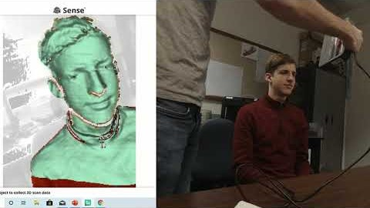
Let's start learning how to create 3D scan using Sense 3D
المسح التصويري
Photogrammetry Scanning
لنبدأ في تعلم كيفية إنشاء مسح ثلاثي الأبعاد باستخدام Sense 3D
Studio56.qa
Notes:
Start from minute 2:20

Slide 13
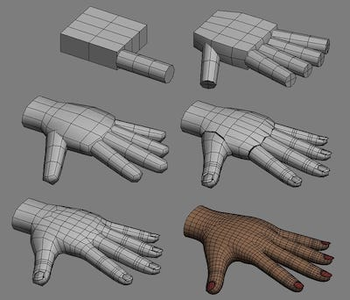
3D Design
التصميم الثلاثي الابعاد
3D models are used for a variety of mediums including video games, movies, architecture, and engineering.
The 3D modeling process produces a digital object.
يتم استخدام النماذج ثلاثية الأبعاد لمجموعة متنوعة من الوسائط بما في ذلك ألعاب الفيديو والأفلام والهندسة المعمارية والهندسة.
تنتج عملية النمذجة ثلاثية الأبعاد مجسما رقميا.
Studio56.qa
Notes:
Explain the 3D design.
We use the 3D design to create 3D models

Slide 14
Now there are plenty of design software and each one is dedicated for a certain job.
Design
التصميم
Architecture
هندسة العمارة
Aerospace
الطيران
Mechanical design
الميكانيك
Product design
المنتجات
Games
الألعاب
Movies
الأفلام
يوجد الآن الكثير من برامج التصميم وكل منها مخصص لوظيفة معينة.
Studio56.qa
Notes:
Engage students in discussions, what is this machine ??
Have you heard about this machine before?
Have you seen it before?

Slide 15
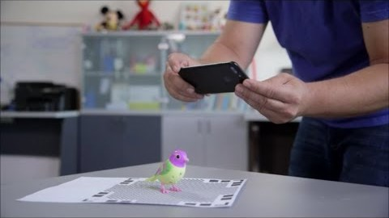
المسح التصويري
Photogrammetry Scanning
Studio56.qa
Notes:
https://www.youtube.com/watch?v=aTLC4qfOHio
3D Systems iSense 3D scanner
Qlone scanner
Photogrammetry: useful for scanning people, animals, etc.
Photogrammetry
Stemming from photography, photogrammetry is an incredibly useful technology in various fields. The technology takes multiple images, taken at different positions, and triangulates points in these images to figure out the location of them in a three-dimensional space.
This 3D Scanner uses Kinect technology to create 3D models and bth they have IR
The device features an "RGB camera, depth sensor, which provide full-body 3D motion capture and facial recognition capabilities.

Slide 16

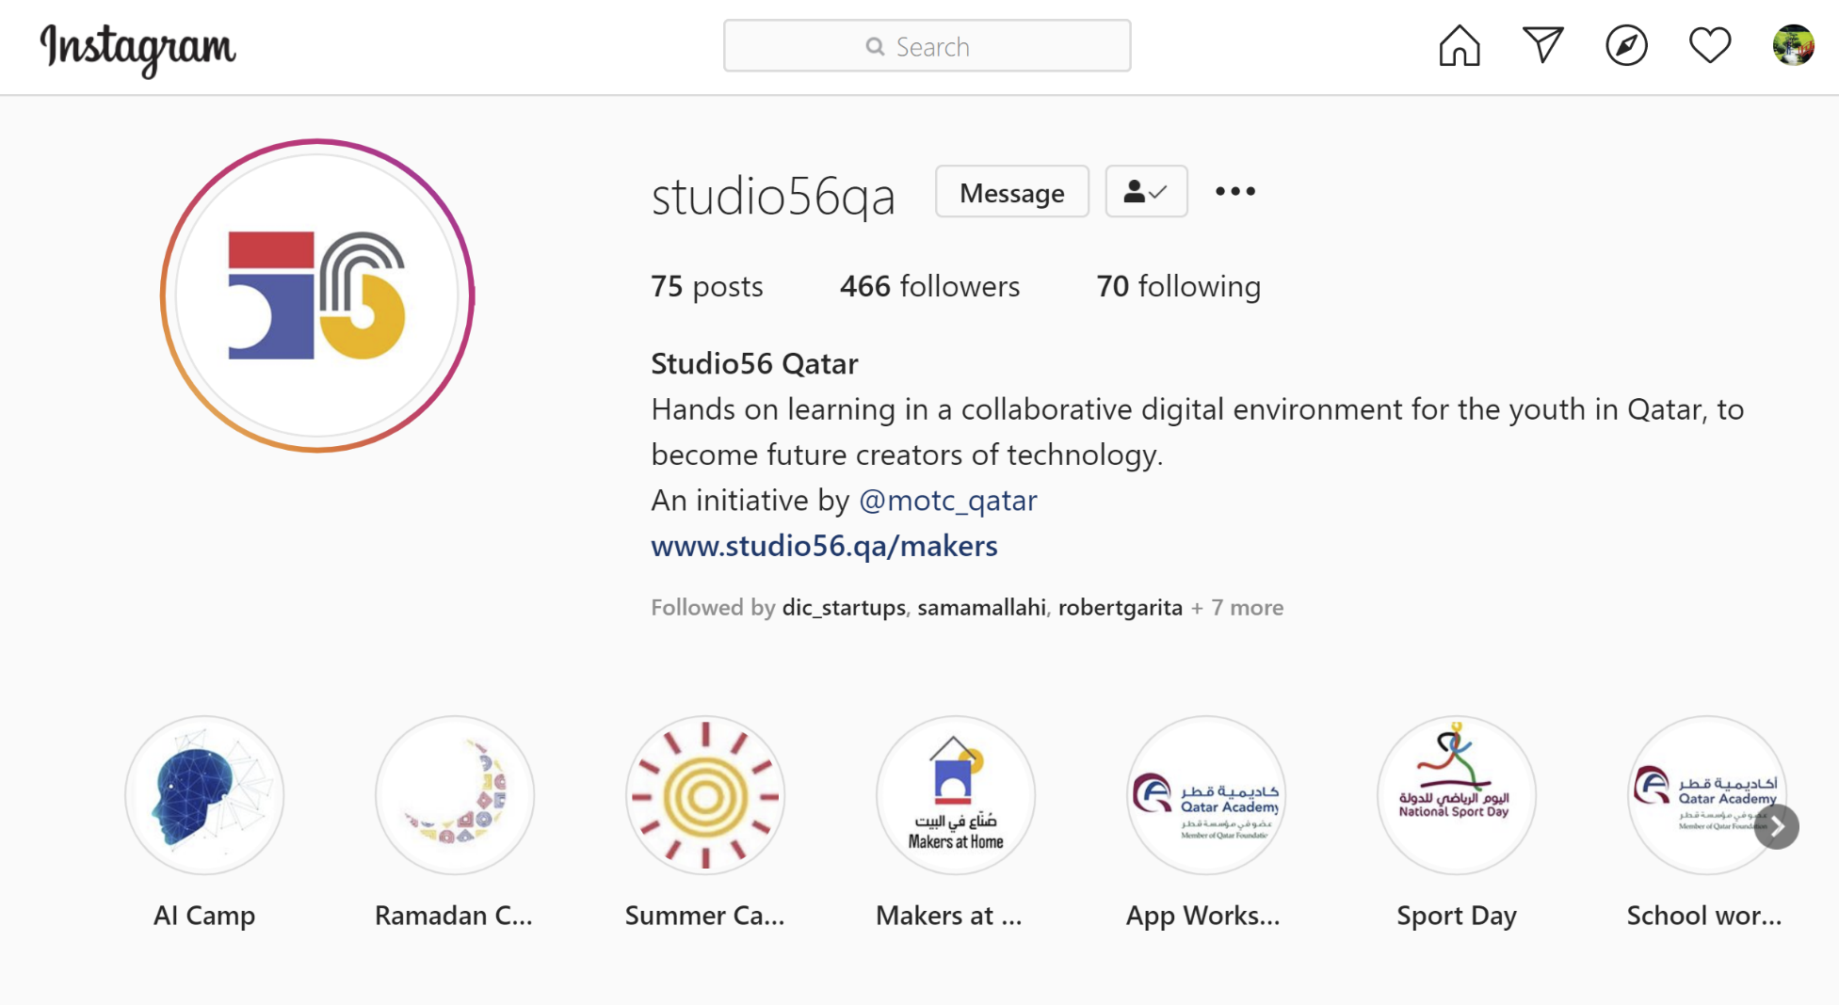
Studio56.qa
Notes:
Encourage participants to follow our studio56qa Instagram

Slide 17
THANKS
info@studio56.qa
Studio56.qa
Notes:
WRAP UP الخاتمة
Debrief استجواب
Ask students to reflect on the day’s activities. What did they learn about Programming? Debugging? How do they feel about computer science and code after spending one hour exploring?
Next Steps Let students know that if they enjoyed today’s activity, they have many options for continuing to code and learn. Encourage students to visit studio56.qa/media-center
tell students what’s coming next in your classroom.

