Slide 1
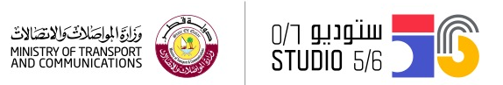
AI and Mask detector
الذكاء الاصطناعي و كاشف الكمام
11-14
Studio56.qa
Notes:
Ask them if they have attended our workshops before.
Introduce Microsoft Teams.
Don’t forget to go through the presentation in just 10 minutes.

Slide 2
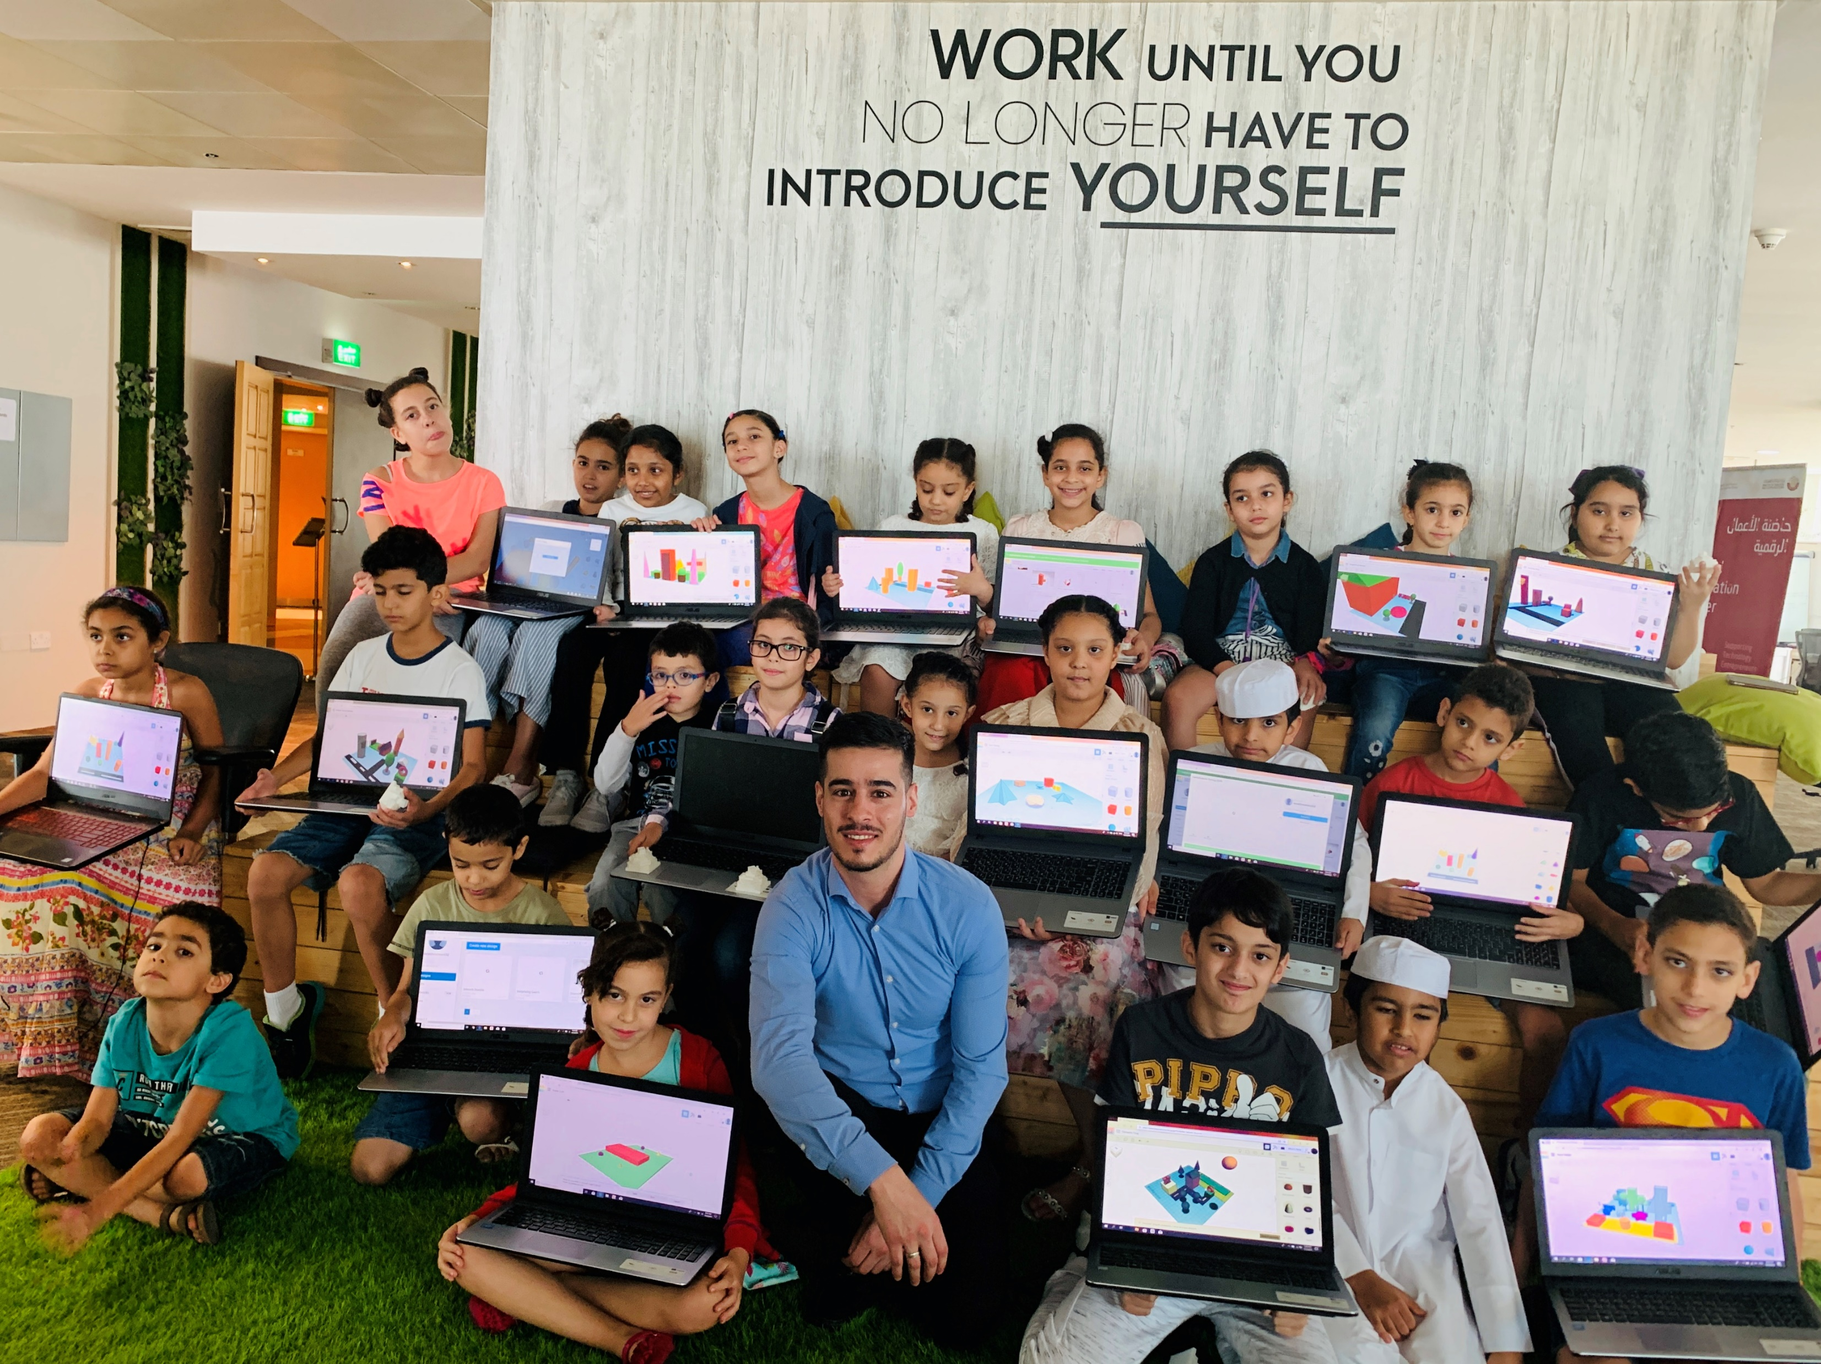

Who are we?
Software Zone.
Technology Zone.
Creative Zone.
Notes:
Our mission is to provide the youth with opportunity to become a technology Makers and not simply consumers

Slide 3
Engineering design process
The engineering design process is a series of steps that guides engineering teams as we solve problems. The design process is iterative, meaning that we repeat the steps as many times as needed, making improvements along the way as we learn from failure and uncover new design possibilities to arrive at great solutions.
Studio56.qa

Slide 4
Developing innovative science, technology, engineering and mathematics (STEM) curricula that elicit student excitement for learning is a continuous challenge for K-12 STEM teachers.
the engineering design process (EDP) can be used as an innovative, effective, and logical means for formalizing the development of K-12 STEM lessons.
Studio56.qa

Slide 5
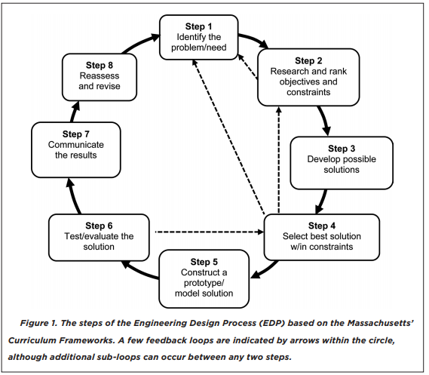
Studio56.qa

Slide 6
Engineering design challenge
The Ministry of health is working on a new precautionary measures to improve the CSS - Covid Safety System and limit the spread of coronavirus, and that will be achieved by integrating a new technology - AI to detect if the people wear a mask or not, so we need your help to develop a new system that will be able to detect masks.
Studio56.qa

Slide 7
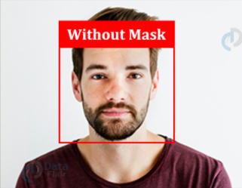
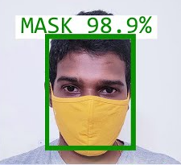
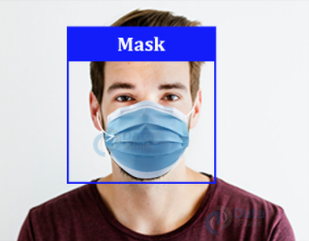
Mask detector - كاشف الكمام
Notes:
If I ask you to describe each picture what would you say!!
You will probably say the 1st picture is for a person without mask …… etc.

Slide 8


What is image classification?
Image classification is the process in which an image is matched to a specific word.
You do this all the time with your eyes and brain just looking around at the world!
Mask
Studio56.qa
Notes:
Can a computer recognize the photos and emotions like us?
Is this hard or easy for a machine?

Slide 9

Why is this hard for machines?
Machines don’t have systems as complex as our brains.
We can see that these images are masks, but they look so different it would be hard for a machine to figure out.
Studio56.qa

Slide 10
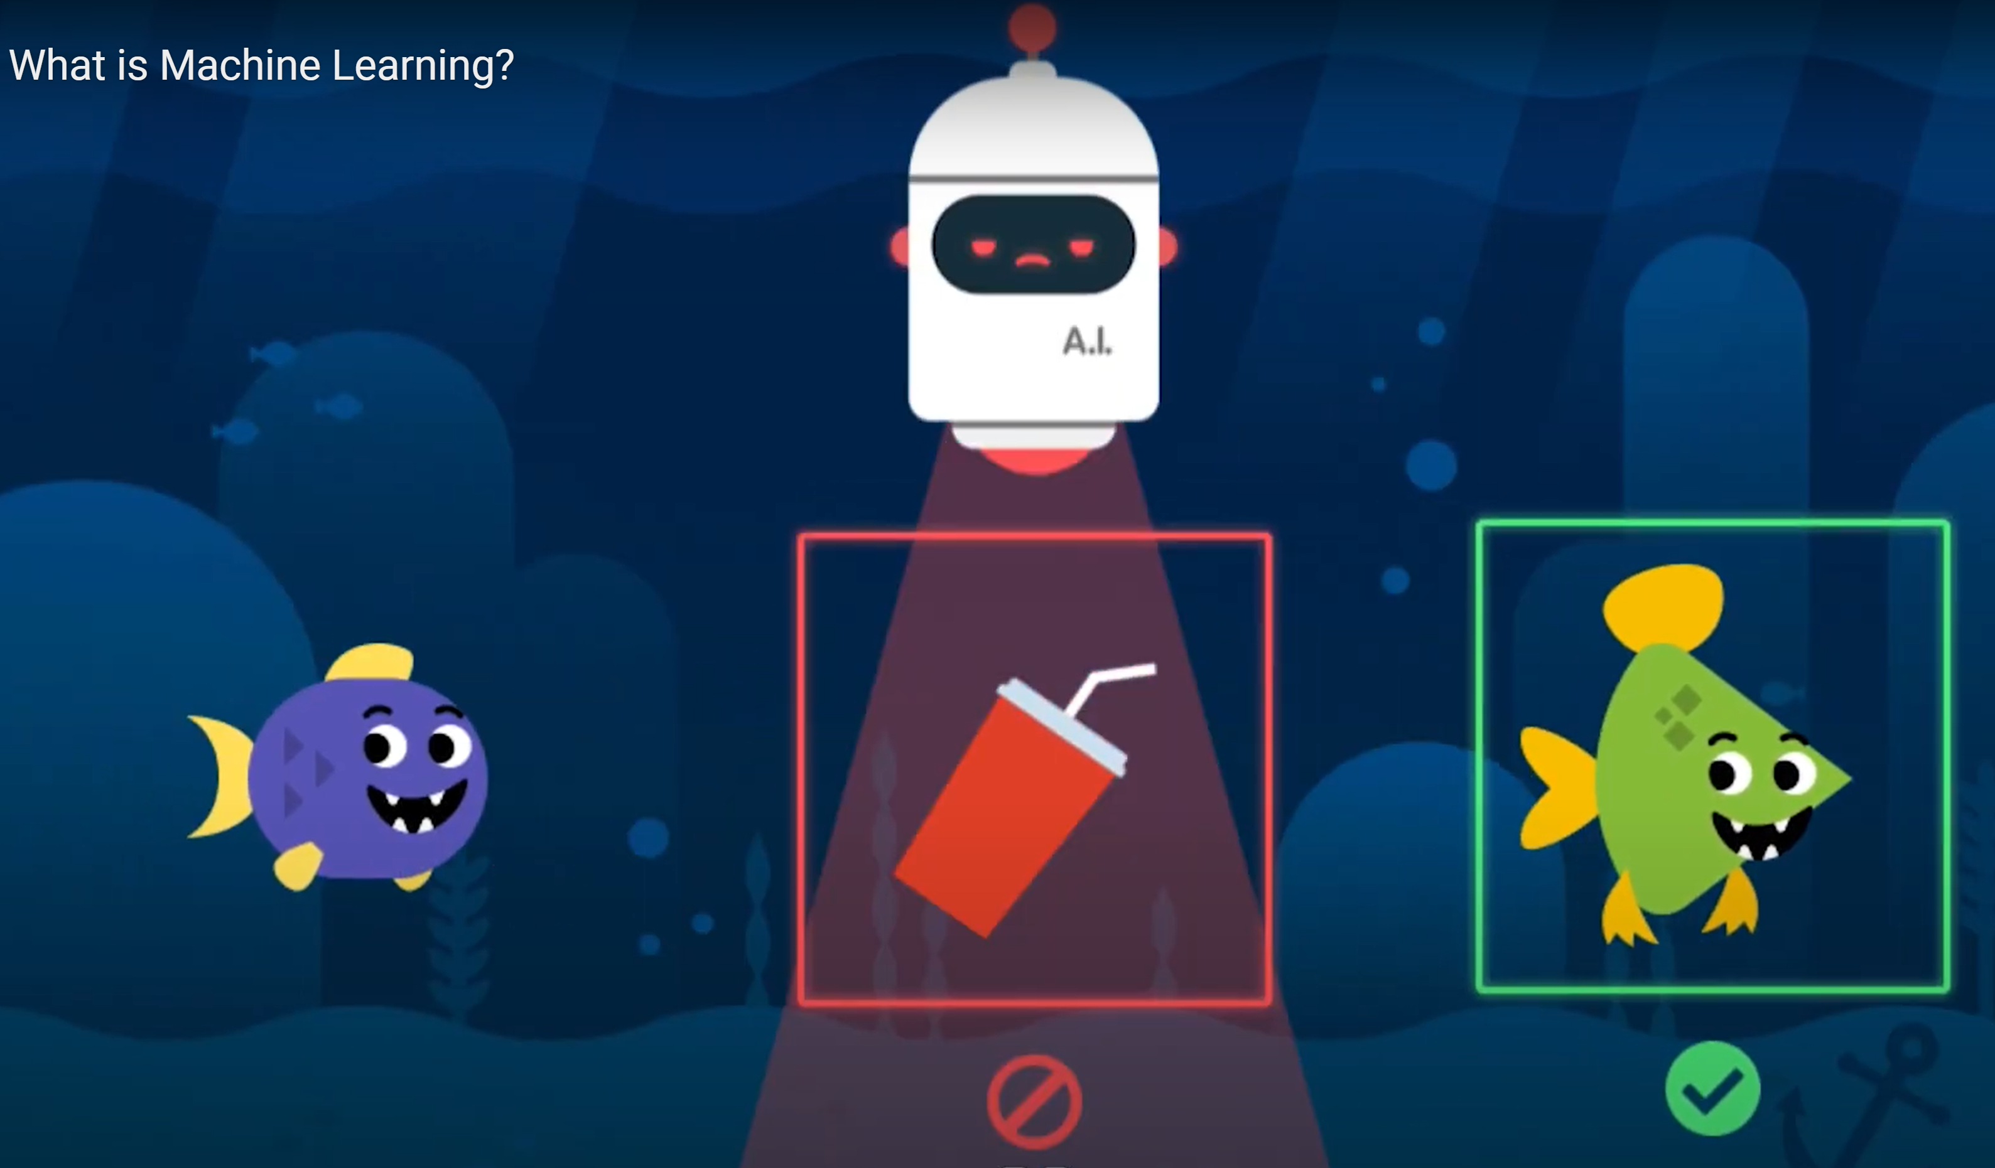



What is Machine Learning ?
ما هو تعلم الالة؟
Notes:
Have you heard about machine learning?
What do you know about machine learning?
What do you understand from the picture?
the AI Robot is detecting trash and remove it to clean the ocean, but how does this Ai robot know how to differentiate between fish and trash??
we train the robot by showing him pictures of fish and pictures of trash, so the Ai robot learns from us how to separate between things without being programmed.
What Will happen if you give wrong training for the machine, for example showing it a purple fish and telling him this is a trash?
He will do the same mistake that you did and classify the fish as trash because the behavior of your Ai robot based in your bias

Slide 11
What is Machine learning
Traditional programming
Data
Computer
Output - Answers
Rules and programs
Machine learning
Data
Computer
Rules and programs
Output - Answers
Studio56.qa
Notes:
Explain traditional programming and machine learning from the point of paper rock and scissor game.
Say >> Instead of thinking all about of these rules and we have to write and express all of these rules in a code, what if we could provide a lot of answers and we could lable those answers and then have a machine infer those rules
Say >> For example, instead of writing a complicated code to describe the shape of a hand for the computer, we can just get a lot of images of people doing a rock so we can diverse hands, diverse skins, and tones. and then we just say to the machine hey this is what rock looks like, this is what a paper looks like.

Slide 12
ما هو تعلم الالة
البرمجة التقليدية
بيانات
Computer
المخرجات - الاجوبة
القواعد و البرامج
تعلم الالة
بيانات
Computer
القواعد و البرامج
المخرجات - الاجوبة
Studio56.qa
Notes:
بدلاً من التفكير في كل هذه القواعد وان علينا كتابتها والتعبير عنها في رمز او برنامج مكتوب ، ماذا لو تمكنا من تقديم الكثير من الإجابات و تصنيفها ثم نحصل على آلة تستنتج تلك القواعد
على سبيل المثال ، بدلاً من كتابة رمز معقد لوصف شكل اليد للكمبيوتر ، يمكننا الحصول على مجموعة من الصور لأشخاص يقومون بعمل صخرة، و لديهم بشرة مختلفة. ثم نقول للألة ، هذا ما تبدو عليه الصخرة ، و هذا ما تبدو عليه الورقة.

Slide 13
AI & Machine Learning (ML)
Machine learning is a subset of Artificial Intelligence, Let’s watch this video to learn more about it.
Machine learning the ability of a computer to or machine to recognize patterns and make decisions without being programmed.
Studio56.qa

Slide 14
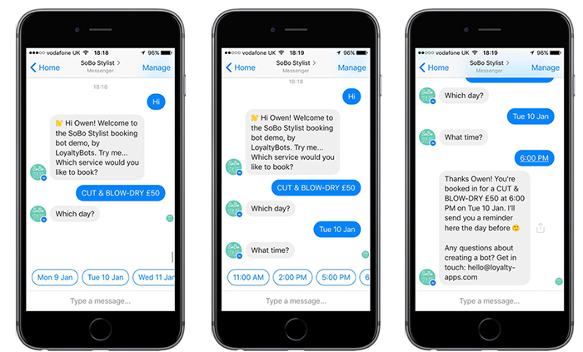
Where have you seen or experienced
artificial intelligence in your lives?
Studio56.qa
Notes:
To interact with students
Put some pictures for kids to recognize
Examples from the video include:
email filters
auto-complete text
video recommendation systems
voice recognition
translation apps
digital assistants
image recognition
Based on what you saw in the video, what is machine learning?
Machine learning the ability of a computer to or machine to recognize patterns and make decisions without being programmed.

Slide 15

Image Recognition using Machine Learning
Because there are so many parts of an image to consider, a machine needs to be able to learn, just like us, to correctly classify an image.
To do this it uses machine learning, a method that lets the machine learn from images.
Studio56.qa

Slide 16
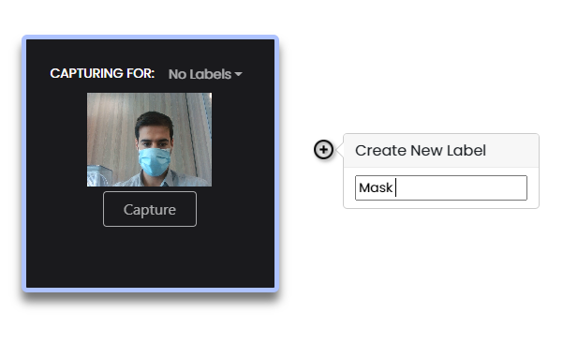
Training Steps
MIT App Inventor – Personal Image Classifier
Define Labels
  Name your classes/labels (happy, sad, angry…)

Slide 17
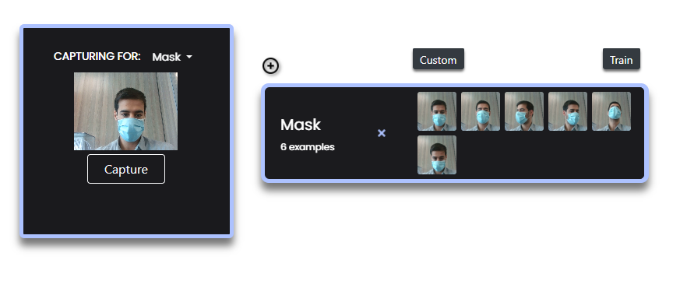
Training Steps
Add Training Data
  Take several pictures for Mask label, and/or drag and drop images

Slide 18
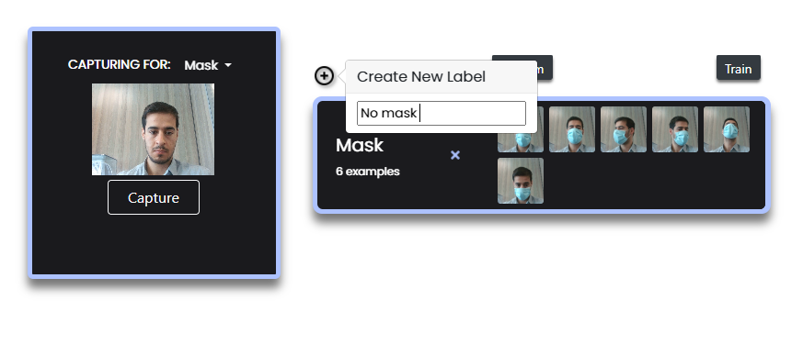
Training Steps
Add new label – No Mask and take some photos

Slide 19
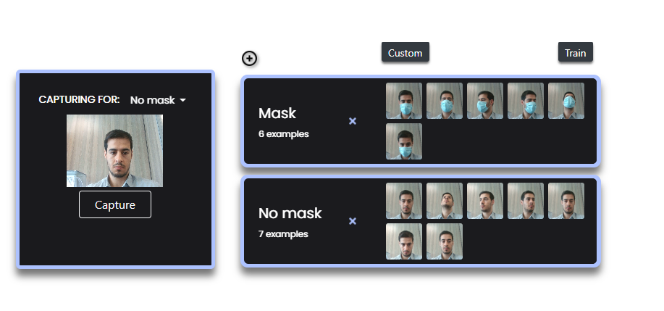

Click on train and start testing the if your training was enough for the computer

Slide 20
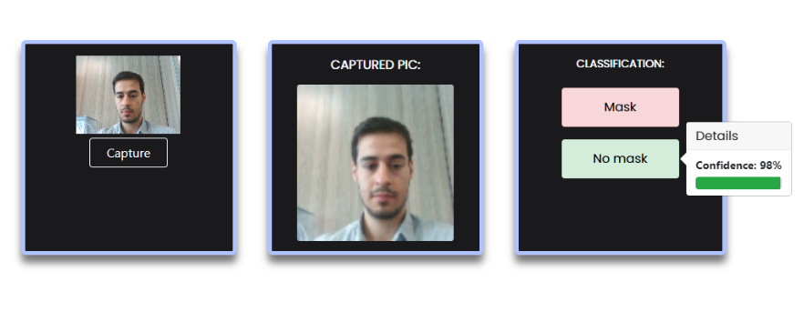
Testing without mask showing acurate results

Slide 21
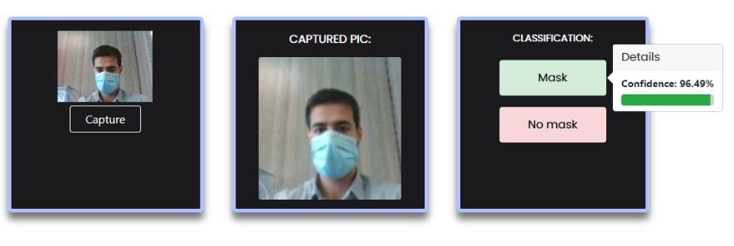
Testing with mask showing great results.

Slide 22
THANKS
info@studio56.qa
Studio56.qa
Notes:
WRAP UP الخاتمة

