Slide 1

Battery Tester
فاحص البطارية
Electronics
11-14
Studio56.qa

Slide 2
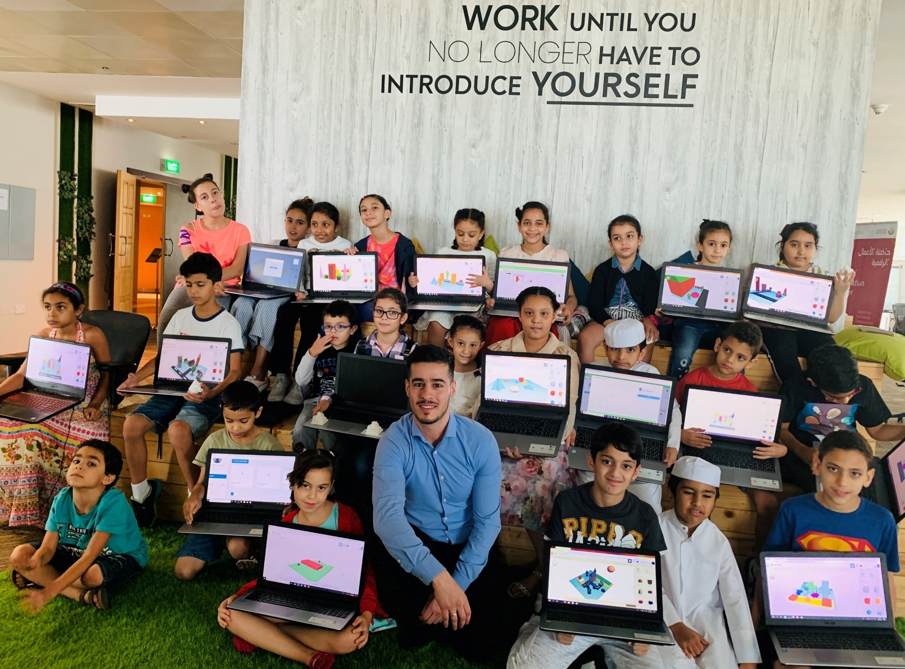

Who are we?
من نحن؟
Software Zone.
Technology Zone.
Creative Zone.
Notes:
We are Fab lab Studio 56 teaching youth about digital fabrication, design and computer science.
Studio 56 has 3 main zones:

Slide 3
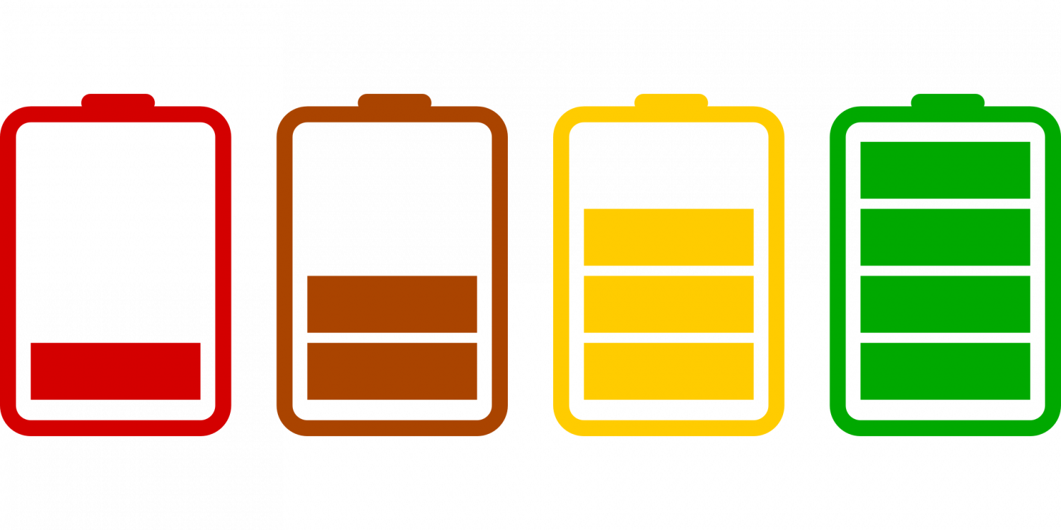
كيف يمكن معرفة حالة البطارية؟
How can we indicate a battery status?
Studio56.qa
Notes:
Discuss they ways that they will do to test a battery.
Identify the possible best solutions
Lights
3. Ask the students what does empty of full mean? Full of what or empty of what?
Introduce the voltage …. Voltage is what makes electric charges move.

Slide 4
اليوم سوف نصنع جهاز يحتوي على كمبيوتر صغير لقياس طاقة البطارية ومن ثم اضائة صمام مشع حسب حالة البطارية
Today we will make a device that has a small computer to measure a battery energy and indicates its status on LED
Studio56.qa
Notes:
Ask students what are the smallest computers that you know and listen to the students answers
Give examples for the computers and tell them a story about how the first computer before 40 years become one thousands times smaller now.

Slide 5
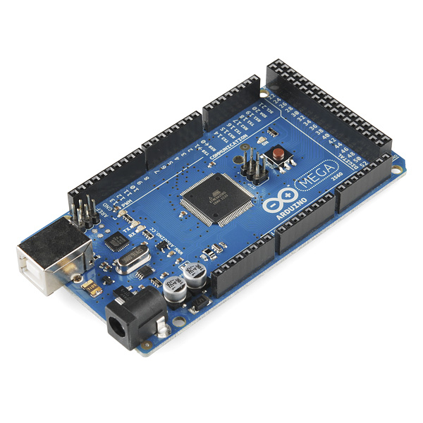
Arduino
لوحة الاردوينو هي عبارة عن حاسوب صغير له قدرات محددة مقارنة مع الحاسوب المحمول او المكتبي
Arduino board is a small computer, so it has limited capabilities comparing with a laptop or a PC.
Notes:
Introduce the Arduino
Assistance will introduce the Arduinos for students

Slide 6
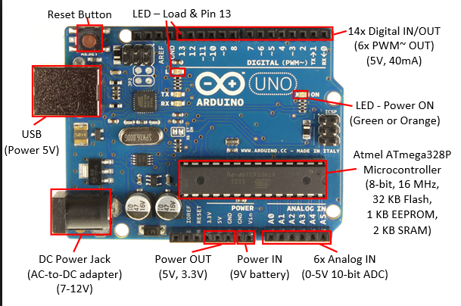
Arduino Uno
Studio56.qa

Slide 7

Arduino IDE
The Arduino Software (IDE) allows you to write programs and upload them to your board.
برنامج الاردوينو يسمح لك بكتابة نصوص البرمجة وتحميلها على لوحة الاردوينو.
Studio56.qa

Slide 8
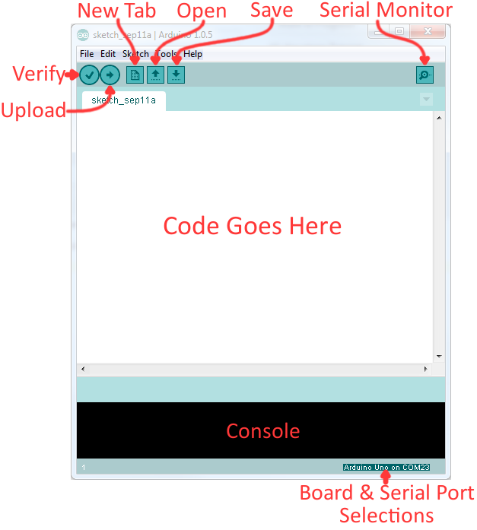
Arduino IDE

Slide 9
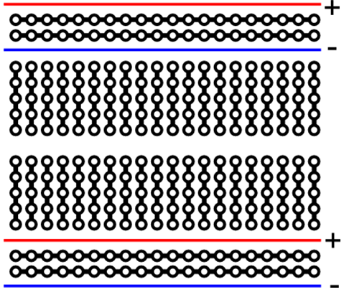
Bread board wiring
Studio56.qa
Notes:
A quick review about breadboard wiring

Slide 10
Activity
Studio56.qa
Notes:
Let the students to build this activity as a revision for level two

Slide 11
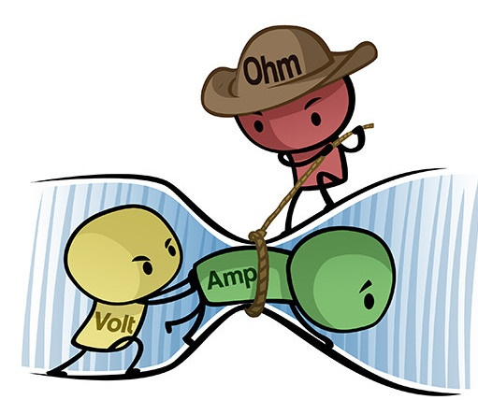
Voltage and Current
Studio56.qa
Notes:
Revision for voltage, current, resistance

Slide 12
Arduino Programming
Studio56.qa

Slide 13
Main Arduino Functions
void setup()
{}
The setup code written to run once:
void loop()
{}
The loop code written to run repeatedly:
Studio56.qa

Slide 14
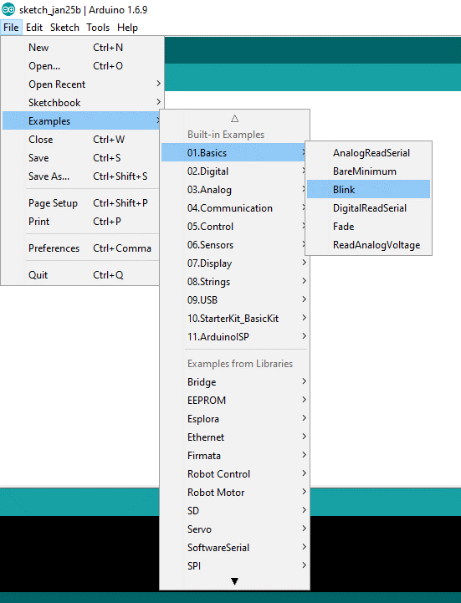
Our First Example
Studio56.qa
Notes:
Explain about examples found in arduino

Slide 15
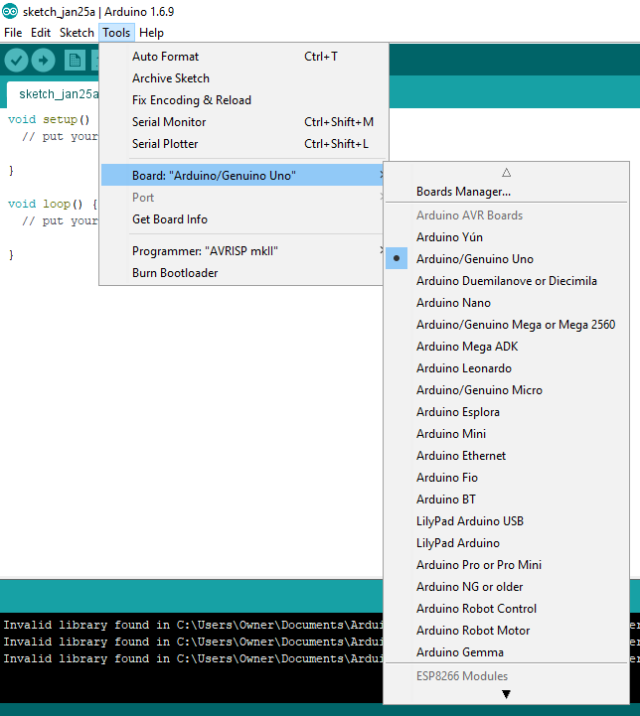
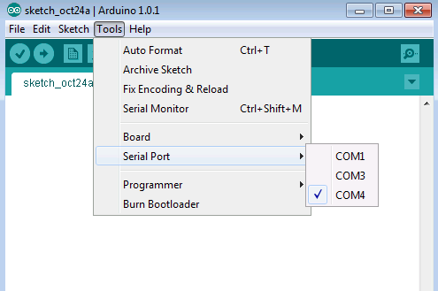
Our First Example
Studio56.qa
Notes:
Our first program (empty)
This program to explain for the students how to upload the Arduino code to the Arduino board

Slide 16
Basic Arduino Instructions
pinMode( number of the pin , OUTPUT / INPUT);
digitalWrite( number of pin, HIGH/LOW or 1/0);
Studio56.qa
Notes:
Let the students to check the number of pins on the Arduino.
Explain for them pinMode instruction and tell them how to write it.
Explain for them digitalWrite instruction and tell them how to write it.
Our first program (empty), then start writing the program instruction by instruction with clarify for all instructions

Slide 17
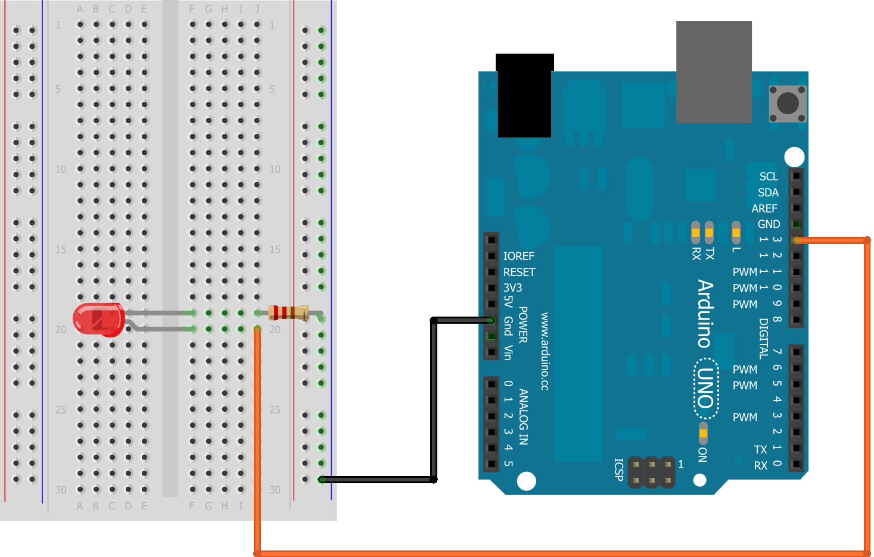
LED circuit with Arduino
Studio56.qa
Notes:
Wiring the circuit to blink the LED
How to write your code:

Slide 18
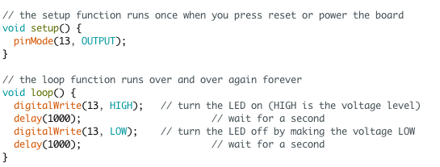
Arduino first program
Studio56.qa
Notes:
In this code explain for students how does delay instruction work.
Delay pauses the program for the amount of time (in milliseconds) specified as parameter. (There are 1000 milliseconds in a second.)
File >>Examples >> Basic >> Blink (Blinking LED)

Slide 19
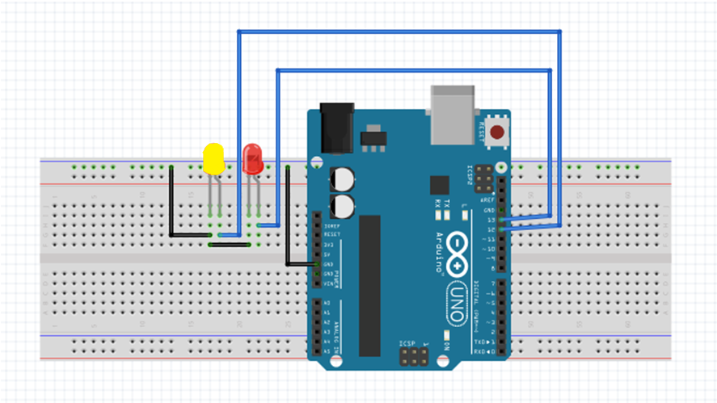
Controlling Two LED
Studio56.qa
Notes:
From the past project add another LED to explain how to define more than Arduino pin at the same program.

Slide 20
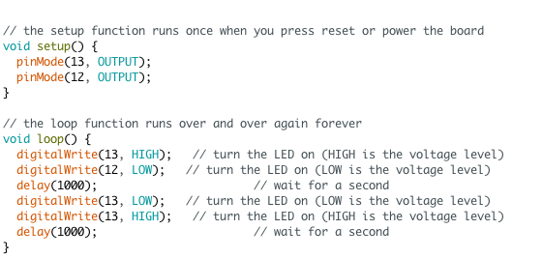
Arduino program
Studio56.qa
Notes:
This is the code of two LED, you can find that there are two pinMode’s and two digitalWrite’s in the code.

Slide 21
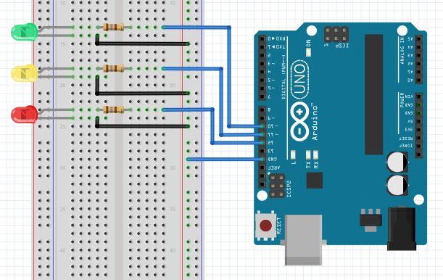
Arduino Traffic Light
Studio56.qa
Notes:
After controlling two LED, three LED should be easy, so in this activity we will build a traffic light.

Slide 22
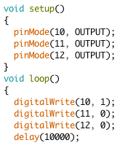
Arduino Traffic Light Code
Studio56.qa
Notes:
This is the code of the traffic light.

Slide 23
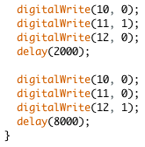
Studio56.qa
Notes:
This is the code of the traffic light.

Slide 24
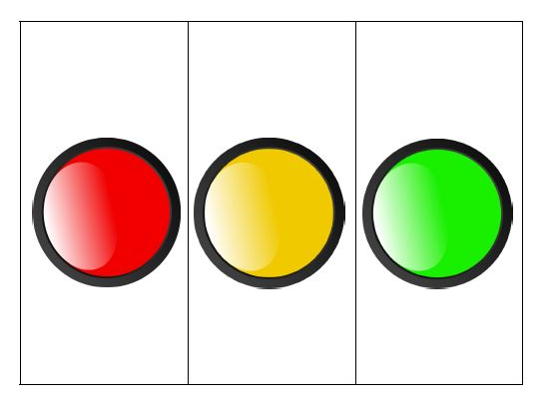

Battery Tester Code
Let’s make the battery tester that will indicate the battery status by light
Empty
Low
High
Studio56.qa
Notes:
This is the code of the traffic light.

Slide 25
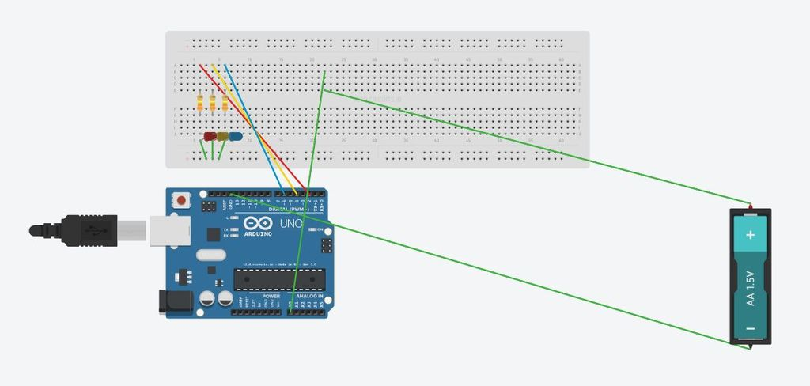
Studio56.qa

Slide 26
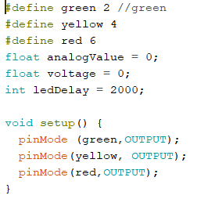
Studio56.qa

Slide 27
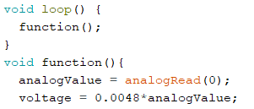
Studio56.qa

Slide 28
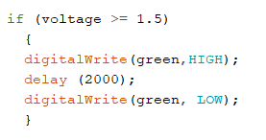
Studio56.qa

Slide 29
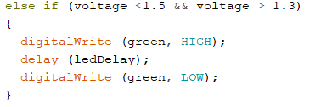
Studio56.qa

Slide 30
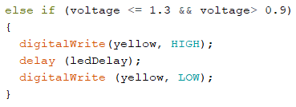
Studio56.qa

Slide 31
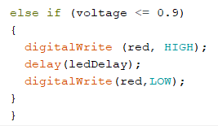
Studio56.qa

Slide 32
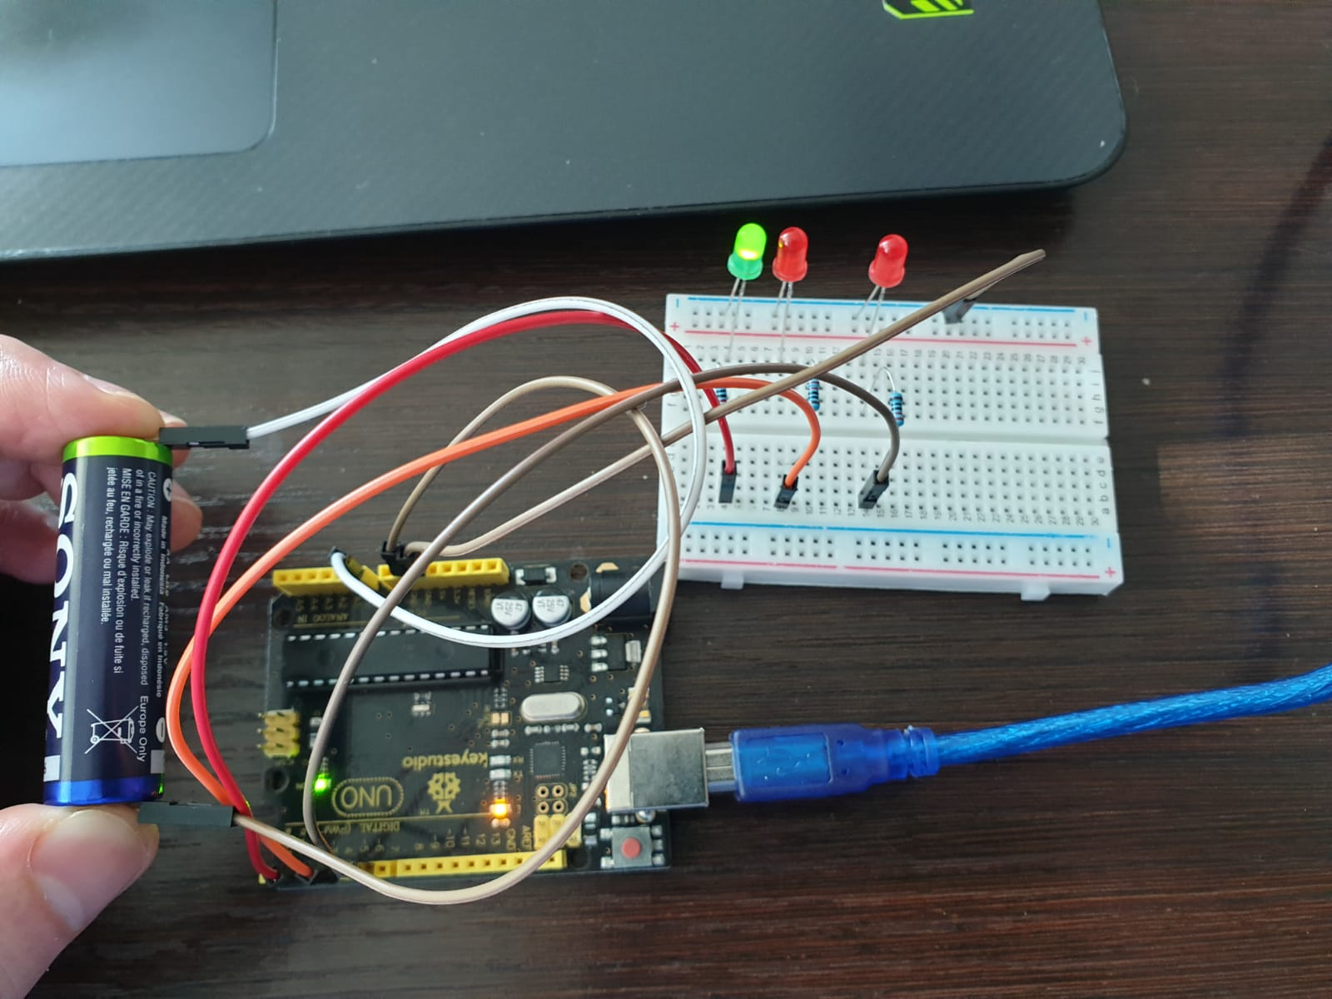
Let’s test our code and make sure it works
هيا لنفحص الكود الخاص بنا ونتاكد من عمله
Studio56.qa
Notes:
Picture of the final proto

Slide 33
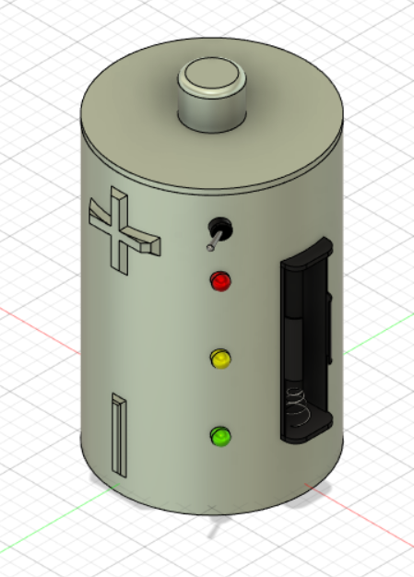
Let’s make our device and connect the electronics with the box inside
هيا لنصنع جهازنا ونوصل الاكترونيات داخل الصندوق
Studio56.qa
Studio56.qa
Notes:
Picture of the final proto

