Slide 1
https://www.youtube.com/watch?v=y20E3qBmHpg
Paper-based prototype
النموذج الورقي
Studio56.qa
Notes:
Explain what is a FabLab and where the word come from.

Slide 2
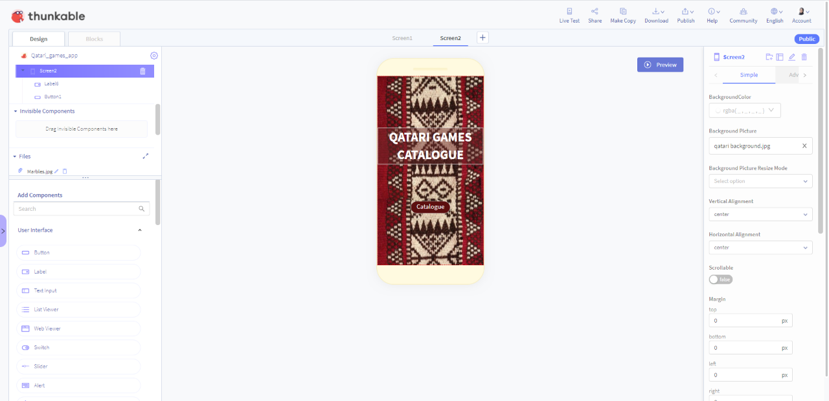
ما الذي سنقوم بتطويره اليوم؟
What we will develop TODAY?
التعرف على هيكل واجهة النظام الأساسي.
تصميم واجهة المستخدم الخاصة بالتطبيق.
إضافة وتحرير وحذف المكونات.
اضافة وتصميم شاشات متعددة.
برمجة التنقل بين الأزرار.
Recognize the interface structure of the platform.
Design the user-interface of the application.
Add, edit and delete components.
Add and design multiple screens.
Program the buttons’ navigation.

Slide 3
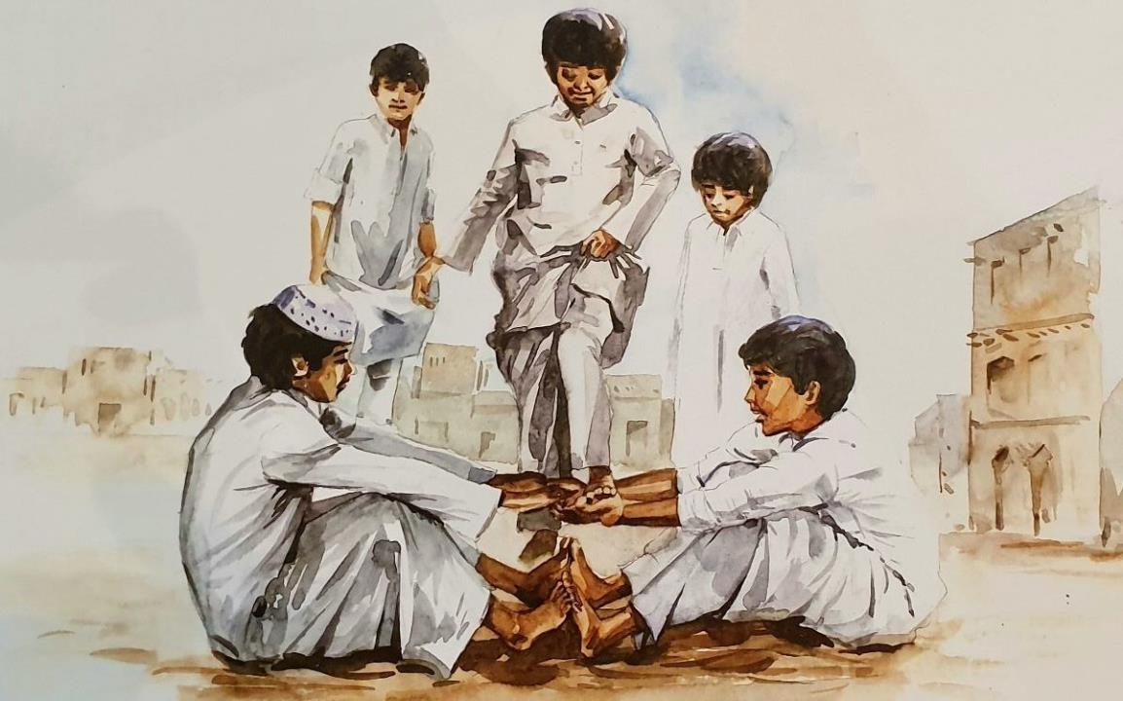

Qatari
TRADITIONAL
GAMES
Studio56.qa

Slide 4
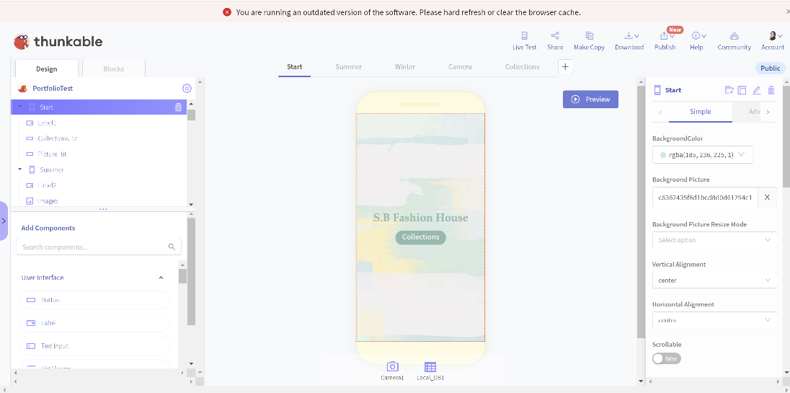
Thunkable - Designer
https://thunkable.com/#/
Studio56.qa
Notes:
Explain what is a FabLab and where the word come from.

Slide 5
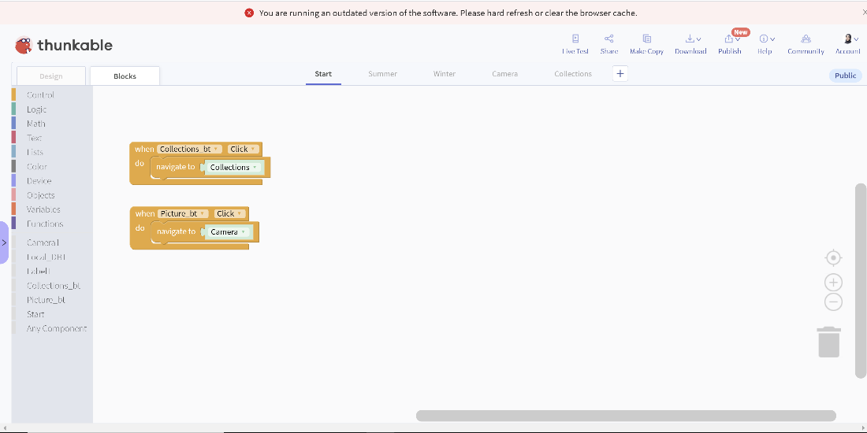
Thunkable - Block
https://thunkable.com/#/
Studio56.qa
Notes:
Explain what is a FabLab and where the word come from.

Slide 6
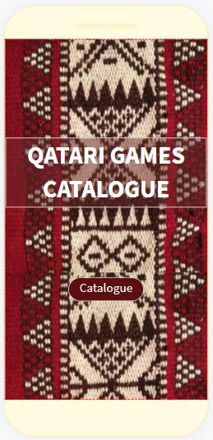
Screen1 - START
1- Title label.
2- Catalogue button.
Studio56.qa
Notes:
Explain what is a FabLab and where the word come from.

Slide 7
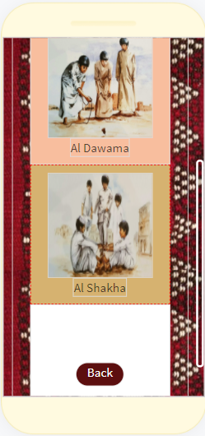
Screen2 – CATALOGUE
1- Games images.
2- Games labels.
3- Back button.
Studio56.qa
Notes:
Explain what is a FabLab and where the word come from.

Slide 8

Thanks
@studio56qa
Studio56.qa

