Slide 1
Plants Needs
Part 2

Slide 2
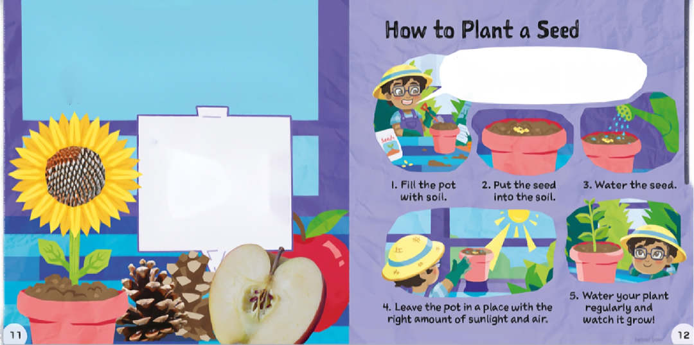
Seeds 种子
Most new plants grow from seeds.
Many seeds grow by themselves when they fall from flowers and trees.
Seeds don’t move, but they still have life inside.
大多数新植物都是从种子中长出来的。
种子从花草树木上掉下来后自己长出来。
种子不会动，但里面仍然蕴含着生命。
Find a place that is large enough for your seeds to grow 找到足够种子长大的地方
Seeds grow in
·flower of a plant.
·inside fruit, like apples.
·inside cones, such as pine cones
种子生长在
·植物的花中。
·水果，如苹果。
·球果内，如松果

Slide 3
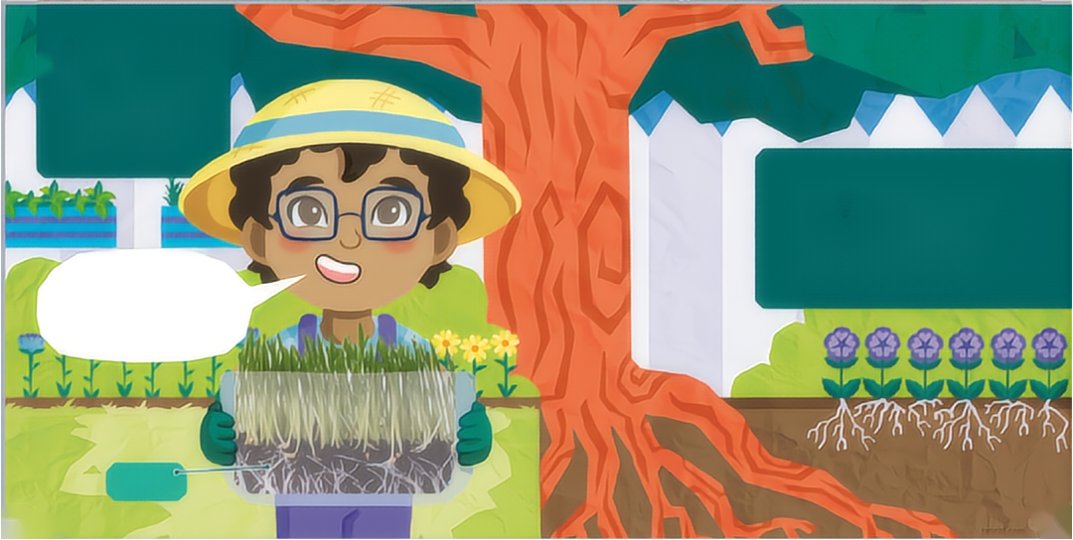
Roots 根茎
Most roots grow down into the soll. They are strong and help to keep the plant in place.
植物的根深扎泥土，帮助固定植物在一个地方。
Roots act a bit like straws by sucking up water and food from the soil. The food is so tiny that we can't see it, but it helps the plant to grow
根像吸管一样，让植物从土里吸收水和食物，虽然小，但帮助植物生长。
These roots are small but some roots can spread out for miles underneath the soil.
植物的根可能很小，也可能延伸到几十米外。

Slide 4
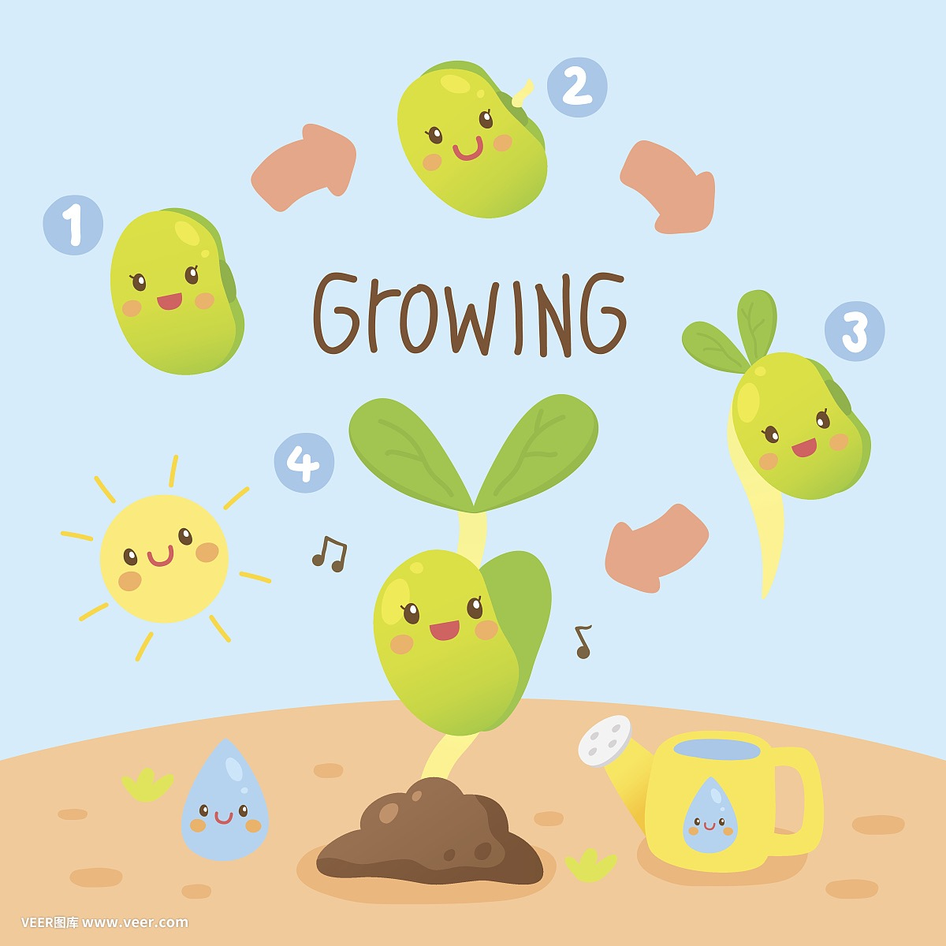
照顾好你的种子
·水:太多或太少？
·阳光：太晒或太暗？
·土壤：是否有适合种子的营养？
·温度：太冷或太热？
Take good care of your seed
· Water: too much or too little?
· Sunlight: too bright or too dim?
· Soil: Does it have the right nutrients for the seeds?
· Temperature: too cold or too hot?
√

Slide 6
错误：频繁、少量浇水
纠正：大量、不频繁地浇水

Slide 7
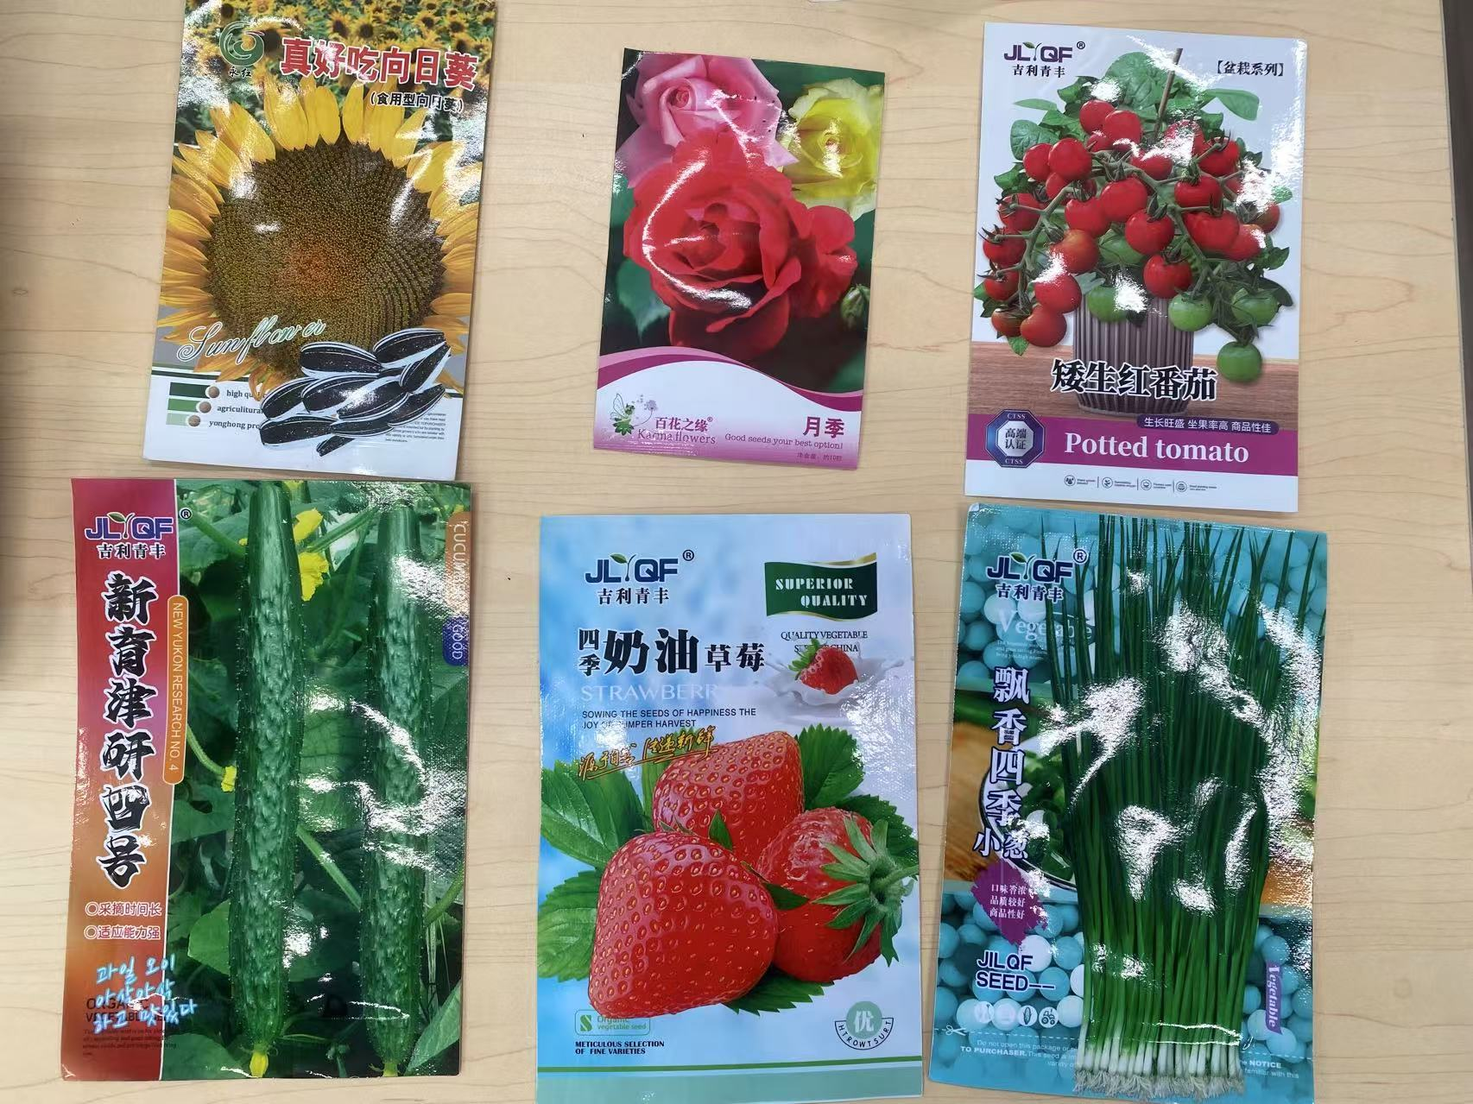
Come and see what seeds we have!
What is different?
来观察我们有哪些种子吧！
他们看起来一样吗？

Slide 8
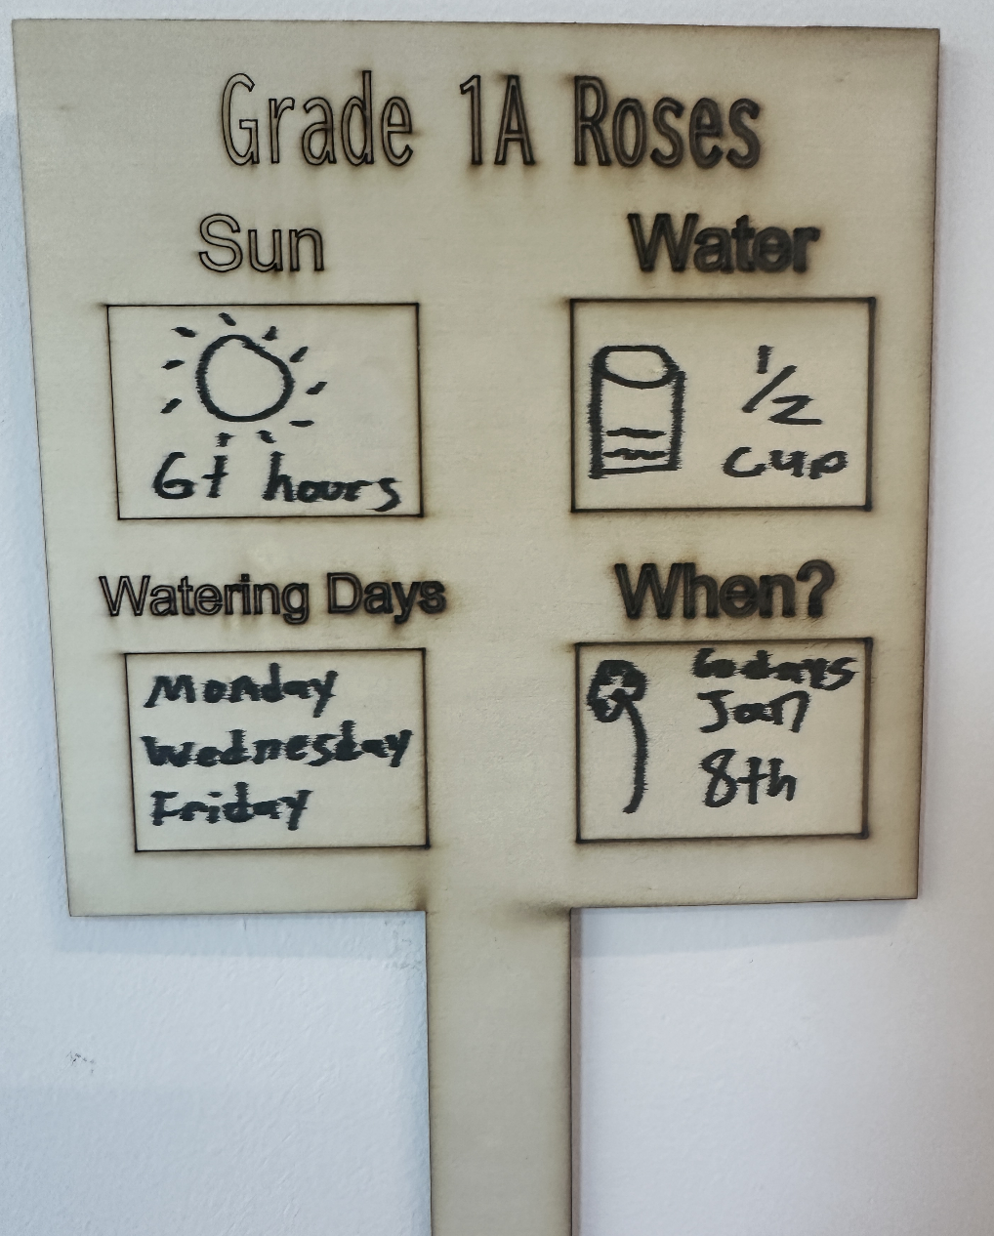
Before we adventure outside… 在我们外出探险之前……
Let’s create our plants sign
According to the seed’s package information… 根据种子的包装信息…
How much sun is needed?
How much should we water it each time?
How often should we water it?
When can we expect it to flower?

Slide 9
Plants Needs
Part 3

Slide 10
Benefits of Plants
There are many things plants can do for us. Can you name three?
植物能为我们做很多事情。你能说出三件吗？
1.
2.
3.

Slide 11
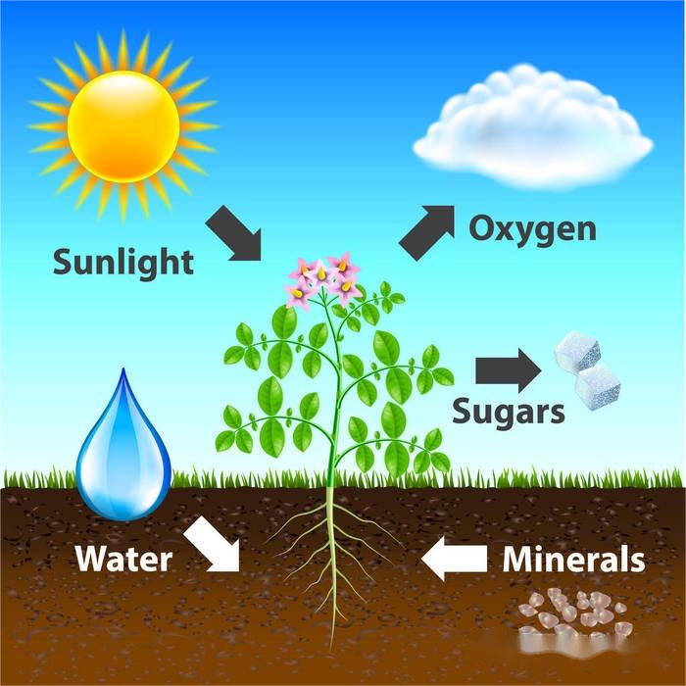
Photosynthesis
光合作用
植物用阳光、水、土壤，生产出自己需要的营养以及氧气的魔法。
Plants use sunlight, water, and soil to produce the nutrients they need and oxygen.

Slide 12
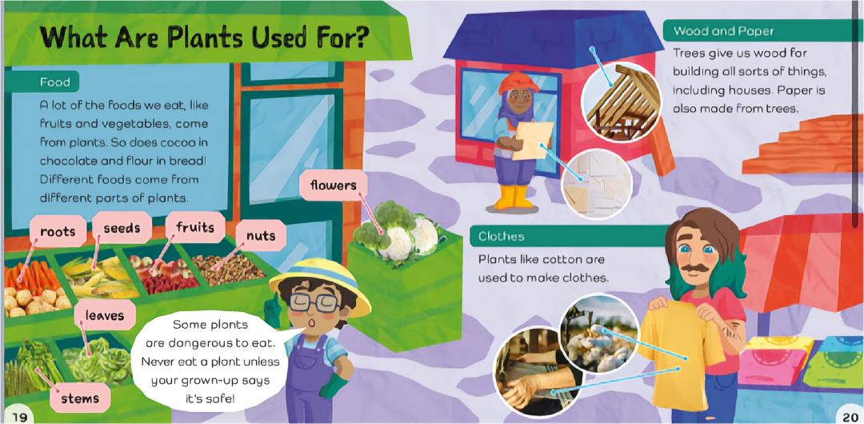

Slide 13
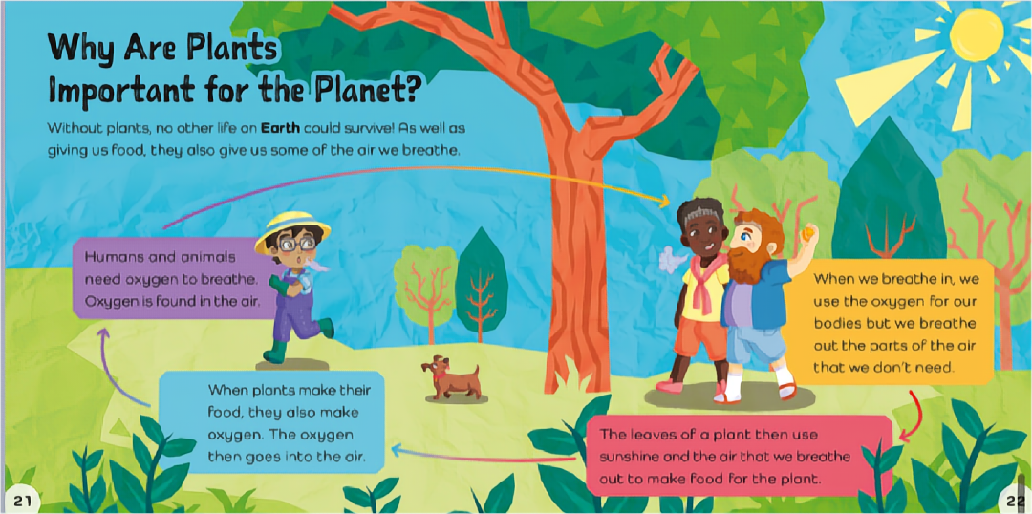

Slide 14
