Slide 1
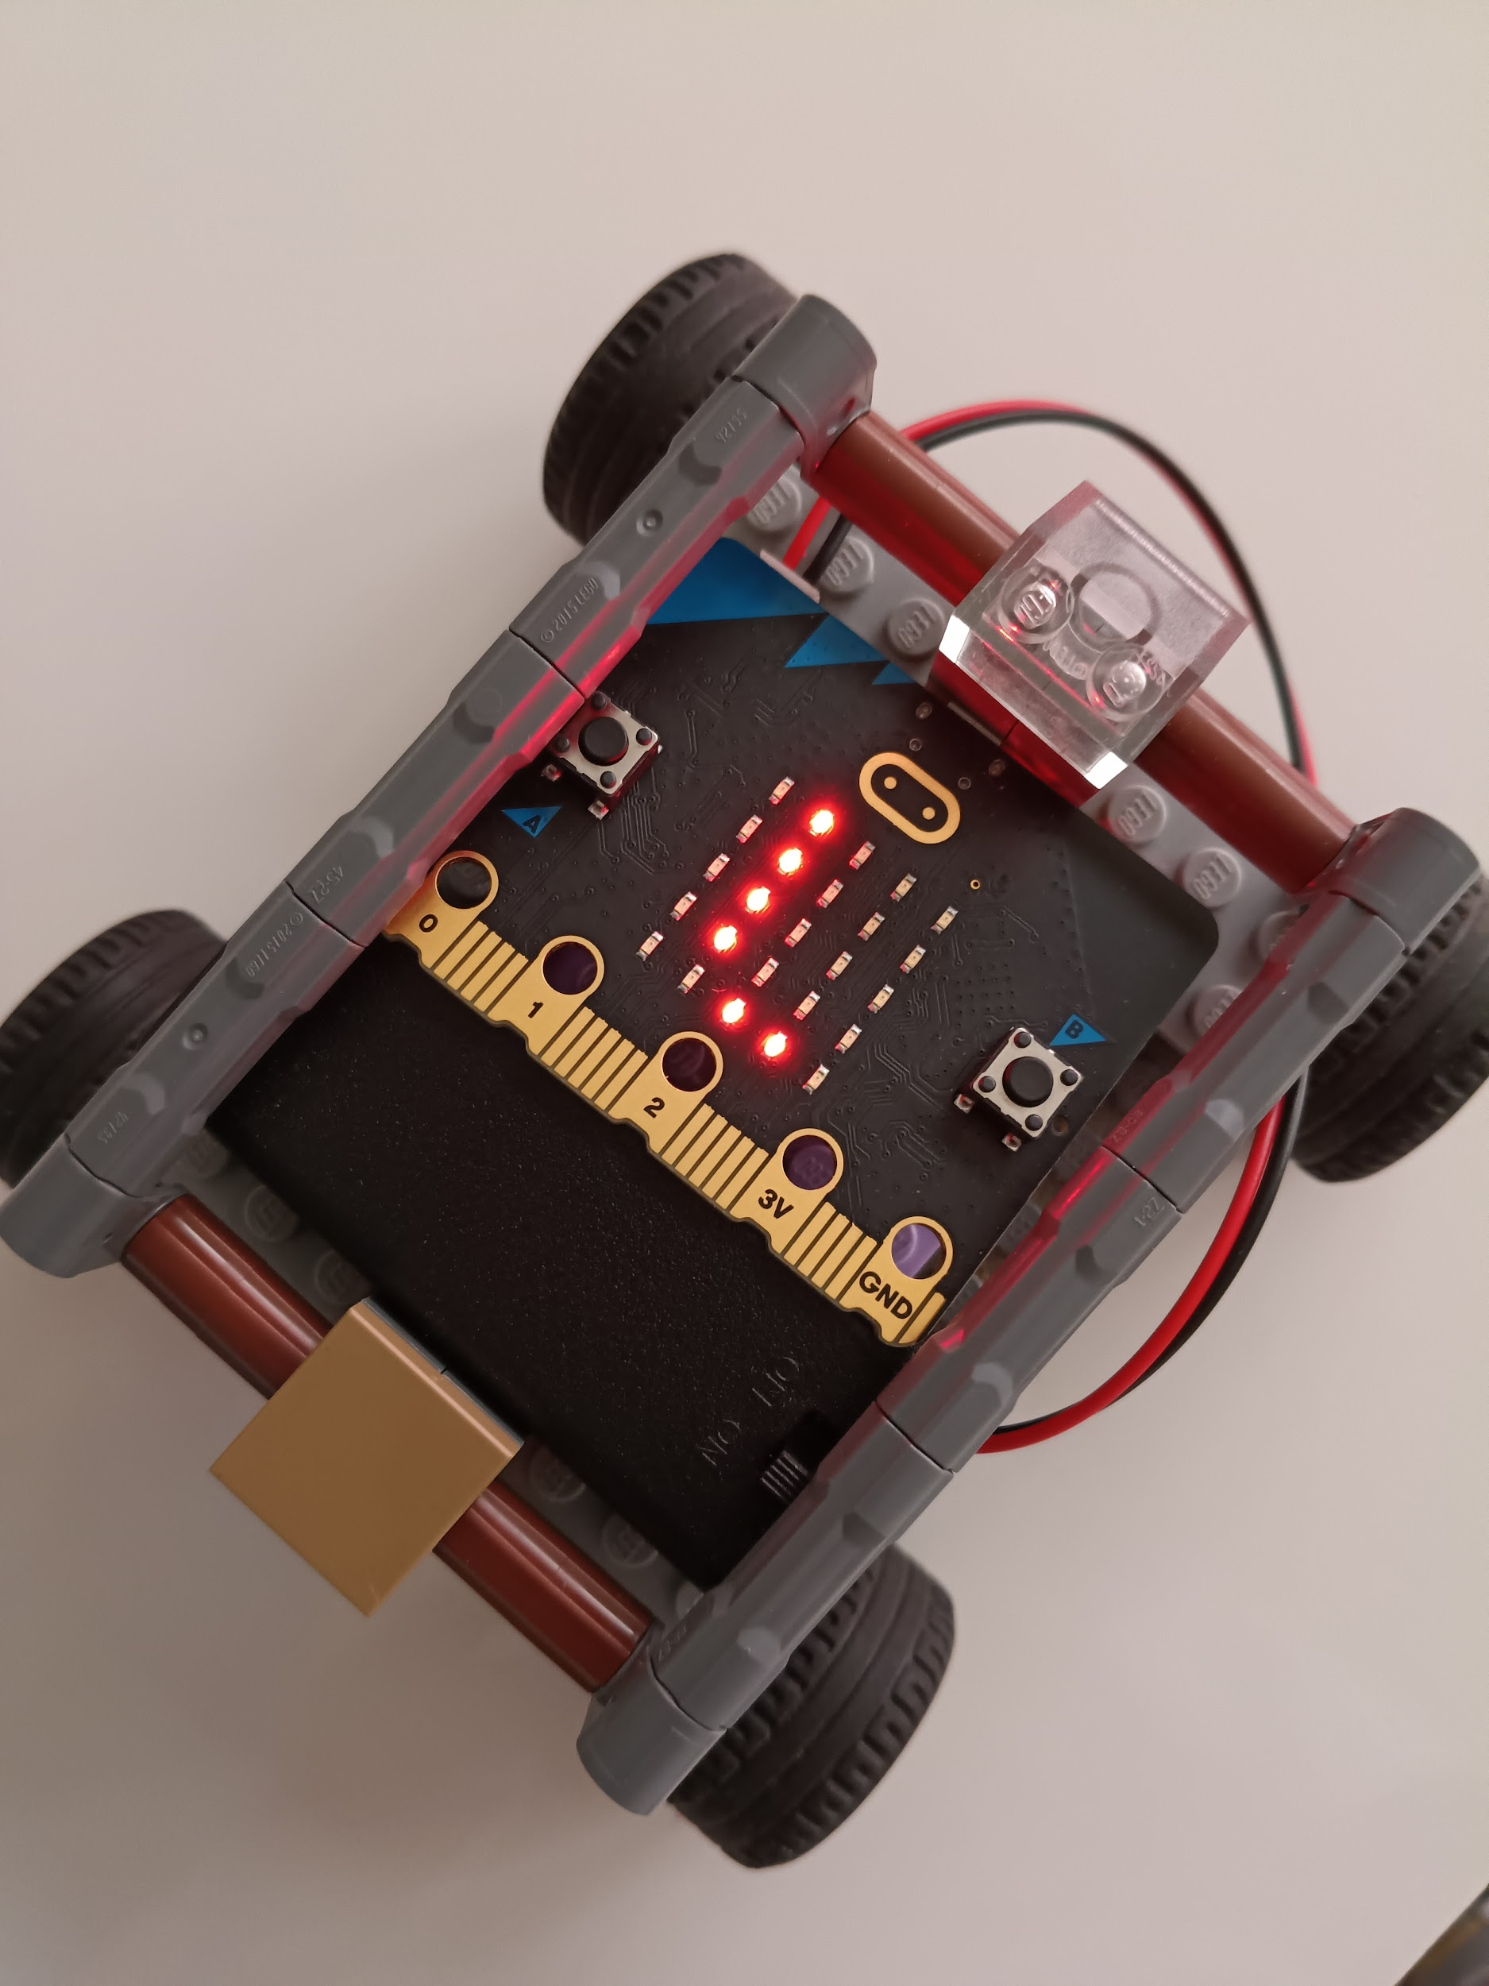
FAB LAB PROJECT
5TH GRADERS
Introduction to the Microbit world
Technology teacher: Paola Mancilla
FAB LAB Teacher: Pamela González

Slide 2
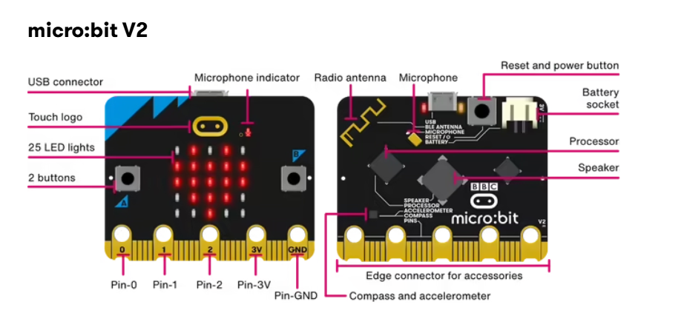

Slide 3

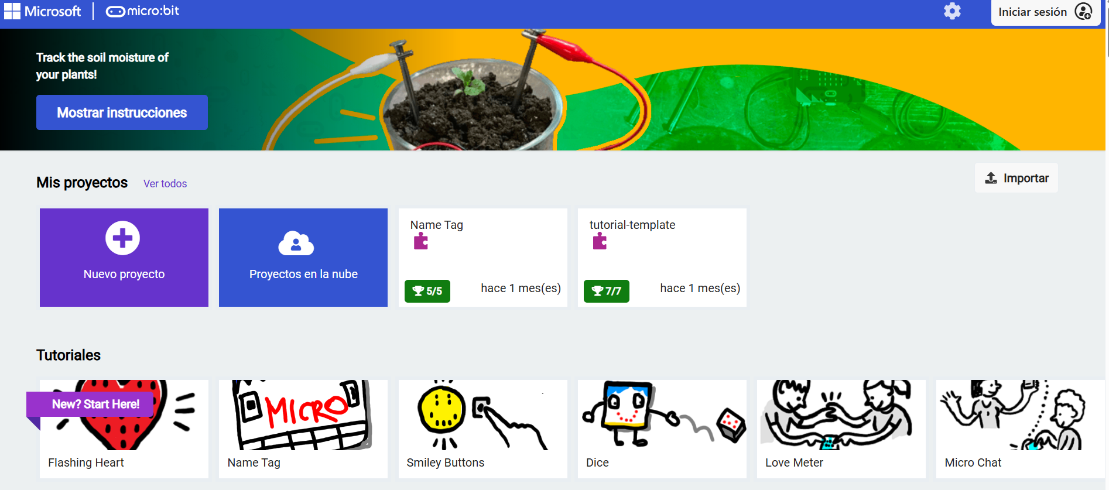
Click to open the following link

Slide 4
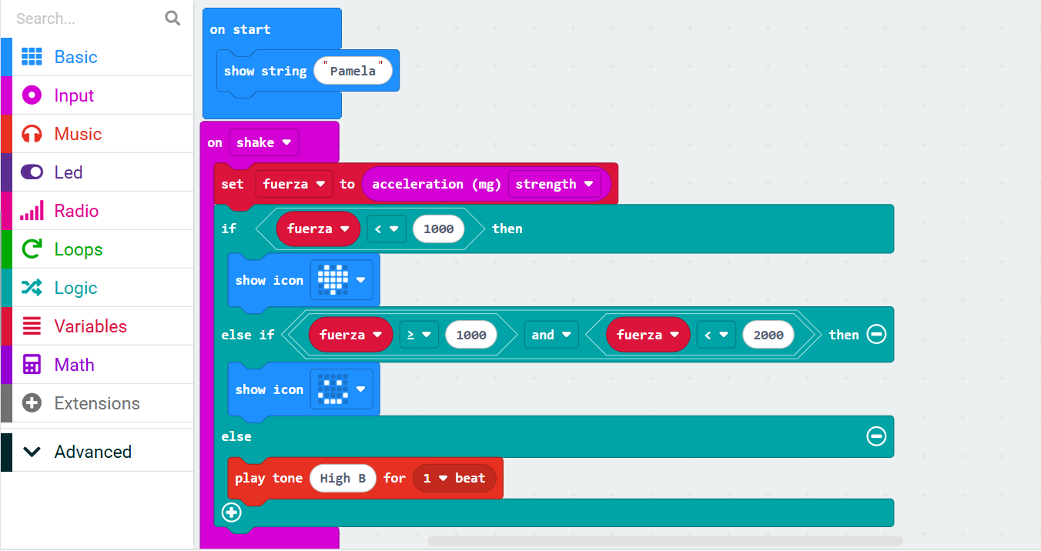

Slide 6
input.onGesture(Gesture.Shake, function () {
fuerza = input.acceleration(Dimension.Strength)
if (fuerza < 1000) {
basic.showIcon(IconNames.Heart)
} else if (fuerza >= 1000 && fuerza < 2000) {
basic.showIcon(IconNames.Happy)
} else {
music.playTone(988, music.beat(BeatFraction.Whole))
}
})
let fuerza = 0
basic.showString("Pamela")

